Slide 1

INTERNAL REVIEW | Machine Learning & Ai internship
Skill Nexis | Project: Heart Disease Prediction
PROBLEM STATEMENT
predict whether a patient is likely to have heart disease from clinical measurements.
PRESENTED BY
COMPANY
DURATION
GUIDANCE
Ayush Shetty
Roll No: 24311A66L5
B.Tech CSE - AI & ML
Skill Nexis
Virtual Internship
Domain: Machine Learning & Ai
05 Sep 2026 – 17 Oct 2026
6 Weeks & 3 Days
45-day program, 4 tasks
Coordinator: K. DivyaSri
HoD, CSE-AI&ML:
Dr. Venkatanarayana Rao
Sreenidhi Institute of Science and Technology (Autonomous) | Department of CSE-AI&ML

Slide 2
Heart Disease Prediction
Machine Learning & AI - Project
Binary classification with Logistic Regression and Decision Tree
Presented by: Ayush Shetty | Roll No: 24311A66L5

Slide 3
Abstract
Heart disease is a leading cause of death, and early screening depends on reading many clinical measurements together. This project builds a machine-learning pipeline that predicts whether a patient has heart disease from 13 clinical features of the UCI Heart Disease dataset (918 patients after cleaning).
Missing values are imputed, numeric features are scaled and categorical features are one-hot encoded inside one scikit-learn Pipeline. Logistic Regression and a Decision Tree are tuned with 5-fold cross-validation and GridSearchCV, then tested on a held-out 20% set.
The Decision Tree gave the best ROC AUC (0.918, accuracy 84.8%); Logistic Regression was close behind (0.915) with higher recall (88.2%). The model is saved with joblib and predicts on new patients.
918
patients after cleaning
13
clinical features
0.918
best ROC AUC

Slide 4
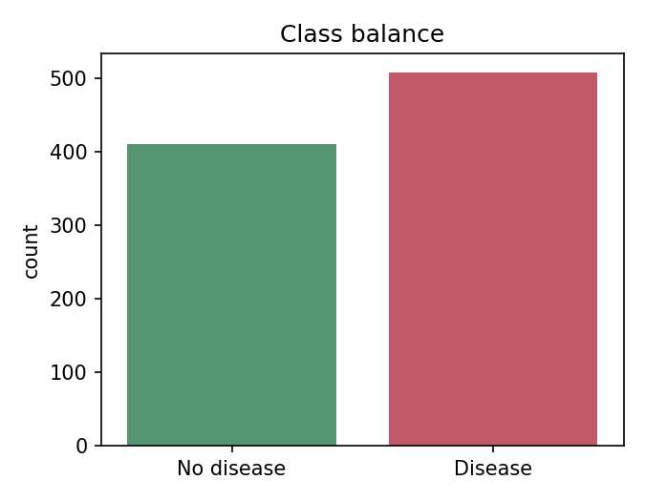
Problem & Dataset
Goal: predict whether a patient is likely to have heart disease from clinical measurements.
Dataset: Kaggle - Heart Disease UCI.
918 patients after cleaning (920 raw rows, 2 duplicates removed).
6 numeric and 7 categorical features.
Target: 0 = no disease, 1 = disease.

Slide 5
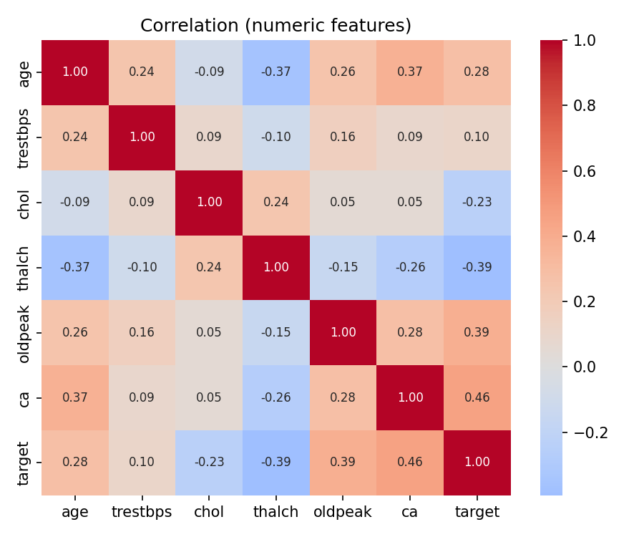
Data Cleaning & Preprocessing
Target converted to binary (any disease grade > 0 becomes 1).
Identifier columns and duplicate rows removed.
Missing values: trestbps (59), chol (29), fbs (90), restecg (2), thalch (55), exang (55), oldpeak (62), slope (307), ca (609), thal (484)
Numeric features: median imputation, then StandardScaler.
Categorical features: most-frequent imputation, then one-hot encoding.
Everything sits inside one scikit-learn Pipeline, so no test data leaks into training.

Slide 6
Method
Stratified 80/20 train-test split (random_state = 42).
Models: Logistic Regression and Decision Tree.
5-fold stratified cross-validation for baseline accuracy.
GridSearchCV tuning (scored on ROC AUC): regularisation C for Logistic Regression; depth, leaf size and criterion for the tree.
Final metrics computed once on the held-out test set.

Slide 7
Results
Model | CV acc. | Accuracy | Precision | Recall | F1 | ROC AUC
Logistic Regression | 0.804 | 0.826 | 0.818 | 0.882 | 0.849 | 0.915
Decision Tree | 0.726 | 0.848 | 0.885 | 0.833 | 0.859 | 0.918
Selected model: Decision Tree (highest ROC AUC, with F1 as tie-breaker).

Slide 8
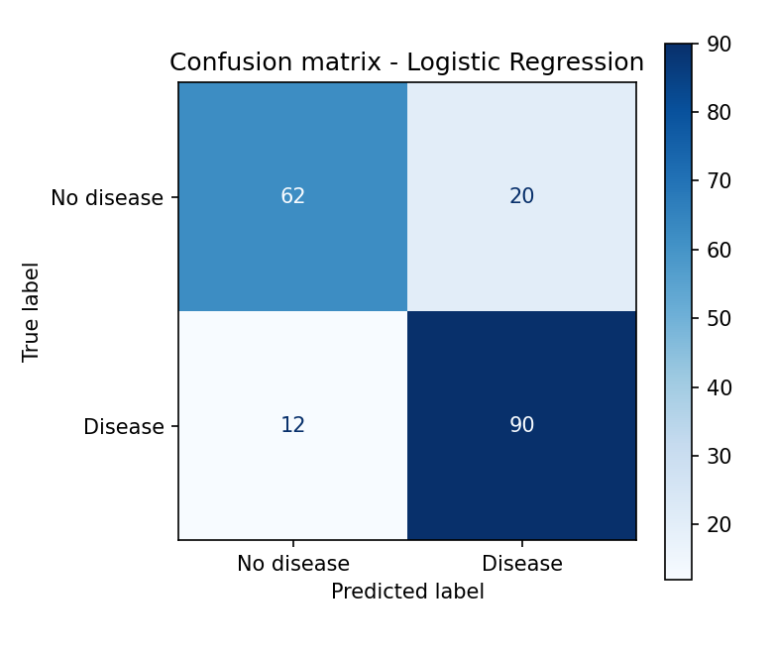
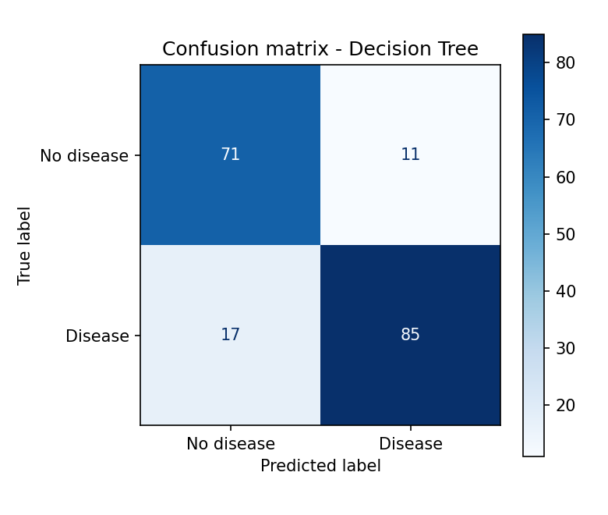
Confusion Matrices

Slide 9
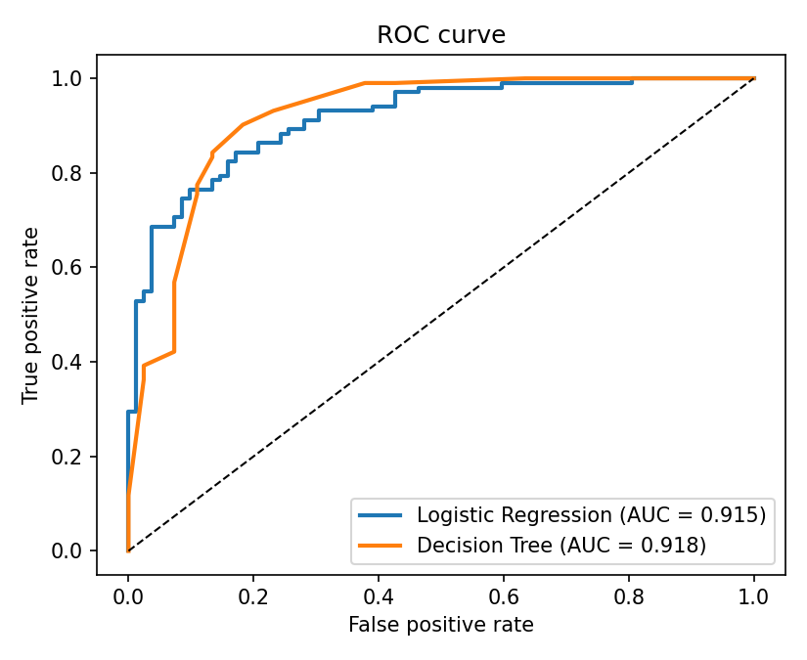
ROC Curve
Logistic Regression: AUC = 0.915
Decision Tree: AUC = 0.918
A curve closer to the top-left corner means better separation between sick and healthy patients.

Slide 10
Conclusion
Decision Tree performed best: ROC AUC 0.918, accuracy 84.8%, recall 83.3%, precision 88.5%.
On 184 unseen patients it caught 85 of 102 true disease cases and missed 17.
The model is saved with joblib (models/heart_model.joblib) and can predict on new patients.
Limitations: small dataset, single train-test split; this is a learning project, not a diagnostic tool.
Next steps: try Random Forest, add calibration, test on external data.

