Slide 1

Greater Noida, Uttar Pradesh
INTERNSHIP PRESENTATION
Web Development Internship
at Codec Technologies Pvt. Ltd.
STUDENT NAME
Session
Ayush Singh
2025-29
ENROLLMENT NUMBER
ORGANIZATION
25SCS1003004676
Codec Technologies Pvt. Ltd.
PROGRAM & SEMESTER
DURATION
B.Tech CSE, 3rd Semester
15 Jul 2026 - 15 Aug 2026

Slide 2
OVERVIEW
What This Presentation Covers
01
Organization Profile
02
Internship Overview
About Codec Technologies Pvt. Ltd.
Role, duration and program details
03
Objectives
04
Technologies Used
Goals set for the internship
Tools and tech stack
05
Work Breakdown
06
Project & Architecture
Week-by-week progress
What was built and how
07
Key Learnings
08
Certificate & Conclusion
Skills gained
Outcome and closing remarks
Web Development Internship | Codec Technologies Pvt. Ltd.
2

Slide 3
CHAPTER 1
Organization Profile
Codec Technologies Pvt. Ltd.
PROGRAM PARTNERS
A technology-driven organization offering AICTE and ICAC approved internship programs, in partnership with the National Internship Portal (Ministry of Education, Govt. of India) and Google for Education.
National Internship Portal
Ministry of Education, Govt. of India
Structured, mentor-led training in Web Development, Data Science, AI, and Cybersecurity
Google for Education
Project-based learning with live doubt-clearing sessions
AICTE & ICAC Approved Program
Focus on building industry-ready, portfolio-worthy skills
Verified certification through the National Internship Portal
Internship Track
Web Developer Intern
Web Development Internship | Codec Technologies Pvt. Ltd.
3

Slide 4
CHAPTER 2
Internship Overview
ROLE
DURATION
MODE
CERTIFICATION
Web Developer Intern
1 Month
(15 Jul - 15 Aug 2026)
AICTE & ICAC Approved
Online Program
Verified via National
Internship Portal
This report presents an account of the one-month internship undertaken as a Web Developer Intern at Codec Technologies Pvt. Ltd., providing hands-on, industry-oriented exposure to modern web development practices - moving beyond classroom theory into practical, project-based learning under the guidance of industry mentors.
“From theory to practice - building real, deployable web applications.”
Web Development Internship | Codec Technologies Pvt. Ltd.
4

Slide 5
CHAPTER 3
Objectives of the Internship
1
Understand the fundamentals of web development - HTML, CSS and JavaScript
4
Apply responsive web design principles for cross-device compatibility
2
Gain hands-on experience with modern front-end frameworks and libraries
5
Build familiarity with Git/GitHub for version control and collaboration
3
Learn the basics of back-end development and client-server interaction
6
Design, develop and deploy a functional web application as a capstone project
Web Development Internship | Codec Technologies Pvt. Ltd.
5

Slide 6
CHAPTER 4
Technologies & Tools Used
01
02
03
Front-End
Styling
Version Control
HTML5, CSS3, JavaScript
Bootstrap / Flexbox / CSS Grid
Git & GitHub
04
05
06
Editor
Debugging
Deployment
Visual Studio Code
Browser Developer Tools
GitHub Pages / Netlify
Web Development Internship | Codec Technologies Pvt. Ltd.
6

Slide 7
CHAPTER 5
Week-by-Week Progress
WEEK 1
WEEK 3
Orientation & Fundamentals
Responsive Design
Semantic HTML5 and CSS3 styling basics
Responsive layouts and UI component building
WEEK 2
WEEK 4
JavaScript Essentials
Capstone Project
DOM manipulation, events and interactivity
Development, testing, debugging and deployment
Regular mentor check-ins, live doubt-clearing sessions and hands-on assignments ensured consistent skill development throughout the program.
Web Development Internship | Codec Technologies Pvt. Ltd.
7

Slide 8
CHAPTER 6
Project & System Architecture
The capstone web application follows a standard client-side architecture, with a modular front-end and clear separation between UI, logic and content layers.
User Interface
Header, navigation, content sections, footer
Application Logic
JavaScript - DOM handling, events, interactivity
Styling Layer
CSS3 / Bootstrap - responsive, cross-device layout
Deployment
Hosted via GitHub Pages / Netlify
Web Development Internship | Codec Technologies Pvt. Ltd.
8

Slide 9
CHAPTER 7
Key Learnings & Skills Gained
Solid, practical understanding of front-end web development
Ability to design responsive, cross-browser compatible websites
✓
✓
Hands-on experience with Git/GitHub collaborative workflows
A deployed, portfolio-ready web application
✓
✓
Improved debugging and self-learning ability
Exposure to real-world, mentor-guided development practices
✓
✓
Web Development Internship | Codec Technologies Pvt. Ltd.
9

Slide 10
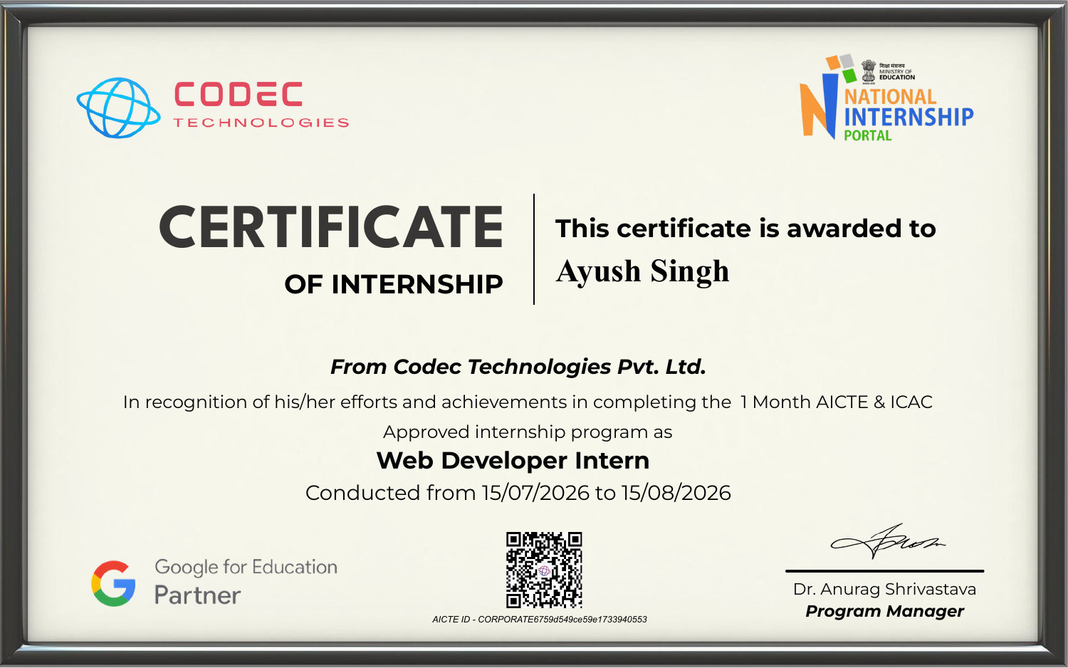
CHAPTER 8
Certificate of Completion
Web Development Internship | Codec Technologies Pvt. Ltd.
10

Slide 11
CONCLUSION
Wrapping Up the Internship
The one-month Web Developer Internship at Codec Technologies Pvt. Ltd. provided valuable, hands-on exposure to industry-standard web development practices - bridging the gap between academic learning and real-world application development.
Practical web development skills
A deployed capstone project
Industry mentorship experience
AICTE & ICAC verified certification
This experience has strengthened my technical foundation and confidence to take on future development roles.
Web Development Internship | Codec Technologies Pvt. Ltd.
11

Slide 12
Thank You
Ayush Singh | 25SCS1003004676 | B.Tech CSE
IILM University, Greater Noida

