Slide 1

HONEYPOT-DRIVEN SOC PLATFORM
Shadow Trust
Deception, detection, investigation and compliance in one local-first security platform
Project presentation
Real telemetry. Explainable detections. Evidence-ready operations.
01
Notes:
Source: README.md. Opening slide. Present the platform as a compact SOC that turns real honeypot activity into usable evidence.

Slide 2

Why Shadow Trust
Security teams need actionable evidence from attack activity, not a dashboard built on simulated numbers
The operational gap
Design principle
Internet-facing services receive noisy scans, password attacks and payload attempts. Teams need a safe way to observe attacker behavior and turn it into cases they can investigate.
Every metric traces to a real query or a real engine. When an external capability has not been configured, the interface reports that state instead of fabricating output.
The platform response
LOCAL-FIRST
EVIDENCE-READY
Shadow Trust runs real honeypots, normalizes their logs, applies rules and correlations, then exposes incident evidence, ATT&CK coverage and reports to analysts.
SHADOW TRUST | SECURITY PLATFORM
02
Notes:
Source: README.md Overview and Security notes.

Slide 3
Platform at a glance
A single laptop deployment combines deception, detection, investigation and governance
3
133
49
25
attack-facing sensors
automated tests
SOC 2 criteria mapped
live evidence collectors
Deception
Detection
Investigation
Cowrie, Dionaea and Honeytrap capture session activity, credentials, payloads and connection attempts.
YAML and Sigma-compatible rules generate explainable detections, incidents and validation results.
Behavior profiling, MITRE mapping, malware tools, labs, reports and compliance evidence support analysts.
SHADOW TRUST | SECURITY PLATFORM
03
Notes:
Sources: README.md Feature highlights, Reports & compliance, Testing.

Slide 4
Attack-facing sensor layer
Three specialized honeypots receive attacker traffic while keeping the application network out of reach
Internet / controlled test traffic
Scans, brute-force attempts, service probes and payload delivery
Cowrie
Dionaea
Honeytrap
SSH / Telnet
Commands, sessions and captured credentials
SMB / FTP / MSSQL
Malware-capture and connection records
Multi-port services
Additional reconnaissance and probe coverage
Sensor outputs are written as newline-delimited JSON for collection. The sensors live only on the isolated honeynet_edge network.
SHADOW TRUST | SECURITY PLATFORM
04
Notes:
Sources: README.md Feature highlights; docker-compose.yml sensor definitions.

Slide 5
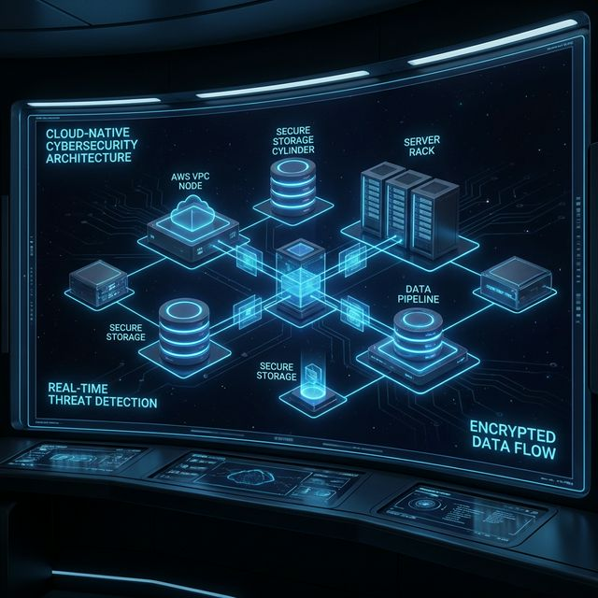
System architecture
The local-first path moves from isolated telemetry to an authenticated analyst workspace
FastAPI backend
Honeynet edge
Raw telemetry
Collector, normalizer, detection engine, incidents, reports and APIs
Cowrie
Dionaea
Honeytrap
Read-only log mount
telemetry/raw
Operator UI
MariaDB 11
Nginx-served dashboard
Authenticated REST + SSE
Application data
Events, sessions, evidence and users
Optional services add APK analysis, remote desktop labs and AWS telemetry / VM orchestration.
SHADOW TRUST | SECURITY PLATFORM
05
Notes:
Sources: README.md Architecture and docker-compose.yml.

Slide 6
Trust boundaries and containment
The edge network and application network do not bridge
honeynet_edge
honeynet_app
Attack-facing sensors
Cowrie
Dionaea
Honeytrap
Compromise is assumed
Backend and database
Frontend / Nginx
MariaDB
Guacamole stack
MobSF / lab services
NO
NETWORK PATH
Permitted channel: sensors write log files; the backend reads them through a read-only mount
SHADOW TRUST | SECURITY PLATFORM
06
Notes:
Sources: docker-compose.yml security model comments; README.md Architecture and Security notes.

Slide 7
Telemetry ingestion and normalization
A cursor-based collector turns sensor-specific logs into a shared investigation schema
1
2
3
4
5
Sensor log
Tail + cursor
Normalize
Deduplicate
Persist + stream
Cowrie, Dionaea or Honeytrap writes raw JSON
Collector reads only new records every few seconds
Map fields into a sensor-agnostic event model
Content hash blocks duplicate records
Store for queries and publish live updates
The system retains raw telemetry while also building structured events, sessions and correlated evidence for the analyst workflow.
SHADOW TRUST | SECURITY PLATFORM
07
Notes:
Source: README.md Feature highlights and Project structure.

Slide 8
Detection to incident lifecycle
Rules, correlation and evidence explain why an alert exists and how it relates to the attack
Normalized event
Rule evaluation
Detection
Incident
Response record
Protocol, source, session, command or payload evidence
YAML detections
Sigma support
Correlation cycle
Risk breakdown
Technique candidates
Linked indicators
Timeline
Evidence chain
Analyst audit trail
Report download
Validation result
GRC evidence
The incident view preserves the reconstruction path rather than reducing an attack to a single unexplained severity score.
SHADOW TRUST | SECURITY PLATFORM
08
Notes:
Sources: README.md Feature highlights, Reports & compliance; backend/detections/*.yml.

Slide 9
Analyst investigation flow
The operator can move from an alert to a defensible case without leaving the platform
1
2
3
4
5
Review
Scope
Explain
Validate
Document
Open live events, health and dashboard signals
Pivot into session, source IP, credentials and IOCs
Read timeline, risk breakdown and MITRE coverage
Run an authorized local scenario to measure detections
Generate evidence-backed report and audit record
Outcome: analysts can connect attack activity with evidence, coverage and an auditable action trail.
SHADOW TRUST | SECURITY PLATFORM
09
Notes:
Sources: README.md Dashboard and Reports & compliance.

Slide 10
Behavior profiling and MITRE mapping
The platform describes what the attacker did from observed signals without claiming named-APT attribution
Observed interaction graph
Measured signals
Actionable classification
Nodes represent sessions, sources, commands or targets. Edges capture observed relationships across attacker activity.
Centrality
Command patterns
Credential behavior
Session timing
Automated scanner
Credential-stuffing bot
Hands-on-keyboard
Mapped ATT&CK techniques
Classification remains evidence-led: observed behavior supports operational triage, while attribution requires separate intelligence and validation.
SHADOW TRUST | SECURITY PLATFORM
10
Notes:
Sources: README.md Feature highlights; backend/app/ai_engine/gnn_profiler.py; backend/ai_engine/mitre_map.py.

Slide 11
Detection validation and SOC 2 readiness
Security controls are tested against controlled scenarios and tied to live evidence collectors
Controlled scenario
Detection grade
Readiness evidence
Authorized local attack scenario targets 127.0.0.1 and exercises a known detection path.
After one detection cycle, the system reports PASS, PARTIAL or FAIL with rate and ATT&CK coverage.
49 Trust Services Criteria map to 25 live collectors. Controls may score met, partial, gap or manual.
The readiness assessment helps identify gaps. It does not replace an independent SOC 2 examination by a licensed CPA firm.
SHADOW TRUST | SECURITY PLATFORM
11
Notes:
Sources: README.md Feature highlights and Reports & compliance.

Slide 12

Threat analysis toolkit
Static and dynamic workflows share the same investigation context
Binary analysis
URL scanner
Static parsing, YARA, ClamAV and secret-pattern checks. CAPE detonation becomes available when configured.
DNS, SSL and HTTP probing with entropy, homograph, WHOIS and geolocation checks.
APK inspector
Unified evidence
MobSF-backed Android analysis with a locally hosted service endpoint.
Findings can feed reports, incident evidence and analyst decision-making.
SHADOW TRUST | SECURITY PLATFORM
12
Notes:
Sources: README.md Analysis tools and Tech stack; backend/requirements.txt.

Slide 13
Hands-on analysis environments
Disposable labs provide a safe place to observe behavior while the platform captures the resulting evidence
Analysis Lab
Virtual Lab
Interactive terminal inside a disposable Linux sandbox. The sandbox uses an internal, egress-free network. Commands and outbound connection attempts feed the pipeline.
Provision Kali as a local Docker desktop, or Windows / Kali in AWS mode. Apache Guacamole streams the session in the browser.
EGRESS-FREE SANDBOX
BROWSER-STREAMED DESKTOP
SHADOW TRUST | SECURITY PLATFORM
13
Notes:
Sources: README.md Analysis tools and Tech stack; docker-compose.yml VM Lab comments.

Slide 14

Operator experience
A dark-theme dashboard puts investigations, telemetry, governance and tools behind one authenticated interface
Command Center
Grid monitoring
Tactical overview
Investigations
Event log
Reports
Honeypot nodes
Splunk Blue Team
Geo intelligence
Intelligence + governance
Tools suite
MITRE matrix
Detection validation
Behavior profiling
GRC and SOC 2
Binary analysis
URL scanner
APK inspector
Virtual Lab
SHADOW TRUST | SECURITY PLATFORM
14
Notes:
Sources: README.md Dashboard and Quick start; frontend/*.html.

Slide 15
Security controls built into the platform
The deployment assumes the honeypots will be attacked and limits the blast radius
Network separation
Read-only rule inputs
Hardened containers
Honeypot and application networks do not bridge
Detection rules, YARA rules and scenarios mount read-only
No-new-privileges, reduced Linux capabilities, memory and PID limits
Protected evidence
Guarded access
Quarantine and incident evidence stay out of Nginx-served paths
Authentication, audit logging and rate limiting support API operations
Deployment note: keep port 8000 off untrusted networks and use a reverse proxy with TLS for public exposure.
SHADOW TRUST | SECURITY PLATFORM
15
Notes:
Sources: docker-compose.yml Security model; README.md Security notes.

Slide 16
Technology stack
The platform combines a Python control plane with containerized sensors, services and a static operator UI
Layer | Selected technology | Platform role
Backend | Python 3.11, FastAPI, SQLAlchemy, aiomysql | Async APIs, collection, detection and incident services
Data | MariaDB 11, PostgreSQL for Guacamole | Application persistence and remote desktop support
Frontend | HTML, CSS, JavaScript, Nginx, Chart.js | Operator dashboard and live visualizations
Detection | YAML, Sigma, NetworkX, MITRE mapping | Explainable rules, correlation and behavior analysis
Analysis | YARA, ClamAV, MobSF, optional CAPE | Binary, APK and malware analysis
Operations | Docker Compose, Guacamole, Boto3 | Local orchestration, labs and optional AWS mode
SHADOW TRUST | SECURITY PLATFORM
16
Notes:
Sources: README.md Tech stack and Project structure; backend/requirements.txt.

Slide 17
Deployment modes and operating entry points
Local mode starts the full honeynet with Docker Compose; AWS mode adds cloud telemetry and cloud VMs
Local mode
AWS mode
docker compose up
Telemetry: local telemetry/raw
Virtual Lab: Kali Docker container
Cost: local infrastructure only
INFRA_PROVIDER=aws
Telemetry: S3 pipeline poller
Virtual Lab: EC2 Windows / Kali
Cost: AWS account usage
Dashboard :5500
API :8000
MobSF :5055
Guacamole :8080
phpMyAdmin :8081
SHADOW TRUST | SECURITY PLATFORM
17
Notes:
Sources: README.md Quick start, Local mode vs AWS mode, docker-compose.yml.

Slide 18
Presentation demo flow
A concise walkthrough that shows how the system converts a controlled signal into an explainable outcome
1
2
3
4
5
Start stack
Generate signal
Investigate
Validate
Report
Run setup and open the operator dashboard
Replay telemetry or execute an authorized local scenario
Trace event, detection, timeline and MITRE coverage
Review pass / partial / fail and evidence
Export an evidence-backed PDF or readiness assessment
Shadow Trust packages the complete security-operations loop: observe the attacker, explain the detection, preserve the evidence and improve coverage.
Thank you
SHADOW TRUST | SECURITY PLATFORM
18
Notes:
Sources: README.md Quick start, Feature highlights, Dashboard.

