Slide 1
Century Plyboards(India) Ltd.
Internship Project Presentation
Under the supervision of : Mr. Bhargab Dutta, CDO
Mr. Arindam Saha, Lead
Created By : Ayush Singh , Pre-Final Year, NIT Kurukshetra

Slide 2
Project Overview
Projects
RPA Console
Lead to Sales data Prediction Model
Email Attachment downloading Automation Script
TechStack :
React for frontend development
Django for backend development.
Material UI, ShadCn.
TechStack :
Python, Numpy and Pandas for data preprocessing and modeling,
one hot encoding for categorical data to numerical data conversion
scikit-learn and XGB Regressor for machine learning algorithms, and
Jupyter Notebook for data analysis and visualization.
TechStack :
Python for scripting
IMAP and SMTP protocols for email communication
various libraries for email parsing and attachment handling.
https://github.com/ayushCPIL21/projectcpil
103.231.126.221

Slide 3
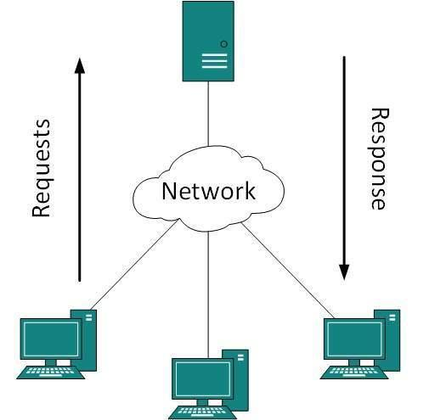
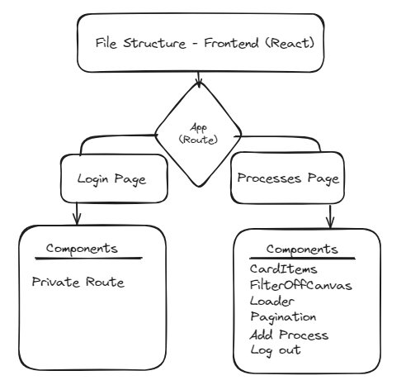
RPA CONSOLE :
Architecture: The architecture of the RPA console project involved a client-server model. The frontend was developed using React, a popular JavaScript library for building user interfaces. The frontend interacted with the backend server, which was developed using Django, a high-level Python web framework.

Slide 4
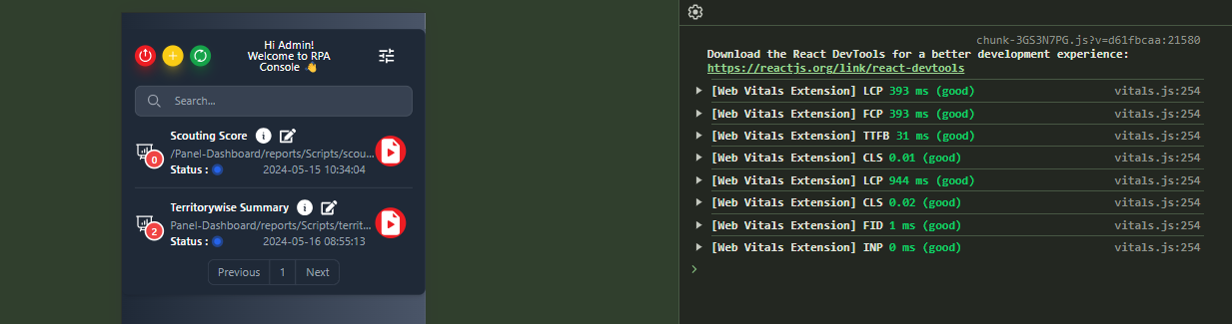
React
React Fiber Architecture
Reconciliation is the algorithm behind what is popularly understood as the "virtual DOM." A high-level description goes something like this: when you render a React application, a tree of nodes that describes the app is generated and saved in memory. This tree is then flushed to the rendering environment — for example, in the case of a browser application, it's translated to a set of DOM operations. When the app is updated (usually via setState), a new tree is generated. The new tree is diffed with the previous tree to compute which operations are needed to update the rendered app.
Hooks : Hooks are a new addition in React 16.8. They let you use state and other React features without writing a class.
Important Hooks used in the project : useEffect , useState, useNavigate, useParams, usePrivateRoute(custom)
Website Performance report
Advantages of using React :
It is composable.
SEO friendly.
Fast, efficient, and easy to learn.
It guarantees stable code.
It is backed by a strong community.

Slide 5
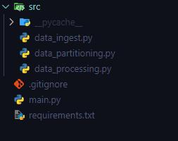
Lead to Sales Days Prediction Model
Class Based clean code: Developed a modular Python framework for machine learning prediction, organized into separate classes and functions across different files, each dedicated to specific tasks such as data ingestion, preprocessing, modeling, and prediction, ensuring clean and efficient code organization and workflow.
Dealing with null value :
Dropping :
2. Filling :

Slide 6
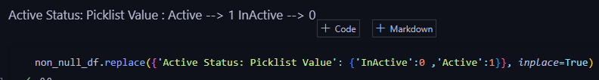
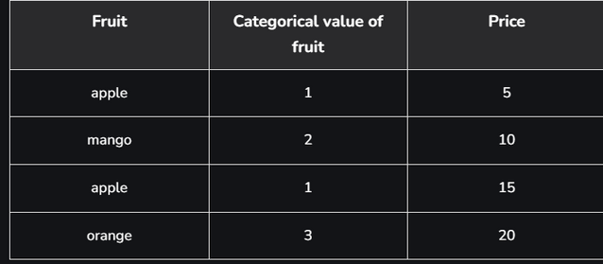

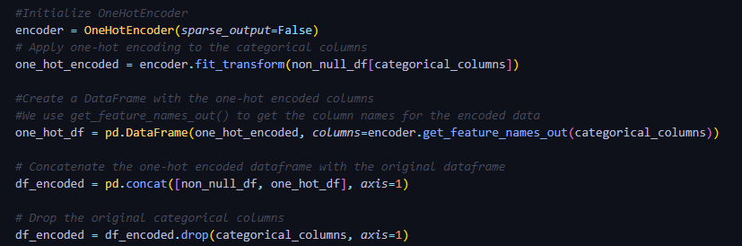
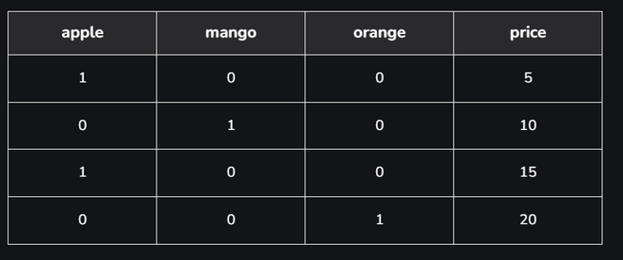
Lead to Sales Days Prediction Model
Dealing with categorial data:
Label Encoding:
2. One Hot Encoding :

Slide 7
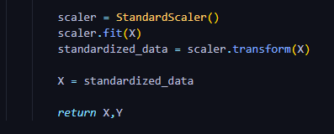
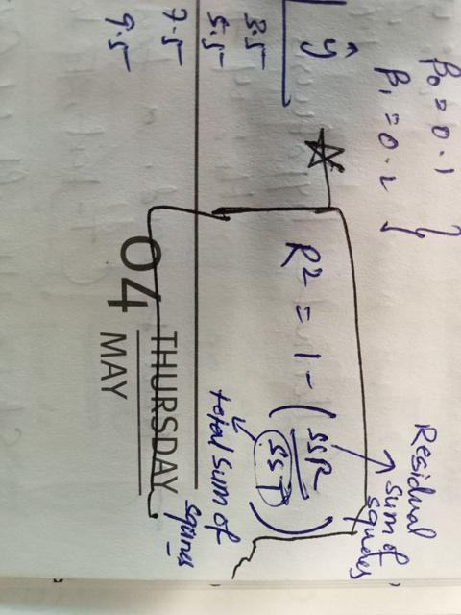
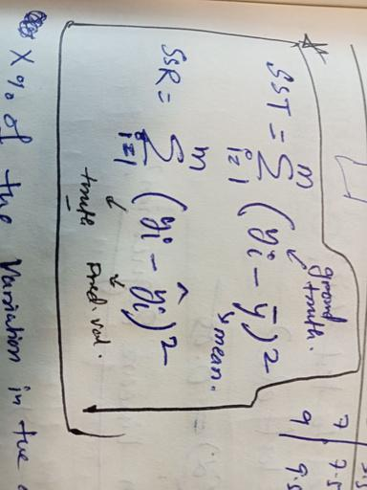



Lead to Sales Days Prediction Model
Feature Scaling : Method used to normalize the range of independent variables or features of data
Model Evaluation :

Slide 8
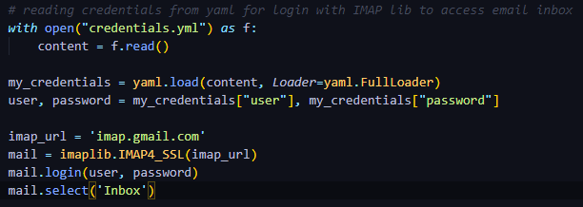
Email Attachment Download Automation
IMAP (Internet Messaging Access Protocol) and SMTP (Simple Mail Transfer Protocol) :

Slide 9
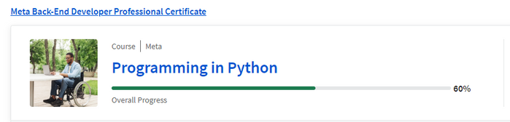
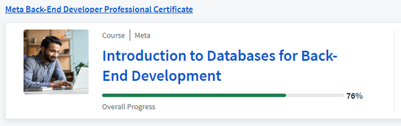
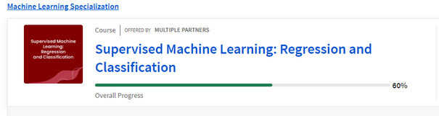
What I Learned Throughtout ?
Robust and Industry Grade Code writing practices
Python Programming and Automation
Supervised Learning Concepts
FastAPI
Databases
Django(Basics)
Teamwork
Maintained the consistency :
Completed more that 60% of 3 courses
Maintained a 138 days daily problem solving streak on leetcode

Slide 10

Resources
https://www.udemy.com/?gad_source=1&utm=47edc241c56cb8c9f1d4de0146f1e119&track=1&pt=2
https://github.com/acdlite/react-fiber-architecture
Youtube ,Google Search and chatGPT

Slide 11
Special
Thanks
Arindam Saha for continuously helping and mentoring throughout the internship period
Anirban Mukherjee for actively helping in the backend part of the project and mentoring in technical part of the projects
Argha Saha for guiding in the conceptual and overall understanding of the project

Slide 12
Thank
You
It was a great team to work
I can do things you cannot, you can do things I cannot; together we can do great things. - Mother Teresa

