Slide 1
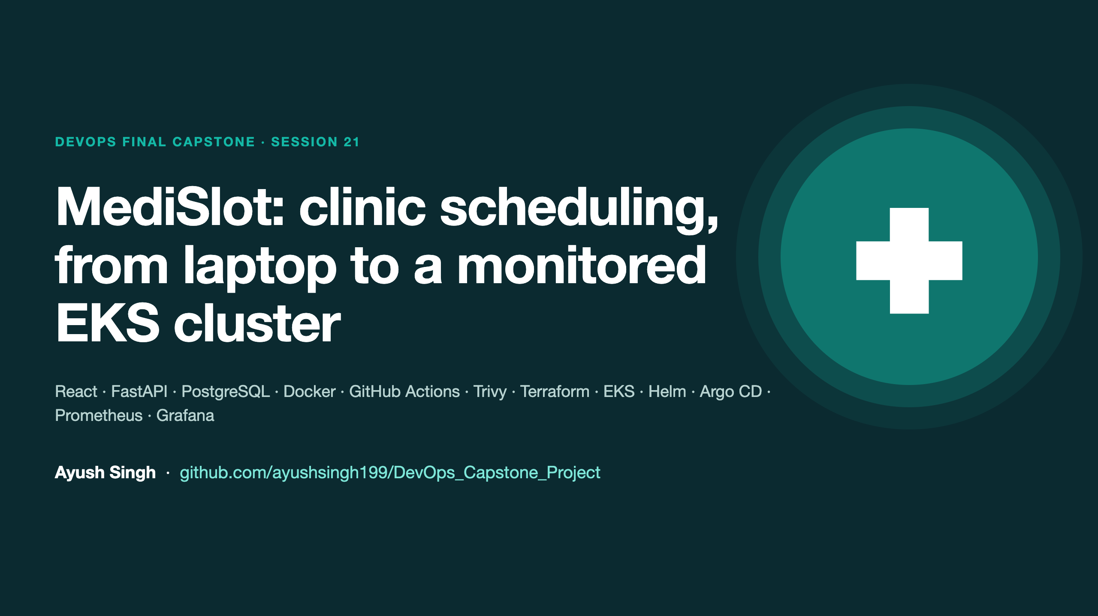
Notes:
Introduce yourself and the project in one sentence: a clinic appointment platform taken from laptop to a monitored, autoscaled, GitOps-managed EKS deployment.

Slide 2
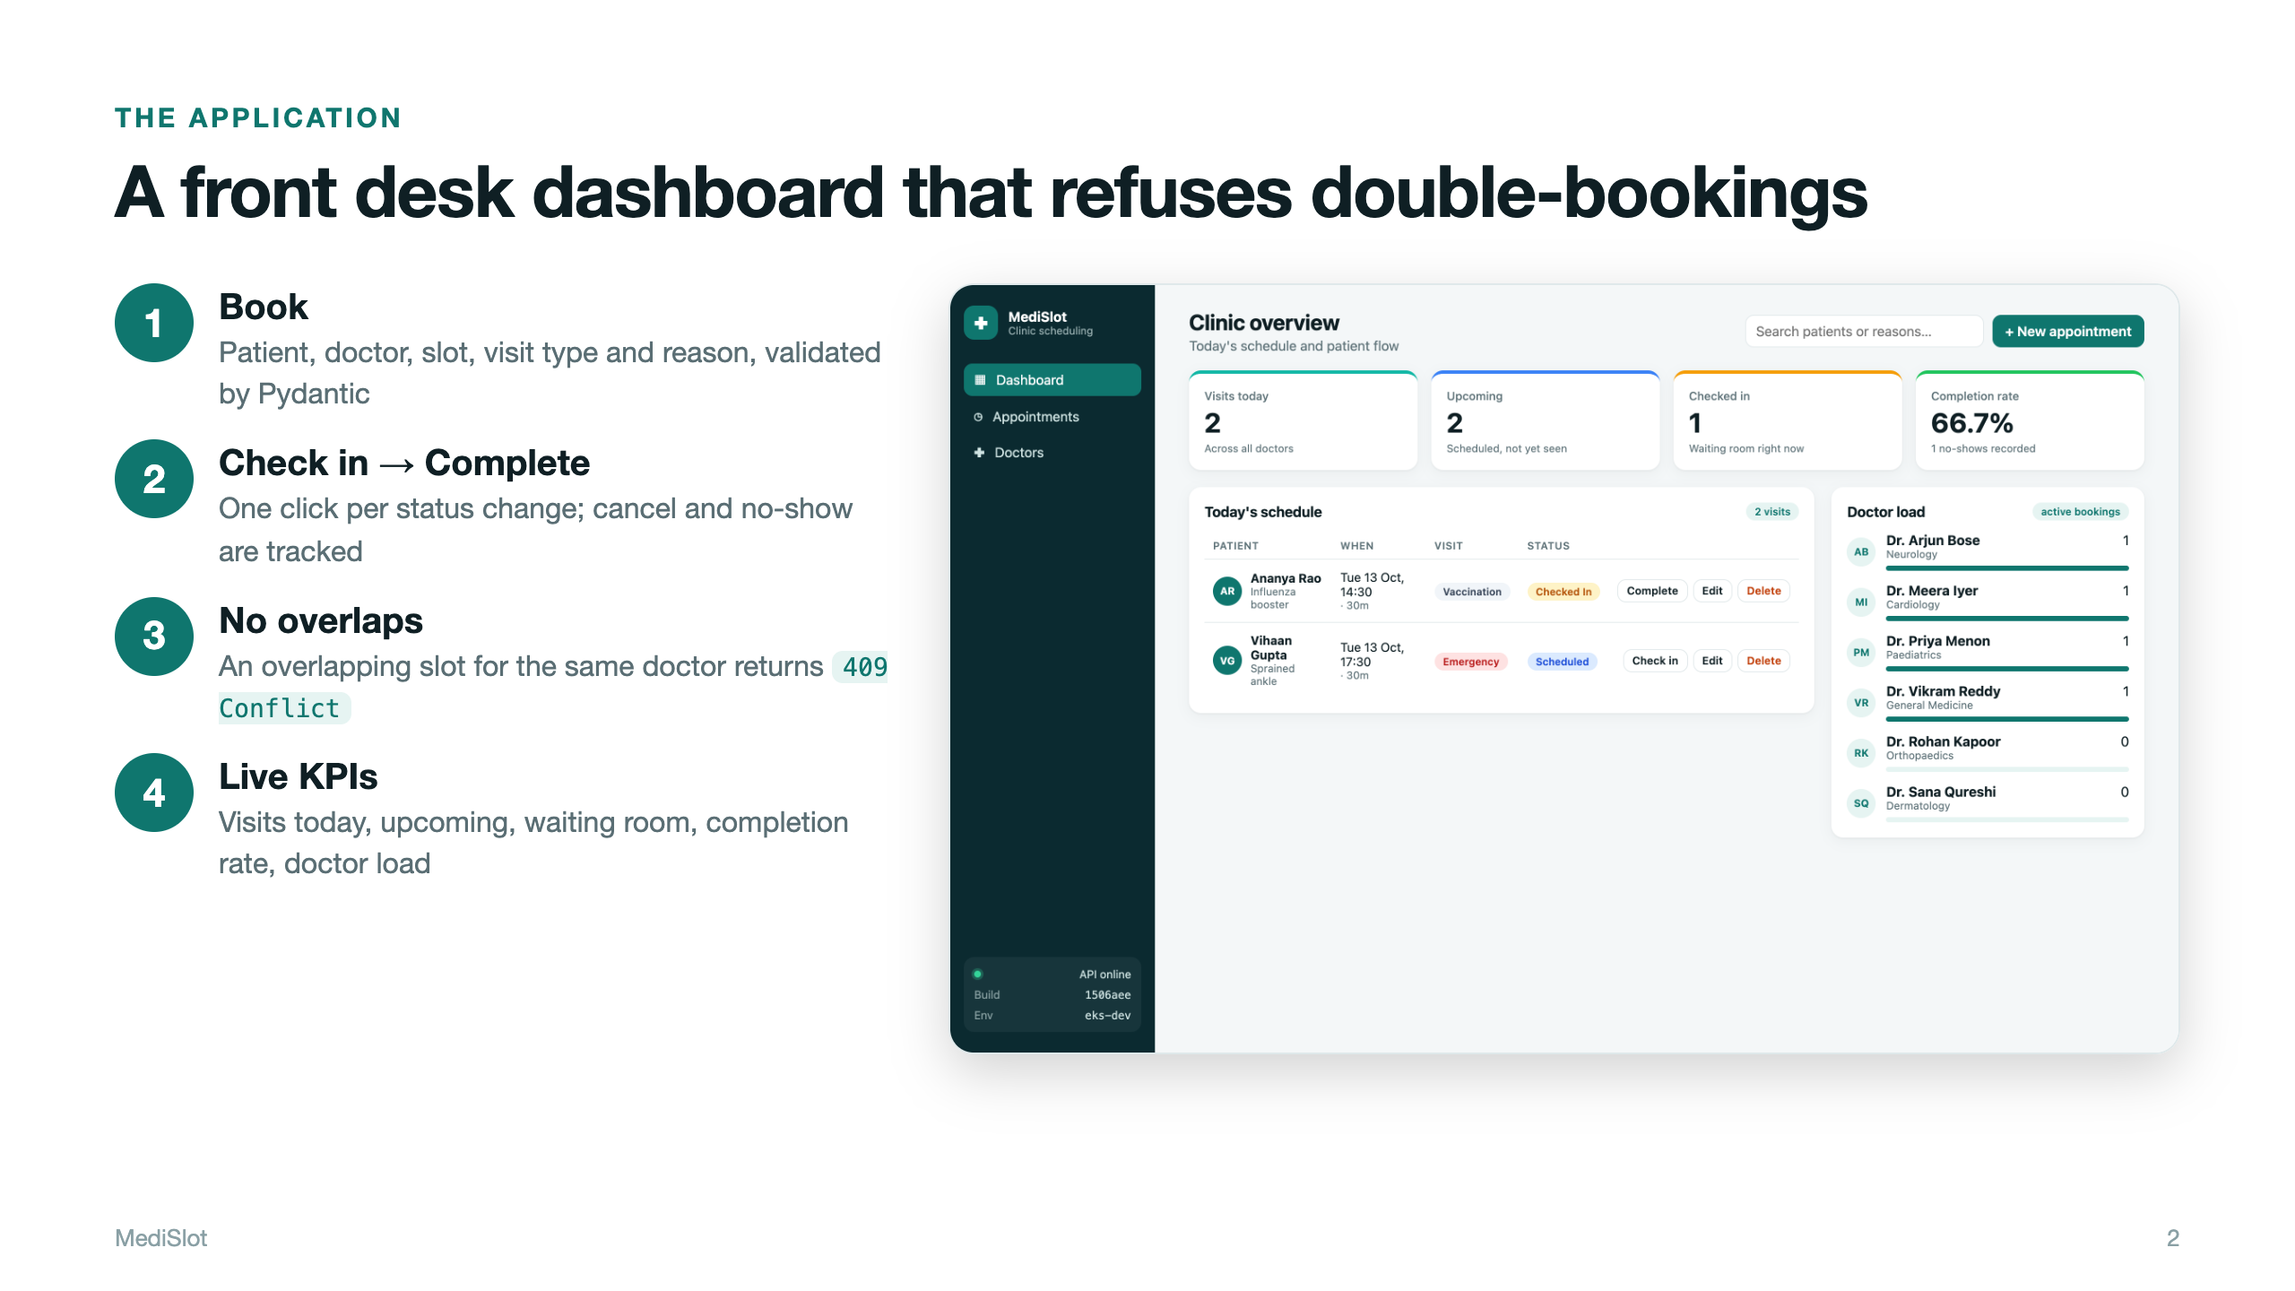
Notes:
Explain the users (front-desk staff), the main workflow (book, check in, complete) and the key business rule: no double-booking, enforced by the API with a 409.

Slide 3
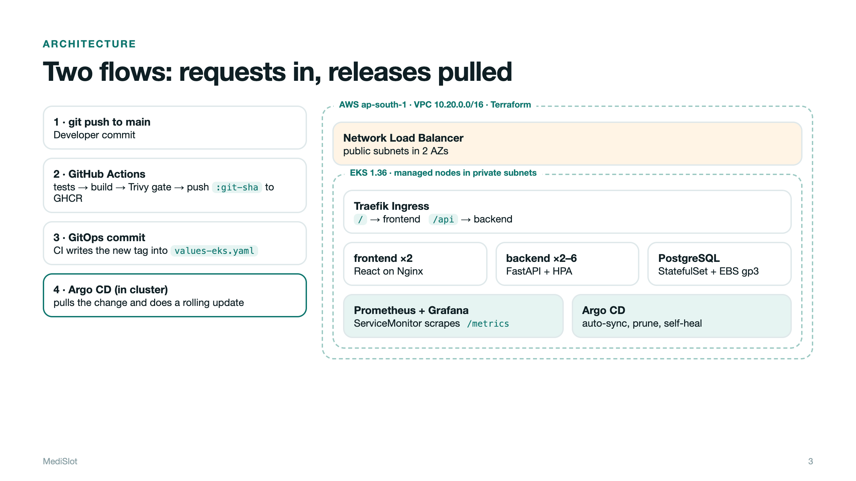
Notes:
Two flows. Request flow: NLB, Traefik, frontend or backend, Postgres. Delivery flow: push, Actions, GHCR, commit of the new tag, Argo CD pulls it. CI never holds cluster credentials.

Slide 4
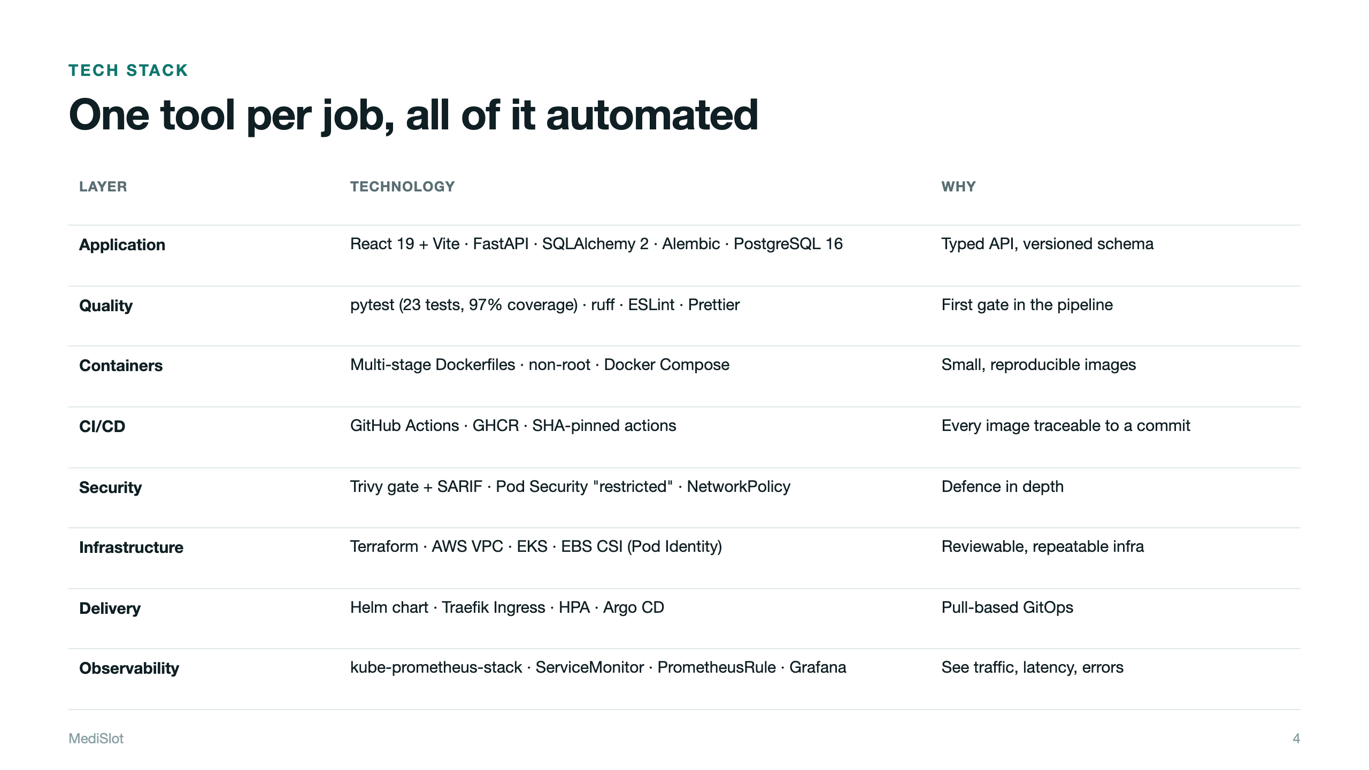
Notes:
Run through the stack quickly. Every row maps to a rubric module.

Slide 5
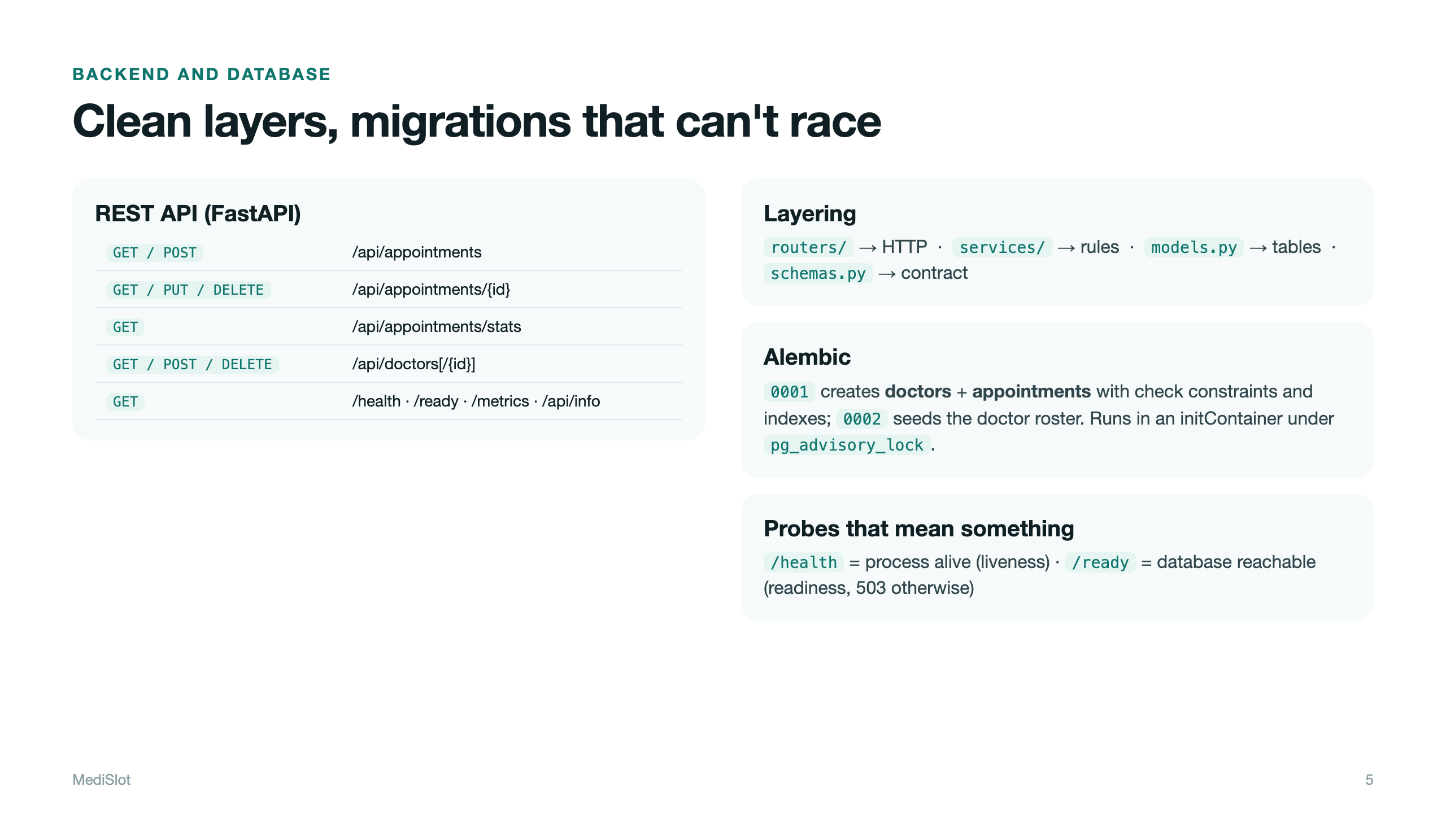
Notes:
Routers handle HTTP only, services hold the business rules, models map tables. Two migrations; they run in an initContainer under a Postgres advisory lock.

Slide 6
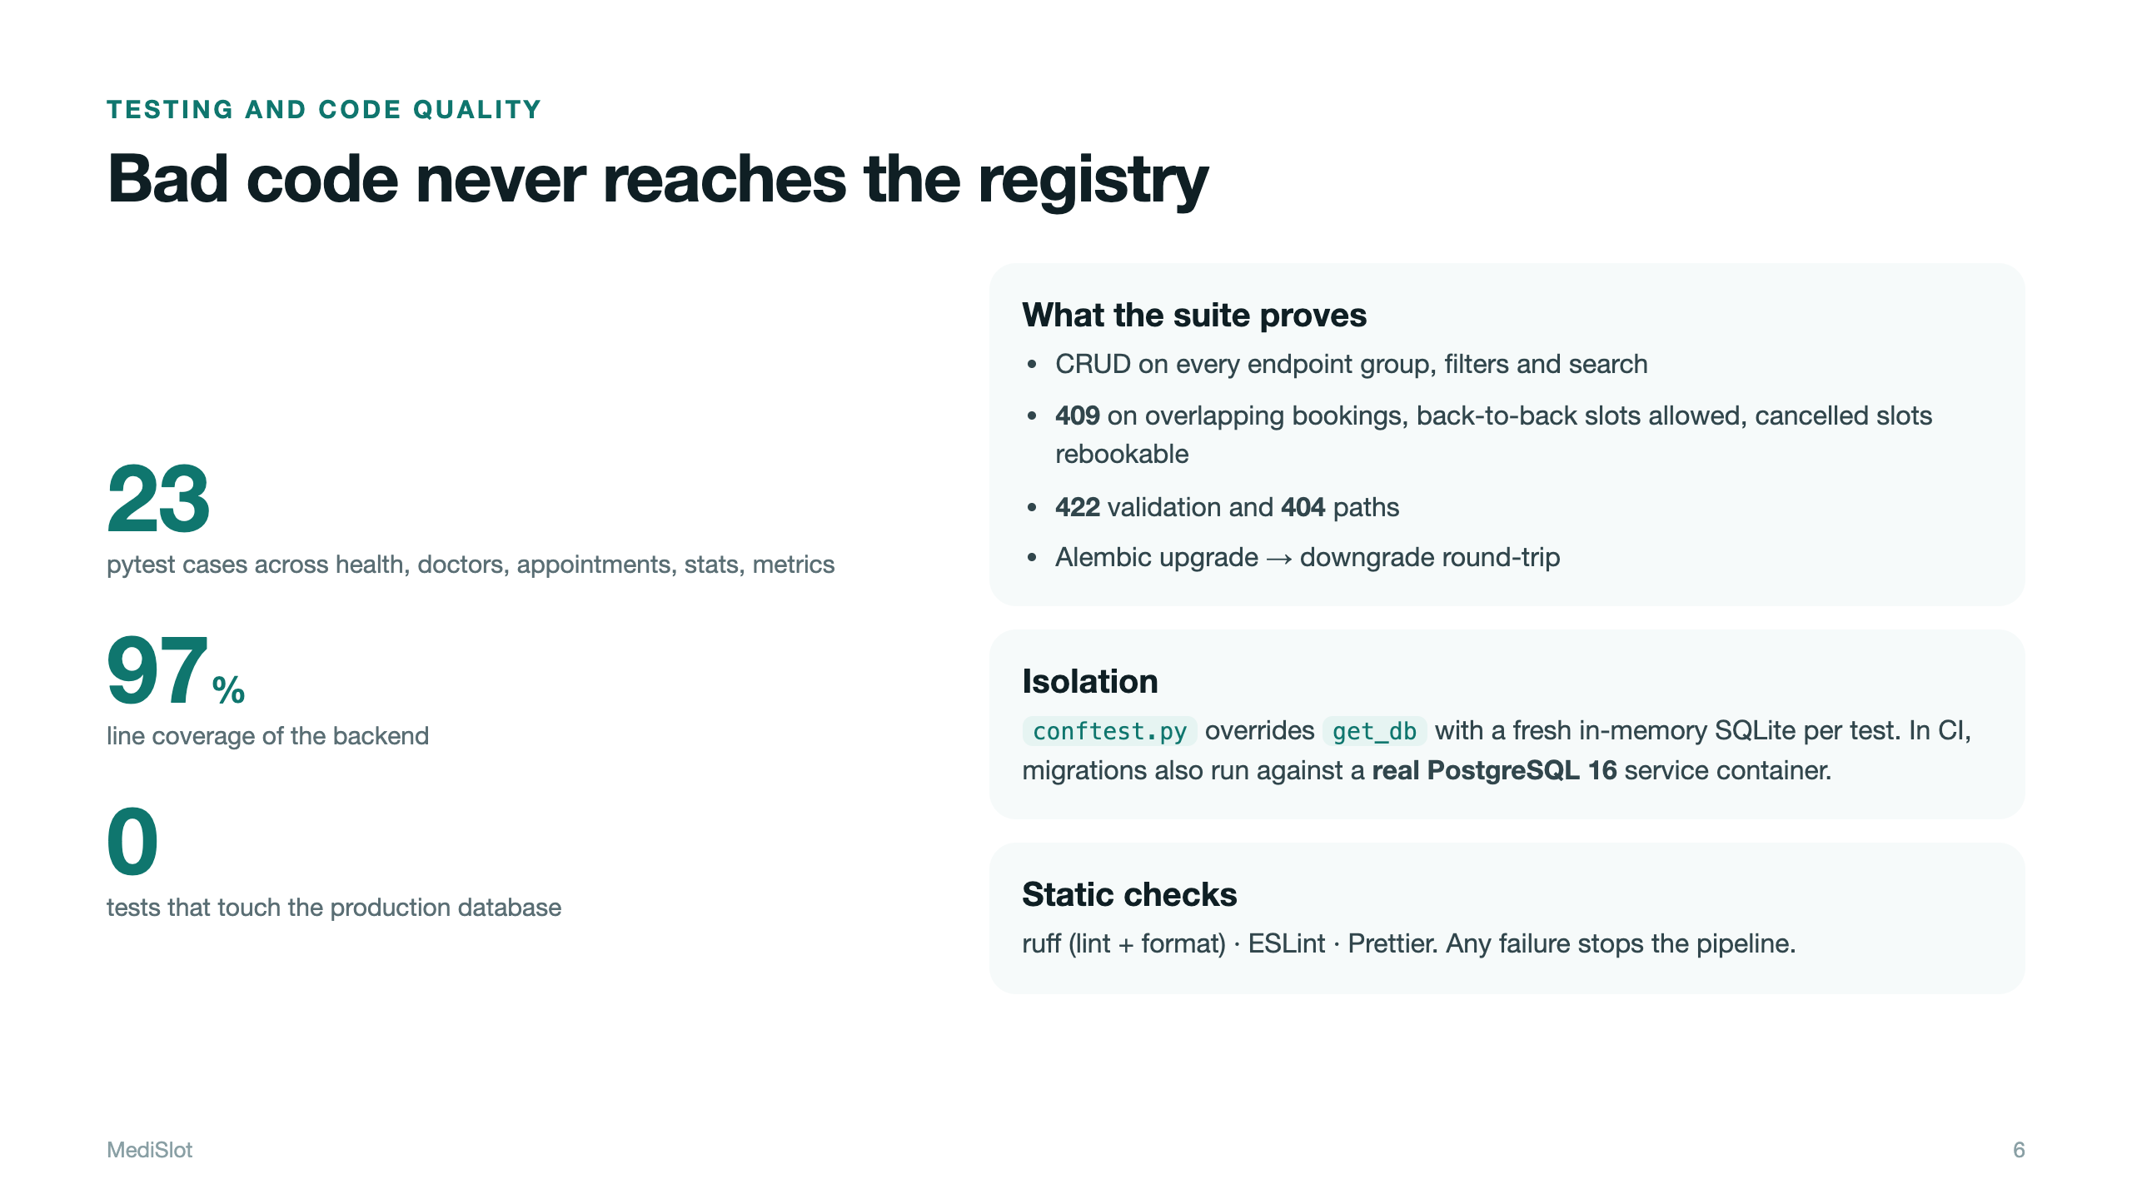
Notes:
Each test gets its own in-memory SQLite DB via dependency override, so production Postgres is never touched. CI also runs the migrations against a real Postgres container.

Slide 7
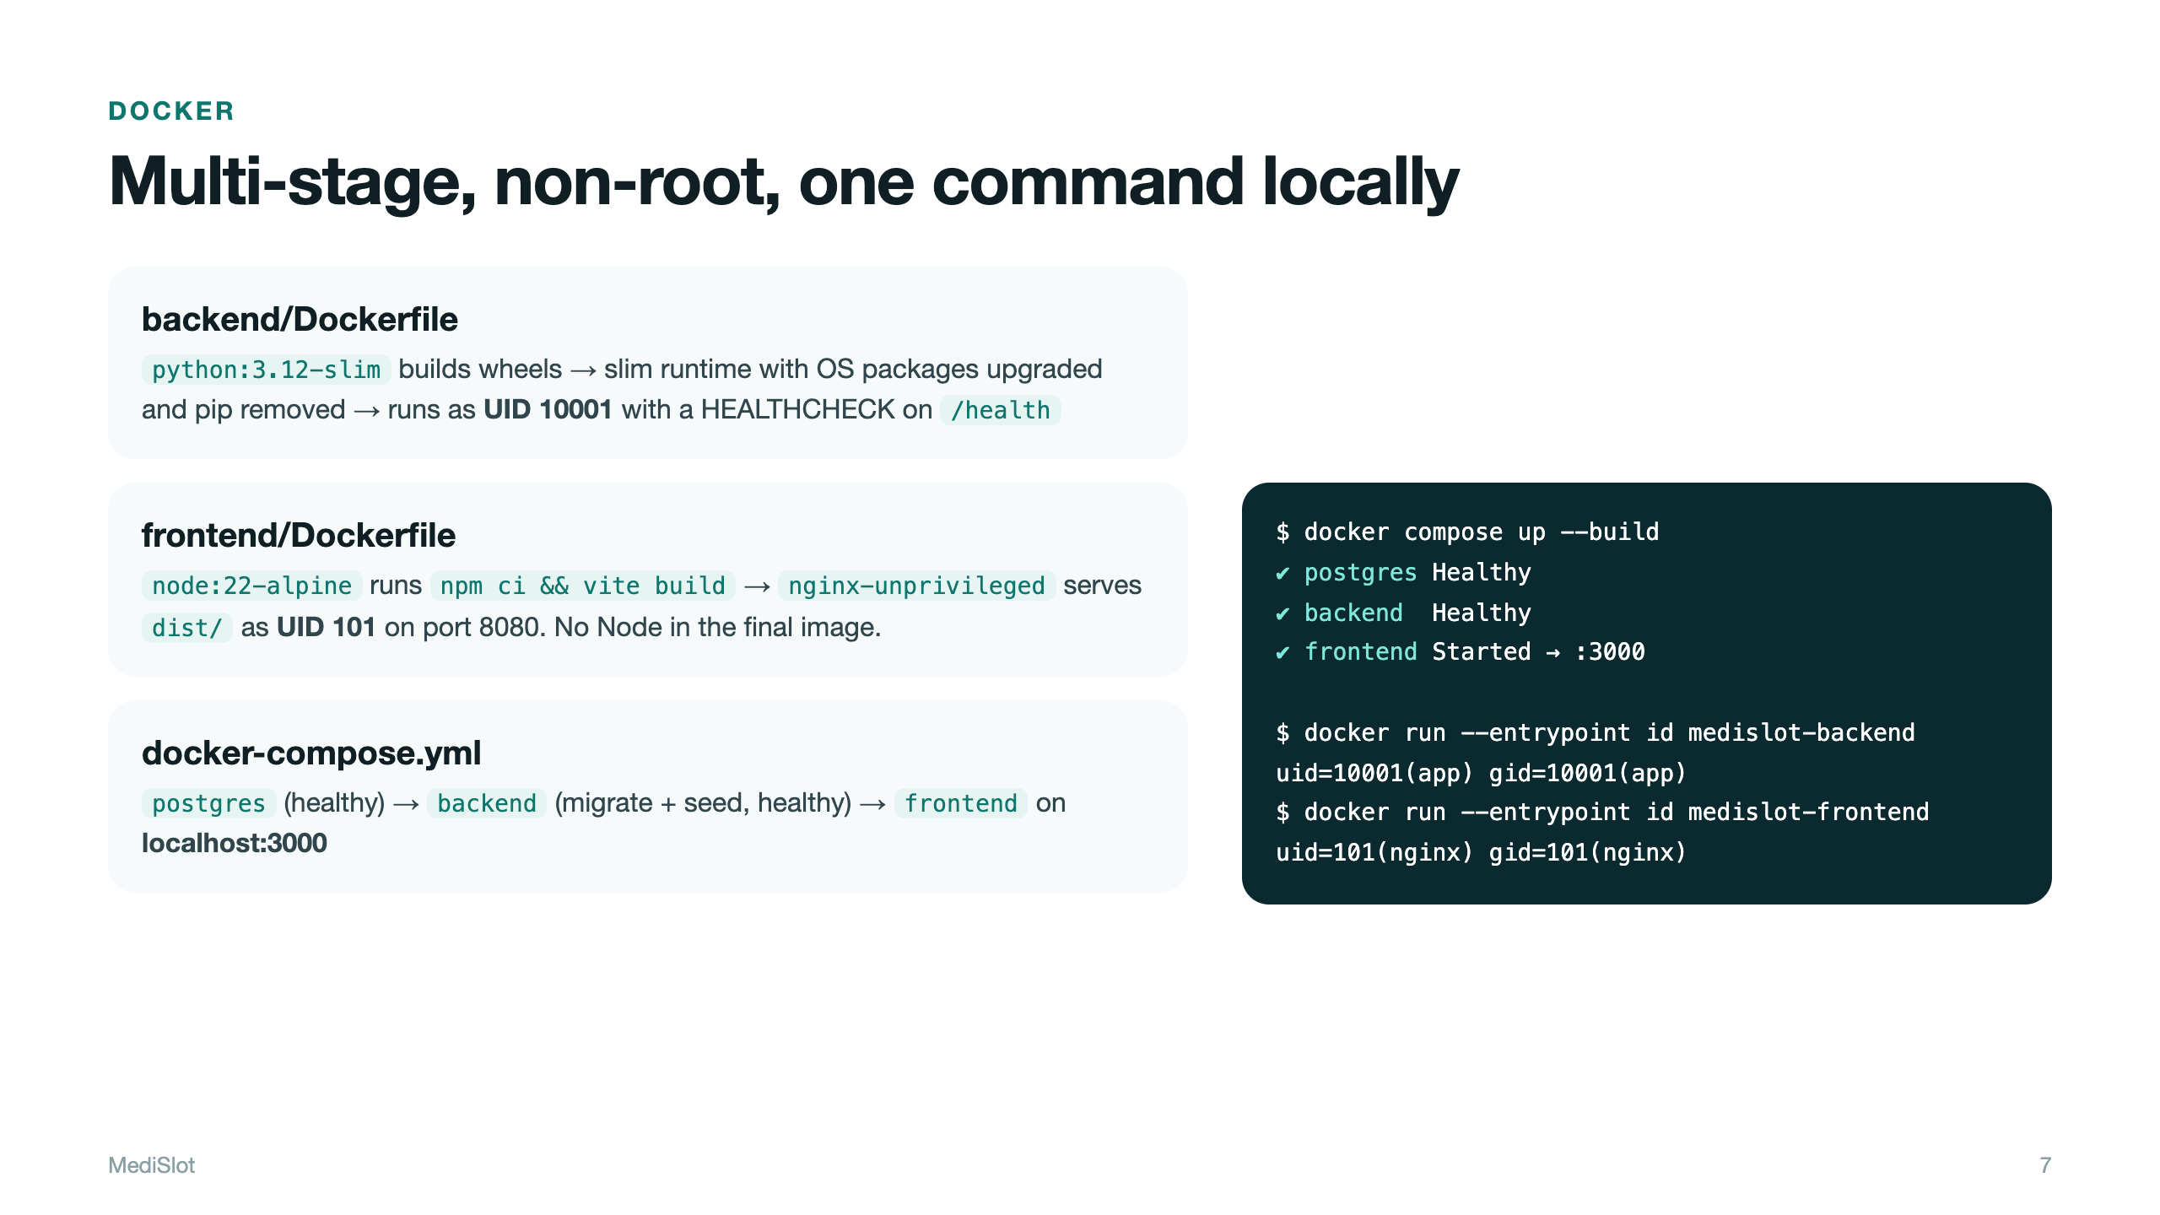
Notes:
Both builds are multi-stage, so build tools never ship. Both run as non-root; the frontend uses nginx-unprivileged on port 8080. Compose starts all three services with health-gated ordering.

Slide 8
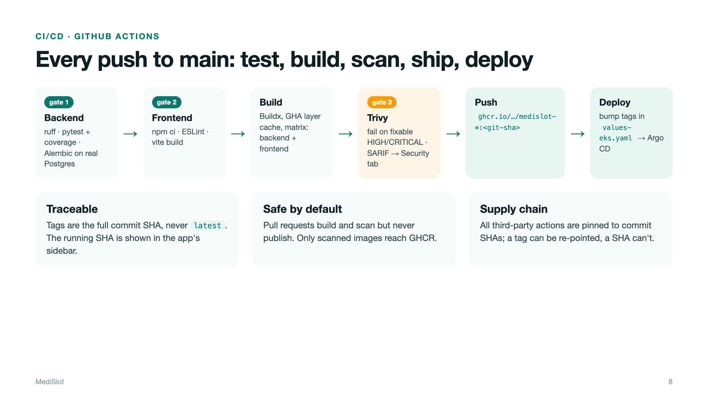
Notes:
Walk the stages left to right. Emphasise SHA tags (never latest), push only after the scan, and actions pinned to commit SHAs because tags can be moved.

Slide 9
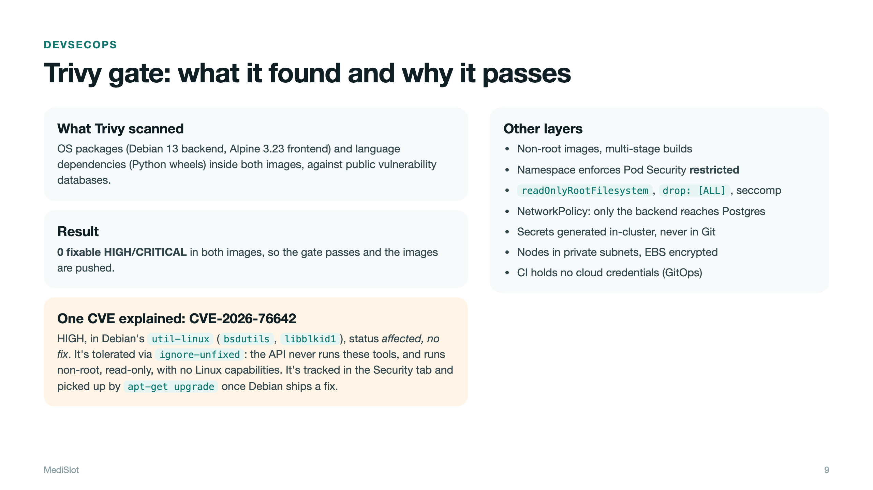
Notes:
Explain the CVE: util-linux packages in Debian, HIGH, no fix released. ignore-unfixed avoids blocking on things nobody can fix; they stay visible in the Security tab, and the runtime hardening limits exposure.

Slide 10
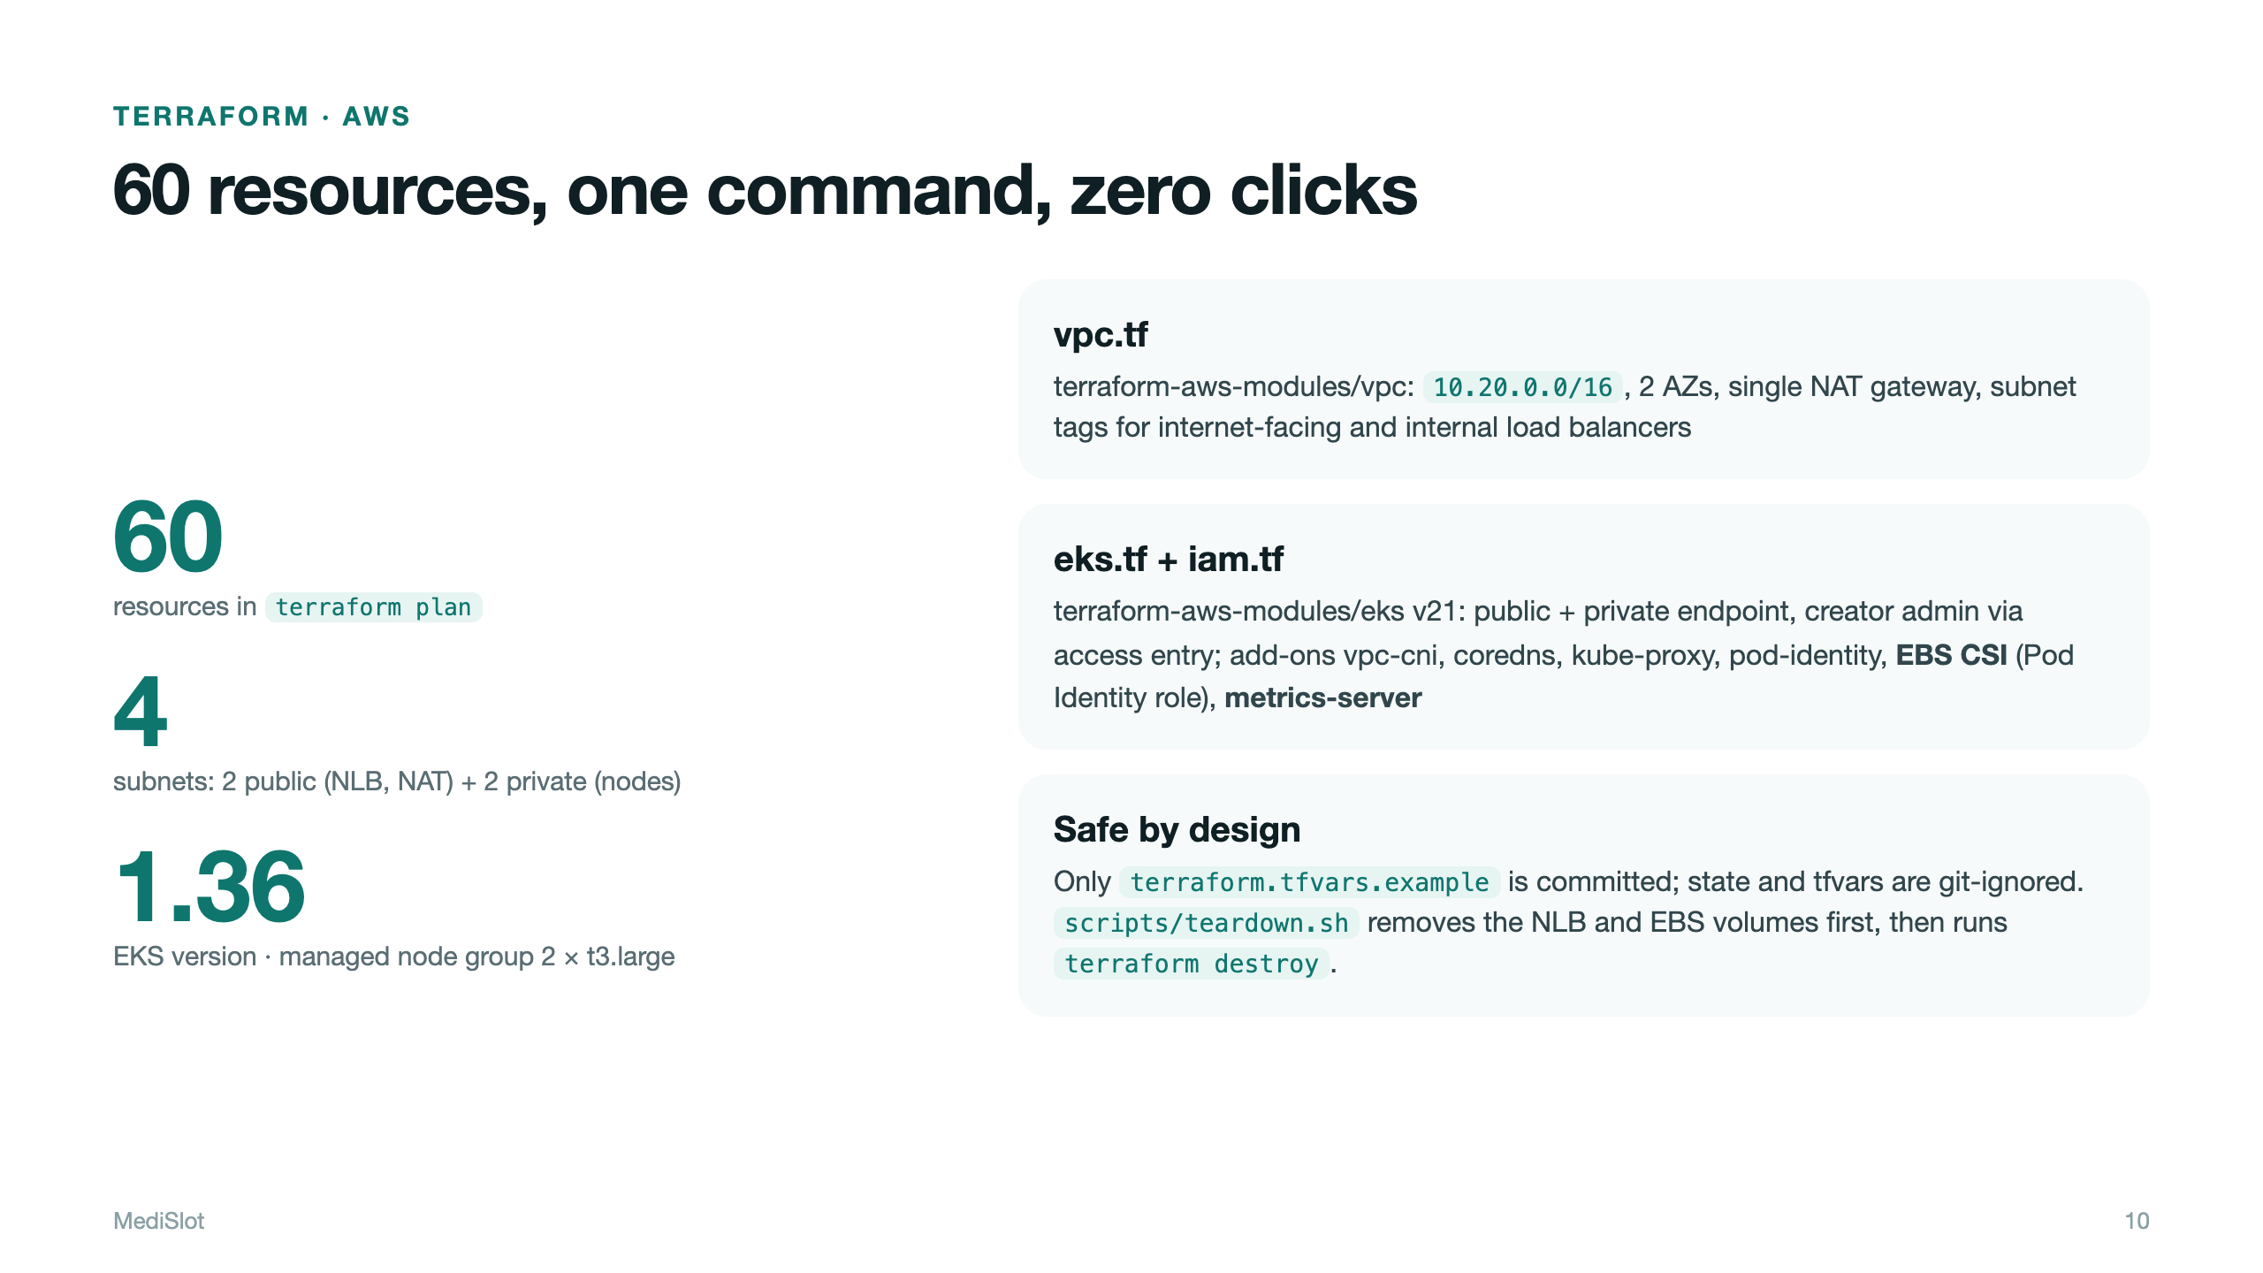
Notes:
Show the module layout and the numbers: 60 resources, 2 public + 2 private subnets, EKS 1.36, node group of 2 t3.large in private subnets. Credentials come from the AWS CLI profile.

Slide 11
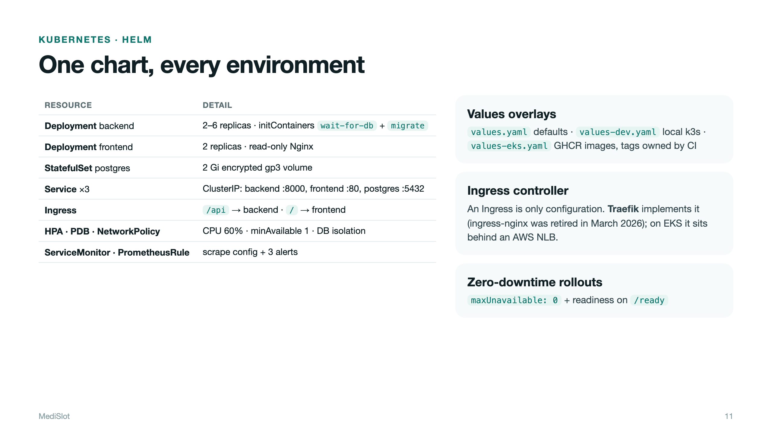
Notes:
Walk through what the chart creates. Mention the initContainers, the probes, HPA, PDBs and the NetworkPolicy. Ingress needs a controller: Traefik, since ingress-nginx was retired in March 2026.

Slide 12
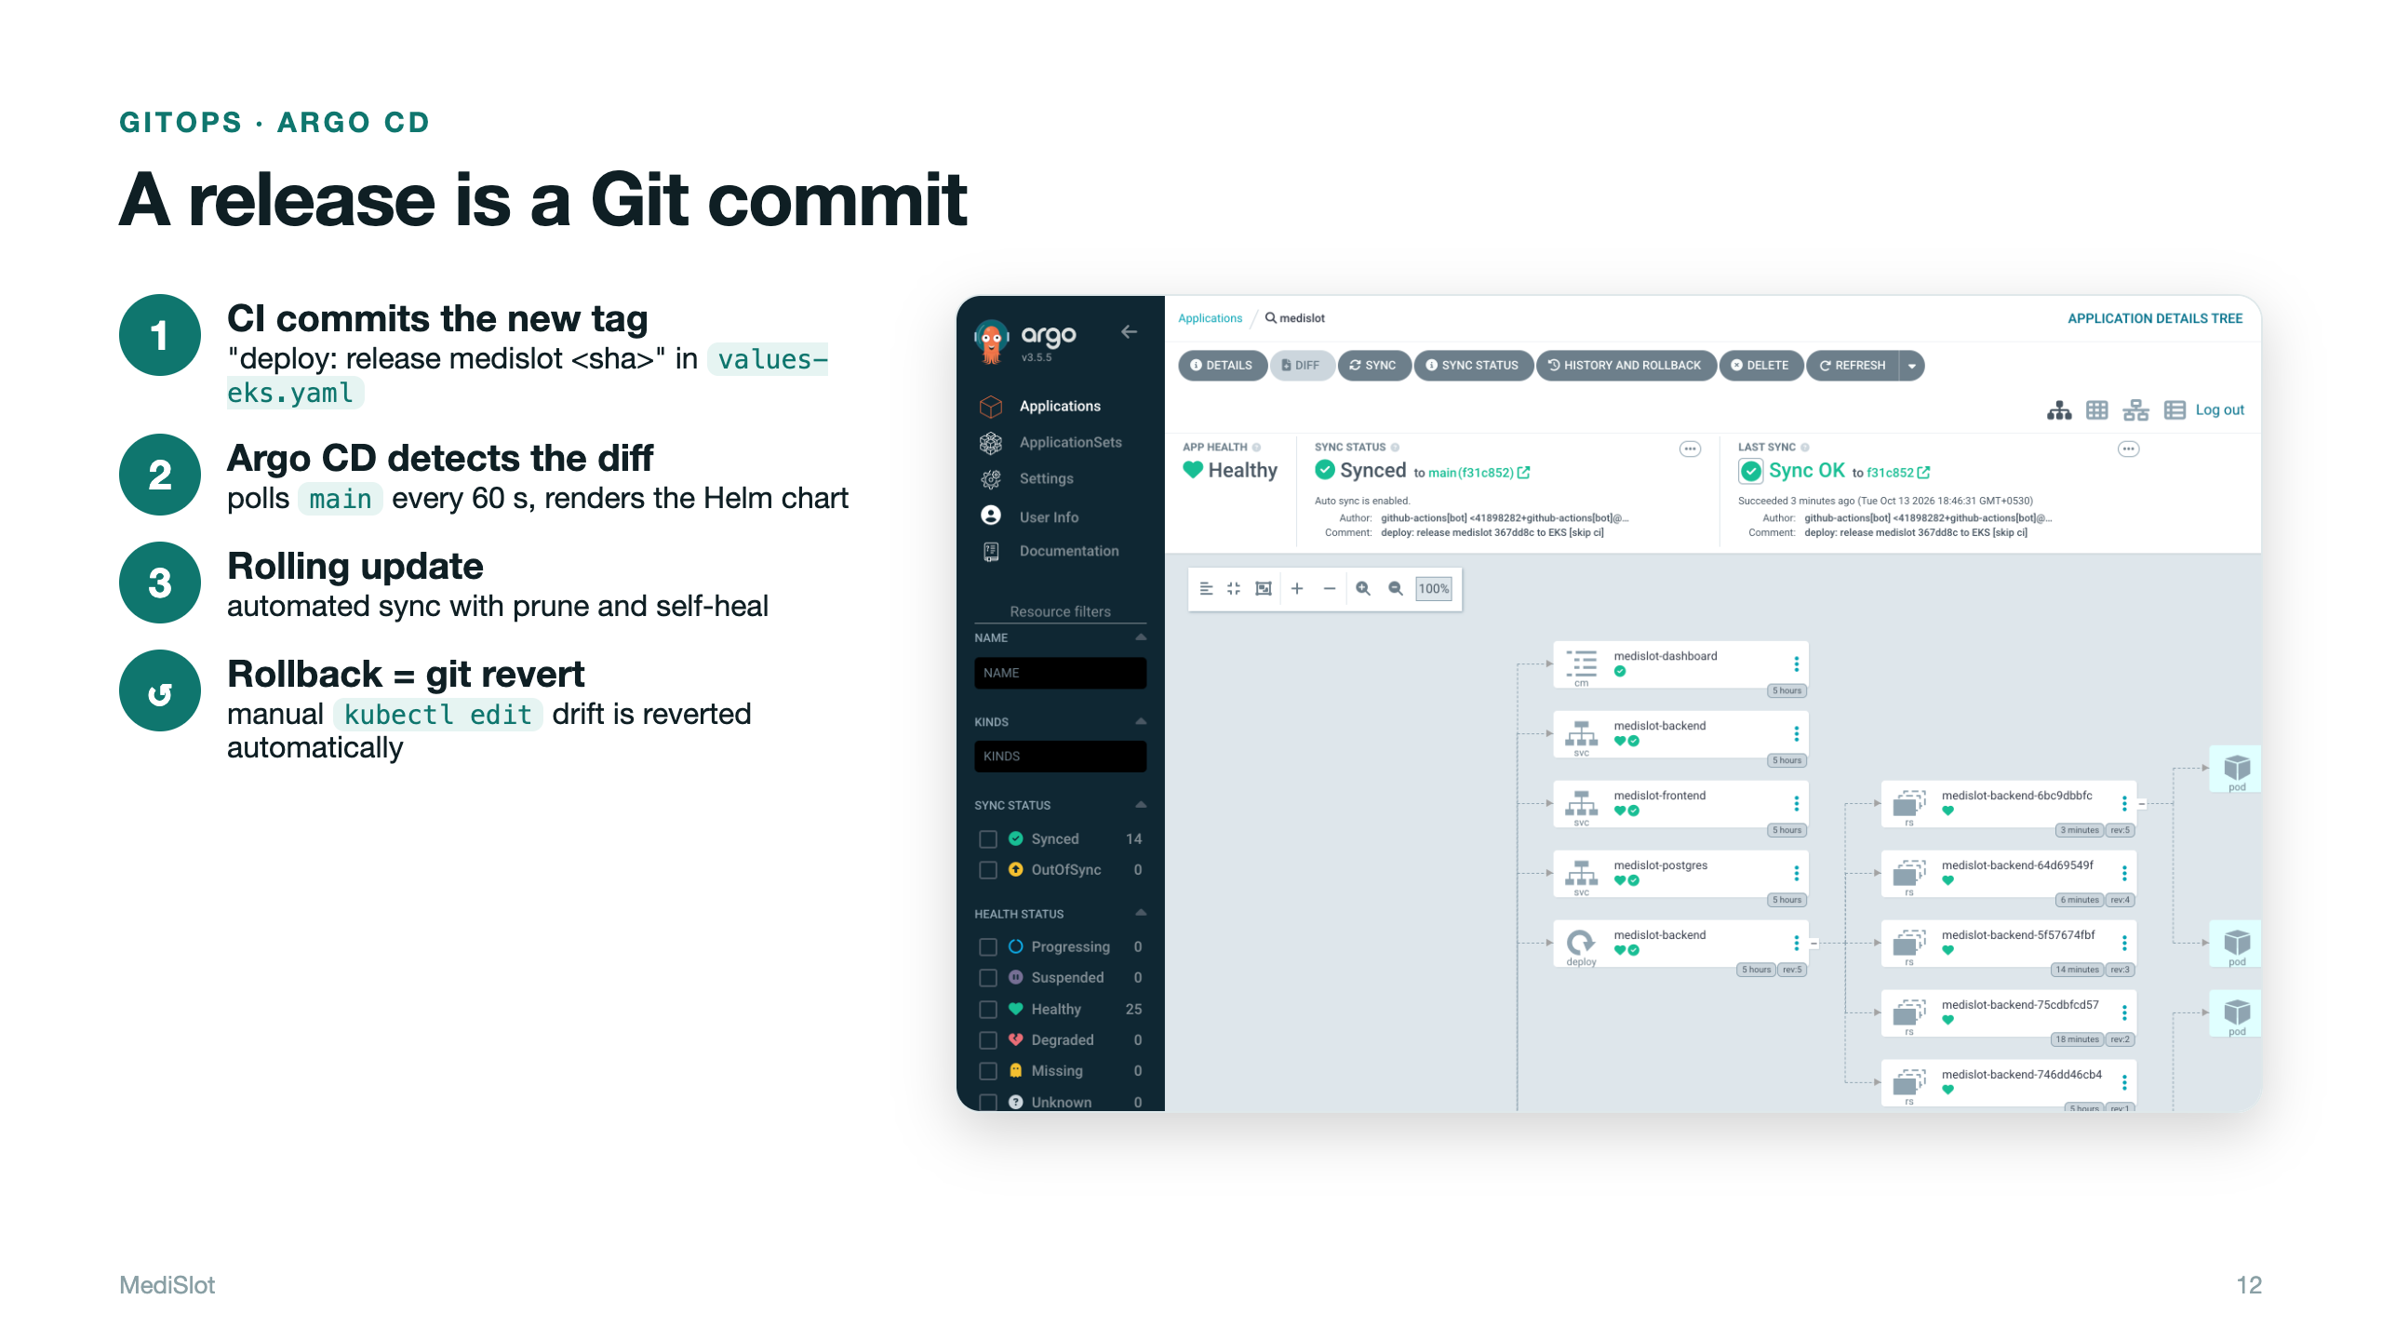
Notes:
Show the Argo CD app: Synced and Healthy. Explain that a release is a Git commit, so rollback is a git revert, and self-heal undoes manual drift.

Slide 13
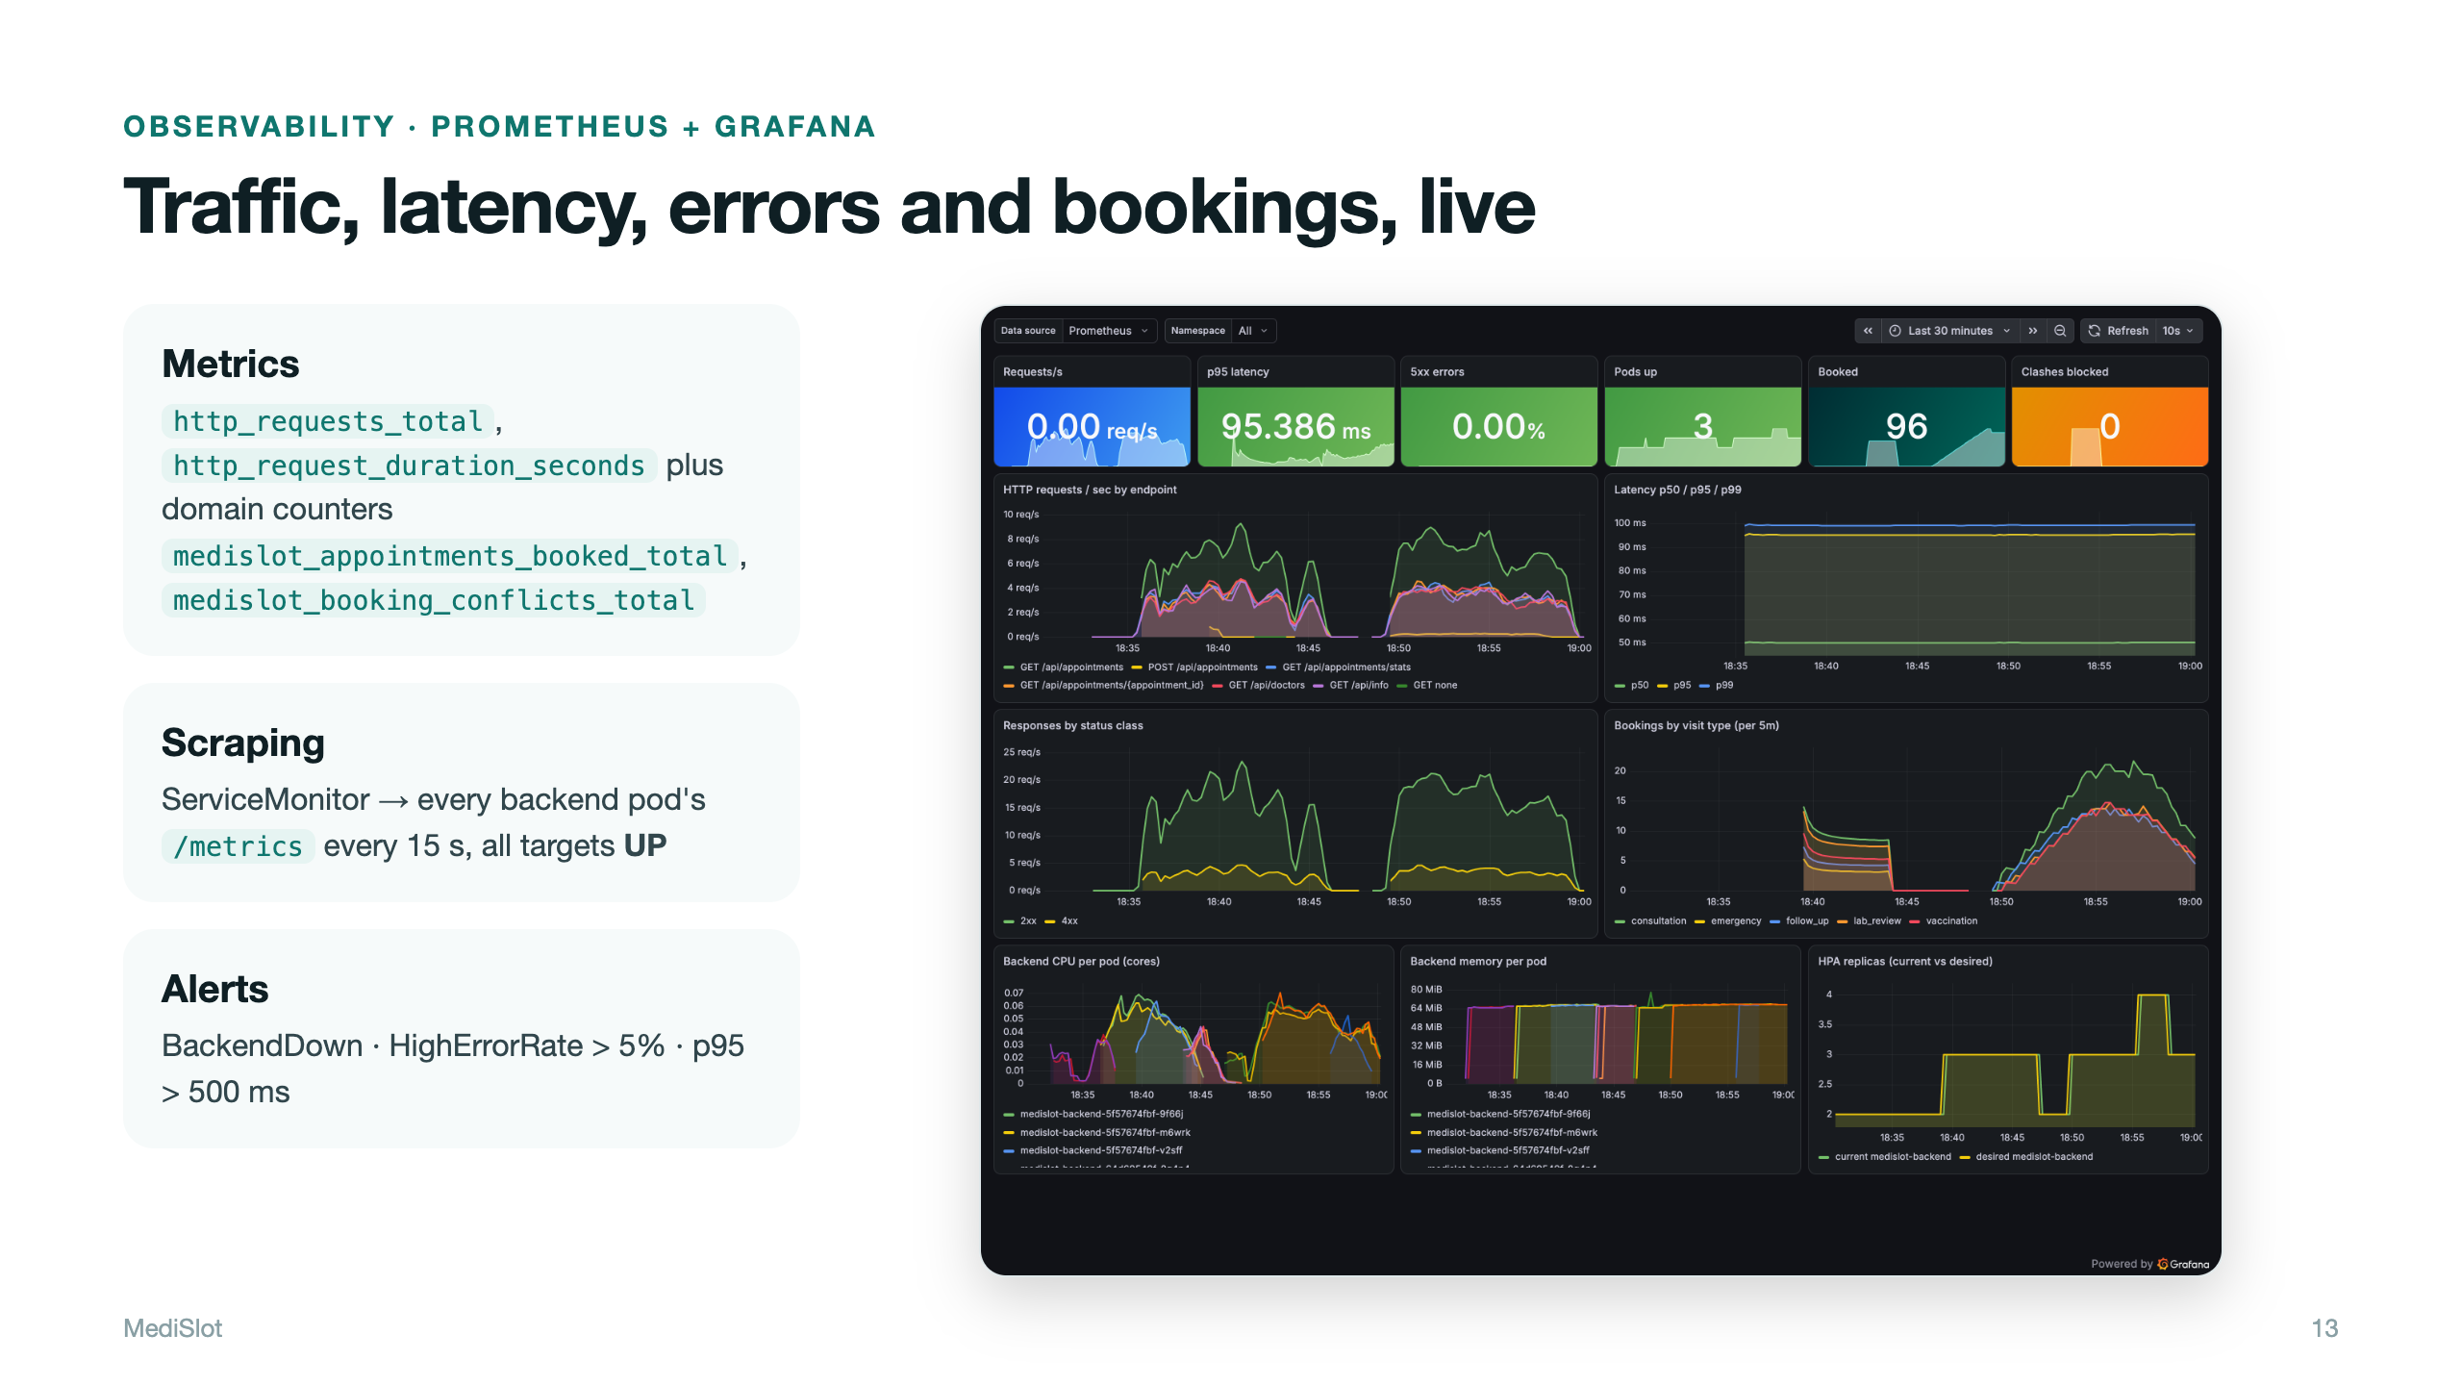
Notes:
Prometheus scrapes both backend pods every 15 s via the ServiceMonitor. Grafana shows traffic, latency percentiles, error rate, business counters and HPA replicas.

Slide 14
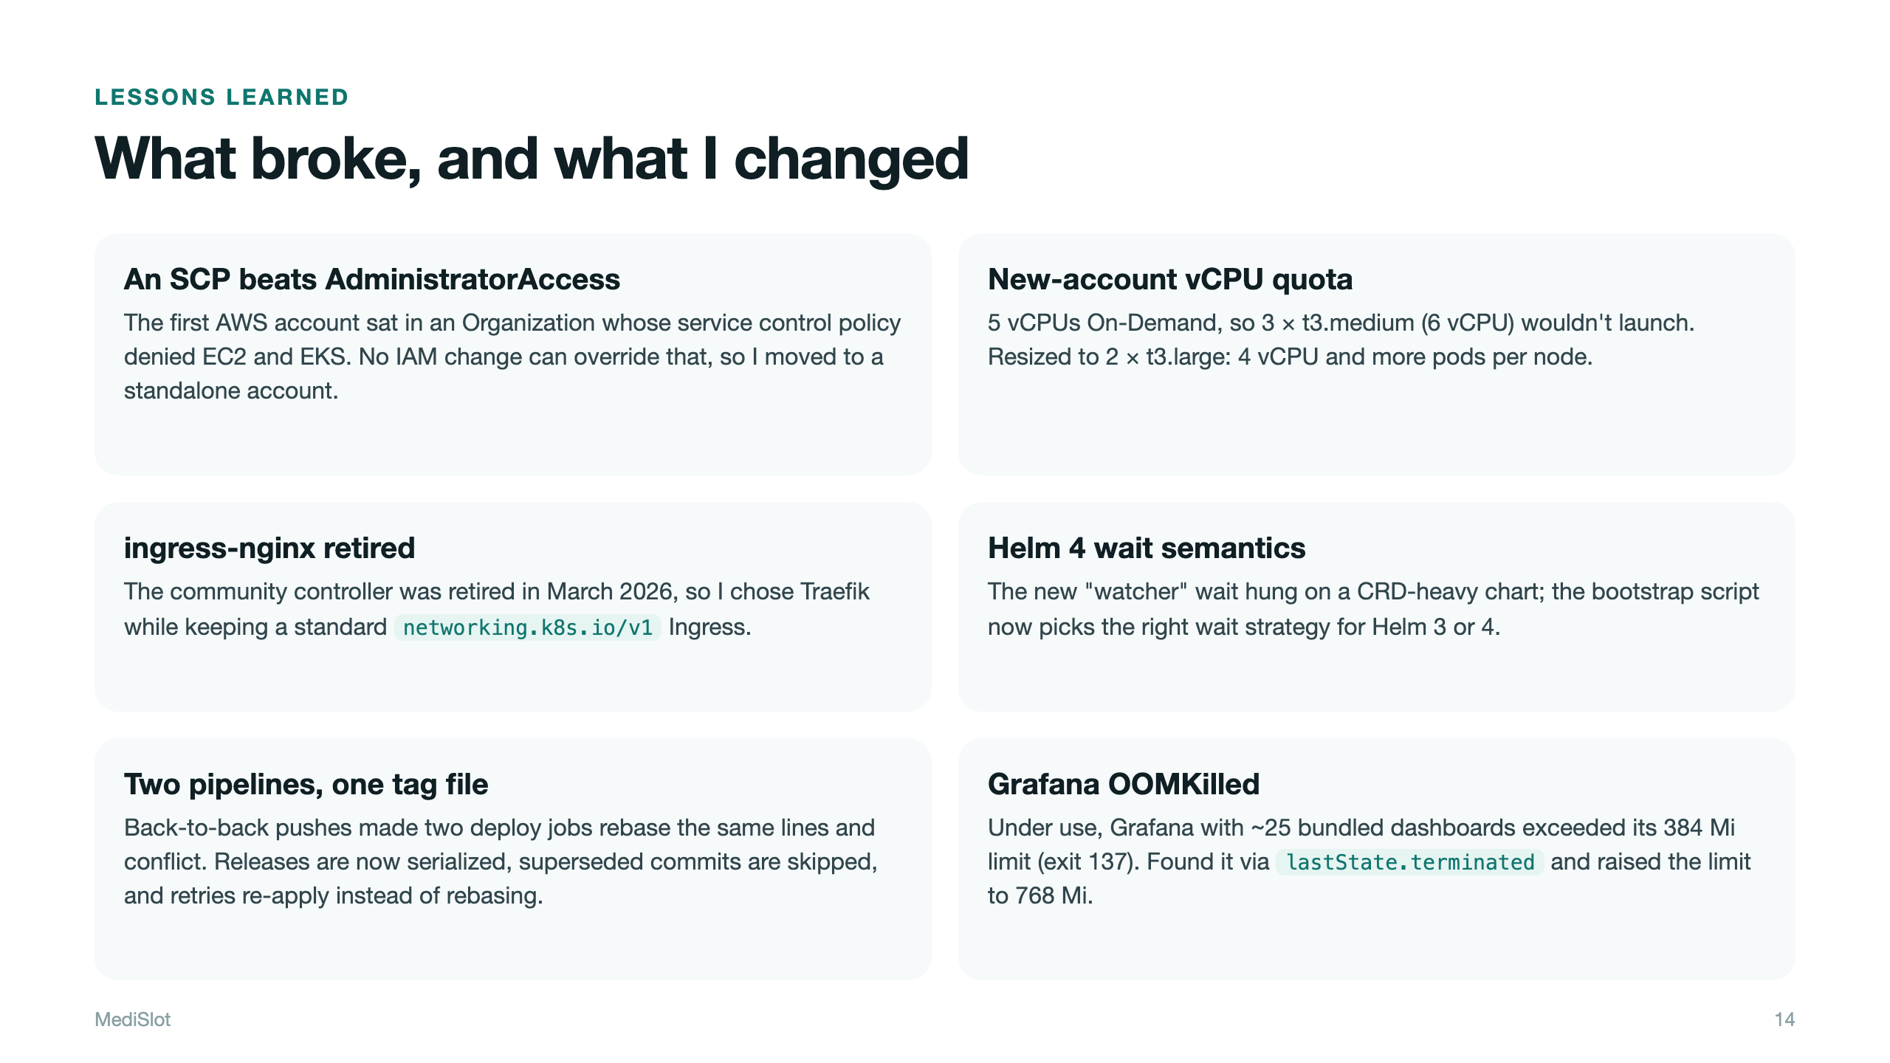
Notes:
Pick two or three of these and tell them as short stories: what broke, how you diagnosed it, what you changed. Also good to mention: the wait-for-db init container hung because UID 10001 has no passwd entry, so pg_isready needed an explicit -U.

Slide 15
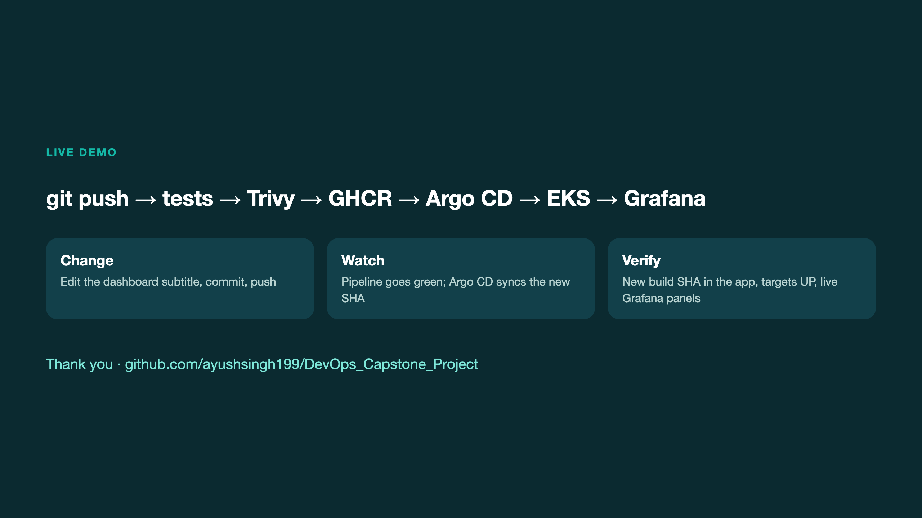
Notes:
Switch to the live demo: push a change, watch the pipeline, see Argo CD sync, refresh the app and point at the new build SHA, then show Prometheus targets and Grafana.

