Slide 1
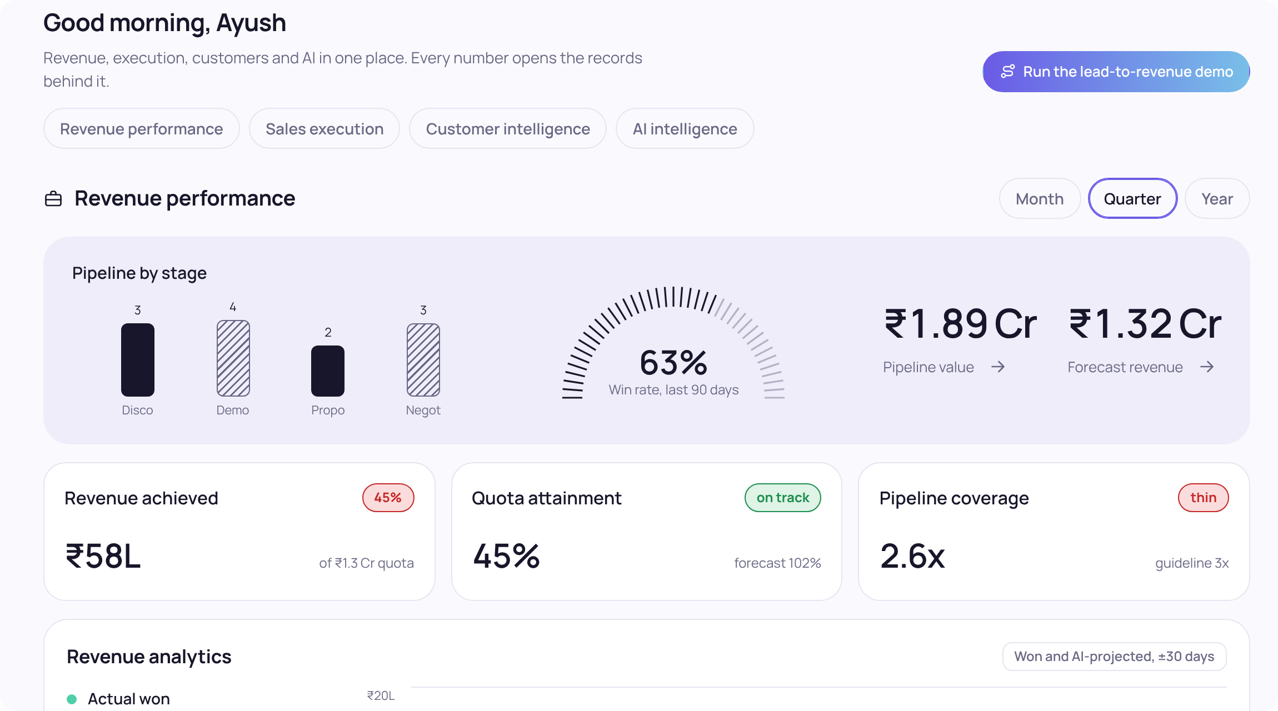

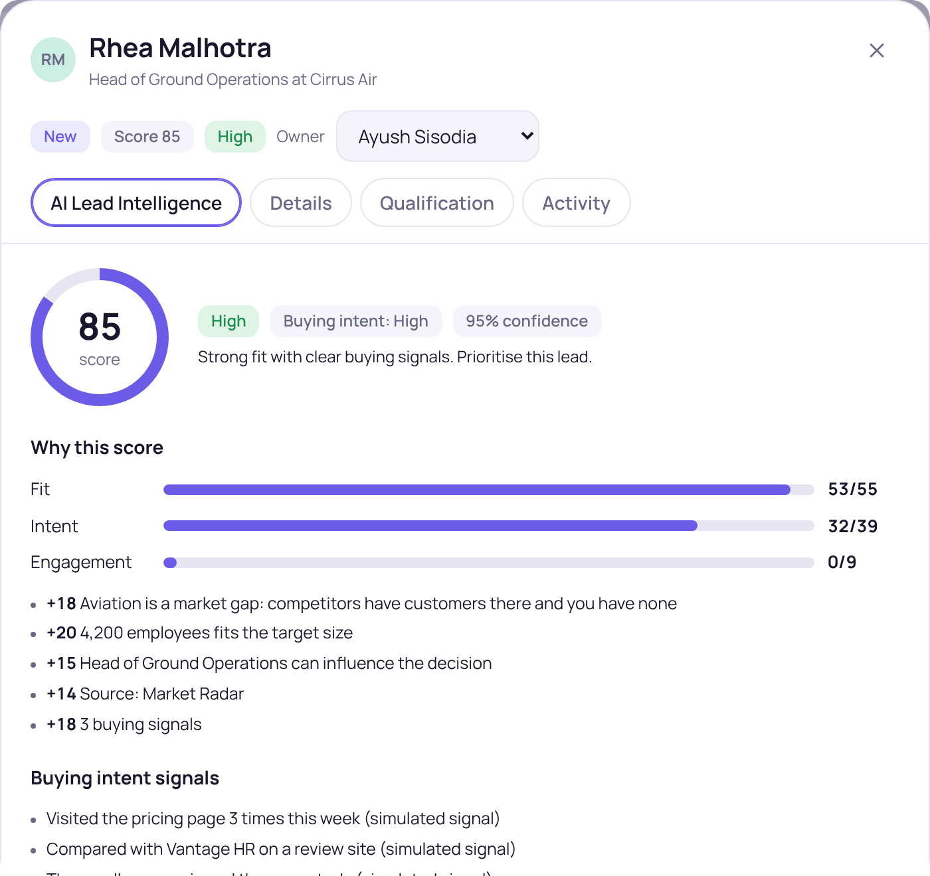
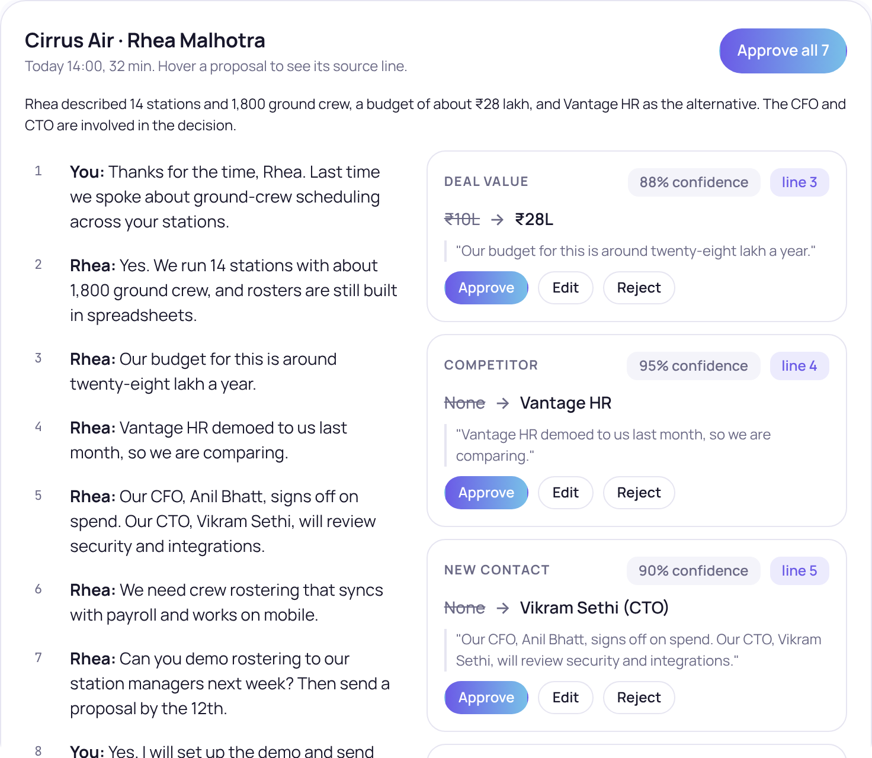
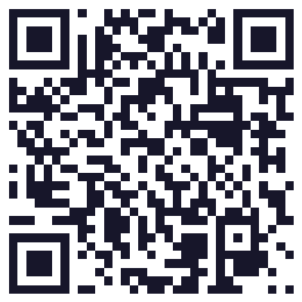
8TH ELEMENT · PRODUCT MANAGER ASSIGNMENT
Kestrel
The AI-native Revenue Operating System
Reimagining CRM for the future of sales
"CRM should not depend on humans to remember everything."
PREPARED BY
Ayush Sisodia
Product Manager, AI Solutions · November 2026
TRY THE LIVE PROTOTYPE
Open Kestrel in your browser
claude.ai/artifact/4rxU4aF7oFMoAdpG9Un7Pd
Sample data only. Click, or scan.
Screens from the working prototype. All data is fictional.
Notes:
Introduce yourself and the assignment: Reimagine CRM for the future of sales, for the Product Manager, AI Solutions role at 8th Element. Name the product, Kestrel, and say the one-line thesis: CRM should not depend on humans to remember everything. Mention the live prototype link and QR code: the panel can open it any time, and everything in it is fictional sample data. About 30 seconds.

Slide 2



Sales teams lose revenue intelligence across fragmented workflows
Manual data entry
Incomplete customer intelligence
Reactive revenue decisions
~70%
76%
44%
of seller time goes to non-selling tasks
say less than half of their CRM data is accurate and complete
estimate poor CRM data costs them over 10% of annual revenue
EXTERNAL
EXTERNAL
EXTERNAL
Salesforce, State of Sales, 6th edition (2024)
Validity, State of CRM Data Management (2025)
Validity, State of CRM Data Health (2022); about 1,240 CRM users
CRM systems capture what sales teams enter, not everything that happens in the customer relationship.
Survey figures are self-reported and published by vendors or research firms. Methodology notes are in the appendix.
Notes:
Three connected problems. Reps spend time updating records instead of selling. What matters is scattered across email, calls and meetings, so the CRM is incomplete. Managers then see deal risk and churn signals too late. The sources are self-reported surveys, so say so if asked. About 1.5 minutes.

Slide 3





AI makes it possible to move from recording activity to executing work
Rule-based automation
AI interprets context
AI coordinates actions
Fixed fields and if-then rules
Reads calls, emails and documents
Proposes and executes defined tasks, with approval
AI capability
Agentic workflows
Enterprise readiness
LLMs can interpret unstructured conversations, emails and documents.
AI can move from generating recommendations to executing defined tasks.
Better integration, retrieval and governance make AI-assisted CRM workflows more practical.
In Kestrel: Meeting Intelligence reads transcripts
In Kestrel: agents propose, workflows execute
In Kestrel: approvals, audit and permissions
PROTOTYPE · SAMPLE DATA
Not every capability is production-ready, so Kestrel assumes errors and keeps people approving material changes.
One meeting transcript became 7 proposed CRM updates, each with its source quote.
Notes:
The argument: until recently CRM automation was rule-based. AI can now interpret context in conversations and documents, and coordinate defined tasks. Be careful not to say everything is production-ready. Kestrel assumes errors and keeps people approving material changes. About 1 minute.

Slide 4



Starting with mid-market B2B SaaS sales teams
INITIAL ICP · HYPOTHESIS
Sales Representative
PRIMARY USER
50–500
Reduce manual updates and prioritise next actions
Approves AI-proposed updates and sees today's next best actions
sales reps at mid-market B2B SaaS companies
Sales Manager
MANAGER
Multiple stakeholders in every deal
Complex, multi-step sales cycles
Forecasts depend on CRM data quality
Email, meetings and engagement tools used side by side
Clear need for sales automation
Improve pipeline visibility and deal forecasting
Sees deal risk with evidence, and a forecast with its drivers
VP Sales / CRO
ECONOMIC BUYER
Improve revenue predictability and sales productivity
Gets governed AI with an audit trail and a clear forecast
Vertical intelligence, such as the aviation Market Radar example, is a later expansion and not part of the first release.
Notes:
Pick one customer. Mid-market B2B SaaS: many stakeholders per deal, complex cycles, forecasts that depend on CRM data quality, and many tools in use. Primary user is the account executive, economic buyer is the VP Sales or CRO. Vertical intelligence like the aviation example comes later. About 1 minute.

Slide 5

Introducing Kestrel: an AI-native Revenue Operating System
Kestrel eliminates manual sales administration, continuously understands customer relationships and helps revenue teams take the next best action.
Traditional CRM
1
2
3
4
5
Manual workflow, five steps
Conduct meeting
Write notes
Update deal stage
Update budget and contacts
Create follow-up task
Kestrel
1
2
3
4
AI-assisted workflow, one human decision
Conduct meeting
AI extracts customer intelligence
AI proposes CRM updates
Rep reviews and approves
5 → 4
steps, with the human acting as reviewer rather than typist
INTENDED WORKFLOW, NOT MEASURED
Pilot metric: admin minutes per rep per week, before and after.
Notes:
State the positioning, then show the before and after. The comparison is the intended workflow, not a measured improvement. The measurement plan is to time admin minutes per rep before and after in a pilot. About 1.5 minutes.

Slide 6
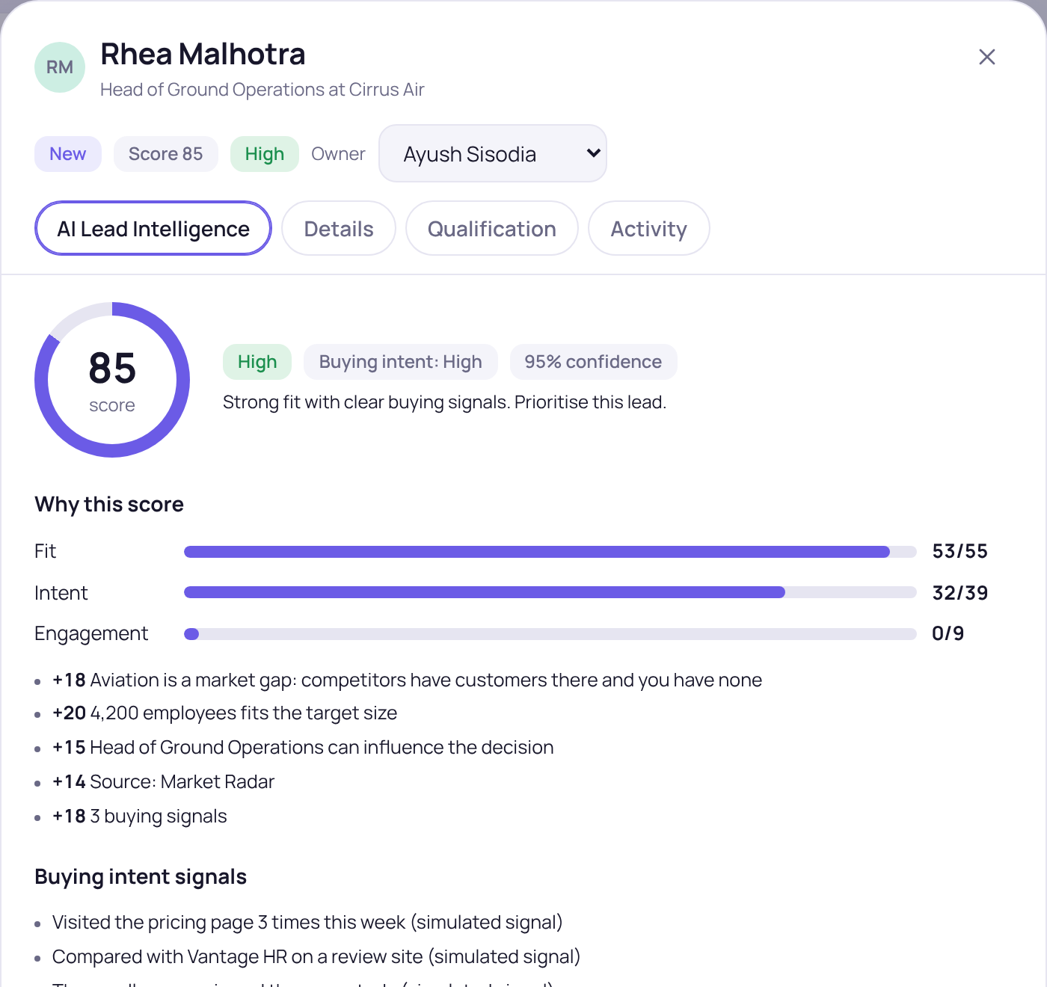
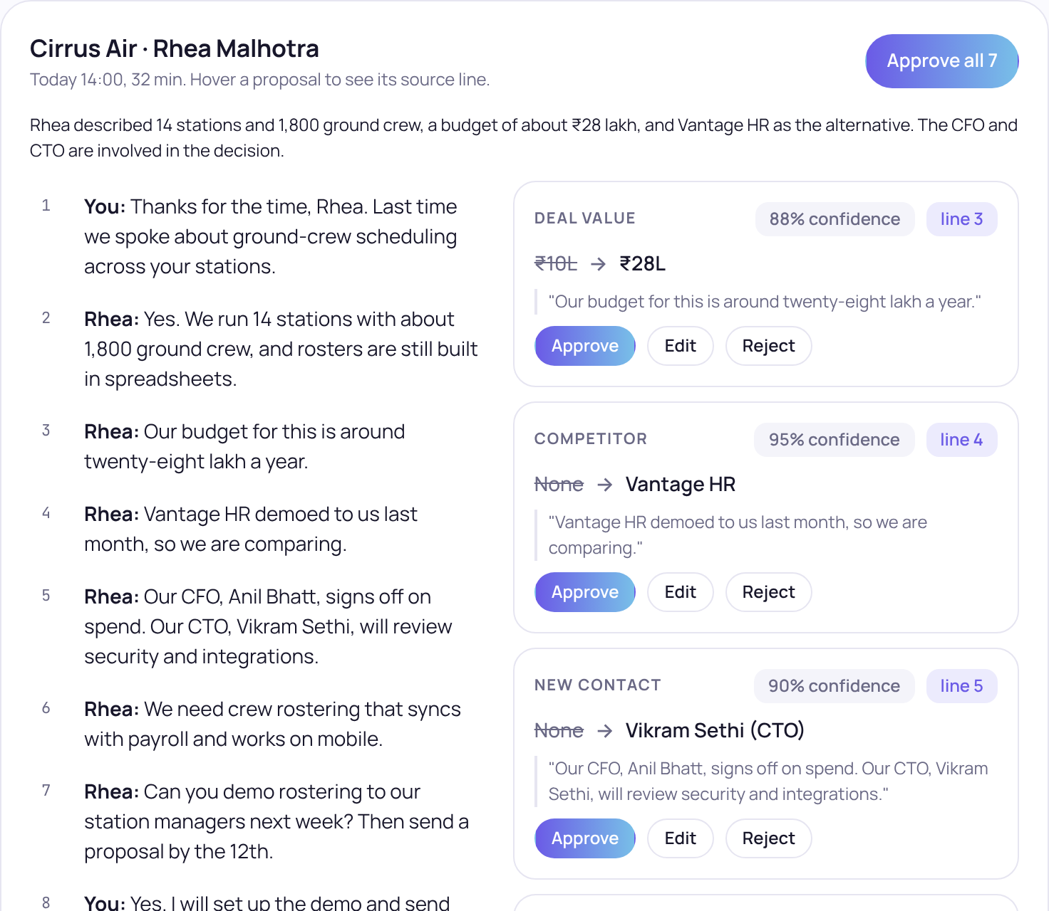
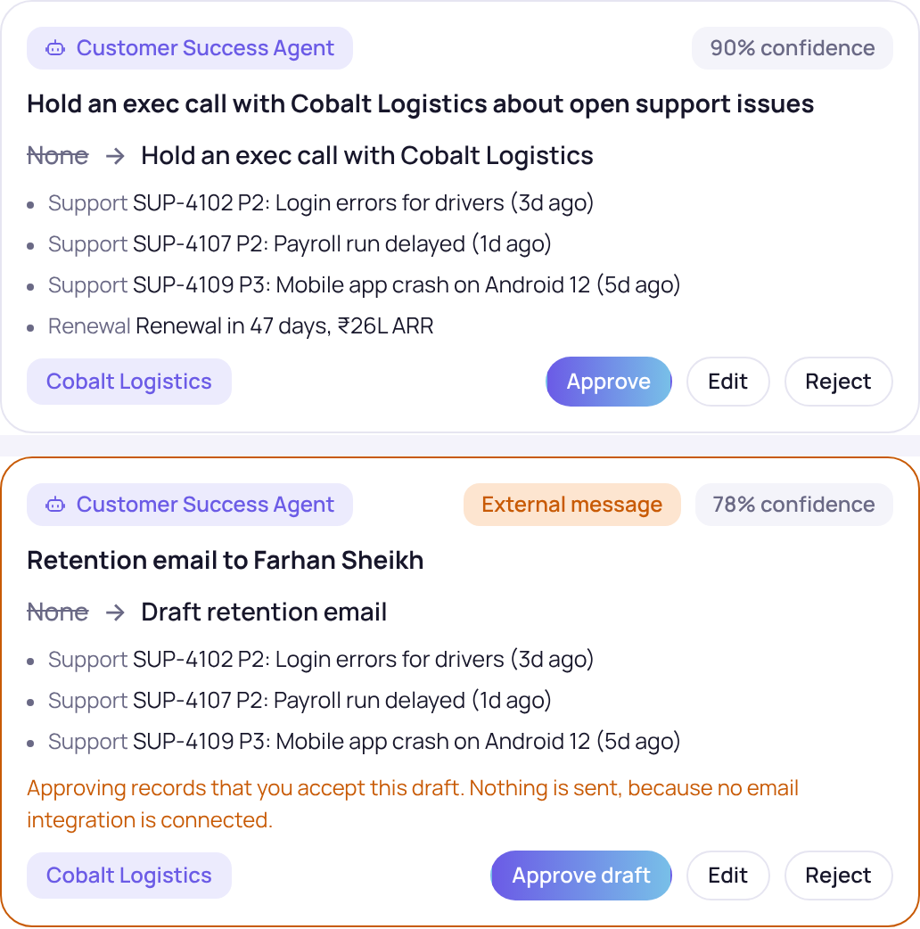
Three workflows that demonstrate the product in action
1
Lead to opportunity
2
Meeting Intelligence
3
Churn prevention
Lead created → AI scores with evidence → rep qualifies → converts to account, contact and deal
Transcript → AI extracts → quote and confidence shown → rep approves, edits or rejects
Health slips to Orange → agent finds the risk → workflow queues work → CSM reviews
85 / 100
AI lead score, explained by 6 evidence points
7 updates
proposed, each with its quote; 85–95% confidence
3 actions
queued for review; email held as a draft
PROTOTYPE · SAMPLE DATA
PROTOTYPE · SAMPLE DATA
PROTOTYPE · SAMPLE DATA
Notes:
Do not tour all eleven modules. Show three journeys: acquisition, execution and retention. Journey one, the lead is scored with six pieces of evidence and a rep decides. Journey two, a transcript turns into seven proposals with quotes and confidence. Journey three, a customer slips to Orange and the agent queues work, with the email held as a draft. All sample data. About 2 minutes.

Slide 7
Why Kestrel is different from traditional CRM platforms
 | Traditional CRM | Typical CRM with AI features added | Kestrel (design intent)
Context-aware capture | Reps type notes and fields | AI summarises, the rep still enters data | Captured from conversations; the rep approves evidence-backed updates
Agentic execution | Rules and reminders | AI suggests next steps | Agents propose and workflows execute; people approve material changes
External revenue intelligence | Separate research tools | Mostly your own CRM data | Competitor and market signals tied to your accounts and pipeline
PROTOTYPE · SAMPLE DATA
Incumbents are adding AI too. This is our positioning thesis, to be proven in pilots.
Market Radar: Aviation shows 3 competitor signals and 0 of your customers. It becomes a target list, then 5 leads in the pipeline.
Notes:
The distinction is not that we have AI agents. It is connecting internal customer intelligence with external market intelligence and governed execution. Be upfront that incumbents are adding AI too. This is our positioning thesis and pilots must prove it. About 1.5 minutes.

Slide 8






Five specialised agents, operating within human-defined guardrails
Agent | Responsibility | Key guardrail
Lead Intelligence | Qualifies and scores leads | Evidence-backed scoring
Deal Intelligence | Identifies deal risks | No automatic stage changes without approval
Meeting Intelligence | Extracts meeting updates | Transcript references for every update
Customer Success | Detects churn signals | Human-approved retention actions
Revenue Intelligence | Analyses pipeline and forecasts | Explainable calculations
Evidence-backed recommendations
Confidence thresholds
Human approval for material CRM changes
No unauthorised external communication
Complete audit trail
Reversible actions
Six guardrails. Approve, edit, reject, undo and audit log are built in the prototype.
AI quality scorecard
Acceptance rate
Edit rate
Rejection rate
Factual accuracy
High-severity errors
Time saved per action
Targets set in pilots
Notes:
Each agent has one job and one guardrail. The rule across all of them: agents propose, people decide. In the prototype you can approve, edit, reject and undo, and every decision lands in the audit log. Do not use a high approval rate as the success target, because it can reward timid recommendations. Use the balanced scorecard. About 1.5 minutes.

Slide 9
A scalable SaaS model with usage-aware AI economics
Starter
$25
Small sales teams
Per-seat subscription
/seat/month
Growth
$60
Mid-market sales teams
Per seat plus an AI usage allowance
/seat/month
Enterprise
Custom
Large organisations
≈72%
≈65%
Platform fee plus seats plus consumption
HYPOTHESIS · TO VALIDATE
Illustrative prices, not market-validated.
gross margin at $60 per seat on $17 total cost
if inference cost triples (+$4 per seat)
Notes:
Three plans. Growth is the mid-market plan and the focus. Every price and cost line here is an illustrative assumption, not a market-validated number. The useful insight from the model is that inference cost is not the main cost driver: support and success, transcription and data matter more. Even if inference cost triples, margin stays healthy. Validate in pilots. About 1.5 minutes.Cost per active Growth seat per month (assumptions): inference 2.0 + enrichment data 2.0 + integrations and infrastructure 2.5 + transcription and storage 3.5 + support and success 7.0 = 17.0. Margin = (60 - 17) / 60 = 71.7%. If inference triples: 17 + 4 = 21, margin = (60 - 21) / 60 = 65.0%. About 1.5 minutes.

Slide 10

A 12-week MVP, technical architecture and measurable success criteria
User experience
Weeks 1–4
CRM core: leads, accounts, contacts, opportunities, activities
Dashboard and AI assistant
Foundation
CRM core
Weeks 5–8
Meeting Intelligence, AI approvals, data capture, integration foundation
Leads, accounts, contacts, opportunities, activities
Intelligence
Intelligence layer
Weeks 9–12
Deal Intelligence, forecasting, workflows, security, pilot testing
AI agents, retrieval, revenue intelligence
Execution and pilot
Orchestration layer
Team: 1 PM, 1 designer, 4–5 engineers (full-stack, integrations, AI/ML), part-time QA. Later: Market Radar and the full agent suite.
Workflow engine, approvals, audit
Data and integrations
PILOT SUCCESS CRITERIA · TARGETS SET IN PILOTS
Database, vector store, email, calendar, telephony, ERP
AI quality scorecard (slide 8)
Admin minutes per rep per week
Forecast accuracy vs baseline
KEY RISKS
Poor CRM data quality
AI hallucination and wrong extraction
Integration failures
Data privacy and security
User adoption and trust
AI inference cost
Notes:
Left: five layers. The differentiating layers are intelligence and orchestration. Right: three phases. Weeks 1 to 4 build the CRM core, 5 to 8 add meeting intelligence and the approval flow, 9 to 12 add deal intelligence, forecasting, workflows, security and a pilot. Market Radar and the full agent suite come later. Close on the six risks and how success is measured. About 2 minutes.

Slide 11
Appendix: evidence, assumptions and what is simulated
PROTOTYPE EVIDENCE
EXTERNAL EVIDENCE
HYPOTHESES TO VALIDATE
11 modules, 5 agent types, 4 workflows and a 12-step lead-to-revenue journey, all on fictional sample data
58 automated checks (28 logic, 30 browser), plus a journey run and a phone-layout check
Dashboard figures such as ₹1.89 Cr pipeline, 63% win rate and 2.6x coverage are illustrative sample outputs
Simulated: integrations, lead enrichment, competitor feed, call recordings
~70% non-selling time: Salesforce, State of Sales, 6th ed. (2024)
76% say under half of CRM data is accurate and complete: Validity (2025)
44% estimate over 10% revenue lost to poor CRM data: Validity (2022, about 1,240 CRM users, self-reported)
Figures taken from published summaries. Primary reports could not be opened in this environment: re-check before presenting
Admin time saved per rep per week
Recommendation acceptance, edit and rejection rates, factual accuracy
Forecast accuracy improvement
Pricing ($25 / $60 / custom) and cost per seat ($17 on Growth)
The 50–500 rep ICP
SOURCES (as published; confirm against the primary reports)
Salesforce, State of Sales, 6th edition (2024): salesforce.com/ca/resources/research-reports/state-of-sales
Validity, The State of CRM Data Management in 2025: validity.com/resource-center/the-state-of-crm-data-management-in-2025
Validity, 2022 State of CRM Data Health (press release): validity.com/press-releases/validity-launches-2022-state-of-crm-data-health-report-finds-data-confidence-does-not-match-reality
Notes:
Use this slide if asked how real the numbers are. Be direct: the prototype uses fictional sample data, external figures are self-reported surveys that should be re-checked against the primary reports, and everything in the hypothesis column is a target to validate in a pilot.

