Slide 1
Objective
DOM Elements
DHTML Or Manipulating HTML

Slide 2
DOM & DHTML
Dynamic web pages with JavaScript and DOM
DHTML (Dynamic HTML)
DOM nodes and DOM tree
Traversing, editing and modifying DOM nodes
Editing text nodes
Accessing, editing and modifying elements' attributes

Slide 3
DOM Concept
DOM makes all components of a web page accessible
HTML elements
their attributes
text
They can be created, modified and removed with JavaScript

Slide 4
DOM Objects
DOM components are accessible as objects or collections of objects
DOM components form a tree of nodes
relationship parent node – children nodes
document is the root node
Attributes of elements are accessible as text
Browsers can show DOM visually as an
dom.html

Slide 5
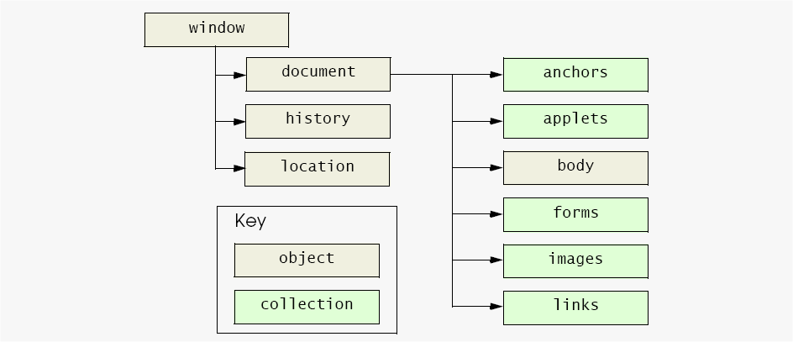
W3C Document Object Model

Slide 6
DOM Objects
window
the browser window
new popup windows can be opened
document
the current web page inside the window
body
<body> element of the document
history
sites that the user visited
makes it possible to go back and forth using scripts
location
URL of the document
setting it goes to another page

Slide 7
idea of DOM
<html>
<head>
<title>The title</title>
</head>
<body>
The body
</body>
</html>

Slide 8
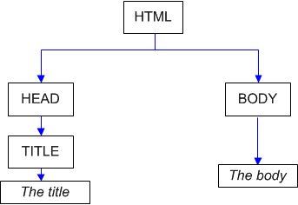
Idea of DOM

Slide 9
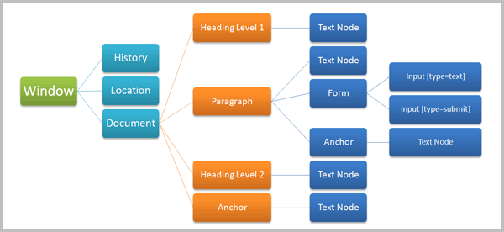
Document Object Model

Slide 10
Accessing Nodes by id
Access to elements by their id
document.getElementById(<id>)
returns the element with id <id>
id attribute can be defined in each start tag
The preferred way to access elements
dom_basic_0.html

Slide 11
Other Access Methods
Access by elements' tag
there are typically several elements with the same tag
document.getElementsByTagName(<tag>)
returns the collection of all elements whose tag is <tag>
the collection has a length attribute
an item in the collection can be reached by its index
e.g.
var html = document.getElementsByTagName("html")[0];
Access by elements' name attribute
several elements can have the same name
document.getElementsByName(<name>)
returns the collection of elements with name <name>
dom_basic_1.html, dom_ele_by_tag_name.html

Slide 12
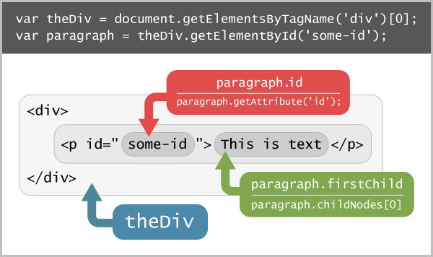
Accessing methods

Slide 13
Traversing DOM tree
Traversal through node properties
childNodes property
the value is a collection of nodes
has a length attribute
an item can be reached by its index
e.g. var body = html.childNodes[1];
firstChild, lastChild properties
nextSibling, previousSibling properties
parentNode property
dom_traversing.html, dom_traversing_1.html

Slide 14
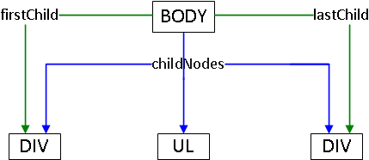
Children links
dom_traversing_2.html
The firstChild and lastChild properties allow to quickly access first or last child.

Slide 15
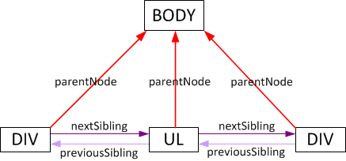
parentNode, previousSibling & nextSibling
dom_traversing_3.html
parentNode property references the parent node.
It equals null for document.documentElement.
The previousSibling and nextSibling allow to access the left or the right neightbour.

Slide 16
Summary
Up
parentNode
Down
children/childNodes, firstChild, lastChild
left/right
previousSibling/nextSibling

Slide 17
Other Node Properties
nodeType property
ELEMENT_NODE: HTML element
TEXT_NODE: text within a parent element
ATTRIBUTE_NODE: an attribute of a parent element
attributes can be accessed another way
CDATA_SECTION_NODE
CDATA sections are good for unformatted text
nodeName property
nodeValue property
attributes property
innerHTML property
not standard, but implemented in major browsers
very useful
style property
object whose properties are all style attributes, e.g., those defied in CSS
dom_trversing_4.html

Slide 18
Accessing JS Object's Properties
There are two different syntax forms to access object's properties in JS (
<object>.<property>
dot notation, e.g., document.nodeType
<object>[<property-name> ]
brackets notation, e.g., document["nodeType"]
this is used in for-in loops
this works for properties of DOM objects, too

Slide 19
Text Nodes
Text node
can only be as a leaf in DOM tree
it’s nodeValue property holds the text
innerHTML can be used to access the text

Slide 20
Modifying DOM Structure
document.createElement(<tag>)
creates a new DOM element node, with <tag> tag.
the node still needs to be inserted into the DOM tree
document.createTextNode(<text>)
creates a new DOM text with <text>
the node still needs to be inserted into the DOM tree
<parent>.appendChild(<child>)
inserts <child> node behind all existing children of <parent> node
<parent>.insertBefore(<child>,<before>)
inserts <child> node before <before> child within <parent> node
<parent>.replaceChild(<child>,<instead>)
replaces <instead> child by <child> node within <parent> node
<parent>.removeChild(<child>)
removes <child> node from within <parent> node

Slide 21
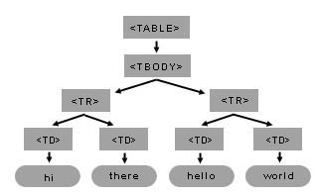
Creating table dynamically
creating_dynamic_table.html

Slide 22
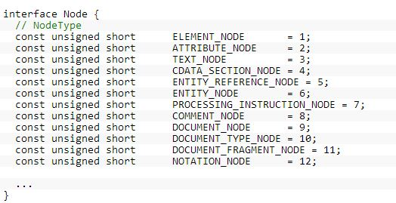
Dom Node properties
nodeType

Slide 23
nodeName, tagName
Both nodeName and tagName contain the name of an element node.

Slide 24
Exercise
Create dynamic UL LI structure
Create dynamic element and remove element dynamically
Set style attributes for UL LI html structure

