Slide 1


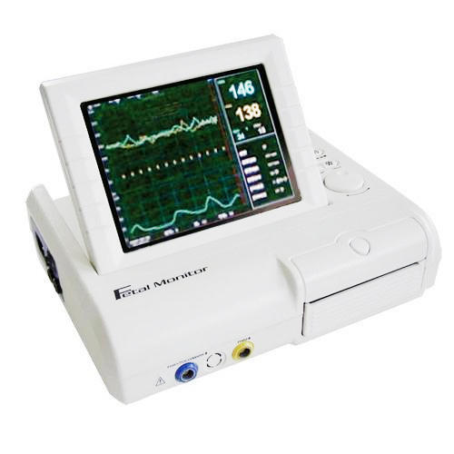
Cardiotocography
Group No: 11
Fahadulla Khan – 1121
Sowmya Shastri - 1136
Nishant - -1309
Ayush Som - 1022

Slide 2
Introduction
Cardiotocography (CTG) is a technical means of recording the fetal heartbeat and the uterine contractions during pregnancy
The machine used to perform the monitoring is called a cardiotocograph, more commonly known as an electronic fetal monitor (EFM)
CTG monitoring is widely used to assess fetal wellbeing

Slide 3
Important Variables
The interpretation of the fetal heart rate tracing should follow a systematic approach with a full qualitative and quantitative description of the following:
Baseline rate
Baseline fetal heart rate (FHR) variability
Presence of accelerations
Periodic or episodic decelerations
Changes or trends of FHR patterns over time
Frequency and intensity of uterine contractions

Slide 4
Baseline Fetal Heart Rate (FHR)
The baseline FHR is the heart rate during a 10 minute
The minimum baseline duration must be at least 2 minutes. If minimum baseline duration is < 2 minutes then the baseline is indeterminate.
The results can be divided in to three types
Normal – (110 BPM – 160 BPM)
Bradycardia – (Mean FHR < 110 BPM)
Tachycardia – (Mean FHR < 110 BPM)

Slide 5
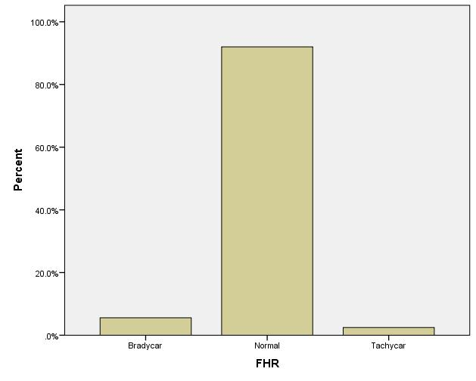
Frequency Distribution
We could see that out of the mean FHR in the total data there are a greater number of people who belong to Normal Category
So we can say that there are a greater number of cases whose Baseline heart rate falls with the 110-160 BPM

Slide 6
Baseline FHR Variability
Baseline variability is defined as fluctuations in the fetal heart rate of more than 2 cycles per minute
There are two types of variability
short-term variability
long-term variability

Slide 7
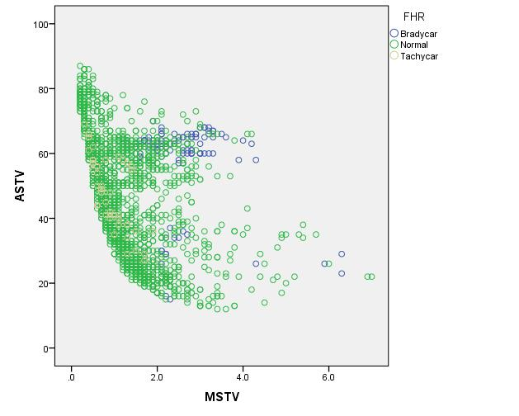
Short Term Variability
We could see that percentage of time with abnormal short term variability is more if the mean value of short term variability
And the Bradycare are more in Mid to Right and the Tachycar is more in left side of the graph

Slide 8
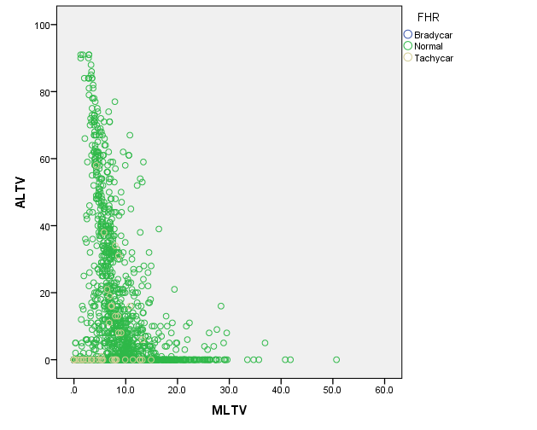
LONG Term Variability
We could see that percentage of time with abnormal Long term variability is more if the mean value of Long term variability is less or zero

Slide 9
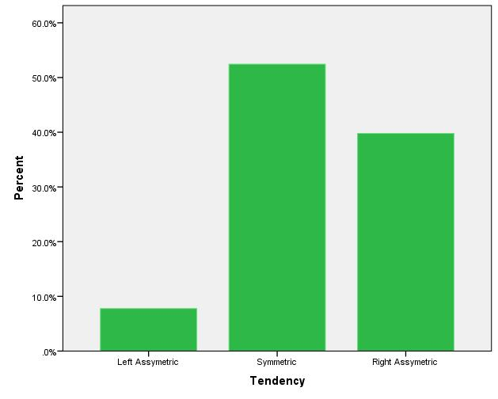
Histogram Tendency
53-55% of people have symmetric tendency of Histogram which means normal
40% of the people have Right Asymmetric test which means they have right tailed histogram
Only 8-9% of the people have left Asymmetric test which means they have left tailed histogram

Slide 10
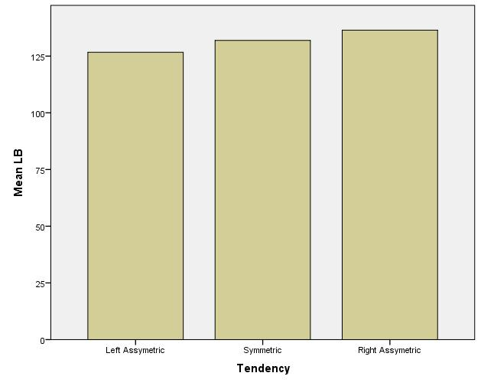
Mean Heart rate v/s Histogram
This shows the Mean base line heart rate increases as the tail moves from left tailed to right tailed

Slide 11
Intrapartum Fetal Monitoring
Intrapartum fetal monitoring, has following interpretation
Normal: No hypoxia/acidosis, no intervention necessary to improve fetal oxygenation state:
Baseline 110-160 bpm
Variability 5-25 bpm
No repetitive decelerations (decelerations are defined as repetitive when associated with > 50% contractions)
Suspicious: Low probability of hypoxia/acidosis, warrants action to correct reversible causes if identified, close monitoring or adjunctive methods:
Pathological: High probability of hypoxia/acidosis, requires immediate action to correct reversible causes, adjunctive methods, or if this is not possible expedite delivery. In acute situations immediate delivery should be accomplished
Baseline <100 bpm
Reduced or increased variability or sinusoidal pattern
Repetitive late or prolonged decelerations for > 30 min, or > 20 min if reduced variability (decelerations are defined as repetitive when associated with > 50% contractions)
Deceleration > 5 min

Slide 12
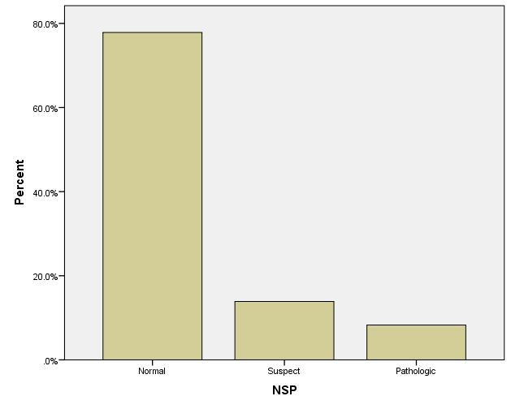
Number of cases
More number of results fall in Normal Intrapartum Fetal Monitoring

Slide 13
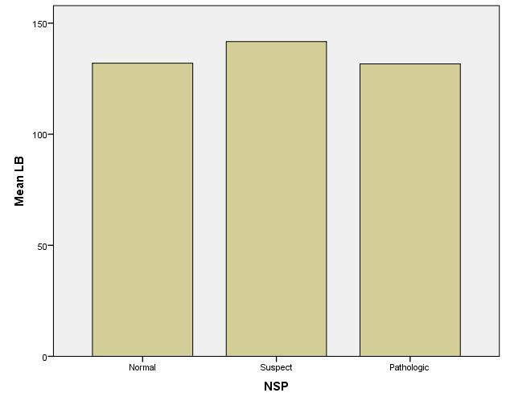
Mean LB v/s NSP
We could see that the suspect Intrapartum Fetal Monitoring have higher mean heart rate

Slide 14
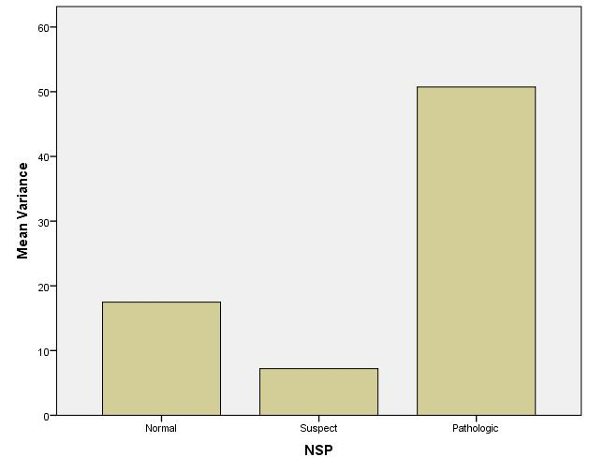
Variance VS NSP
Pathologic has more number of variance in heart rate when compared to others

Slide 15
Acceleration Histogram
An acceleration is an abrupt increase in FHR above baseline with onset to peak of the acceleration less than < 30 seconds and less than 2 minutes in duration. The duration of the acceleration is defined as the time from the initial change in heart rate from the baseline to the time of return to the FHR to baseline.
Interpretation: Lowest acceleration has been found in most of the fetus population.

Slide 16
Uterine Contract Histogram
Uterine contractions are quantified as the number of contractions present in a 10-minute window, averaged over 30 minutes.
Interpretation: Surge of uterine contraction between the range of 130 to 140, with 130-135 being the highest.
A normal distribution curve can be observed.

Slide 17
Uterine contractions per min
Uterine contractions were associated with fetal trunk movements. Fetal movements which lasted lo-15 s, 98% of accelerations with an amplitude of 25-30 bpm and 96.4% of accelerations with a duration of 40-50 s were associated with fetal trunk movements.

Slide 18
Prolonged Declaration Histogram
Prolonged deceleration : A decrease in FHR of > 15 beats per minute measured from the most recently determined baseline rate. The deceleration lasts >= 2 minutes but less than 10 minutes.
Interpretation:
Prolonged decelarations are highest in fetus between 0.000 to 0.001.
Further values are decreasing gradually

Slide 19
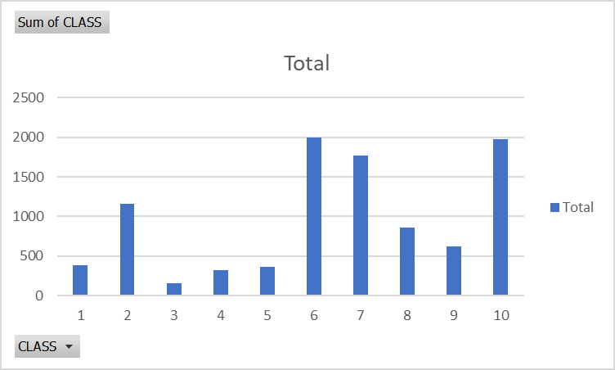
CLASS
There are more number of people in Class 10

Slide 20
Thank You

