Slide 1

Introduction to Predictive Analytics Project
Submitted By: Group – 9
Ayush Som (2019JULB01022)
Utkarsh Chauhan (2019JULB01034)
Chirag S (2019JULB01115)
Samanth BM (2019JULB01122)

Slide 2
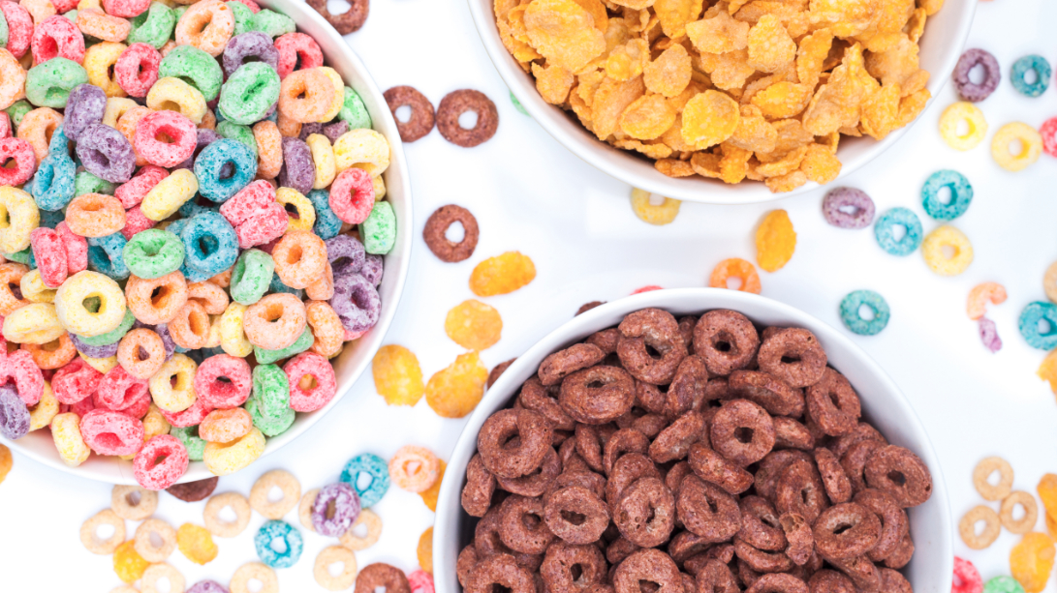
Cereal Dataset

Slide 3
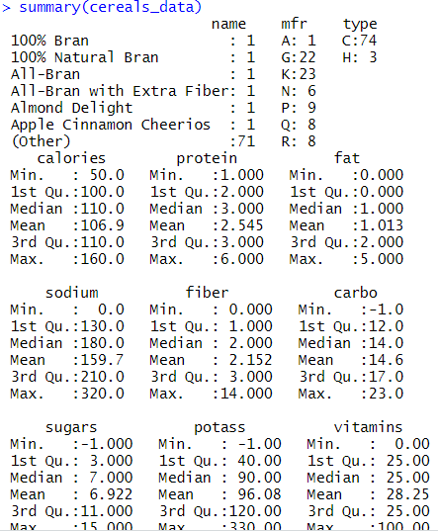
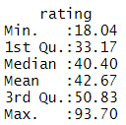
Brief Description
Dataset contains variables (Ex. Protein, calories etc.) given to cereals sold by various manufacturers
77 observations, 16 variables.
Rating is the output variable.
Summary shows min, max, quartiles, mean and median of the variables

Slide 4
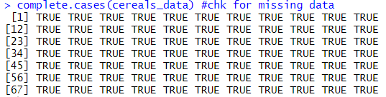
Data cleaning Objective : Check for missing data. Result: No missing data found

Slide 5
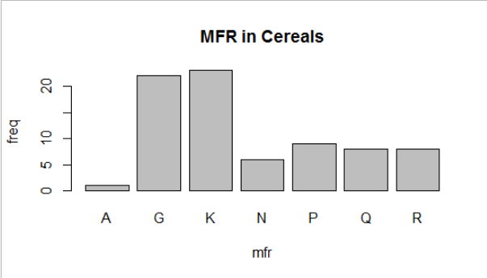
Manufacturer of cereal
We can see people prefer K (Kelloggs cereals) and G (General Mills) cereals most and least A (American Home Food Products cereals).

Slide 6
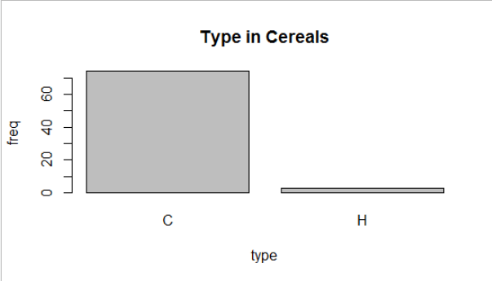
Types in cereals
We can clearly see people prefer more C (Cold) cereals than H (Hot) cereals

Slide 7
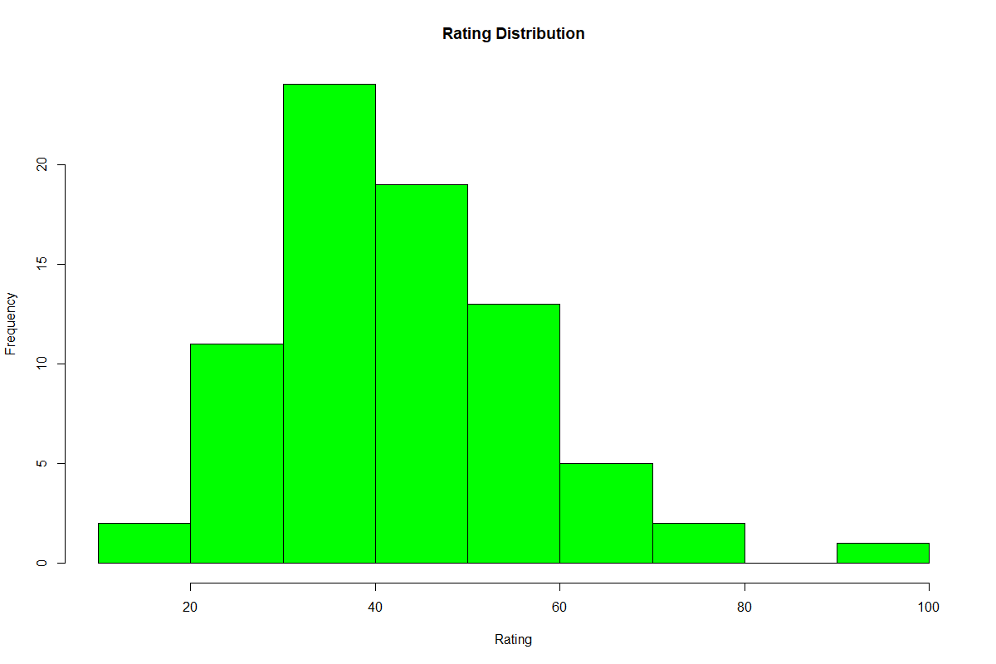
Rating
We can see in rating distribution that maximum cereals rating is between 30 – 40
There is a outlier in rating we can see it has a rating between 90-100.
From the analysis we can see a normal distribution pattern in the graph

Slide 8
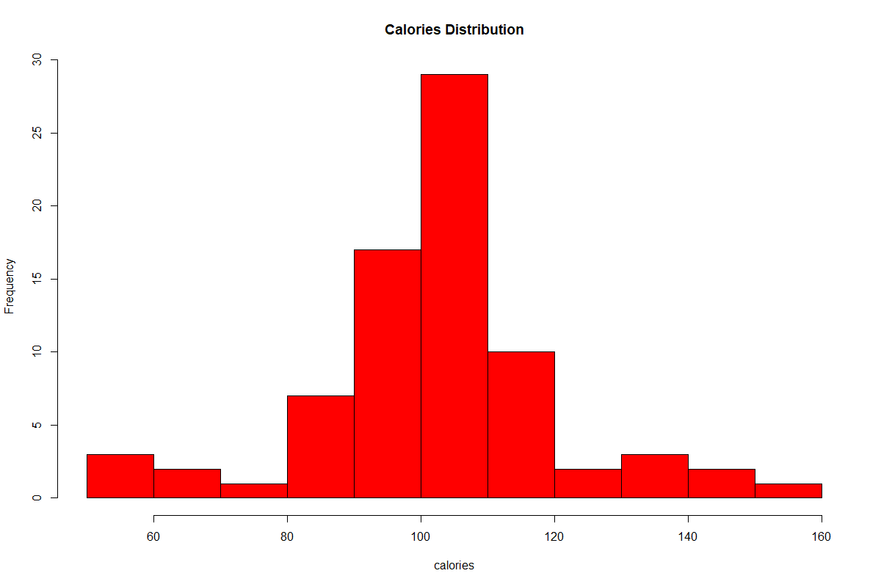
Calories
In this graph we can see the maximum cereal company have calories between 100 -110.
we can make out a normal distribution pattern from the histogram

Slide 9
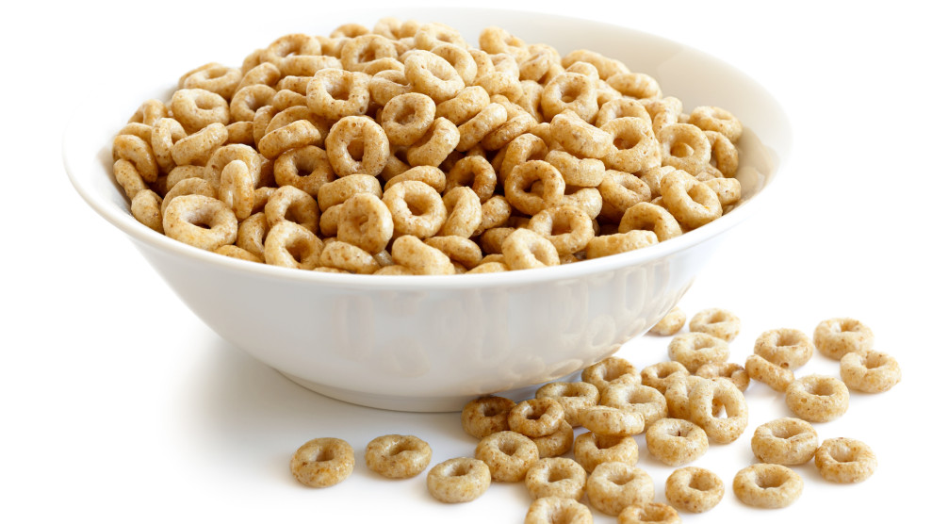
Output variable
By analysis of the data our group decided to use rating as the output variable or dependent variable for the prediction model

Slide 10
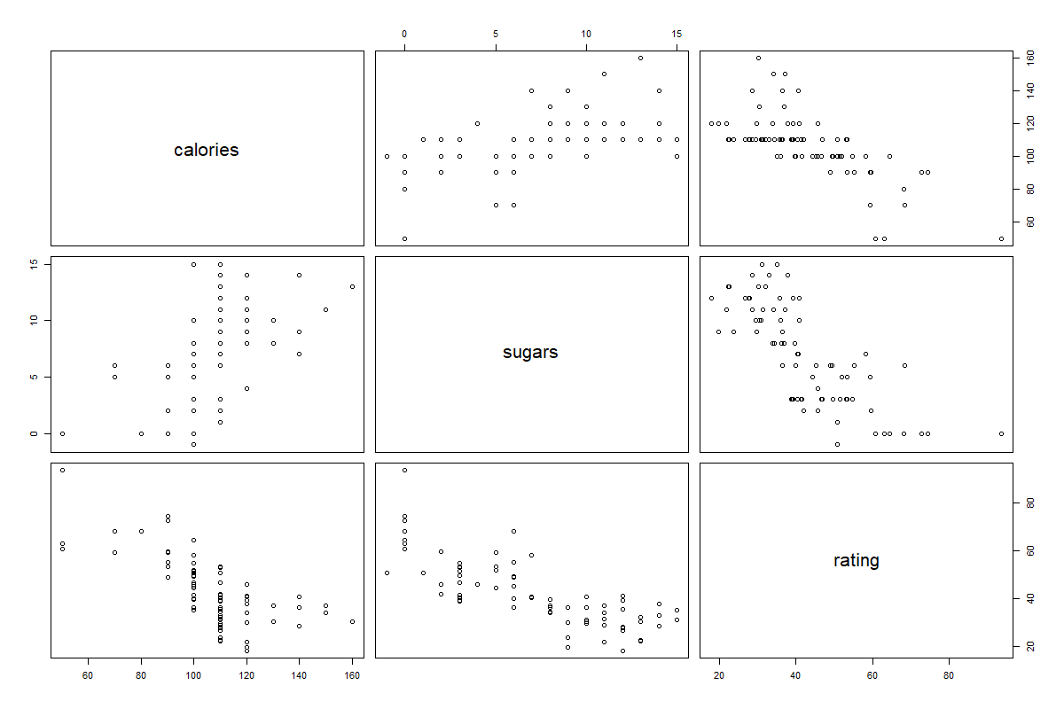
Understanding the relation between rating, sugar and calories using Bivariate analysis
We can see there is an inverse relationship between calories and rating as the calories increases rating decrease.
There is an inverse relationship between sugar and rating as the calories increases rating decrease.
Thus, we came to the conclusion that sugar and calories present in cereals give a negative attribute to rating

Slide 11
Linear regression models
Rating - dependent variable calories, sodium, potass, carbo and sugars - independent variable.
We can see our model is correct as significance value is near zero(p – value) and efficiency of our model is 90.35% (Adjusted R – squared)
rating = 68.866154 – 0.288098calories - 0.054825sodium + 0.089275potass + 0.949630carbo -1.313614sugars

Slide 12
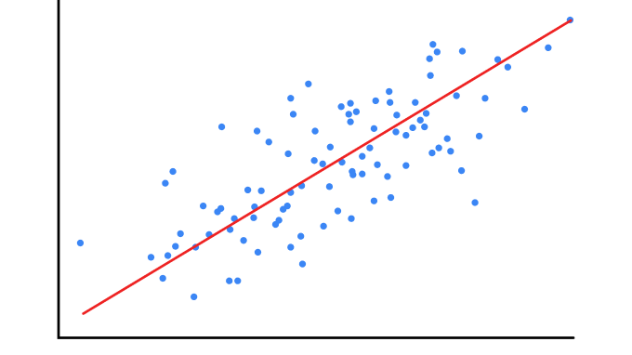

linear regression models
$$\text{rating}\text{ = 68.866154 – }\text{0.288098}\text{calories}\text{ − 0.054825}\text{sodium}\text{ + 0.089275}\text{potass}\text{ + 0} \text{.949630}\text{carbo}\text{ −1.313614}\text{sugars}$$
By using this model we can predict the rating.
We can see calories , sodium and sugar have negative coefficient because they have negative relation with rating so if any of this will increase rating will decrease

Slide 13
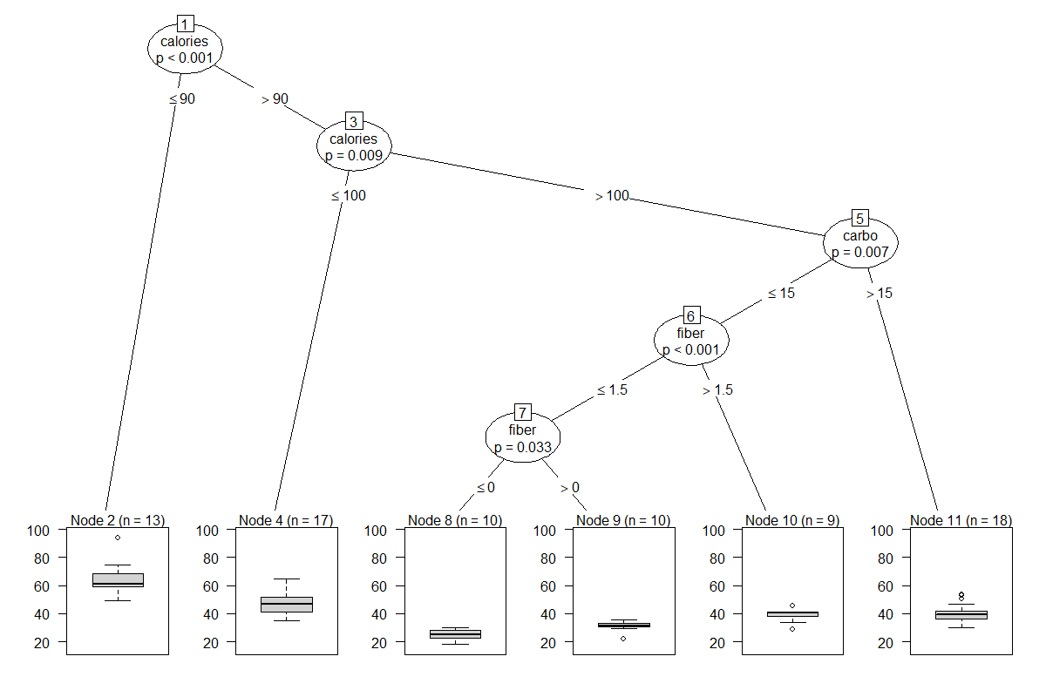
Decision Tree
We are using rating as a response variable or output variable
For input variable we are using calories, fiber and carbo.

Slide 14
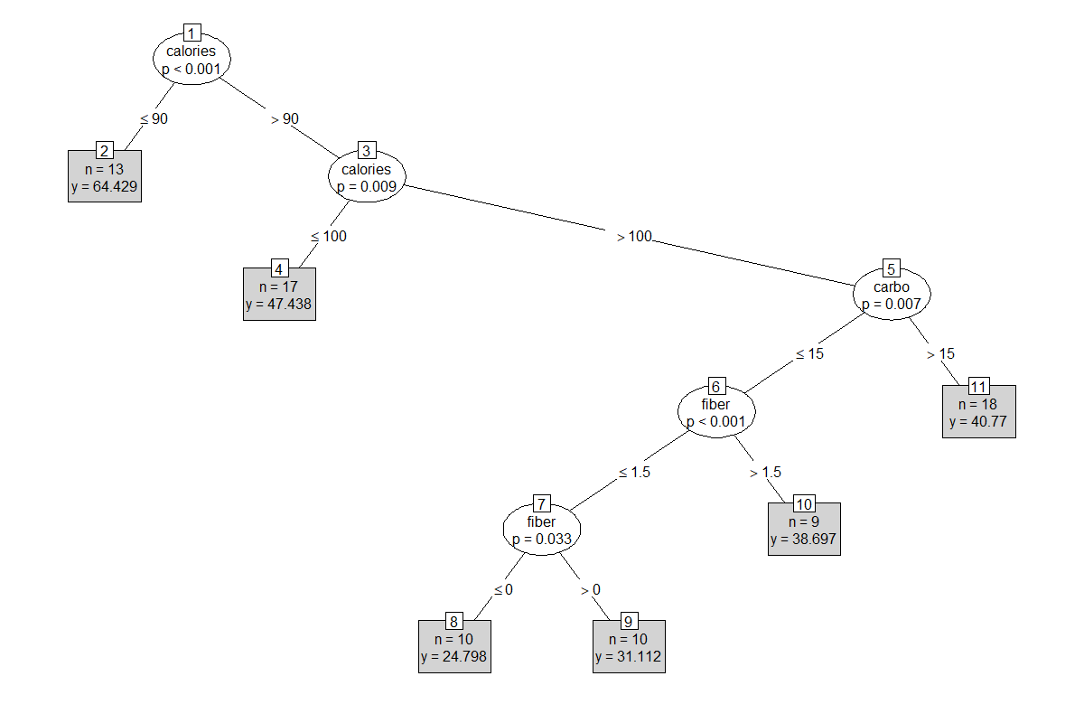
Decision tree
If calories is less than or equal to 90 then our rating will be 65 approx.
If calories lie between 90 to 100, the rating will be 48 approx.
If calories is more than 100 then:
If carbo is less then or equal to 15 and fiber is less than less than or equal to 0 then rating will be 25 approx.
If carbo is less or equal to 15 but fiber is between 0 to 1.5 then rating will 32 approx.
If carbo is less than or equal 15 but fiber is more than 1.5 then rating will be 39 approx.
If carbo is more than 15 then rating will 41 approx.

Slide 15
Conclusion
No missing values in data found
Calories and sugar, if more present per serving, will have a negative impact on rating.
Linear model suggested sodium also has a negative impact on rating
Model efficiency= 90.35%

Slide 16


