Slide 1

SCHOLARHUB HPU
Unified Ph.D. Research Lifecycle & Academic Governance Ecosystem
Integrated Research Management (ScholarSync) • Biometric Attendance & Leave Engine (ScholarTrack) • Academic Research Directory
Executive Institutional Presentation for the Hon'ble Vice Chancellor, Registrar & University Leadership
Himachal Pradesh University, Summer Hill, Shimla (H.P.)

Slide 2
STRATEGIC VISION
Executive Context: Modernizing Ph.D. Governance at HPU
01
The Legacy Challenge
Paper-Heavy & Fragmented
• Ph.D. lifecycle files moving across physical desks for months.
• Lack of unified tracking for RAC reviews, coursework & synopsis.
• Disparate paper registers for scholar attendance & leave records.
• Difficult manual collation of research metrics during NAAC/NIRF audits.
02
The ScholarHub Vision
Zero-Paper Digital Trust
• Unified monorepo connecting all departments under one portal.
• End-to-end transparent doctoral lifecycle tracking from admission to degree.
• Live biometric & digital attendance tied to fellowship disbursements.
• Instant, verifiable data extraction for statutory UGC & NAAC inspections.
03
Direct Leadership Impact
Control, Speed & Prestige
• Real-time institutional oversight on VC and Dean dashboards.
• Zero risk of proxy attendance or audit vulnerabilities in stipends.
• Elevates HPU's NIRF Perception & NAAC Criterion 3 scoring.
• Empowers scholars and supervisors with transparent digital timelines.
Himachal Pradesh University, Shimla | ScholarHub Digital Research & Governance Ecosystem | Slide 2 of 25

Slide 3
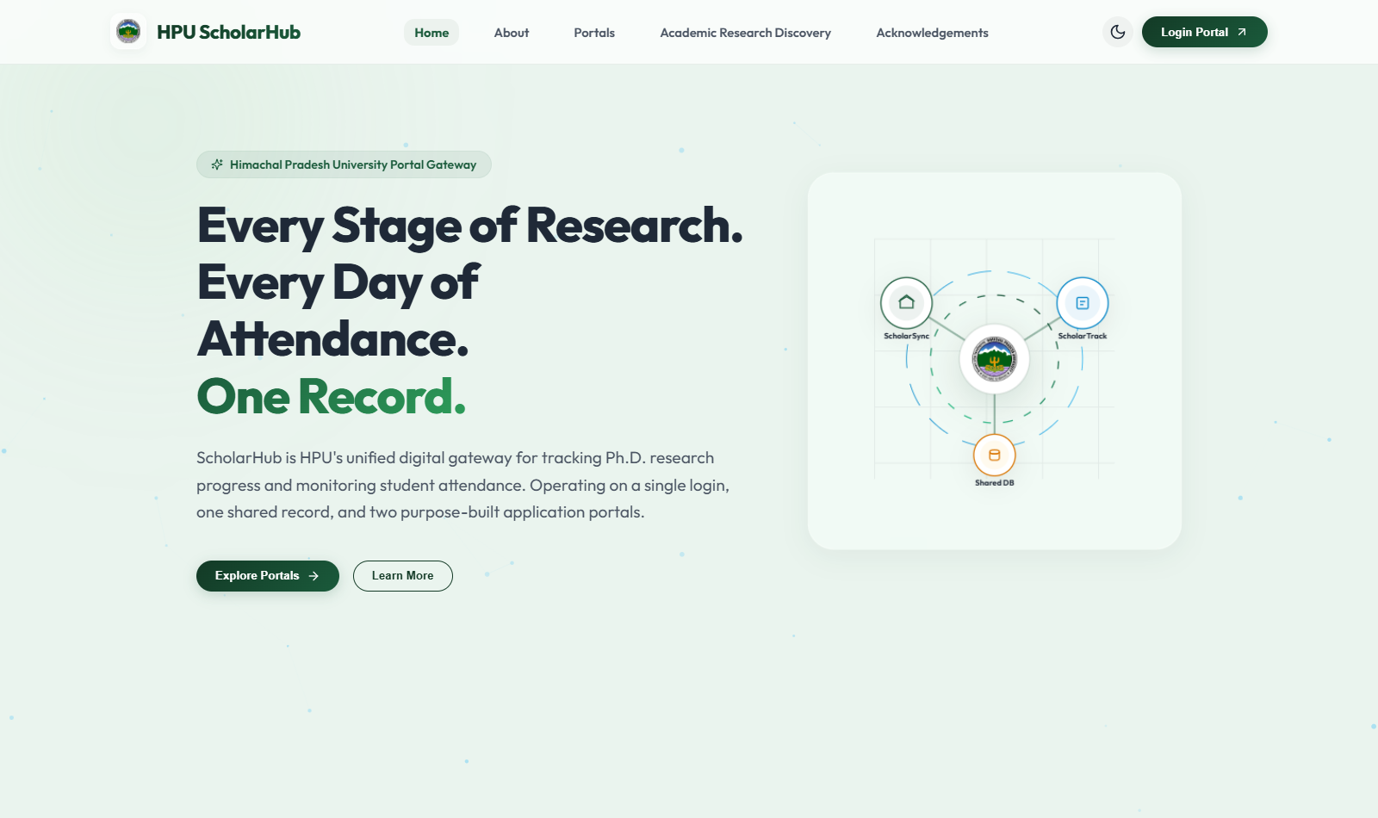
PORTAL 1: GATEWAY
The Central Gateway: Unified Digital Entrance for HPU
WHAT IS THE GATEWAY?
The Single Unified Front Door (scholarhubhpu.in)
The gateway serves as the central landing hub connecting all university academic modules. Instead of navigating separate, disjointed departmental systems, every student, faculty member, and external visitor enters through one verified official portal.
WHY IT WAS DEVELOPED:
• Eliminates confusion between different departmental links and credentials.
• Provides dynamic role routing: direct entry to Ph.D. Lifecycle (ScholarSync) or Attendance Engine (ScholarTrack).
• Hosts the Public Academic Research Directory accessible worldwide.
• Reinforces HPU's modern, prestigious digital identity with glassmorphic institutional branding.
LIVE INTERFACE: HPU Student Services Central Gateway Landing Page
Himachal Pradesh University, Shimla | ScholarHub Digital Research & Governance Ecosystem | Slide 3 of 25

Slide 4
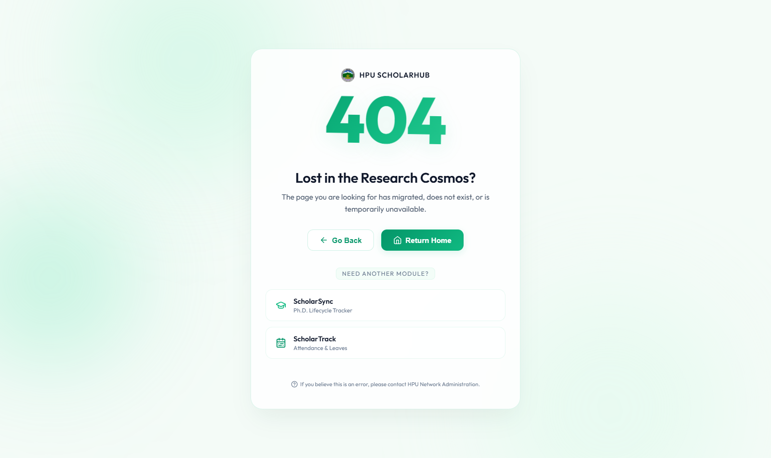
PORTAL 1: GATEWAY
Academic Research Directory: Showcasing HPU's Intellectual Wealth
PUBLIC RESEARCH DISCOVERY & TRANSPARENCY
A Window to Global Academic Collaborations
A live, searchable public repository displaying all HPU academic departments, approved research supervisors, enrolled doctoral scholars, and active research thrust areas.
KEY UNIVERSITY BENEFITS:
• Attracts National & Global Funding: Agencies (DST, DBT, CSIR, ICSSR) can instantly discover HPU's domain capabilities.
• Boosts NIRF 'Perception' Rating: Public scholarly profiles raise academic visibility across India.
• Encourages Interdisciplinary Research: Scholars across faculties easily find co-supervisors and joint project partners.
• Who is it for? Prospective doctoral candidates, peer universities, industry R&D partners, and NAAC peer reviewers.
LIVE INTERFACE: Public Academic Research Directory & Department Explorer
Himachal Pradesh University, Shimla | ScholarHub Digital Research & Governance Ecosystem | Slide 4 of 25

Slide 5
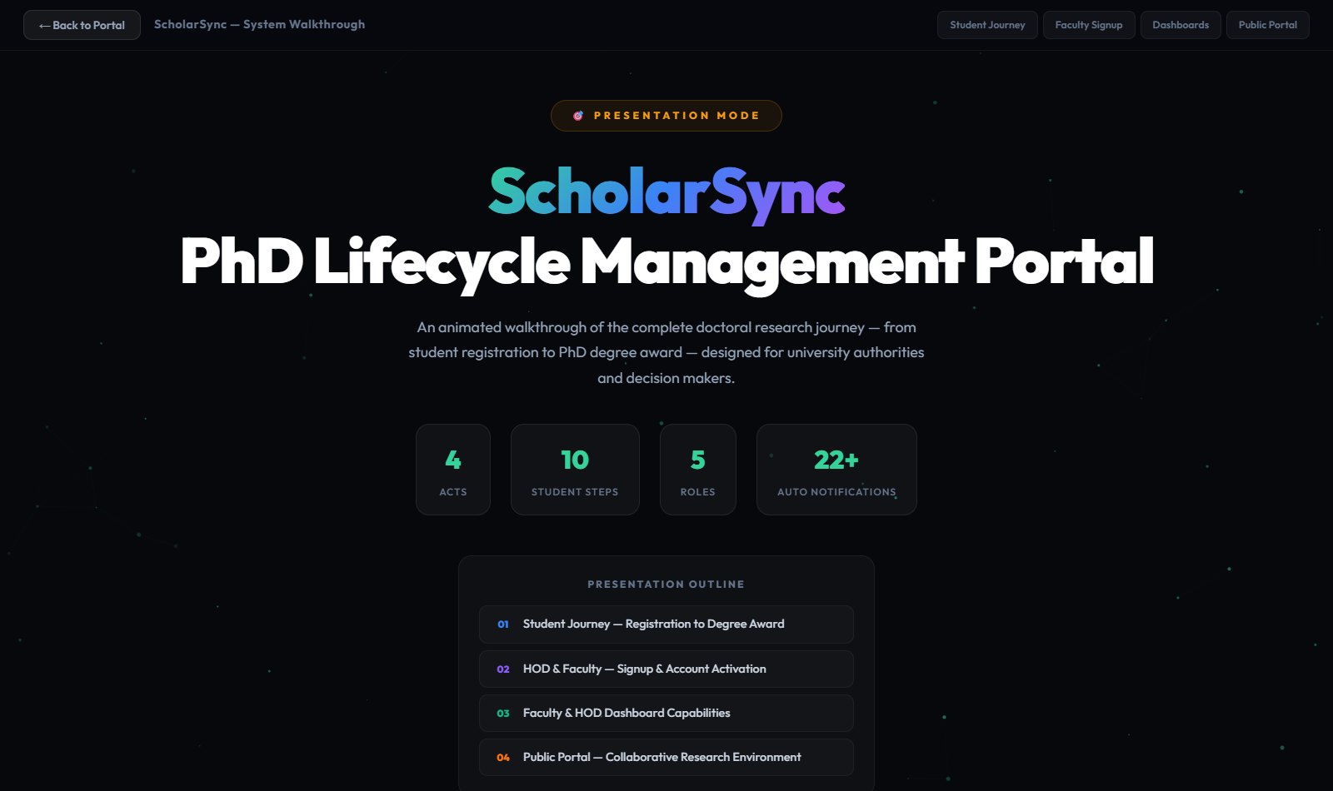
PORTAL 2: RESEARCH MANAGEMENT
ScholarSync: Complete Ph.D. Lifecycle Tracking Engine
RESEARCH MANAGEMENT SYSTEM (RMS)
Transforming Doctoral Administration
ScholarSync (sync.scholarhubhpu.in) is a purpose-built doctoral lifecycle automation platform guiding every candidate from their first day of enrollment to the final Viva-Voce defense and degree award.
WHY IT WAS CREATED FOR HPU:
• Replaces bulky physical files that get stuck during inter-departmental transfers.
• Guarantees compliance with UGC (Minimum Standards for Award of Ph.D.) Regulations.
• Automates notifications for every milestone: Coursework, Synopsis, DRC, RAC, Viva.
• Who is it for? Ph.D. Scholars, Research Guides, DRC/RAC Committee Members, Department HODs, Dean of Studies, and Vice Chancellor.
LIVE INTERFACE: Complete Interactive Ph.D. Lifecycle Workflow Map
Himachal Pradesh University, Shimla | ScholarHub Digital Research & Governance Ecosystem | Slide 5 of 25

Slide 6
CORE UNIVERSITY BENEFIT
Institutional Impact: Automated NAAC & NIRF Data Readiness
NAAC CRITERION 3.1 & 3.2
Grants, Innovations & Patents Tracking
Automatically catalogues all sanctioned extramural research grants (DST, ICSSR, UGC), funding amounts, research labs, and intellectual property/patents filed by university faculty.
NAAC CRITERION 3.4.2
Ph.D. Candidates Awarded per Guide
Maintains an immutable digital ledger of Ph.D. completion turnaround times, registered guides, and degree award dates with zero discrepancy during peer team verifications.
NAAC CRITERION 3.4.5 & 3.4.6
Scopus & UGC CARE Publications
Digital validation of research papers with DOI, Scopus indexing, and UGC CARE category verification before any scholar is permitted to submit their final thesis.
NIRF & STATUTORY COMPLIANCE
One-Click Institutional Data Export
Replaces months of frantic paper compilation across 30+ departments. Leadership can generate verified accreditation reports in seconds with complete timestamp audit trails.
Himachal Pradesh University, Shimla | ScholarHub Digital Research & Governance Ecosystem | Slide 6 of 25

Slide 7
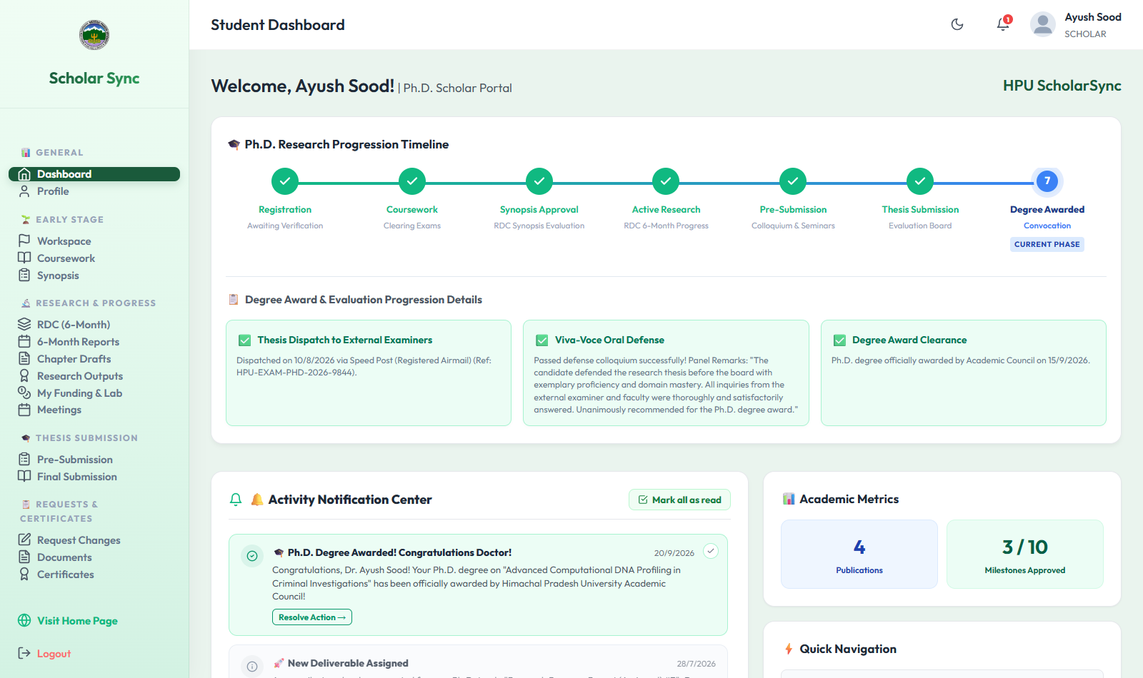
SCHOLARSYNC FEATURE
Stage 1: Verified Onboarding & DRC Supervisor Allocation
FOUNDATIONAL ADMISSION & ALLOCATION
Automated 9-Digit SH-No. & Guide Allotment
• Unique ScholarHub ID: Dynamically generates a tamper-proof 9-digit 'SH No.' linked across both portals.
• Coursework Verification: Scholars upload coursework marks cards; verified sequentially by Supervisor and HOD.
• DRC Supervisor Allocation: Departmental Research Committee allocates approved supervisors respecting UGC guide quotas (Prof: 8, Assoc: 6, Asst: 4).
• Single-Action Clearance: Eliminates weeks of manual file movement between admission office and departmental boards.
LIVE INTERFACE: Doctoral Candidate Overview & Registered Ph.D. Profile
Himachal Pradesh University, Shimla | ScholarHub Digital Research & Governance Ecosystem | Slide 7 of 25

Slide 8
SCHOLARSYNC FEATURE
Stage 2: Research Synopsis Clearance & Formal DRC Review
RESEARCH TOPIC VALIDATION
Transparent Synopsis Defense Scheduling
• Digital Synopsis Submission: Candidate uploads complete synopsis document and research methodology.
• Supervisor Endorsement: Research guide signs off digitally before forwarding to the HOD.
• Formal DRC Meeting Scheduling: HOD records DRC date, time, venue, and panel members with automated calendar email invites to candidate and guide.
• DRC Outcome Ledger: Records formal committee verdict (Approved, Provisional Clearance, Revisions Required) with permanent feedback notes.
LIVE INTERFACE: DRC Scheduling & Milestone Transition Architecture
Himachal Pradesh University, Shimla | ScholarHub Digital Research & Governance Ecosystem | Slide 8 of 25

Slide 9
SCHOLARSYNC FEATURE
Stage 3: Mandatory 6-Month RAC Progress Monitoring
CONTINUOUS ACADEMIC MONITORING
Eliminating Dormant & Inactive Candidacies
• Semestral Progress Uploads: Scholars must upload 6-monthly progress reports documenting literature review, experiments, and chapters.
• Research Advisory Committee (RAC) Sign-Off: RAC members record meeting minutes, evaluation remarks, and milestone clearances online.
• Early Intervention Warning: Flags stalled research early, allowing university leadership and guides to intervene productively.
• Audit-Proof Records: Guarantees full UGC compliance proving continuous active research before thesis submission.
LIVE INTERFACE: Scholar Milestone Dashboard & 6-Month RAC Tracking
Himachal Pradesh University, Shimla | ScholarHub Digital Research & Governance Ecosystem | Slide 9 of 25

Slide 10
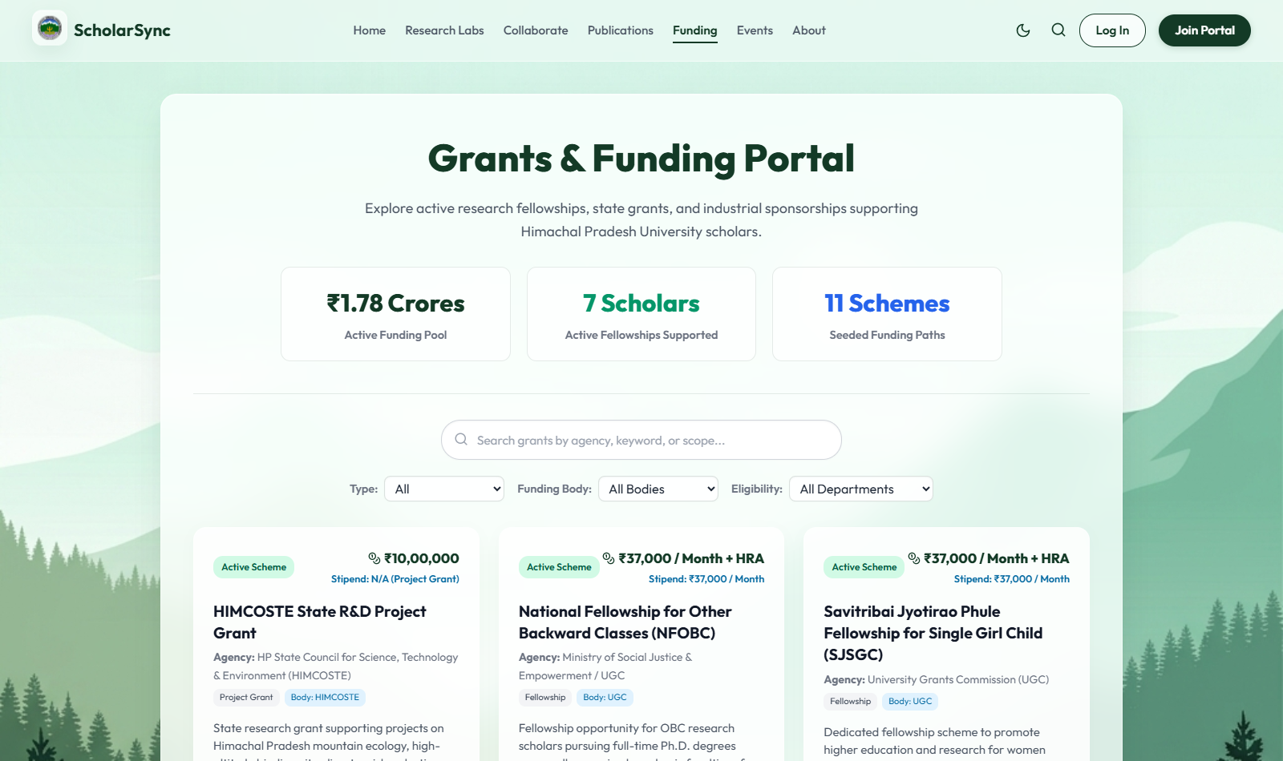
SCHOLARSYNC FEATURE
Stage 4: Research Publications, Patents & Extramural Grants
RESEARCH OUTPUT & INTELLECTUAL ASSETS
Validated Intellectual Property Bank
• Publication Gatekeeping: Automatically verifies that the scholar has satisfied UGC criteria (mandatory Scopus / UGC CARE publications) prior to thesis drafting.
• DOI & OpenAlex Integration: Automated retrieval of publication metadata, citations, and journal impact factor.
• Extramural Grants Management: Tracks research funding awards, sanctioned budgets, project PIs, and funding agencies.
• Patent Ledger: Centralized repository of intellectual property filed or granted under HPU.
LIVE INTERFACE: University Research Grants & Extramural Funding Ledger
Himachal Pradesh University, Shimla | ScholarHub Digital Research & Governance Ecosystem | Slide 10 of 25

Slide 11
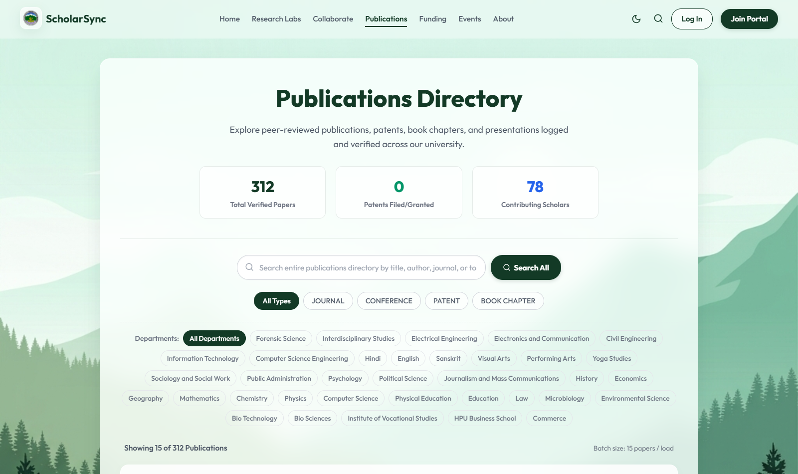
SCHOLARSYNC FEATURE
Stage 5: Pre-Submission Colloquium & Plagiarism Verification
ACADEMIC INTEGRITY ASSURANCE
Strict Pre-Submission Seminar Protocol
• Rough Draft & Plagiarism Upload: Candidate submits draft dissertation and official Turnitin/Urkund plagiarism clearance report (<10% similarity).
• Pre-Submission Seminar Scheduling: HOD schedules departmental presentation open to faculty and scholars.
• Seminar Evaluation Clearance: Committee records 'Cleared' or 'Uncleared with Revisions'.
• Binding Thesis Unlock: The portal locks out final bound thesis submission until seminar clearance is officially recorded.
LIVE INTERFACE: Scholarly Publications & Dissertation Repository
Himachal Pradesh University, Shimla | ScholarHub Digital Research & Governance Ecosystem | Slide 11 of 25

Slide 12
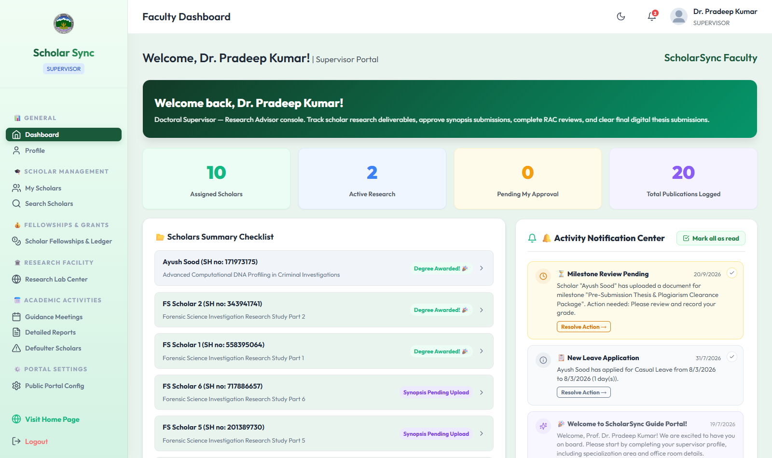
SCHOLARSYNC FEATURE
Stage 6: External Dispatch, Viva-Voce & Degree Award
FINAL DOCTORAL CONVOCATION
Full Accountability to Degree Conferment
• Supervisor & HOD Final Sign-off: Final bound thesis receives digital signature approvals.
• External Examiner Dispatch Tracking: Eliminates 'lost in transit' delays with dispatch method and tracking number logs.
• Evaluation Report Recording: Positive examiner reports trigger oral Viva-Voce defense scheduling.
• Official Degree Conferment: Following successful defense, the degree award status is updated, generating an immutable doctoral archive record.
LIVE INTERFACE: Supervisor Sign-Off & Candidate Evaluation Console
Himachal Pradesh University, Shimla | ScholarHub Digital Research & Governance Ecosystem | Slide 12 of 25

Slide 13
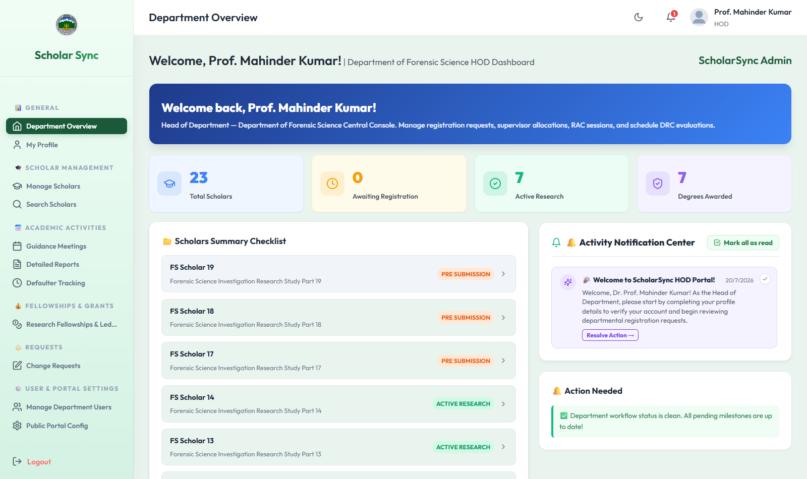
SCHOLARSYNC DASHBOARDS
Role-Based Leadership: Scholar, Supervisor & HOD Dashboards
LIVE INTERFACE: Supervisor Dashboard: Active Scholars, Pending RAC Reviews & Coursework Approvals
LIVE INTERFACE: HOD / Dean Dashboard: Department Allocation, DRC Meetings & Degree Awarding
Himachal Pradesh University, Shimla | ScholarHub Digital Research & Governance Ecosystem | Slide 13 of 25

Slide 14
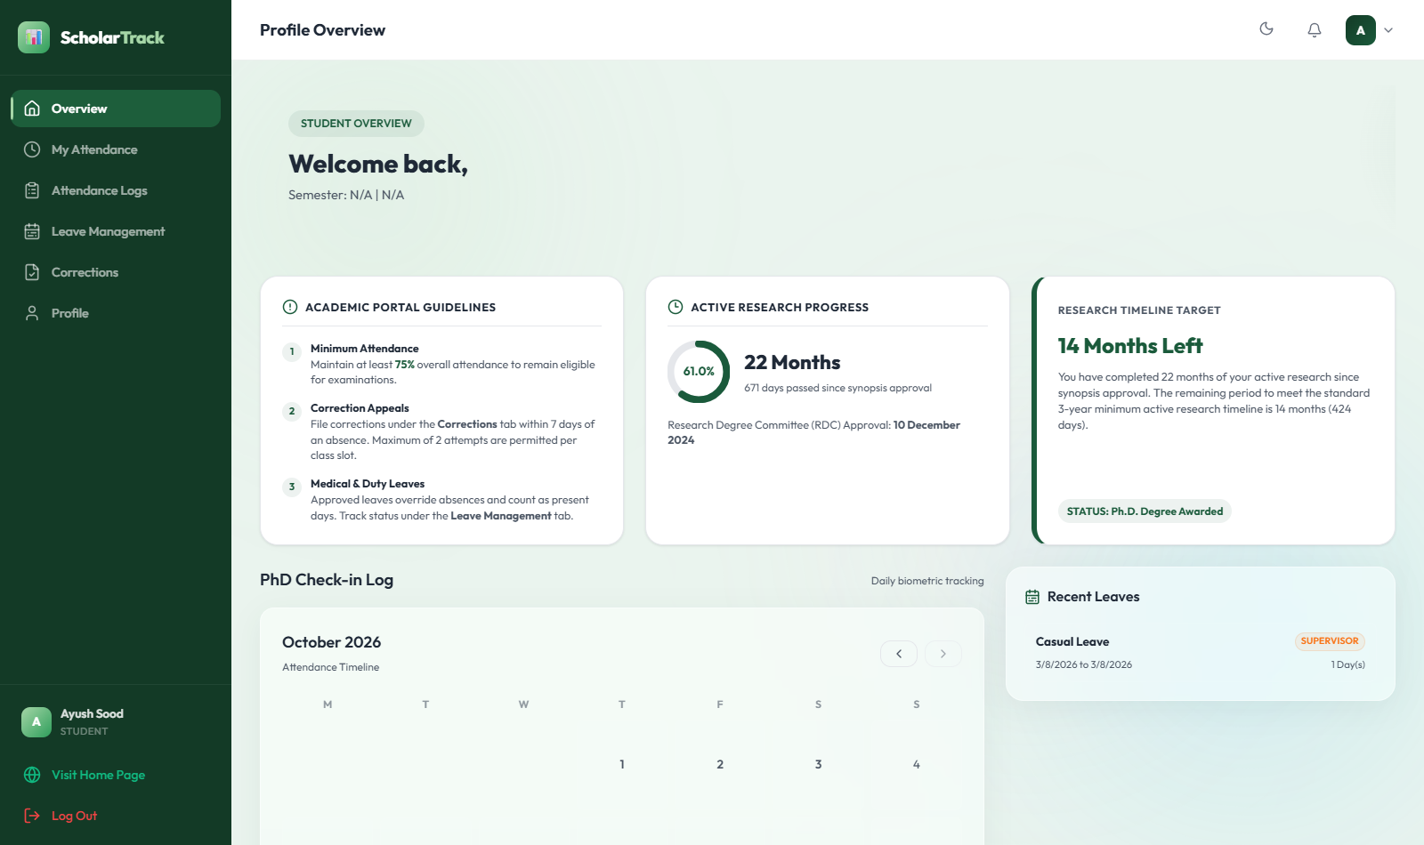
PORTAL 3: ATTENDANCE MANAGEMENT
ScholarTrack: Integrated Attendance & Leave Engine
ATTENDANCE MANAGEMENT SYSTEM (AMS)
Rigorous Academic Presence Monitoring
ScholarTrack (track.scholarhubhpu.in) is an institutional-grade attendance and leave management platform connecting scholars, faculty, department chairs, and the university finance office.
WHY IT WAS DEVELOPED:
• Enforces the mandatory UGC 75% attendance rule for semester exams and course credits.
• Eliminates paper attendance registers prone to tampering, proxy attendance, and wear-and-tear.
• Guarantees that research scholars maintain verified daily presence before monthly stipends are released.
• Who is it for? Ph.D. Scholars, Postgraduate Students, Faculty Instructors, Department HODs, and Finance/Accounts branch.
LIVE INTERFACE: ScholarTrack Student & Scholar Attendance Overview Console
Himachal Pradesh University, Shimla | ScholarHub Digital Research & Governance Ecosystem | Slide 14 of 25

Slide 15
CORE UNIVERSITY BENEFIT
University Benefit: Fiscal Integrity & Fellowship Stipend Compliance
STATUTORY AUDIT PROTECTION
CAG & State Audit Compliance
Government audit teams strictly demand verified proof of physical attendance before admitting fellowship expenditures. ScholarTrack creates an immutable, timestamped digital attendance trail for every disbursed rupee.
ZERO GHOST SCHOLARS
JRF / SRF / NFSC Fellowship Verification
Prevents unauthorized stipend disbursements to candidates absent without approved leave. Finance office receives certified attendance extracts directly from HOD dashboards with zero manual tampering.
INSTITUTIONAL PEACE OF MIND
Eliminates Dispute & Friction
Transparent leave balance ledgers and automated percentage metrics prevent end-of-semester arguments regarding detention, hall tickets, and fellowship deductions.
Himachal Pradesh University, Shimla | ScholarHub Digital Research & Governance Ecosystem | Slide 15 of 25

Slide 16
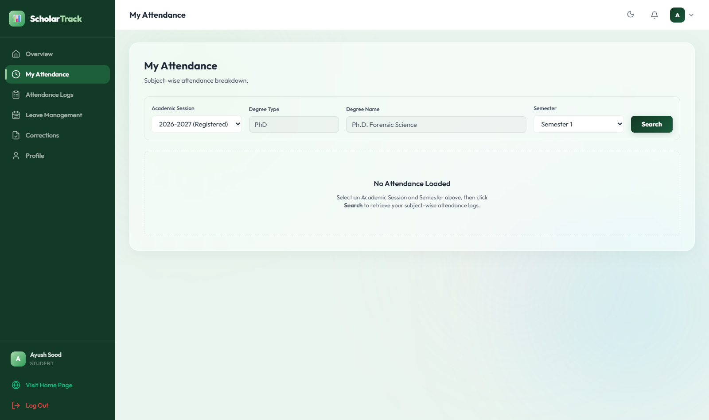
SCHOLARTRACK FEATURE
Feature 1: Daily Attendance Logs & Real-Time Percentage Tracking
ATTENDANCE VISIBILITY AT A GLANCE
Live Attendance Meter & Detailed Daily Ledger
• Live Percentage Gauge: Visual circular progress rings alert scholars immediately if their attendance approaches the 75% critical cutoff.
• Daily & Subject-Wise Records: Detailed historical ledger with status (Present, Absent, Duty Leave, Approved Leave) and session timestamps.
• Zero End-of-Term Shocks: Students and research scholars know their attendance status on any given day without having to request manual records from departmental clerks.
LIVE INTERFACE: Real-Time Student Attendance Ledger & Monthly Analysis
Himachal Pradesh University, Shimla | ScholarHub Digital Research & Governance Ecosystem | Slide 16 of 25

Slide 17
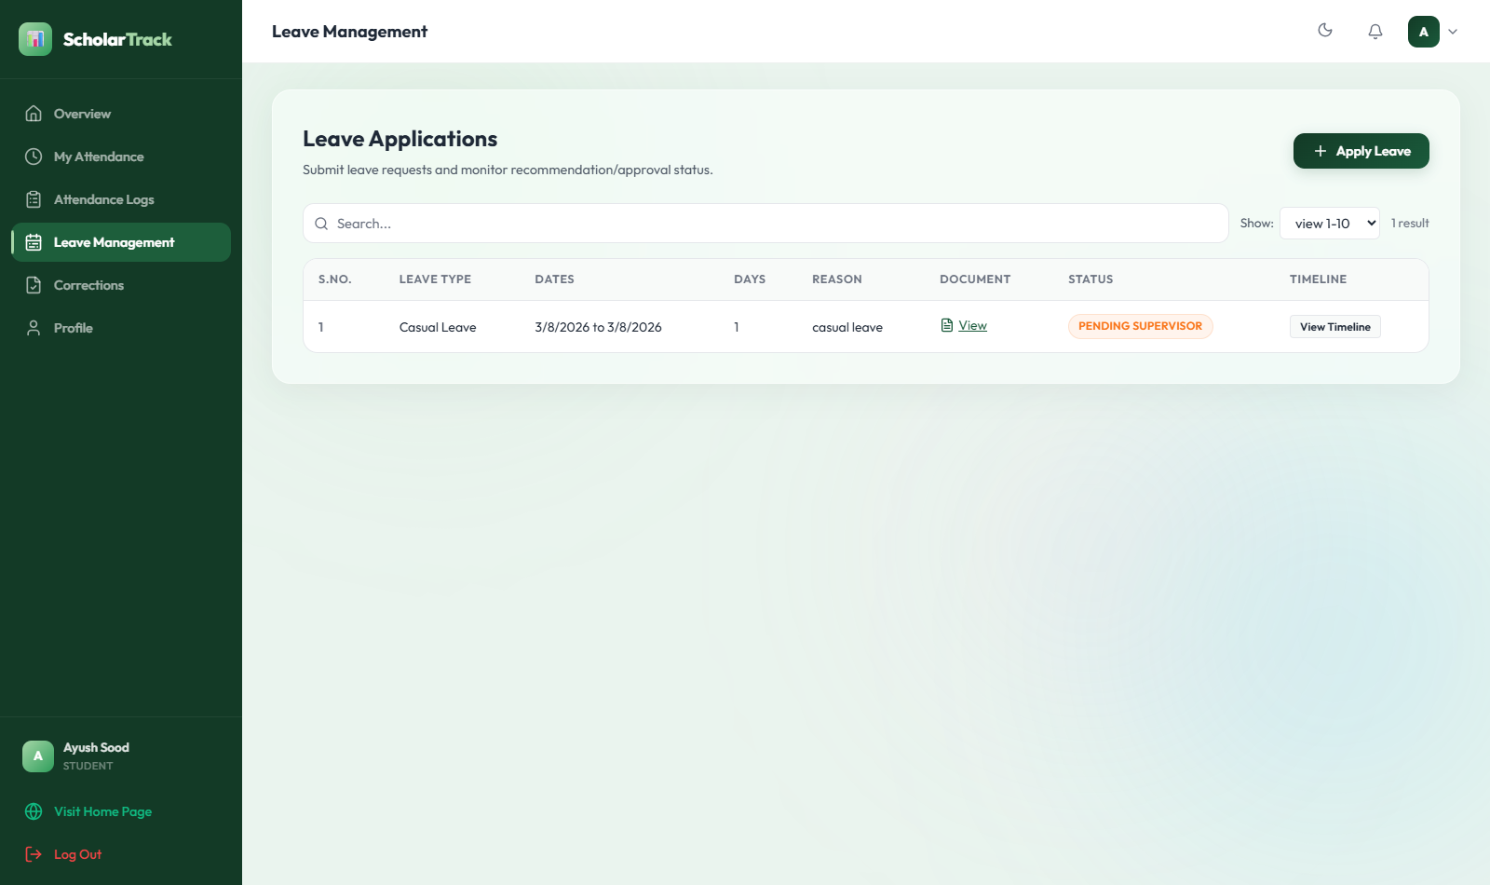
SCHOLARTRACK FEATURE
Feature 2: Multi-Tier Paperless Leave Management
DIGITAL WORKFLOW WITH AUDIT TRAIL
Transparent Leave Balances & Fast Approvals
• Multiple Leave Categories: Configurable for Casual Leave, Duty Leave (conferences, field surveys), and Medical Leave.
• Supporting Document Upload: Medical certificates or conference invitations are uploaded directly and archived digitally.
• Two-Tier Approval Chain: Candidate submits -> Supervisor/Faculty recommends -> Department HOD provides final approval.
• Automatic Balance Deduction: Approved leaves adjust student attendance and balance counters in real-time.
LIVE INTERFACE: Paperless Student Leave Application & Quota Balance Ledger
Himachal Pradesh University, Shimla | ScholarHub Digital Research & Governance Ecosystem | Slide 17 of 25

Slide 18
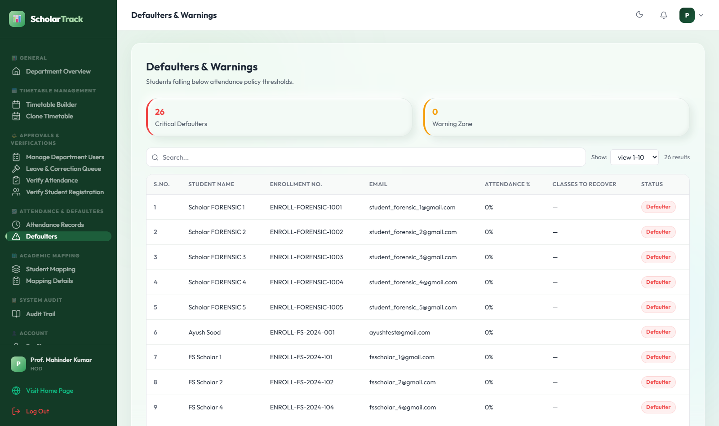
SCHOLARTRACK FEATURE
Feature 3: Defaulter Risk Engine & Automated Detention Alerts
ACADEMIC STANDARDS ENFORCEMENT
Instant Identification of At-Risk Students (<75%)
• Automated Defaulter Computation: Algorithm scans attendance across all departments and categorizes students <75% and critical <65%.
• Executive HOD & Dean Drill-Down: Leadership can view student-wise attendance logs, missed classes, and medical exemptions.
• Legally Defensible Examination Holds: Eliminates subjective favoritism or last-minute disputes over admit card issuance.
• Automated Warning Emails: Students receive proactive alerts weeks before exams to recover their required attendance.
LIVE INTERFACE: Department Defaulter Analytics & Multi-Level Approvals Tab
Himachal Pradesh University, Shimla | ScholarHub Digital Research & Governance Ecosystem | Slide 18 of 25

Slide 19
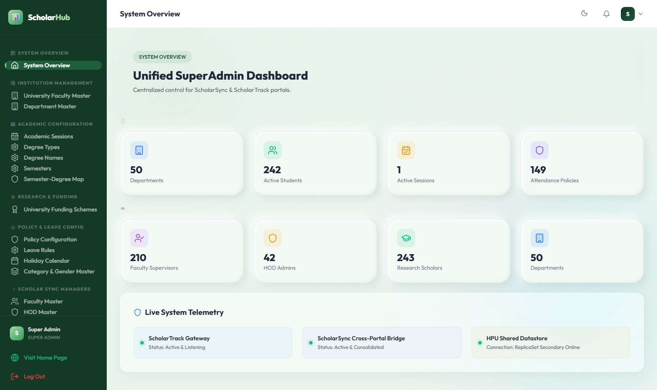
SCHOLARTRACK MASTERS
Operational Controls: Attendance Corrections & Policy Engine
FLEXIBLE INSTITUTIONAL ADMINISTRATION
Complete Departmental Flexibility
• Attendance Correction Workflow: If a student misses punching due to official duty, they can request correction with reason and document; approved by course teacher and HOD.
• Subject-Semester Mapping: Easily map enrolled students to faculty members, course codes, and timetables.
• Master Holiday & Session Rules: Admin controls university holiday lists, session start/end dates, and maximum allowed leaves per category.
• Audit Logging: Every attendance modification is logged with user ID, IP address, and timestamp.
LIVE INTERFACE: Admin Master Controls & Institutional System Configuration
Himachal Pradesh University, Shimla | ScholarHub Digital Research & Governance Ecosystem | Slide 19 of 25

Slide 20
CORE TECHNOLOGY
Technology Advantage: Lightweight, Ultra-Fast MERN Architecture
ZERO ERP BLOATWARE
React (Vite) + Express Architecture
Built using modern React Single Page Application (SPA) with Vite. Pages load in milliseconds under 0.8s even on slow internet connections in hilly areas, unlike heavy proprietary ERPs that crash under peak load.
DURABLE STORAGE
Centralized MongoDB Monorepo
A unified database powers Gateway, ScholarSync, and ScholarTrack. Candidate records, credentials, and SH-numbers are shared seamlessly across modules without redundant data entry or desynchronization.
ENTERPRISE SECURITY
Role-Based Access Control & SSL
Bank-grade JWT session authentication with bcrypt password hashing. Granular role-based permissions (Scholar, Guide, HOD, Dean, Admin) with end-to-end HTTPS SSL encryption on all university subdomains.
Himachal Pradesh University, Shimla | ScholarHub Digital Research & Governance Ecosystem | Slide 20 of 25

Slide 21
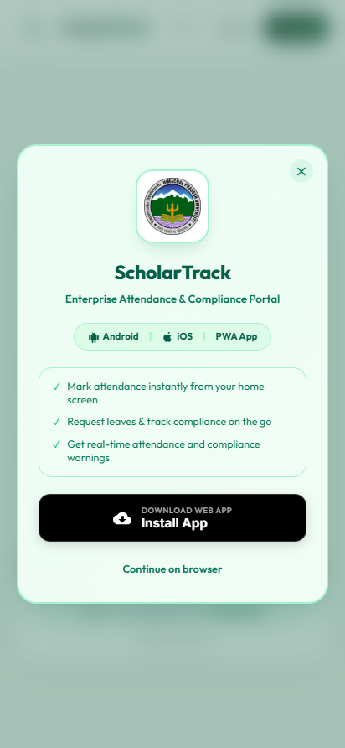
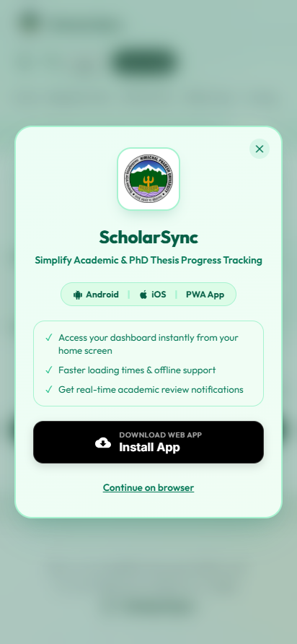
CORE TECHNOLOGY
Mobile Accessibility: Progressive Web Apps (PWA) on Any Phone
ZERO APP STORE FRICTION
Native Mobile Experience on Android & iOS
• One-Click Direct Install: Users tap 'Install App' directly in Chrome or Safari. No waiting for Google Play Store or Apple App Store approval cycles.
• Ultra-Lightweight (<2MB): Occupies negligible phone storage. Perfect for students and busy professors.
• Optimized for Hilly Terrain Connectivity: Service worker caching allows offline review of attendance logs and cached profiles during intermittent mobile connectivity.
• Responsive Adaptive Layout: Designed specifically for handheld touch navigation with bottom action tabs and quick biometric login.
LIVE INTERFACE: ScholarTrack PWA
LIVE INTERFACE: ScholarSync PWA
Himachal Pradesh University, Shimla | ScholarHub Digital Research & Governance Ecosystem | Slide 21 of 25

Slide 22
CORE TECHNOLOGY
Enterprise Communications: Self-Hosted Stalwart SMTP Server
DEPENDABLE TRANSACTIONAL MESSAGING
Automated Event-Driven University Alerts
• Dedicated Mail Server: Powered by self-hosted high-throughput Stalwart SMTP server (admin@scholarhubhpu.in) with SPF, DKIM, and DMARC verification.
• Durable MongoDB Queue: Emails are queued via EmailQueue model and processed steadily by background worker processes with retry logic.
• Catalog of 39+ Trigger Events: Instant notifications for account verification, DRC meeting schedules, RAC reviews, leave approvals, and degree awards.
• Delivery Audit Trail: Live admin dashboard tracks delivery status, timestamps, and error diagnostics for 100% accountability.
LIVE INTERFACE: Admin Communications & Real-Time Delivery Tracking Logs
Himachal Pradesh University, Shimla | ScholarHub Digital Research & Governance Ecosystem | Slide 22 of 25

Slide 23
STRATEGIC SUMMARY
Transformation Summary: Before vs. After ScholarHub at HPU
BEFORE SCHOLARHUB (Legacy Operations)
❌ Ph.D. files take weeks to travel between departmental desks and dean's office.
❌ Missing research synopses, handwritten RAC reviews, and untracked coursework.
❌ Paper registers for scholar attendance prone to proxy marking and disputes.
❌ Stipend disbursements vulnerable to statutory audit objections due to lack of proof.
❌ Frantic, months-long paper collation before NAAC peer team and NIRF rankings.
❌ No public visibility into HPU faculty research thrusts and active labs.
AFTER SCHOLARHUB (Modern Digital Governance)
✅ Instant digital lifecycle forwarding with timestamped supervisor & HOD sign-offs.
✅ Structured digital records for every milestone: DRC, RAC, Turnitin, & Viva-Voce.
✅ Verified digital/biometric daily attendance with real-time 75% percentage gauge.
✅ 100% audit-proof fellowship certificates for Accounts & Finance branch.
✅ One-click NAAC Criterion 3 & NIRF metrics export with verified proof links.
✅ Prestigious Public Academic Research Directory showcasing HPU globally.
Himachal Pradesh University, Shimla | ScholarHub Digital Research & Governance Ecosystem | Slide 23 of 25

Slide 24
NEXT STEPS
Institutional Implementation & Phased Rollout Roadmap
PHASE 1 (WEEKS 1 - 4)
Flagship Department Pilot
• Deploy pilot in 3 leading faculties (e.g. Computer Science, Biotechnology, Physics).
• Onboard active research scholars and supervisors.
• Conduct brief 30-minute orientation workshops for HODs and faculty.
• Verify live biometric / daily attendance & leave logging.
PHASE 2 (WEEKS 5 - 8)
University-Wide Rollout
• Expand to all Humanities, Social Sciences, Law, and Sciences departments.
• Backfill existing Ph.D. scholars with unique 9-digit SH numbers.
• Integrate institutional holiday calendars and departmental leave rules.
• Deploy PWA mobile app links across student notice boards.
PHASE 3 (WEEKS 9+)
Paperless Governance Integration
• Mandate digital DRC and RAC meeting logs across all faculties.
• Direct electronic synchronization with Finance branch for monthly stipend release.
• Automated NAAC Criterion 3 data compilation for upcoming accreditation.
• Complete operational transition to paperless research administration.
Himachal Pradesh University, Shimla | ScholarHub Digital Research & Governance Ecosystem | Slide 24 of 25

Slide 25
Thank You, Hon'ble Vice Chancellor & University Officers
ScholarHub is Ready for Immediate Institutional Pilot at H.P. University
• Zero New Hardware Investment Required • Fully Deployed & Verified Live on Cloud Servers
• PWA Mobile Apps Ready for All Faculty & Scholars • Automated NAAC & UGC Regulatory Compliance
Open for Leadership Questions & Discussion

