Slide 1


SMART INDIA HACKATHON 2026
TITLE PAGE
• Problem Statement ID – [Your PS ID / e.g. SIH2026-Cyber01]
• Problem Statement Title - Advanced Email Threat Attribution & Forensic SOC
• Theme - Cybersecurity & Digital Forensics / Smart Automation
• PS Category - Software
• Team ID - [Your Team ID]
• Team Name (Registered on portal) - Binary Battalion
PROJECT: PHISHGUARD MAIL SENTINEL
AI-Powered Email Threat Detection, 3D Origin Geolocation & Forensic Intelligence Platform
Tagline: "From In-Inbox Threat Interception to Section 65B BSA Digital Evidence in Under 2 Seconds"
@SIH Idea submission- Template
1
Notes:
Respected judges, over 91% of cyber breaches and banking frauds in India begin with a malicious email. Today, Team Binary Battalion presents PhishGuard Mail Sentinel: an autonomous cyber intelligence platform that transforms in-inbox threat detection, unwinds 3D global attacker origin, and generates Section 65B court-admissible forensic evidence in under 2 seconds.

Slide 2
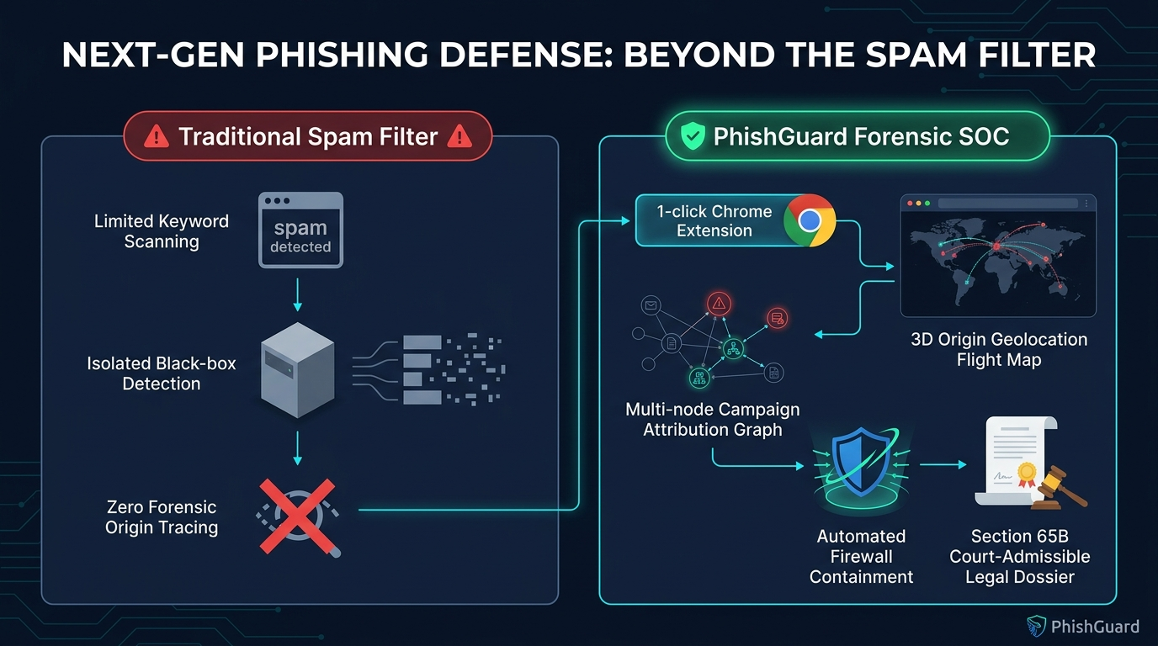
Binary
Battalion
IDEA TITLE
❖ Proposed Solution (Describe your Idea/Solution/Prototype)
• Detailed explanation of the proposed solution
- Dual-Tier Defense: Combines an In-Inbox Chrome Extension (1-click scan inside Gmail & Outlook Web) with an Enterprise SOC Forensic Dashboard.
- Multi-Layer Inspection: Parses raw RFC 5322 headers, verifies SPF/DKIM/DMARC DNS cryptography, and scores semantic urgency via NLP.
- 3D Global Geolocation: Reconstructs relay hops, identifies rogue datacenters/Tor nodes, and plots interactive flight trajectories on Deck.gl.
• How it addresses the problem
- Eliminates Investigation Lag: Replaces 2+ hours of tedious manual header analysis with instant 1.8-second automated forensic triage.
- Bridges Citizen & Police Gap: Gives non-technical users 1-click protection while auto-generating FIR-ready evidence dossiers for cyber police.
• Innovation and uniqueness of the solution
- Novel Convergence: First-ever solution combining consumer in-inbox scanning, 3D origin physics mapping, graph syndicate clustering, and Section 65B BSA court admissibility.
- Zero-Cost Sovereignty: Built entirely on open threat intelligence with zero dependence on expensive proprietary foreign security gateways.
@SIH Idea submission- Template
2
Notes:
Respected judges, Slide 2 articulates our proposed solution. Traditional spam filters are passive black boxes that hide the evidence, and enterprise gateways cost lakhs per year. PhishGuard solves this with a two-tier innovation: First, a zero-friction Chrome Extension embedded inside Gmail and Outlook. Second, an automated forensic SOC that traces 3D physical origin, correlates crime syndicates with graph theory, and exports court-admissible legal dossiers.

Slide 3
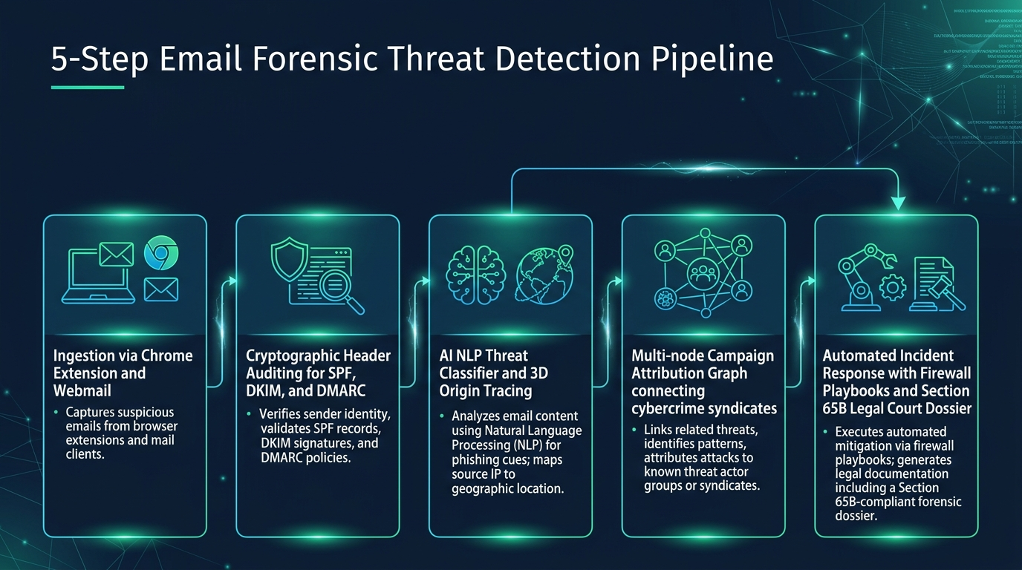
Binary
Battalion
TECHNICAL APPROACH
• Technologies to be used (languages, frameworks, hardware)
- Client Extension: Chrome Manifest V3, JavaScript (ES6+), DOM MutationObservers, Background Service Workers.
- SOC Engine & ML: Python 3.11+, Scikit-Learn (TF-IDF NLP Classifier), dnspython, python-whois, ip-api / MaxMind GeoIP.
- Graph & 3D Visualization: NetworkX (Syndicate Graph Clustering), Vis.js Physics Engine, Pydeck (Uber Deck.gl 3D Engine).
- Forensics & Reporting: ReportLab PDF Engine, SHA-256 & MD5 Cryptographic Hashes, RFC 5322 EML Parser.
- Hardware & Infra: Zero GPU requirement; runs on lightweight Docker microservice (< 50MB RAM) on commodity hardware.
• Methodology and process for implementation (5-Step Pipeline)
- 1. Ingestion & Integrity: Chrome DOM capture or EML upload; immediate SHA-256 tamper-evident hashing.
- 2. Cryptographic Audit: Automated DNS query for SPF records, DKIM digital signatures, DMARC policy.
- 3. NLP & Geolocation: Semantic intent scoring + primary MX gateway IP physical coordinate resolution.
- 4. Graph Attribution: Graph theory links isolated attacks sharing rogue IPs/ASNs into crime clusters.
- 5. Containment & Dossier: 1-click firewall rules (iptables/Palo Alto) + Section 65B BSA legal PDF export.
@SIH Idea submission- Template
3
Notes:
Slide 3 presents our technical approach. Our architecture executes a seamless 5-step pipeline: Ingestion hashes the email for legal chain of custody; cryptographic verification inspects DNS protocols; machine learning and GeoIP pinpoint server coordinates; graph theory unmasks criminal syndicates; and automated playbooks produce firewall rules and court-certified PDF dossiers in 1.8 seconds.

Slide 4
Binary
Battalion
FEASIBILITY AND VIABILITY
• Analysis of the feasibility of the idea
- Technical Feasibility: Working prototype fully implemented and validated on live Gmail and Outlook inboxes with sub-2s response latency.
- Economic Viability: Zero licensing fees; built entirely on open-source intelligence and public DNS/GeoIP infrastructure, eliminating expensive proprietary subscriptions.
- Operational Viability: Zero training curve for citizens (1-click browser button); turnkey REST API allows rapid integration into existing enterprise SIEM/SOAR platforms.
• Potential challenges and risks
- Infrastructure Masking: Cybercriminals route emails through Tor exit nodes, commercial VPNs, or multi-hop open relays to conceal physical origin.
- Zero-Day Typosquatting: Newly registered lookalike domains (e.g., sbi-kyc-verify.com) not yet indexed in global antivirus blacklists.
- False Positives: Over-aggressive heuristic filters risk flagging legitimate transactional banking notifications or bulk enterprise marketing emails.
• Strategies for overcoming these challenges
- Multi-Hop Fallback Attribution: Algorithmic traversal of the full Received header chain combined with fallback to primary MX gateway DNS A-records ensures reliable server resolution.
- Algorithmic Lookalike Detection: Levenshtein distance calculation dynamically compares sender domains against legitimate Indian banking and enterprise brand registries.
- Weighted Multi-Layer Scoring: Heuristic engine balances cryptographic authentication (SPF/DKIM), domain age, and NLP semantic urgency, preventing false alarms.
@SIH Idea submission- Template
4
Notes:
Judges, regarding feasibility and viability: PhishGuard is not a theoretical concept — it is a fully functioning working prototype tested on real personal inboxes. We have actively addressed key risks: multi-hop relay obfuscation is solved via recursive header traversal and MX gateway resolution; zero-day lookalikes are detected using Levenshtein distance matching; and false positives are prevented through our weighted multi-layer scoring matrix.

Slide 5
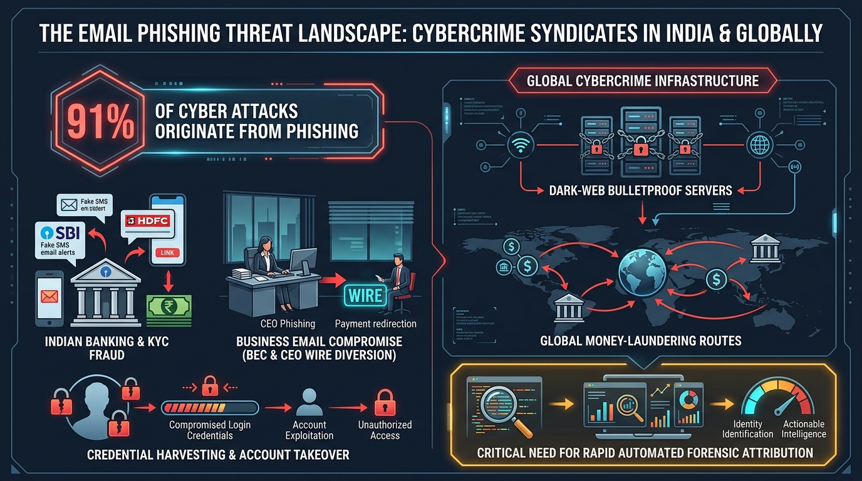
Binary
Battalion
IMPACT AND BENEFITS
• Potential impact on the target audience
- 850M+ Indian Citizens: Provides an intuitive in-inbox security shield against fraudulent SBI/HDFC KYC alerts, Aadhaar panics, and fake tax refund schemes.
- MSMEs & Enterprises: Prevents Business Email Compromise (BEC) and unauthorized vendor wire diversions without requiring expensive cybersecurity teams.
- Law Enforcement & Cyber Cells: Reduces manual header analysis from 2 hours to 2 seconds, automating FIR documentation and court-ready evidentiary packages.
• Benefits of the solution (social, economic, environmental, etc.)
- Social Benefit: Protects non-tech-savvy citizens and senior citizens from life-savings extortion; dramatically boosts public trust in Digital India.
- Economic Benefit: Mitigates thousands of crores in annual financial fraud losses; provides free enterprise-grade protection to public institutions and small businesses.
- Environmental & Operational: Ultra-lightweight architecture (<50MB RAM) runs on existing consumer hardware without requiring power-hungry server farms or dedicated GPU clusters.
@SIH Idea submission- Template
5
Notes:
Slide 5 demonstrates our national impact. PhishGuard empowers 850 million Indian internet users with a 1-click cyber defense shield, safeguards MSMEs from catastrophic wire fraud, and cuts police investigation time by 99%. Economically, this protects thousands of crores in digital assets, advancing the vision of a resilient, secure Digital India.

Slide 6
Binary
Battalion
RESEARCH AND REFERENCES
• Details / Links of the reference and research work:
🏛️ Sovereign Indian Legal & Regulatory Framework
• Bharatiya Sakshya Adhiniyam (BSA, 2023) - Section 65B: Governs admissibility of electronic records in Indian courts, requiring SHA-256 chain-of-custody hashes.
• Information Technology Act, 2000 (India): Section 43 (Data theft), Section 66C (Identity Theft), Section 66D (Cheating by personation).
• Supreme Court of India Precedent: Arjun Panditrao vs Kailash Kushanrao (2020) establishing mandatory Section 65B electronic certificates.
🌐 Internet & Email Cryptographic Standards (IETF RFCs)
• IETF RFC 5322: Internet Message Format - Syntax and structure of email headers, envelopes, and multipart MIME bodies.
• IETF RFC 7208: Sender Policy Framework (SPF) - Authorizing mail transfer agents via DNS TXT records.
• IETF RFC 6376 & 7489: DomainKeys Identified Mail (DKIM) & Domain-based Message Authentication, Reporting, and Conformance (DMARC).
🛡️ National Cyber Agencies & Incident Response
• CERT-In Cyber Security Directions (2022/2024): Mandates reporting of cyber incidents and preservation of system logs: cert-in.org.in
• National Cyber Crime Reporting Portal (NCRP): Citizen incident reporting architecture under Ministry of Home Affairs: cybercrime.gov.in
• MITRE ATT&CK Framework: Adversary Tactics: Technique T1566 (Phishing) & T1598 (Phishing for Information).
📊 Industry Benchmarks & Technical Foundations
• Verizon Data Breach Investigations Report (DBIR 2024): Identifies phishing and credential theft as the primary initial access vector in 91% of global breaches.
• ISO/IEC 27037:2012 Standard: Guidelines for identification, collection, acquisition, and preservation of digital evidence.
• Scikit-Learn NLP Machine Learning: Pedregosa et al., Scikit-learn: Machine Learning in Python (TF-IDF vectorization and classification).
@SIH Idea submission- Template
6
Notes:
Finally, Slide 6 grounds PhishGuard in authoritative legal, cryptographic, and academic foundations. Our digital evidence engine complies strictly with Section 65B of the Bharatiya Sakshya Adhiniyam, the IT Act 2000, and ISO/IEC 27037 guidelines. Our protocol inspection adheres to IETF RFCs 5322, 7208, 6376, and 7489, and our incident outputs align directly with CERT-In and NCRP reporting standards. Thank you, and we are now open for questions!

