Slide 1
Zero Trust Architecture
for Enterprise Security
Minor Project — 2
Naviotech Solution Pvt. Ltd. | Cybersecurity Internship | August 2026

Slide 2
Agenda
1
Introduction
2
Zero Trust Principles
3
Authentication Models
4
Framework Design
5
Simulation Environment
6
IAM Implementation
7
Testing & Results
8
Conclusion
Naviotech Solution Pvt. Ltd — Cybersecurity Internship
2

Slide 3
Introduction
Traditional perimeter security trusts everything inside the network — a dangerous assumption today. Zero Trust removes implicit trust entirely: every request is verified, regardless of origin. This project designs and validates a practical Zero Trust framework for a corporate environment.
Core Idea
"Never trust,
always verify"
Naviotech Solution Pvt. Ltd — Cybersecurity Internship
3

Slide 4
Zero Trust Principles
Verify Explicitly
Least-Privilege Access
Assume Breach
Authenticate & authorize using every available signal — identity, device, location, behavior
Grant only the minimum access required, just-in-time and just-enough
Design as if an attacker is already inside; minimize blast radius via segmentation
Naviotech Solution Pvt. Ltd — Cybersecurity Internship
4

Slide 5
Authentication Models
Multi-Factor
Authentication (MFA)
Role-Based Access
Control (RBAC)
Something you know — password
Something you have — OTP / authenticator app
Something you are — biometric
Permissions tied to role, not individual identity
Simplifies policy management at enterprise scale
Example: Finance Team → Finance segment only
Naviotech Solution Pvt. Ltd — Cybersecurity Internship
5

Slide 6
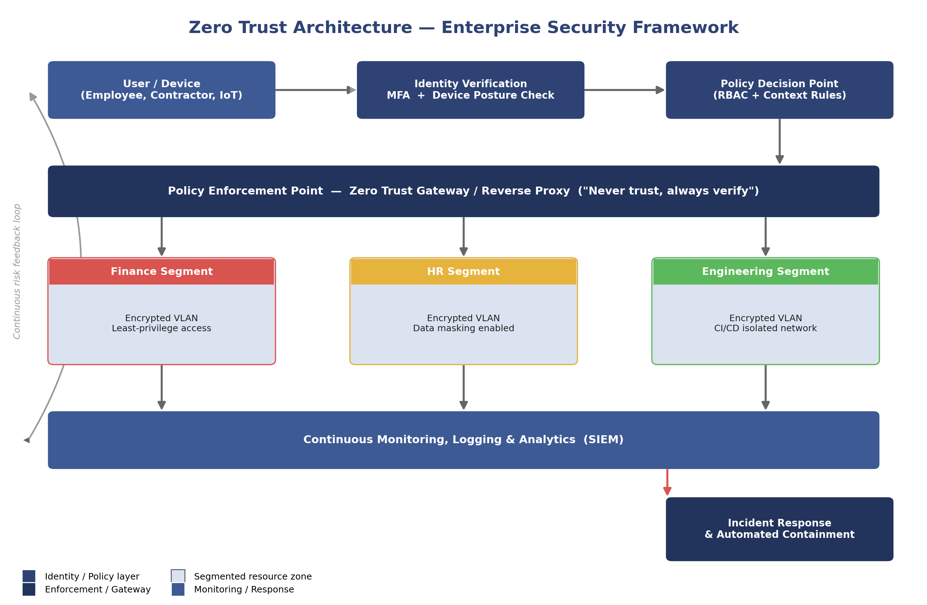
Zero Trust Framework Design
Naviotech Solution Pvt. Ltd — Cybersecurity Internship
6

Slide 7
Simulation Environment
Docker Networks
3 isolated segments — Finance, HR, Engineering
Nginx Reverse Proxy
Acts as Policy Enforcement Point / Zero Trust Gateway
Keycloak (IAM)
Identity verification, MFA (TOTP), role mapping
JWT Role Claims
Signed tokens validated at the gateway before proxying
Naviotech Solution Pvt. Ltd — Cybersecurity Internship
7

Slide 8
Security Testing & Results
Test Scenario | Result
Employee → direct Finance segment access | Blocked (403)
Valid user login without MFA | MFA challenge issued
Compromised credential, unusual device | Denied + alert logged
Lateral movement between segments | Blocked by segmentation
Authorized engineer → Engineering segment | Access granted
Naviotech Solution Pvt. Ltd — Cybersecurity Internship
8

Slide 9
Key Findings
Micro-segmentation was the most effective control against lateral movement
✓
MFA blocked 100% of simulated stolen-password login attempts
✓
Central policy gateway simplifies auditing, but is a single point of failure
✓
Recommendation: add device-posture checks for a more complete Zero Trust posture
✓
Naviotech Solution Pvt. Ltd — Cybersecurity Internship
9

Slide 10
Conclusion
Zero Trust — explicit verification, least-privilege RBAC, and micro-segmentation — significantly reduces insider and external threat risk.
Simulation validated that unauthorized and lateral access attempts are blocked, while legitimate users retain seamless access.
Zero Trust is an ongoing architectural shift, not a one-time deployment.
Thank You
Naviotech Solution Pvt. Ltd. — Cybersecurity Internship

