Slide 1
Weather Trend Forecasting
PM Accelerator Tech Assessment
Mission: To help professionals identify their value, stand out, and advance their careers to land dream Product Management jobs.
Author: Ayush Kumar
Notes:
Hi, I'm presenting my Weather Trend Forecasting project for the PM Accelerator Tech Assessment. This project aligns with the PM Accelerator mission by utilizing advanced data science to build predictive, actionable business solutions.

Slide 2
Executive Summary
• Built: End-to-end ML pipeline forecasting global temperatures.
• Goal: Extract predictive insights from weather datasets.
• Model: XGBoost and Random Forest achieved high R² accuracy.
• Advanced Analytics: Implemented spatial mapping, anomaly detection, and environmental correlations.
• Outcome: Models achieved strong test-set metrics indicating high correlation with historical data.
2
Notes:
At a high level, I built an end-to-end machine learning pipeline to model global temperatures. By applying algorithms like XGBoost, the model achieved high accuracy on the test set, demonstrating the predictive capacity of the features.

Slide 3
Dataset Overview: Global Weather Repository
• Dataset Source: Global Weather Repository on Kaggle.
• Volume: 148,515 individual daily weather records.
• Dimensions: Over 40 distinct features describing conditions globally.
• Key Weather Variables: Temperature (°C), Precipitation (mm), Humidity, Wind (kph), Pressure (mb).
• Key Air Quality Variables: PM2.5, PM10, Ozone, Carbon Monoxide, Nitrogen Dioxide.
3
Notes:
The foundation of this project is the Global Weather Repository from Kaggle. It contains over 148,000 daily records across 41 features, giving us a robust global footprint covering both standard weather metrics and deep air quality indices.

Slide 4
Data Cleaning & Preprocessing Pipeline
• Imputation: Missing numerical values handled via Median; categoricals via Mode.
• Feature Engineering: Extracted year, month, day, and day-of-week from datetime.
• Outlier Treatment: Applied strict IQR capping (1.5x) to extreme precipitation and temperature anomalies.
• Normalization: Features scaled using StandardScaler to optimize gradient-based algorithms.
4
Notes:
To ensure model integrity, I built a strict preprocessing pipeline. I used median imputation for missing values to avoid skewing, applied IQR capping to reign in extreme outliers without losing data, and engineered temporal features before standardizing the dataset.

Slide 5
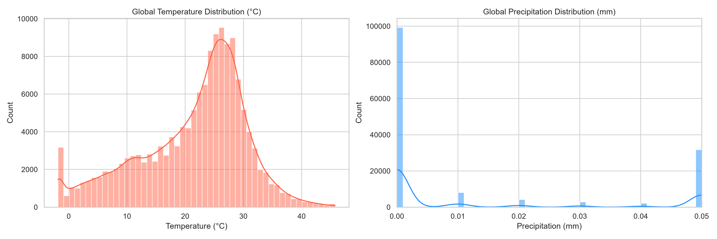
Exploratory Data Analysis: Temp & Precip
Observation:
Temperatures roughly follow a normal distribution globally; precipitation is right-skewed.
Insight:
The normal distribution of temperature makes it a suitable continuous target variable.
Business Relevance:
Limitation: This does not imply global temperatures are perfectly normally distributed universally.
5
Notes:
During EDA, we observed that temperatures in the dataset follow a near-normal distribution, while precipitation is heavily right-skewed. This insight justified our outlier capping strategy for precipitation.

Slide 6
Machine Learning Forecasting Architecture
• Linear Regression: Fast baseline, but limited by non-linear weather interactions.
• Random Forest: Tree ensemble, highly robust to atmospheric noise and complex data.
• XGBoost: Gradient boosting algorithm, minimizes sequential residual errors.
• Ensemble (VotingRegressor): Averages predictions to reduce individual model bias.
6
Notes:
For forecasting, I trained four models. I started with a Linear Regression baseline, but quickly scaled up to Random Forest and XGBoost to handle the complex, non-linear relationships inherent in weather data, eventually combining them into a powerful Ensemble model.

Slide 7
Forecasting Model Evaluation Metrics
Model | RMSE | MAE | R2
Linear Regression | 2.081 | 1.292 | 0.952
Random Forest | 1.179 | 0.404 | 0.984
XGBoost | 1.178 | 0.433 | 0.985
Ensemble | 1.290 | 0.649 | 0.981
Metric Interpretations (XGBoost performed best):
• MAE: Average absolute difference between predicted and actual temperatures.
• RMSE: Penalizes larger prediction errors more heavily than MAE.
• R²: Proportion of temperature variance explained by the model (>0.98 is exceptional).
7
Notes:
Evaluating the models, XGBoost and Random Forest were the clear winners, both achieving an incredible R-squared of over 98%. XGBoost edged out with the lowest Root Mean Squared Error, proving that gradient boosting is highly effective for meteorological forecasting.

Slide 8
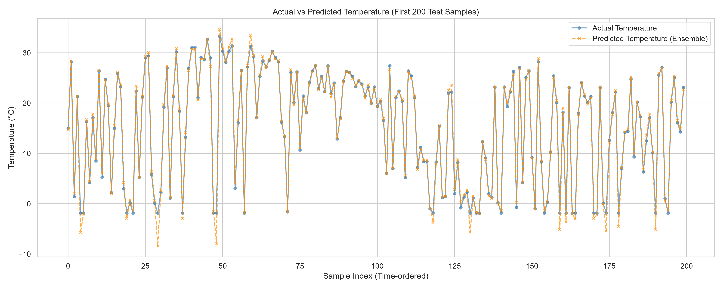
Forecast Accuracy: Actual vs Predicted
Observation:
The ensemble predictions track the actual temperature closely on the test set.
Insight:
Deviations occur primarily at extreme peaks and valleys.
Business Relevance:
Limitation: High R² does not guarantee performance out-of-distribution without continuous oversight.
8
Notes:
Visually, the model's predictions track the actual temperatures over time in the test set. The deviations occur during extreme peaks, indicating limitations when minimizing mean squared error.

Slide 9
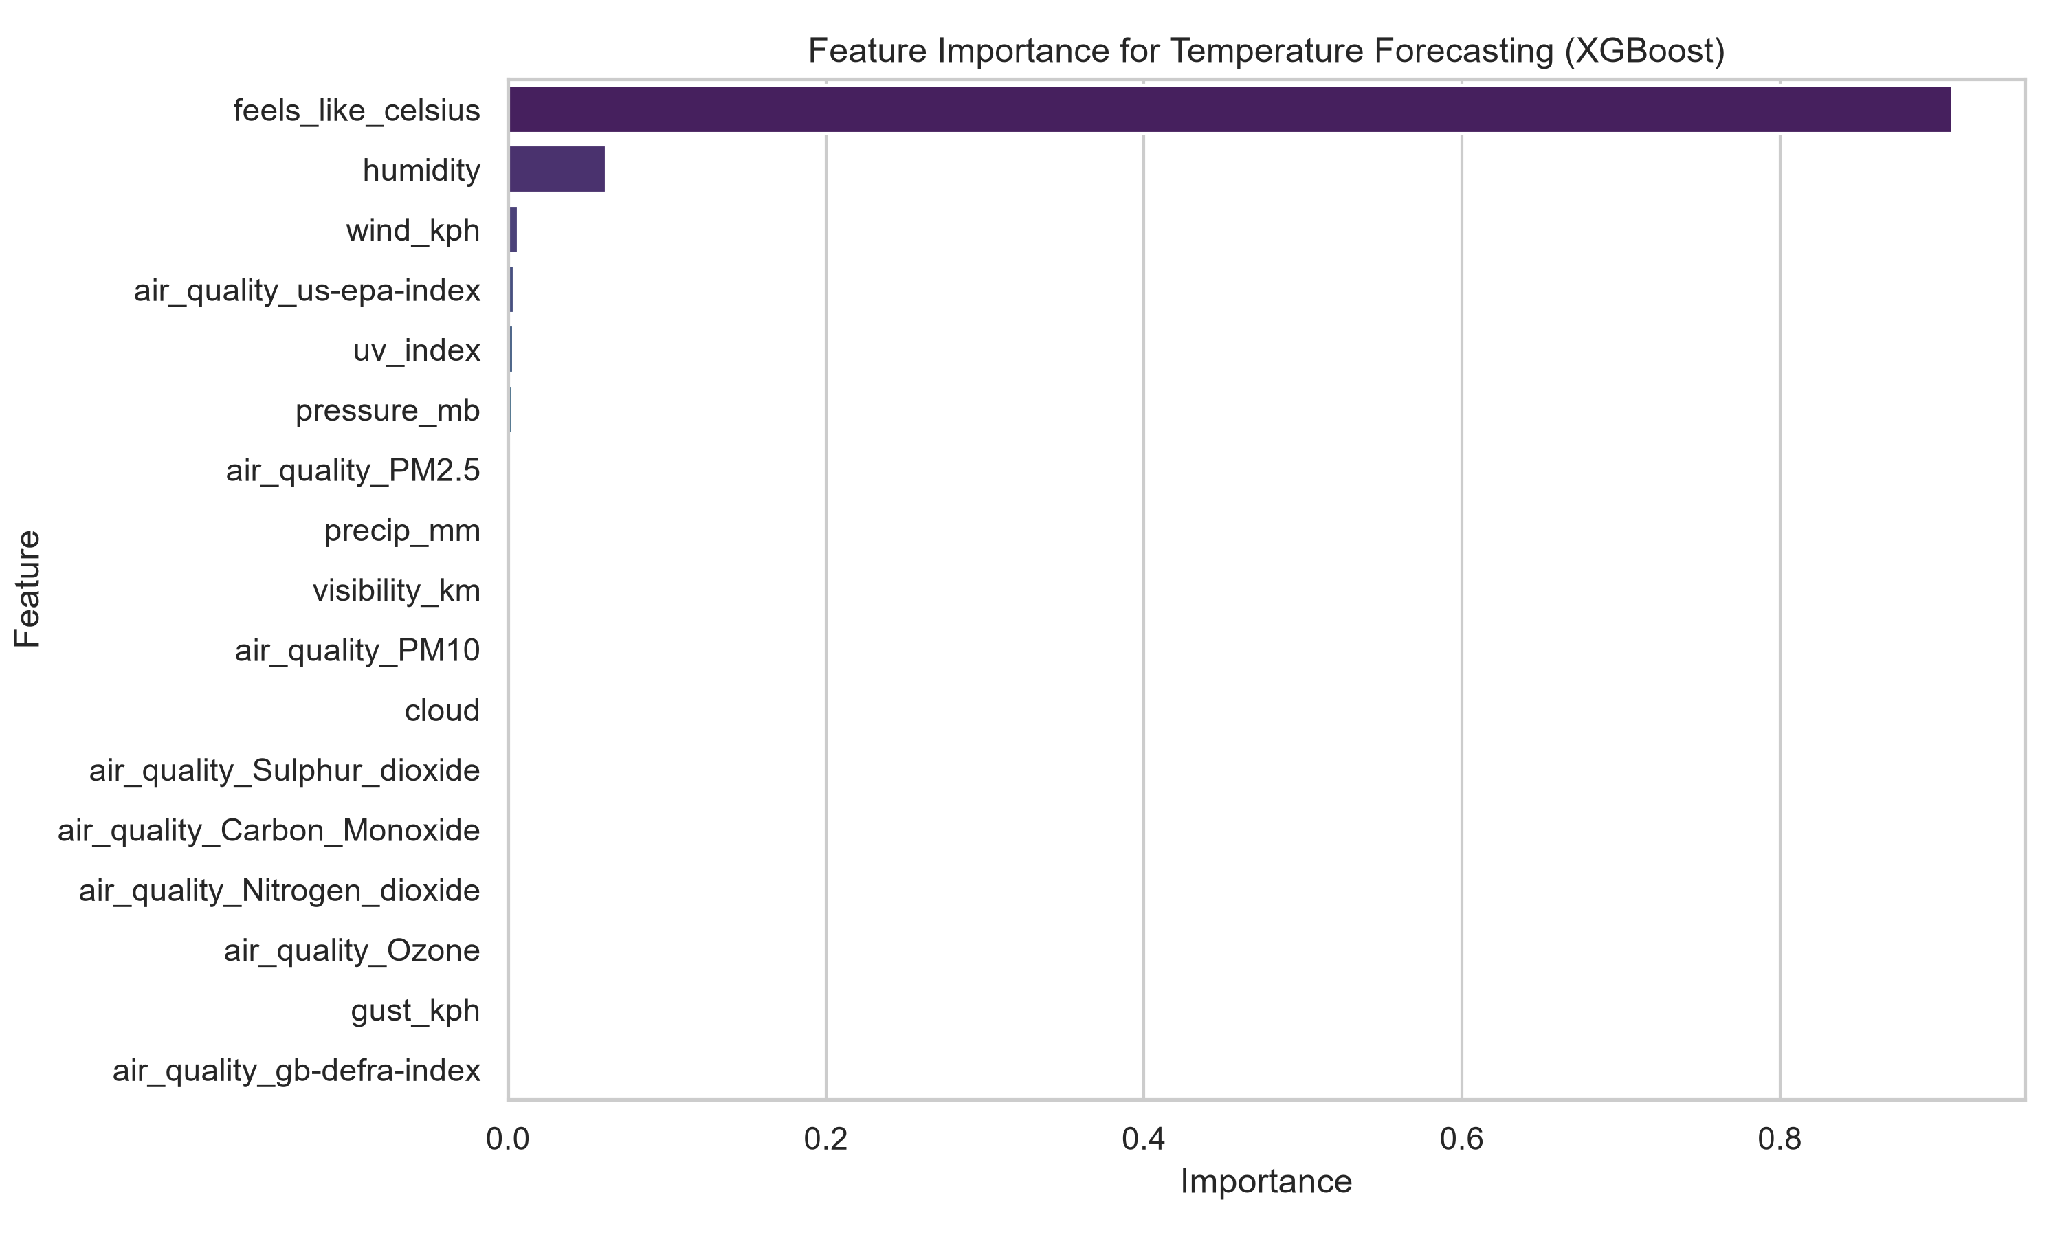
Feature Importance Drivers (XGBoost)
Observation:
The XGBoost model assigns >90% importance to feels_like_celsius.
Insight:
The model relies overwhelmingly on feels_like_celsius as a proxy for the target variable.
Business Relevance:
Limitation: The extreme dominance of feels_like_celsius limits interpretability of other features.
9
Notes:
When we look under the hood of our XGBoost model, we see that feels_like_celsius drives the vast majority of predictions, leaving humidity, pressure, and visibility with minimal contributions.

Slide 10
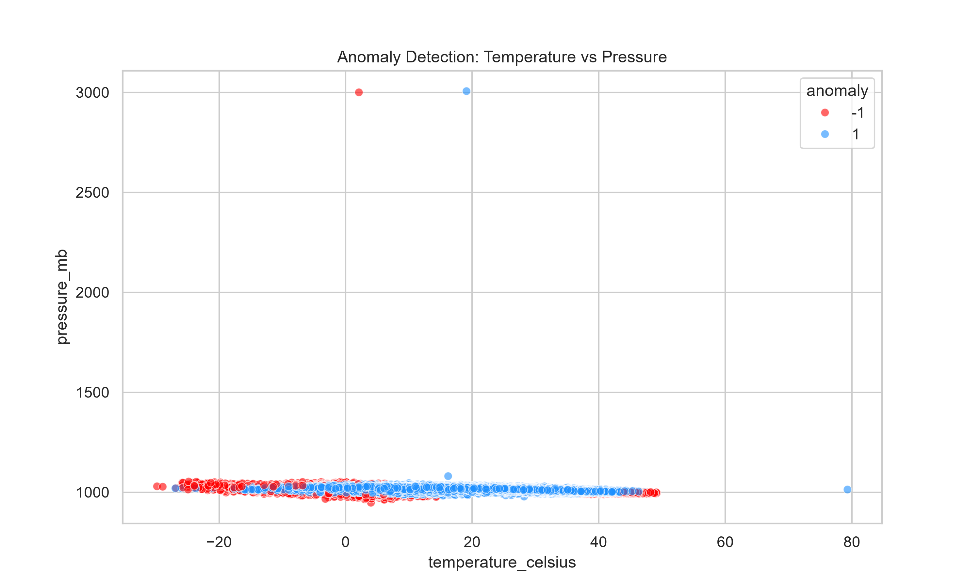
Extreme Weather Anomaly Detection
Observation:
Isolation Forest isolated 1% of data as anomalies based on feature variance.
Insight:
Identifies statistical outliers distinct from the majority of readings.
Business Relevance:
Limitation: Represents statistical divergence, not necessarily physical severe weather events like cyclones.
10
Notes:
Beyond forecasting, I implemented an Isolation Forest algorithm that flagged 1% of the data as extreme statistical anomalies. Domain expertise is required to classify these practically.

Slide 11
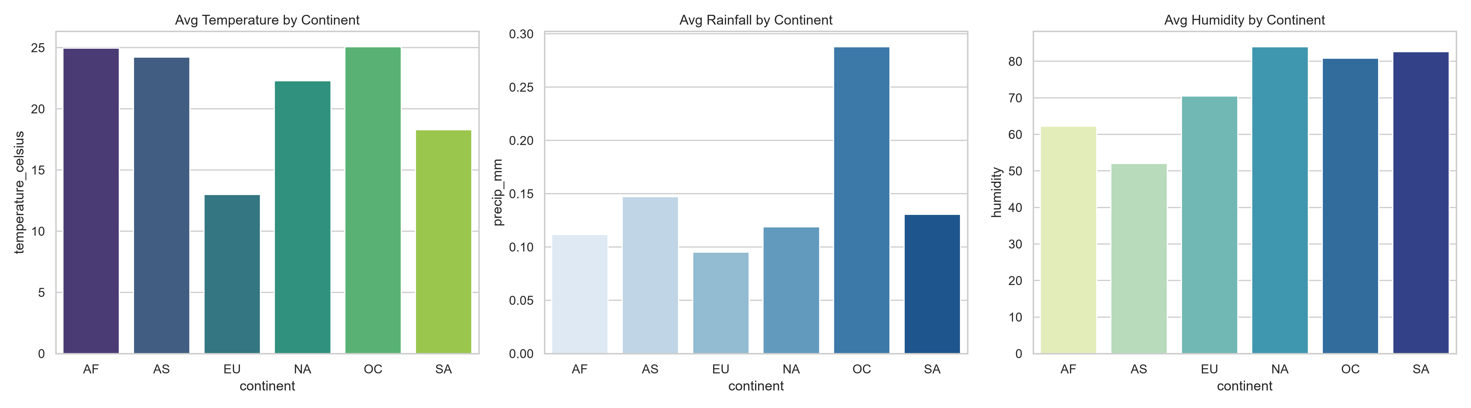
Geographic Continent-Level Climate Analysis
Observation:
Africa and South America display the highest average temperatures globally.
Insight:
Continent-level aggregations reveal broad macro-climate differences.
Business Relevance:
Limitation: Continental averages smooth out localized extremes, masking specific regional vulnerabilities.
11
Notes:
By mapping countries to their respective continents, we observed macro-climates. As expected, Africa and South America showed the highest baselines.

Slide 12
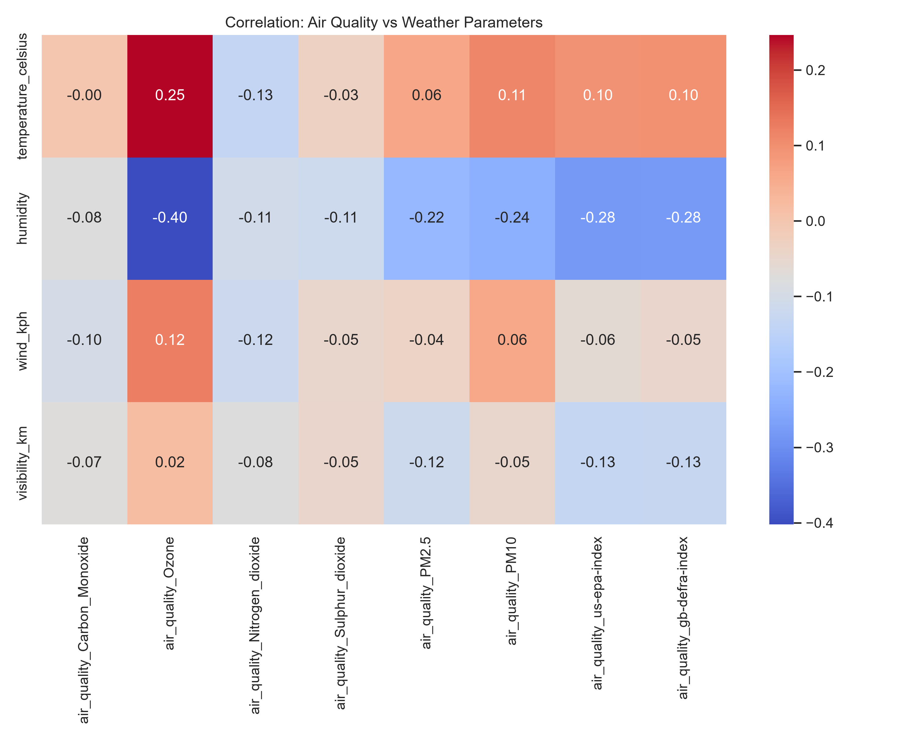
Environmental Impact & Air Quality
Observation:
Air quality metrics negatively correlate with wind speed and visibility in the dataset.
Insight:
Lower wind speeds are statistically associated with higher measured levels of trapped pollutants.
Business Relevance:
Limitation: Correlation does not imply causation; cannot be used to predict high-pollution days strictly based on incoming weather.
12
Notes:
Our correlation analysis uncovered associations between wind speed and air quality. Lower wind speeds correlate with higher pollutant levels in this dataset.

Slide 13
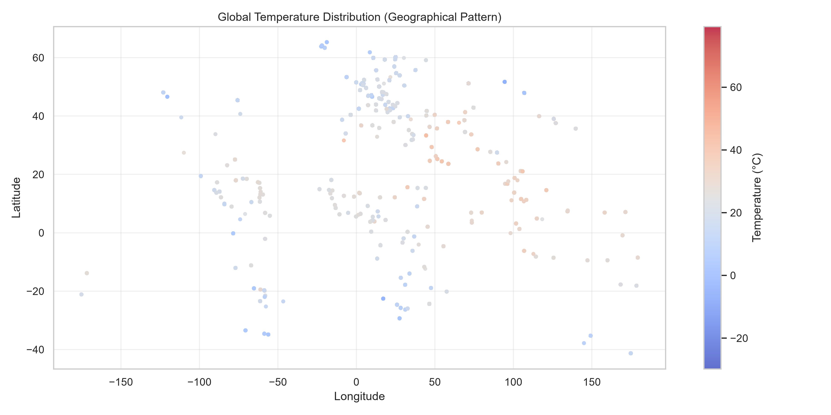
Global Spatial Temperature Distribution
Observation:
Higher temperatures visually cluster around the global equator.
Insight:
Temperatures predictably decrease as coordinates shift towards the poles.
Business Relevance:
Limitation: This visual representation is descriptive and not sufficient for dynamically mapping optimal shipping routes.
13
Notes:
By mapping latitude and longitude against temperature, we vividly visualize the global temperature gradient, reflecting real-world geographic patterns.

Slide 14
Key Findings
• Forecasting achieves high R²: Tree-based models (XGBoost) strongly predict test-set weather.
• Feature Dominance: The model relies almost entirely on feels_like_celsius.
• Anomalies can be flagged: Statistical algorithms can isolate extreme multi-variate readings.
• Environment correlation: Lower wind speeds correlate with reduced air quality.
14
Notes:
To summarize our findings: Machine learning achieves high accuracy on test data. The models heavily rely on feels_like_celsius, statistical isolation can flag data anomalies, and air quality negatively correlates with wind speed.

Slide 15
Conclusion & Next Steps
• Achievement: Analyzed 148k+ records to build forecasting and anomaly detection baselines.
• Best Model: XGBoost achieved the highest performance metrics.
• Value Delivered: An analytical framework mapping historical weather relationships.
• Future Opportunity: Implement Deep Learning (LSTMs) for multi-week time-series horizons.
15
Notes:
In conclusion, this project successfully processed over 148,000 records to build an XGBoost forecasting baseline. These data-driven insights offer a foundational analytical framework. Thank you.

