Slide 1
Airline Sentiment Analysis
Ayush Tibra(15ucs032)
Bhavin Agarwal(15ucs033)

Slide 2
Problem and Dataset
The Research has shown that responding to tweets has revenue generating potential, drives higher satisfaction than other customer service channels, and perhaps most importantly, satisfied Twitter users spread the word.
Classifying the tweets to negative, positive and neutral

Slide 3
Problem and Dataset
About Dataset:
The data set contains about 15,000 tweets, collected from February 2015 on various airline reviews. Every review is labeled as either positive, negative or neutral. First, we want to build a model to perform sentiment analysis on the data set. Second, more interestingly, we want to assign a reason to each negative response, such as late flight, lost luggage, etc.

Slide 4
Related Papers
Here a few papers that we referred :
https://cs224d.Stanford.edu/reports/yixin.pdf
https://nlp.stanford.edu/IR-book/html/htmledition/stemming-and-lemmatization-1.html
https://nlp.stanford.edu/pubs/glove.pdf

Slide 5
Proposed solution and Expected results
Analyse the twitter data and come out useful conclusions.
Apply Machine Learning models to classify the tweets as negative, positive or neutral.
Expected Results:
Proper classification of the tweets with above 70% accuracy.

Slide 6
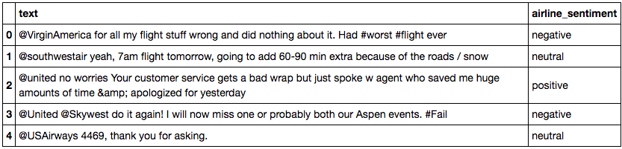
Proposed solution and Expected results
The dataset provided has two columns, one for the text and other for the actual sentiment.

Slide 7
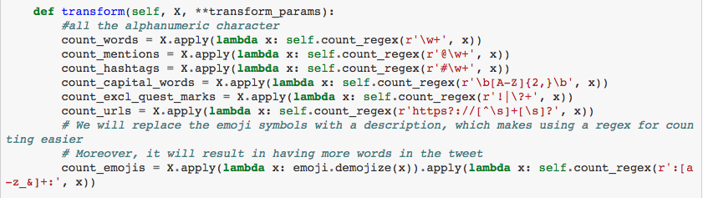
Text Analysis

Slide 8
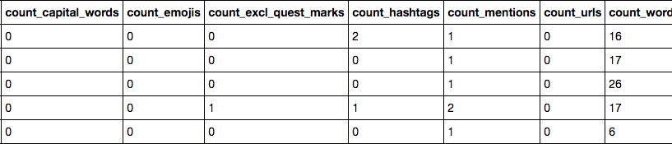
Feature Set after analysis

Slide 9
Work done so far and issues faced
Up till now, we have created our dataset with tweets classified and their confidences captured.
We have analyzed the tweets on the basis of their:
Word Count
Hashtag Count
Mention Count
Exclamation Count
Emojis Count

Slide 10
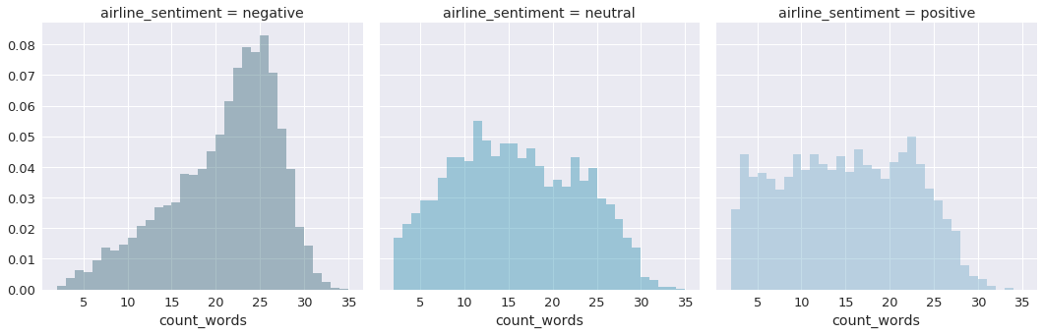
People use more words to express their negativity than expressing their positive or neutral sentiments.

Slide 11
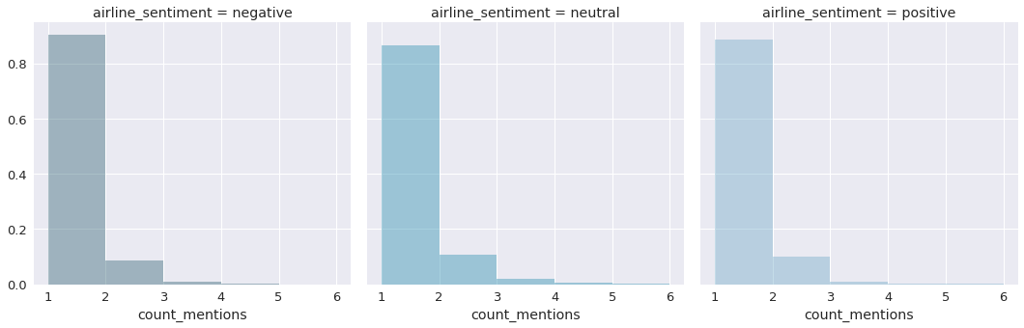
Count of mentions in all types of tweets is same . Means that this feature is of no use.

Slide 12
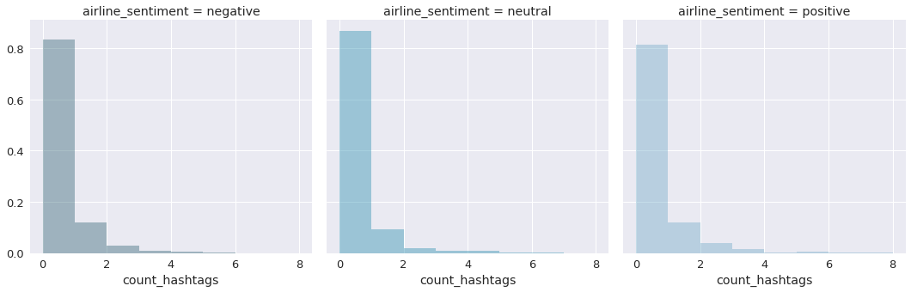
Similarly for hashtags.

Slide 13
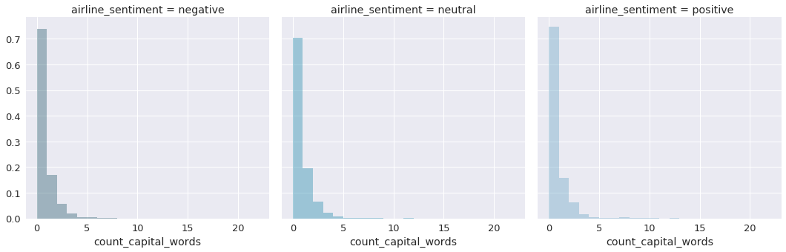
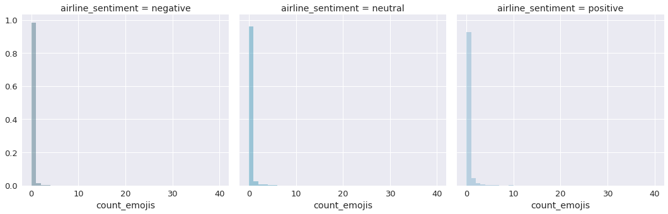

Slide 14
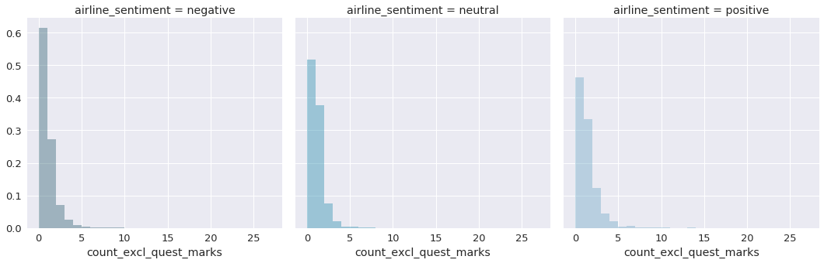
Use of More Exclamation and question mark for negative
tweets as compared to others.

Slide 15
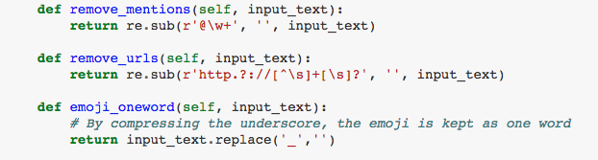
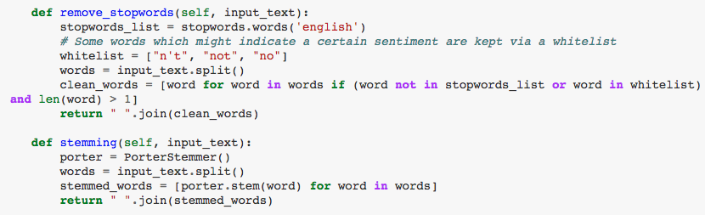
Cleaning of dataset using graph analysis

Slide 16
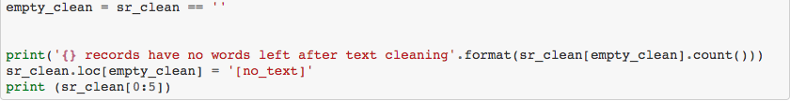
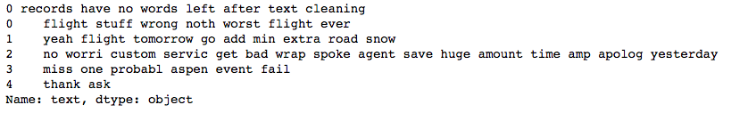
Text after cleaning the dataset

Slide 17
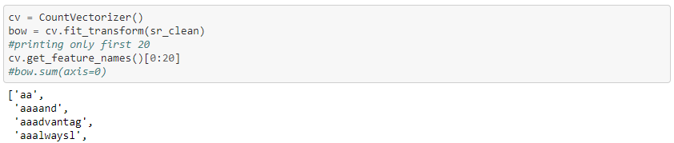
Count Vectorizer
After cleaning of the text, the tweets needed to be converted to some vector representation so that it could be fed to the training models .
Countvectorizer converts the text documents to a matrix of token counts. So we will gather word presence (boolean) associated with text into document term matrix.
To use words in our model we have to convert it in number and this is done by count vectorizer, it take all words in all tweets.
ex. - My name is ….

Slide 18
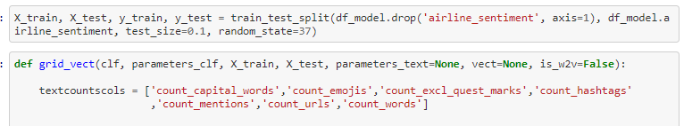
Test and Train Data
We have split the data into test and train.

Slide 19
Applying the models
After splitting the data to train and test, we now train the model using Logistic Regression and MultinomialNB.

Slide 20

Applying GridSearchCV

Slide 21

MNB using Count Vectorizer
The train score achieved was 0.881
The test score achieved was 0.787

Slide 22
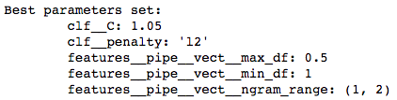
Logistic Regression using Count Vectorizer
The train score achieved was 0.982
The test score achieved was 0.811

Slide 23
Is Count Vectorizer Good? Not Really!!!!!
Because many words occur frequently in the corpus. These words does not contain any discriminatory information.
TF_IDF would be good to use.

Slide 24
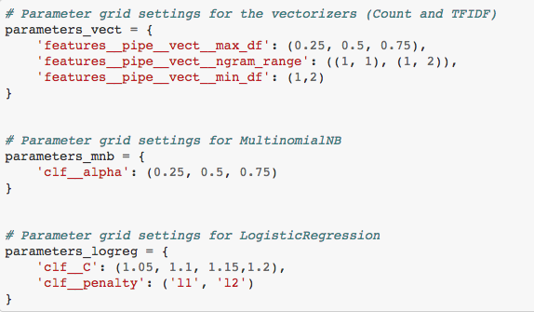
Parameters
The following parameters were used for the Logistic Regression and MulinomialNB.

Slide 25
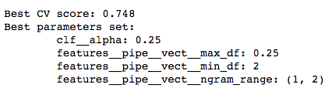
TF-IDF
The train score achieved was 0.848
The test score achieved was 0.770

Slide 26
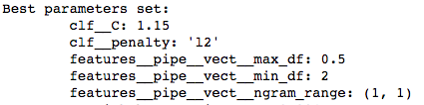
TF-IDF
The train score achieved was 0.804
The test score achieved was 0.843

Slide 27
Let’s Go DEEP….
We then dived to deep learning and found Word2Vec interesting to try on.
It basically provides a multidimensional vector for each tweet on the basis of SEMANTICS or closeness to a particular context.

Slide 28
Preparation
The words in the tweets needed to be tokenized to a list and then we needed to provide the dimension.
The dimension chosen was 50.

Slide 29
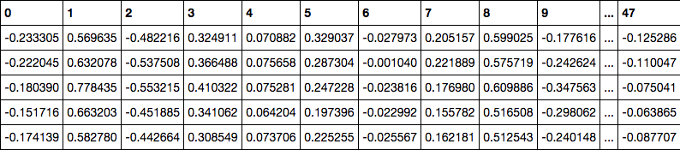
Dataset after Word2Vec

Slide 30

Results after Word2Vec
The train score achieved was 0.729
The test score achieved was 0.726

Slide 31
Conclusions...
Both classifiers achieve their best results with features of CountVectorizer
Overall, Logistic Regression outperforms the MultinomialNB.
The best performance was with Logistic Regression with features from Count Vectorizer.
Best Parameters:
C value of 1
L2 regularization
max_df: 0.5 and min_df: 1

Slide 32
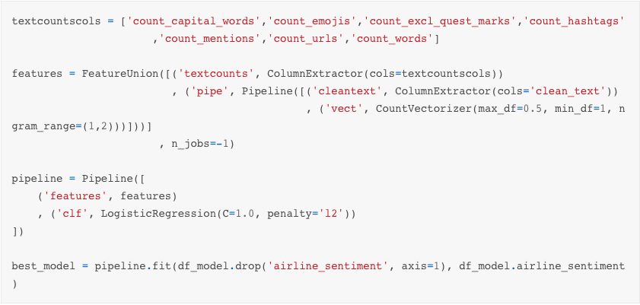
Train the model… Finally!!!!

Slide 33
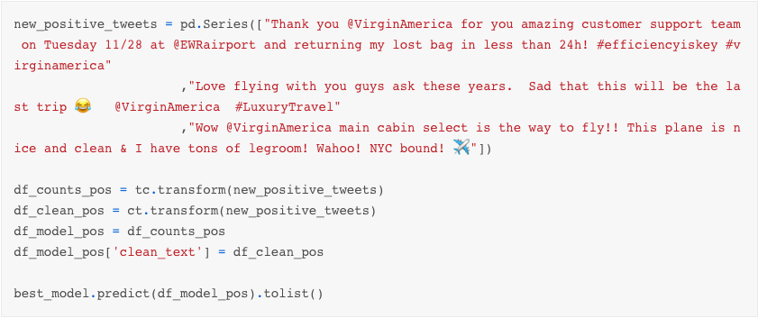
Results
Positive Tweets:

Slide 34
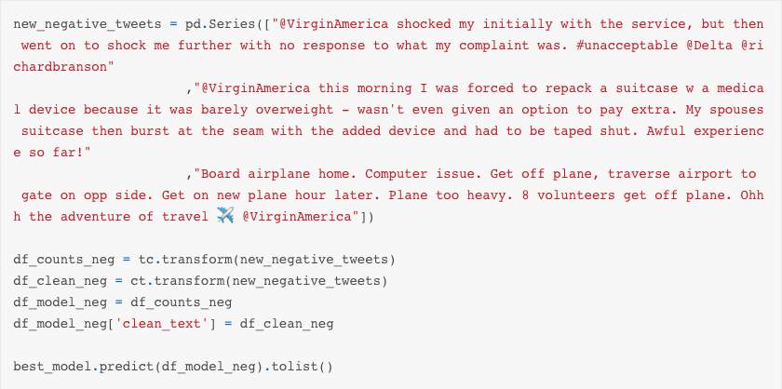
Results
Negative Tweets:

Slide 35
Thank You

