Slide 1
Web Based Attendance System
Java Project

Slide 2
About
Attendance capture pattern and tracking designed for Lectures, track and manage attendance in all the days at any time. It is using RF-ID card, punch card and scanners to systematic the attendance recording procedure. Attendance reports can be generated in various criteria and assist teachers about student entry details and ease to calculate percentage of leaves, present date, gives relevant systematic information to the administration department and checks the individual attendance record and alert to parents.
It is a three tier called presentation, application and storage system. A web browser is the first tier (presentation), an engine using dynamic Web content technology using JAVA servlets and JAVA is the middle tier (application logic), and a database with HSQLDB is the third tier (storage).The web browser sends requests to the middle tier, which services them by making queries and updates against the database and generates a user interface.

Slide 3
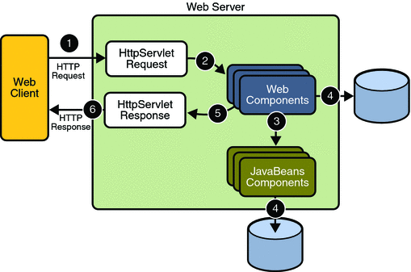
Flow Chart

Slide 4
Modules
Separate login for Admin and other users (Teachers,Student):
This module is the UI for are Management that accepts the user input as an Admin or User which further contains Student or Teacher along with their password. This module uses Admin classes and the Users classes to verify the username and the password and deliver the corresponding rights to them.
2. Attendance for a Lecture Delivery:
This module handles the attendance assignment of the students. It uses the Student class to fetch the details of the students in a particular course and further uses the Attendance class to assign the attendance accordingly.

Slide 5
3. Student Attendance report:
It covers the generation of the student report covering the complete information of the student on all the courses.
4. Add or delete Teacher/Student:
It give rights to the admin to add or delete teacher or a student to our database.
5. View Teacher/Student:
It gives the rights to the admin to view all the teachers or students in a particular course.

Slide 6
Tables in our database:
Attendance(Uid [int], Cname[String], Date [Date], Status [char])
Student(Uid [int], Name[String], Password [String], Cname [String])
Teacher(Tid [int], Name[String], Password [String], Cname [String])

Slide 7
Object Orientation
Student:
1. Student Class-> This Section holds the details of a student containing all the properties related to it(name, password etc.) along with the getters and setters.
2. StudentDao Class-> It Contains all the function that are required for the updation, deletion, insertion, and verification of the student.
Teacher:
1. Teacher Class-> This Section holds the details of a student containing all the properties related to it(name, password etc.) along with the getters and setters.
2. TeacherDao Class-> It Contains all the function that are required for the updation, deletion, insertion, and verification of the Teacher.

Slide 8
Admin:
1.EditDeleteStudent Class->This class allows the admin to edit or delete a Student in the database.
2.EditDeleteTeacher Class->This class allows the admin to edit or delete a Teacher in the database.
3.ViewTeacher-> This allows the admin to view all the teachers enrolled in all the courses.
4.3.ViewStudent-> This allows the admin to view all the Students enrolled in all the courses.
5.AddTeacher->It gives admin the rights to add a teacher in our database.
6.AddStudent->It gives admin the rights to add a teacher in our database.

Slide 9
Attendance:
1. Attendance->It holds the UId, Cname, Date, Status of a particular student along with the getters and setters.
2.EnterAttendanceServlet class-> It displays a list of students enrolled in the course of a particular teacher which furthers allows the teacher to enter the attendance of the students.
3.AttendanceToServlet Class-> It connects the data entered by the teacher in the above class to connect to the database.
Other Classes:
Servlet1->It checks the password of the admin entered.
Servlet2->This class invalidates the session created for each login which is common to all I.e. Student, Teacher, Admin.

Slide 10
LOGIN
1. Student Login 2. Teacher Login 3. Admin Login
1. Credentials
2. From Date
3. To Date
4. Cname
1. Credentials
2.Cname
Credentials
View of the attendance
Insert Attendance
Options to add, delete, edit and view.
Further forms and Tables
Logout

Slide 11
Worked on By:
Vinay Jain
Pranshu Sharma
Bhavin Agarwal
Ayush Tibra

