Slide 1

KRISEVA / ATTEST
KRISEVA ATTEST
01
An entity-side evidence-integrity and human-accountability layer for AI-assisted regulatory reporting in GIFT IFSC.
GIFT IFIH
YOUNG BUILDERS
2026
This prototype is final for this application. Whether it becomes the company's product is deliberately still open.
Research-stage prototype · synthetic data · no filing · no regulator connection
APPLICATION EVIDENCE
ayushtiwary-ops.github.io
/kriseva-attest
Notes:
Superseded cover framing, retained for audit only (replaced 2026-08-13):
"Application product lock. Company wedge not locked."
[Sources]
- repo:docs/superpowers/specs/2026-08-12-attest-submission-system-design.md
- repo:docs/PRODUCT_DECISION.md
[/Sources]

Slide 2
KRISEVA / ATTEST
The problem: which source backs a reported field?
ACCOUNTABILITY QUESTION
STATEMENT
Structured returns do not remove the source question.
LEDGER
Which source supports this reported field?
SCHEDULE
Statements, ledgers and schedules can disagree or leave evidence missing.
The operator, buyer, frequency, pain and willingness to pay remain unvalidated.
SOURCES IN SPEAKER NOTES · RESEARCH-STAGE PROTOTYPE
02 / 10
Notes:
[Sources]
- workspace:10_GIFT_CITY/00_CONTROL/STATUS.md
- workspace:10_GIFT_CITY/00_CONTROL/DECISION_LOG.md
- repo:docs/superpowers/specs/2026-08-12-attest-submission-system-design.md
[/Sources]

Slide 3
KRISEVA / ATTEST
DRR targets submission; evidence starts upstream
DRR
ATTEST
DRR (IFSCA's Digital Regulatory Reporting platform, procured 2026): structured reporting channels, validation and submission infrastructure.
Provider-neutral source references, disagreement and human review
No filing. No DRR connection. No claimed gap.
Public absence is not proof.
SOURCES IN SPEAKER NOTES · RESEARCH-STAGE PROTOTYPE
03 / 10
Notes:
[Sources]
- https://www.ifsca.gov.in/Document/Tender/concept-note_drr-consultation_2003202520032025073433.pdf
- https://www.ifsca.gov.in/CommonDirect/ViewFile?fileName=Award_of_Contract_under_RFPs_for_DRR_Solution_and_ERP_System_20260309_0153.pdf&id=d575554ec59b09e7fde503d3a82787c7
- https://bsmedia.business-standard.com/_media/bs/data/announcements/bse/29012026/13c21166-8138-4630-a8b3-4f6b2202472e.pdf
[/Sources]

Slide 4
KRISEVA / ATTEST
One fictional case makes three evidence states visible
Meridian Horizon Fund I (Meridian Horizon Fund Management IFSC Pvt Ltd)
SUPPORTED
Closing NAV
USD 12.4M agrees across two sources
CONFLICTING
Committed capital
USD 25M vs USD 24M
QE 30 Jun 2026
FICTIONAL
UNSUPPORTED
Complaints closed
no candidate evidence
SOURCES IN SPEAKER NOTES · RESEARCH-STAGE PROTOTYPE
04 / 10
Notes:
[Sources]
- repo:data/synthetic-case.json
- repo:src/case-engine.js
[/Sources]

Slide 5
KRISEVA / ATTEST
Preserve the handoff, not just the answer
01 SOURCE · exact page, region or cell
03 ESCALATE · no default winner
05 RETAIN · local JSON and printable HTML manifest
02 COMPARE · preserve agreement and disagreement
04 DECIDE · named reviewer and reason
SOURCES IN SPEAKER NOTES · RESEARCH-STAGE PROTOTYPE
05 / 10
Notes:
[Sources]
- repo:docs/superpowers/specs/2026-08-12-attest-submission-system-design.md
- repo:src/case-engine.js
- repo:src/manifest.js
[/Sources]

Slide 6
KRISEVA / ATTEST
The prototype knows when to stop
DETERMINISTIC TRACE
PROPOSE
candidate evidence and exact references
No live model. No compliance conclusion. Harness built and tested before any model enters.
ABSTAIN
no candidate evidence; request more
DECIDE
only a named human can accept, correct, reject or defer
SOURCES IN SPEAKER NOTES · RESEARCH-STAGE PROTOTYPE
06 / 10
Notes:
[Sources]
- repo:prototype/app.js
- repo:artifacts/prototype-trace-1440.png
- repo:docs/superpowers/specs/2026-08-12-attest-submission-system-design.md
[/Sources]

Slide 7
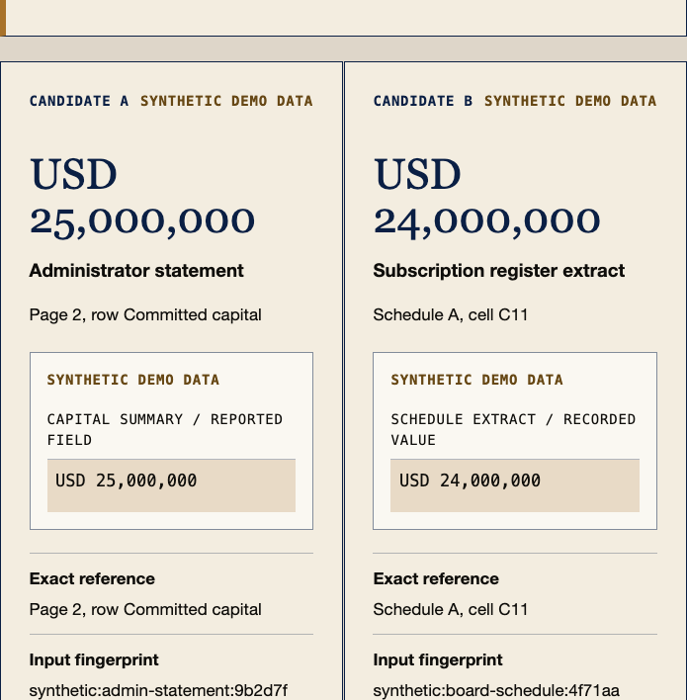
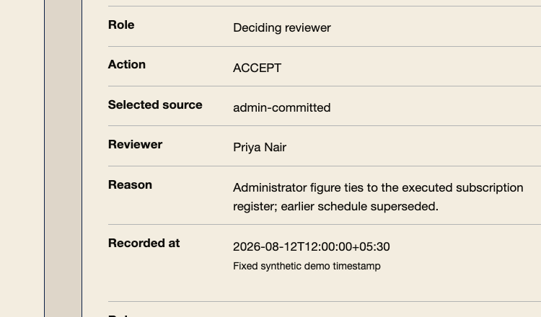
KRISEVA / ATTEST
The current build exposes the full evidence record
CURRENT LOCAL BUILD
Conflict stays side by side.
Human reason is required.
Receipt retains fingerprints, both candidates and unresolved evidence.
Synthetic data only · no filing · no regulator connection
SOURCES IN SPEAKER NOTES · RESEARCH-STAGE PROTOTYPE
07 / 10
Notes:
[Sources]
- repo:artifacts/prototype-conflict-1440.png
- repo:artifacts/prototype-receipt-1440.png
- repo:.superpowers/sdd/2026-08-12-attest-submission-system/task-5-report.md
[/Sources]

Slide 8
KRISEVA / ATTEST
Revenue here is a sensitivity test, not a forecast
ILLUSTRATIVE ARR SENSITIVITY
ENTITIES
₹3L
₹12L
Unproven gates: buyer, bundling risk, legal perimeter, paid test, support economics
5
₹15L
₹60L
50
₹1.5Cr
₹6Cr
HYPOTHESIS
If the wedge locks: the same evidence substrate extends to adjacent regulated-reporting workflows (hypothesis)
Not TAM/WTP.
SOURCES IN SPEAKER NOTES · RESEARCH-STAGE PROTOTYPE
08 / 10
Notes:
[Sources]
- repo:docs/BUSINESS_VIABILITY.md
- repo:docs/superpowers/specs/2026-08-12-attest-submission-system-design.md
[/Sources]

Slide 9
KRISEVA / ATTEST
One accountable founder. One defined finance lane.
AYUSH TIWARY
FINANCE & BUSINESS ANALYSIS LANE
Engineering, integration, test evidence, packaging. KRISEVA ships evidence-first, human-review procurement software in Indian defense today.
Case consistency, buyer hypotheses, pricing research, workflow QA.
Proposed contributor · pending written acceptance and public attribution.
SOURCES IN SPEAKER NOTES · RESEARCH-STAGE PROTOTYPE
09 / 10
Notes:
[Sources]
- repo:docs/CONTRIBUTOR_SCOPE.md
- repo:docs/superpowers/specs/2026-08-12-attest-submission-system-design.md
[/Sources]

Slide 10
KRISEVA / ATTEST
Use eight weeks to lock the wedge, or reject it
ACCESS
CHALLENGE
2 FME (fund management entity) officers + 2 administrators + 1 independent compliance provider
Is upstream evidence outside DRR/bundled services?
TEST
One controlled synthetic workflow only if discovery survives
Help us falsify quickly.
DECIDE
Lock or reject by week 8
Live: ayushtiwary-ops.github.io/kriseva-attest · Code: github.com/ayushtiwary-ops/kriseva-attest
SOURCES IN SPEAKER NOTES · RESEARCH-STAGE PROTOTYPE
10 / 10
Notes:
[Sources]
- https://www.giftifih.in/young-builders-program
- repo:docs/MEETING_BRIEF_2026-08-12.md
- repo:docs/PRODUCT_DECISION.md
[/Sources]

