Slide 1
BSc Computer Science Mini Project
UrbanClean
Geospatial Smart City Waste Management
Node.js / Express
& Route Optimization System
Leaflet.js / OSM
Student:
Ayush Santosh Toraskar
OSRM Routing
Roll No.:
CS-9147
Class:
TY BSc Computer Science / Division II
TSP Optimization
College:
D. G. Ruparel College of Arts, Science & Commerce
SQLite -> PostgreSQL
Academic Year:
2026 - 2027
Notes:
VIVA INTRO: Greet the panel. State: 'Good morning/afternoon. I am Ayush Toraskar, Roll No. CS-9147, TY BSc CS. I am presenting my mini-project: UrbanClean -- a Geospatial Smart City Waste Management and Route Optimization System.'
Key talking points:
- The system addresses urban waste mismanagement using geospatial technology.
- Built with Node.js backend, Leaflet.js maps, OSRM road routing, and TSP waypoint ordering.
- Supports 4 user roles: Guest, Citizen, Driver, Admin.
- Designed for D.G. Ruparel College BSc CS Mini Project 2026-27.

Slide 2
Introduction
What is UrbanClean?
UrbanClean is a full-stack web-based geospatial waste management platform that connects citizens, garbage collection drivers, and municipal administrators in a single unified system.
► Citizens: Report waste complaints with geo-tagged photos and live location
► Drivers: Get AI-optimized daily collection routes using TSP + OSRM road routing
► Admins: Monitor complaints, manage drivers, and oversee city-wide operations
► Public Guest: View real-time waste complaint map without login
► Route Locking: Daily route snapshot locks at driver's choice; tomorrow's queue auto-populated
► Tech Stack: Node.js/Express backend | Leaflet.js + OpenStreetMap | SQLite (current) | PostgreSQL/PostGIS (proposed)
Smart City Initiative
Notes:
VIVA POINT: UrbanClean is not just a complaint portal -- it is an end-to-end operations system.
Mention the 4-role architecture: Guest, Citizen, Driver, Admin.
Emphasize that complaints are geo-tagged (latitude/longitude captured from browser).
Driver route optimization uses TWO distinct algorithms:
1. TSP (Nearest-Neighbor Heuristic) -- determines ORDER of waypoints
2. OSRM (Open Source Routing Machine) -- provides road-based geometry and distance
Current DB: JSON (db.json) + SQLite mirror | Production target: PostgreSQL + PostGIS.

Slide 3
Problem Statement
Urban Waste Management Challenges
► No Real-Time Reporting: Citizens have no digital channel to report overflowing bins or missed pickups
► Inefficient Routes: Drivers follow fixed schedules regardless of actual complaint density
► No Accountability: Complaints are untracked -- no status updates, no SLA enforcement
► Data Silos: Complaint data, driver data, and route data are isolated with no unified view
► Wasted Resources: Fuel and manpower wasted on areas with no complaints; high-priority zones missed
► Lack of Transparency: Public cannot view current waste situation or complaint resolution status
Impact: Inefficient waste collection leads to public health hazards, environmental degradation, and increased municipal operational costs in urban areas.
Notes:
VIVA POINT: Be ready to explain why each problem is significant.
Problem 1 (No Reporting): Currently citizens call or physically visit offices -- very inefficient.
Problem 2 (Routes): Fixed routes ignore real-time data -- driver may empty half-filled bins while overflowing bins exist elsewhere.
Problem 3 (Accountability): Without tracking, there is no way to verify if a complaint was resolved.
Problem 4 (Data Silos): Our system unifies complaints, drivers, and routes in one platform.
Problem 5 (Resources): Our TSP optimization addresses exactly this -- route based on actual complaint locations.
Problem 6 (Transparency): Public dashboard (Guest view) shows live complaint map.

Slide 4
Existing System vs Proposed System
Comparative Analysis
Feature
Existing System
Proposed UrbanClean
Complaint Reporting
Manual / Phone calls
Digital geo-tagged + photo upload
Route Planning
Fixed schedules
TSP-optimized dynamic routes
Road Routing
None
OSRM road network API
Tracking
No complaint tracking
Live status: Pending->In Progress->Resolved
Public Visibility
None
Real-time public complaint map (Guest)
Data Storage
Paper / Excel sheets
JSON db.json + SQLite (current)
Scalability
Not scalable
PostgreSQL + PostGIS (proposed)
Driver Management
Manual assignment
Admin assigns; driver locks daily route
Notes:
VIVA POINT: This slide shows the core value proposition of UrbanClean.
Key comparisons to emphasize:
- Manual -> Digital: Complaint reporting becomes geo-tagged and photo-evidenced.
- Fixed routes -> Dynamic TSP routes: Route changes daily based on actual complaints.
- OSRM: This is an ADDITIONAL layer on top of TSP -- OSRM gives road-level paths between waypoints.
- PostgreSQL + PostGIS is the PROPOSED upgrade; current system runs on JSON + SQLite.
If asked: 'Why not implement PostgreSQL now?' -- Answer: SQLite is sufficient for the prototype; PostGIS would be needed for production-scale spatial queries.

Slide 5
Objectives
What UrbanClean Aims to Achieve
O1
Geo-Tagged Reporting
O2
Route Optimization
Enable citizens to report waste with GPS location, category, and photographic evidence
Minimize driver travel distance using Nearest-Neighbor TSP heuristic over active complaints
O3
Road Network Routing
O4
Multi-Role Access Control
Use OSRM API for real road-based routes between waypoints (not straight-line)
Separate portals for Guest, Citizen, Driver, and Admin with JWT-style session management
O5
Complaint Lifecycle Mgmt
O6
Daily Route Locking
Track complaints from Pending -> Assigned -> In Progress -> Resolved with timestamps
Driver locks route snapshot daily; tomorrow's auto-populated from overflow queue
O7
Administrative Dashboard
O8
Scalable Architecture
Admin can manage users, view KPI metrics, and oversee all city complaints
Design system to migrate to PostgreSQL + PostGIS for production-scale deployment
Notes:
VIVA POINT: Walk through 2-3 key objectives if asked.
O2 + O3 together are critical -- TSP orders the stops, OSRM draws road paths between them.
O6 (Route Locking) is a unique feature: once driver locks route, complaints are tagged 'assigned_today'.
O8 shows architectural foresight -- designed to scale without major rework.
If asked about O4 (access control): We use session-based auth stored in db.json accounts store. Passwords use bcrypt hashing.

Slide 6
Users & System Roles
4-Role Access Architecture
GUEST
CITIZEN
DRIVER
ADMIN
Public / Visitor
Registered Resident
Garbage Collector
Municipal Administrator
>> View live complaint map (read-only)
>> Submit geo-tagged waste complaints
>> View assigned complaints on map
>> Manage all users and accounts
>> See complaint markers on Leaflet map
>> Upload photo evidence
>> Generate TSP-optimized route
>> Assign complaints to drivers
>> No login required
>> Track complaint status in real-time
>> Lock daily route snapshot
>> View system KPI and statistics
>> Encourages transparency & public trust
>> View own complaint history
>> Mark complaints Resolved after collection
>> Override complaint statuses
Notes:
VIVA POINT: The 4-role architecture is a key design decision.
Guest: Anyone can view the public map -- no login. This ensures transparency.
Citizen: Submits complaints. Geo-location is captured from the browser (navigator.geolocation).
Driver: Uses the route optimization portal. Can lock route to commit to the day's plan.
Admin: Has full CRUD access. Can assign, escalate, or close complaints.
If asked about authentication: Signup/login via /api/signup and /api/login. Passwords stored as bcrypt hashes in accounts store in db.json.
If asked about role separation: Role stored in account record. Frontend checks role on page load.

Slide 7
Major System Modules
5 Core Modules of UrbanClean
M1
Complaint Management Module
Accepts geo-tagged complaints (lat/lng/photo/category). Manages full lifecycle: Pending -> Assigned -> In Progress -> Resolved. REST API: POST /api/complaints, GET, PATCH.
M2
Geospatial Mapping Module
Leaflet.js + OpenStreetMap renders live complaint markers, driver position, and route polylines. Supports color-coded markers by status. Clustering for dense areas.
M3
Route Optimization Module
TSP (Nearest-Neighbor Heuristic) orders complaint waypoints. OSRM API fetches road-geometry and actual road distance. Daily route lock saves snapshot to dailyRouteSnapshots in db.json.
M4
User & Account Management Module
Multi-role accounts (Guest/Citizen/Driver/Admin). Signup, login, session management. Passwords: bcrypt hashed. Stored in accounts{citizens[], drivers[], admins[]} in db.json.
M5
Admin Dashboard Module
System-wide complaint oversight, driver assignment, user management, KPI metrics. Admin can change complaint status, assign drivers, and view analytics.
Notes:
VIVA POINT: Be able to explain each module briefly.
M1 -- Complaint Management: The core of the system. Know the REST endpoints.
M2 -- Mapping: Leaflet.js is a lightweight open-source JS mapping library using OpenStreetMap tiles.
M3 -- Route Optimization: TWO DISTINCT systems -- TSP (internal algorithm) + OSRM (external API).
M4 -- Accounts: bcrypt ensures passwords are never stored in plaintext.
M5 -- Admin: Admin is the 'super user' -- only admin can change complaint assignments.
If asked: 'What is the difference between TSP and OSRM?'
TSP = decides the ORDER to visit complaint locations.
OSRM = draws the ACTUAL ROAD PATH between those locations.

Slide 8
System Architecture
Layered 3-Tier Architecture
PRESENTATION LAYER
Project File Structure
HTML5 | CSS3 (Glassmorphism) | Vanilla JS | Leaflet.js
d:\Urban clean\
backend/
server.js (Express API)
db.json (JSON store)
urban_clean.db (SQLite mirror)
sync_sqlite.py (auto-sync)
uploads/ (complaint photos)
frontend/
script.js (client logic)
styles.css (glassmorphism)
index.html (Guest view)
citizen.html (Citizen portal)
driver.html (Driver portal)
admin.html (Admin dashboard)
APPLICATION LAYER
Node.js v20 | Express.js | Multer (file uploads) | bcryptjs
DATA LAYER
JSON db.json (runtime) | SQLite urban_clean.db (mirror) | sync_sqlite.py
EXTERNAL SERVICES
OSRM Routing API | OpenStreetMap Tiles | Browser Geolocation API
PROPOSED UPGRADE
PostgreSQL v16 + PostGIS v3.3 (production target -- not yet implemented)
Notes:
VIVA POINT: The architecture is a standard 3-tier web application.
Tier 1 (Presentation): HTML/CSS/JS frontend. No framework -- vanilla JS for full control.
Tier 2 (Application): Node.js + Express backend. RESTful API on port 3000.
Tier 3 (Data): db.json is the primary runtime store. SQLite is a read-optimized mirror.
sync_sqlite.py: Called automatically inside writeDB() every time db.json is updated.
OSRM + OpenStreetMap: External APIs -- no cost, open source.
If asked about backend choice: Node.js chosen for event-driven I/O, fast prototyping, and compatibility with frontend JS ecosystem.
ESM modules: package.json has 'type': 'module' -- uses import/export syntax.

Slide 9
Complaint Management Workflow
Full Lifecycle from Report to Resolution
1. CITIZEN REPORTS
2. PENDING STATUS
3. ADMIN ASSIGNS
4. DRIVER COLLECTS
5. RESOLVED
• Captures GPS location
• Complaint stored in db.json
• Admin views in dashboard
• Driver sees on route map
• Driver marks collected
• Selects waste category
• Visible on public map
• Assigns to a driver
• TSP + OSRM route generated
• Status = 'resolved'
• Uploads photo
• Status = 'pending'
• Status = 'assigned'
• Route locked for the day
• Timestamp + auto-sync to SQLite
->
->
->
->
• Submits via /api/complaints POST
• Timestamp recorded
• Driver notified
• Status = 'in_progress'
• Complaint archived
REST API Endpoints:
POST /api/complaints | GET /api/complaints | PATCH /api/complaints/:id | GET /api/complaints/:id
Notes:
VIVA POINT: Walk through each stage clearly.
Stage 1: Citizen uses browser geolocation API. Photo uploaded via Multer to /backend/uploads/.
Stage 2: Complaint stored as JSON object in db.json complaints array. Status field = 'pending'.
Stage 3: Admin uses PATCH /api/complaints/:id to update status and assign driverId.
Stage 4: Driver generates route. TSP orders complaints by nearest-neighbor. OSRM fetches road paths.
Stage 5: PATCH status to 'resolved'. sync_sqlite.py triggers automatically to update SQLite mirror.
If asked about photo storage: Stored on server filesystem in backend/uploads/. Filename saved as 'photo' field in complaint object. URL served as /uploads/<filename>.

Slide 10
Geospatial & Route Optimization
TSP Waypoint Ordering + OSRM Road Routing -- Two Distinct Systems
TSP -- Traveling Salesman Problem
OSRM -- Open Source Routing Machine
• Algorithm: Nearest-Neighbor Heuristic
• External API: router.project-osrm.org
• Purpose: Determines ORDER of complaint waypoints
• Purpose: Road-based geometry & distance
• Starts from driver's current GPS position
• Input: Ordered waypoints from TSP output
• Greedily picks closest unvisited complaint next
• Output: GeoJSON polyline on actual roads
• Implementation: Internal JavaScript function
VS
• Also returns: Total road distance (meters)
• Input: Array of complaint {lat, lng} coordinates
• Also returns: Estimated travel duration
• Output: Ordered array of waypoints for that day
• Drawn on Leaflet map as blue route line
• Complexity: O(n^2) -- practical for city-scale routes
• NOT the same as TSP -- uses real road network
• Documented project estimate: 22-32% fuel reduction
• No installation required -- public API call
Notes:
VIVA CRITICAL SLIDE -- This is the most technically nuanced slide. Know it thoroughly.
TSP answers: 'In what ORDER should the driver visit complaint locations?'
- Uses Nearest-Neighbor: start at driver location, always go to closest unvisited complaint.
- This is an APPROXIMATION algorithm -- not guaranteed to be globally optimal, but fast.
- Runs entirely in JavaScript (client-side in script.js).
OSRM answers: 'What is the ACTUAL ROAD PATH between those ordered locations?'
- Makes an HTTP request to router.project-osrm.org with the TSP-ordered waypoints.
- Returns a GeoJSON LineString that follows actual roads, not straight lines.
- Also provides total road distance and estimated duration.
The PIPELINE: Complaint locations -> TSP orders them -> OSRM draws road route between ordered stops.
Fuel savings (22-32%) is a DOCUMENTED PROJECT ESTIMATE / claim from the project proposal. It is NOT independently verified experimental data.

Slide 11
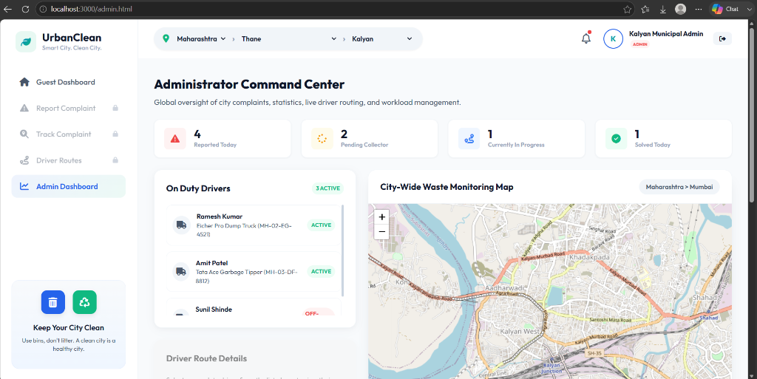
Driver Module
Route Optimization Workspace
► View all assigned complaints on interactive Leaflet map
► Generate TSP-optimized daily route with one click
► OSRM provides road-network path visualization
► Lock today's route as a committed daily snapshot
► Overflow complaints auto-queued for tomorrow
► Mark complaints 'In Progress' or 'Resolved' on map
► View tomorrow's queue (complaints scheduled next day)
► Driver status card shows route distance + stop count
Screenshot: Driver Route Optimization Portal (driver.html)
Notes:
VIVA POINT: The driver portal is the most complex UI in UrbanClean.
Key flow:
1. Driver opens driver.html -> initDriverPage() called.
2. Complaints within 1km of driver's location are fetched as 'eligible complaints'.
3. Driver clicks 'Generate Route' -> TSP orders complaints -> OSRM API called -> route drawn on map.
4. Driver clicks 'Lock Route' -> POST /api/driver/route/lock -> complaints tagged 'assigned_today'.
5. Complaints outside 1km or overflow -> tagged 'scheduled_tomorrow'.
6. Tomorrow's queue visible via GET /api/driver/route/tomorrow.
Implementation note: STATE.isRouteLocked prevents re-ordering after locking. Route data stored in db.json dailyRouteSnapshots[driverId][date].

Slide 12
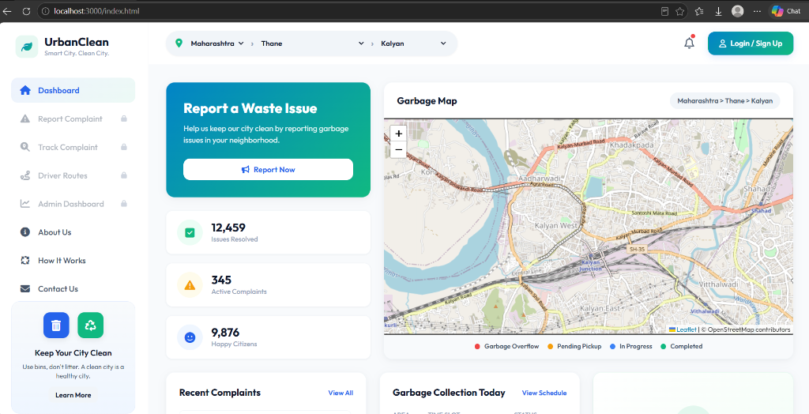
Admin Dashboard
Municipal Command Center
► View all complaints across the city with full details
► Assign complaints to registered garbage drivers
► Change complaint status (Pending/Assigned/Resolved)
► Manage citizen and driver accounts (add/suspend)
► KPI metrics: total complaints, resolution rate, active drivers
► Complaint map overlay for geographic distribution view
► Export and audit complaint logs
► System health monitoring and driver activity tracking
Screenshot: Admin Command Center (admin.html)
Notes:
VIVA POINT: Admin is the highest-privilege role.
Admin API endpoints include:
- GET /api/admin/complaints -- fetch all complaints
- PATCH /api/admin/complaints/:id -- update status or assignment
- GET /api/admin/users -- fetch all users
- POST /api/admin/assign -- assign complaint to driver
The admin dashboard uses the same Leaflet map as other portals but with additional controls.
Admin can see complaints in ALL statuses, not just pending.
If asked about security: Admin routes protected by role-check middleware on backend. Frontend checks role from session before rendering admin elements.

Slide 13
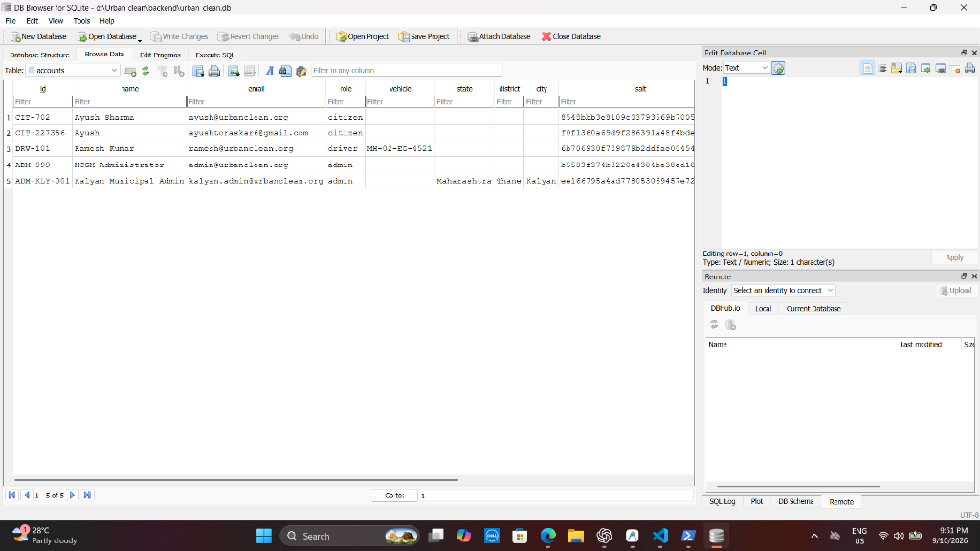
Database Design
Current: JSON + SQLite | Proposed: PostgreSQL + PostGIS
CURRENT IMPLEMENTATION
PROPOSED: PostgreSQL v16 + PostGIS v3.3
Primary Store: db.json (JSON document store)
Structure: db.json
complaints[] -> all complaint records
drivers[] -> driver profiles
accounts{}
citizens[] -> citizen accounts
drivers[] -> driver accounts
admins[] -> admin accounts
driverRoutes{} -> historical route data
dailyRouteSnapshots{} -> daily locked routes
Mirror: urban_clean.db (SQLite)
Auto-synced via sync_sqlite.py on every write
Tables: accounts, complaints, drivers
• Full ACID-compliant relational DB
• PostGIS: Spatial data type GEOGRAPHY(Point)
• Spatial indexing: GIST index on geom column
• Geospatial queries: ST_DWithin, ST_Distance
• Tables: complaints, users, drivers, routes
• Complaint location stored as PostGIS geometry
• ST_DWithin for 1km radius filtering (no JS)
• ORM: SQLAlchemy (reference main.py ready)
• Scalable: millions of complaints with indexes
• FastAPI + psycopg2 for async DB access
NOTE: PostgreSQL is PROPOSED future upgrade.
• Current implementation uses JSON + SQLite.
DB Browser: accounts table (urban_clean.db)
Notes:
VIVA CRITICAL: Always clarify current vs proposed when discussing database.
CURRENT: db.json is the ACTIVE runtime store. Node.js reads/writes JSON directly.
SQLite (urban_clean.db): Mirror only. Synced automatically via sync_sqlite.py on every db.json write.
Why JSON? Simple, no setup, great for prototyping. Works well for hundreds of records.
PROPOSED (PostgreSQL + PostGIS):
- PostGIS adds spatial data types like GEOGRAPHY(Point, 4326) -- stores lat/lng natively.
- ST_DWithin: Spatial function for 'within X meters' queries -- replaces JS radius filtering.
- Scalable to millions of records with GiST spatial indexes.
- reference/main.py already implements SQLAlchemy ORM for PostgreSQL -- ready to migrate.
If asked: 'Why not use PostgreSQL now?' -- Answer: SQLite is sufficient for the project scale. JSON store gives flexibility without schema constraints during development.

Slide 14
UML & System Design
Key Diagrams from the Design Suite
Use Case Diagram
Class Diagram
Sequence Diagram
4 actors (Guest, Citizen, Driver, Admin) with use cases:
Report Complaint, Track Status, Optimize Route, Manage Users, View Map
Key classes: User (base), CitizenUser, DriverUser, AdminUser, Complaint, Route, MapMarker, RouteOptimizer
Complaint submission flow: Citizen -> Frontend -> Express API -> db.json -> SQLite sync -> Admin notification
Activity Diagram
Component Diagram
Deployment Diagram
Route optimization flow: Load complaints -> TSP ordering -> OSRM API call -> Draw polyline -> Lock route
Components: Frontend SPA, Express REST Server, JSON Store, SQLite Mirror, OSRM External, Leaflet Map
Browser (Client) <-> Node.js Server (localhost:3000) <-> db.json / SQLite <-> OSRM API (internet)
Notes:
VIVA POINT: Be ready to sketch or describe any of these diagrams verbally.
Use Case: 4 actors. Guest can only view map. Citizen can report and track. Driver can view, generate route, lock, and resolve. Admin has full access.
Class Diagram: User base class with role. Complaint has fields: id, lat, lng, category, status, photo, citizenId, driverId, timestamps. Route has: driverId, date, waypoints, isLocked, totalDistance.
Sequence: Citizen submits -> POST /api/complaints -> server writes db.json -> triggers sync_sqlite.py -> response sent back -> map updated.
Activity: Driver opens portal -> fetches eligible complaints -> clicks Generate -> TSP runs -> OSRM called -> polyline drawn -> Driver locks -> snapshot saved.
Component: Frontend is a Single Page Application. Backend is a monolithic Express server.
Deployment: All runs locally (localhost). In production, would deploy to cloud (AWS/GCP) with Nginx reverse proxy.

Slide 15
Security & Non-Functional Requirements
NFR Suite from SRS Document
Security Requirements
Non-Functional Requirements
• NFR-01: Passwords hashed with bcryptjs (cost factor 10)
Performance:
API response < 500ms for standard queries
• NFR-02: Role-based access control -- endpoint-level checks
Scalability:
Designed for PostgreSQL/PostGIS migration
• NFR-03: Input validation on all form submissions (client + server)
Usability:
Mobile-responsive glassmorphism UI design
Reliability:
JSON + SQLite dual-store prevents data loss
• NFR-04: File upload restricted to images (Multer MIME check)
Availability:
Local server; cloud deployment for production
• NFR-05: HTTPS enforced in production deployment
Maintainability:
Modular code: separate frontend/backend layers
• NFR-06: SQL injection prevention via parameterized queries (SQLite)
Portability:
Node.js -- runs on Windows/Linux/macOS
• NFR-07: Session tokens invalidated on logout
Compliance:
No PII beyond account data; GDPR-aware design
• NFR-08: Complaint data accessible only to authorized roles
Testability:
REST API testable via Postman/curl; TC-01 to TC-20
Localization:
Geolocation uses WGS84 coordinate system
Notes:
VIVA POINT: NFRs show that the system was designed with quality attributes in mind.
Security: bcryptjs is a Node.js library for password hashing. Cost factor 10 means 2^10 = 1024 iterations.
Role-based access: Every backend route checks the caller's role from the session.
Multer MIME check: Prevents uploading non-image files as complaint evidence.
Performance NFR: < 500ms target for Express routes. Local SQLite queries are near-instant.
Scalability: The architectural design anticipates PostgreSQL + PostGIS for production scale.
Reliability: Dual store (JSON + SQLite) provides redundancy. If JSON write fails mid-flight, SQLite still has previous good state.
Test Cases: TC-01 to TC-20 defined in the project report covering all major user flows.

Slide 16
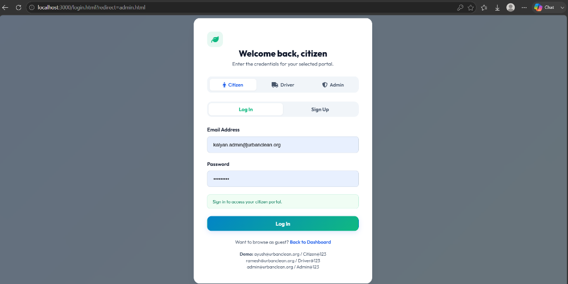
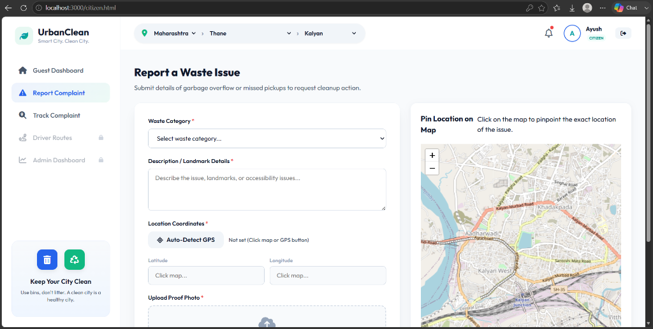
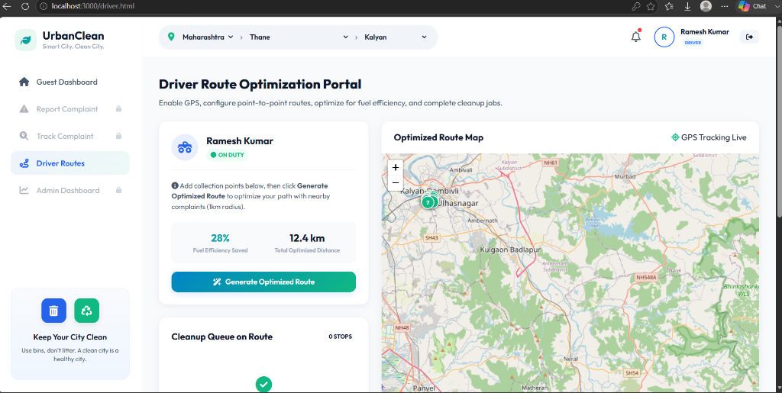
Implementation & Screenshots
Actual System UI -- All 5 Portals
Guest Dashboard
(index.html)
Login Portal
(login.html)
Citizen Reporting
(citizen.html)
Driver Route Portal
(driver.html)
Admin Dashboard
(admin.html)
SQLite DB Browser
(urban_clean.db)
Notes:
VIVA POINT: Point to specific elements in each screenshot.
Guest Dashboard: Shows live complaint markers on Leaflet map. No login required. Public transparency feature.
Login Portal: Role-selection interface. Separate login paths for Citizen/Driver/Admin.
Citizen Reporting: Form with geo-location capture, category dropdown, photo upload. Complaint submitted via POST /api/complaints.
Driver Route Portal: Interactive map with complaint markers. 'Generate Route' button runs TSP + OSRM. 'Lock Route' commits the day's plan.
Admin Dashboard: Full control panel. Complaint list with status badges. Driver assignment controls.
SQLite DB Browser: Shows urban_clean.db accounts table -- confirms data is synced from db.json.
UI Design: Glassmorphism style (frosted glass panels, blur effects, gradient borders). Responsive design using CSS Grid + Flexbox.

Slide 17
Results, Advantages & Future Scope
Results & Advantages
Future Scope
• Full-stack working prototype with 4 user roles
DB Upgrade:
Migrate to PostgreSQL v16 + PostGIS v3.3 for spatial queries
• Geo-tagged complaint submission with photo evidence
Mobile App:
React Native app for citizen reporting + driver navigation
• TSP + OSRM dual-engine route optimization functional
AI Priority:
Machine learning model to predict complaint hotspots
• Daily route lock system with tomorrow auto-queue
IoT Sensors:
Smart bin sensors for proactive overflow detection
• Dual data store: JSON runtime + SQLite auto-sync
Push Alerts:
FCM push notifications for complaint status updates
• Mobile-responsive glassmorphism UI design
Analytics:
Power BI / Tableau dashboard for city-level waste analytics
• All 5 HTML portals operational end-to-end
Multi-City:
Multi-tenant architecture for multiple municipalities
• REST API with 15+ documented endpoints
Offline Mode:
PWA with offline complaint drafting capability
• Documented project estimate: 22-32% fuel reduction
API Gateway:
Rate limiting, caching, microservices decomposition
(Estimate from project proposal -- not independently verified)
Notes:
VIVA POINT: Results prove the system works; Future Scope shows architectural thinking.
IMPORTANT -- Fuel savings (22-32%): This is a documented estimate from our project proposal. It is NOT independently verified experimental data. If asked, say: 'Our project proposal documents an estimated 22-32% fuel reduction from route optimization. This is based on documented estimates and would require field testing to verify.'
Key results to highlight:
- Working prototype with all 5 portals functional
- Dual-algorithm route optimization (TSP + OSRM)
- Auto-sync SQLite on every db.json write
- Daily route locking system
Future scope: PostgreSQL + PostGIS migration is the highest priority -- already have ORM models in main.py. Mobile app would allow GPS tracking of driver in real-time.

Slide 18
Conclusion
► UrbanClean successfully demonstrates a full-stack geospatial smart city solution
► Integrates citizen reporting, driver route optimization, and admin oversight in one platform
► TSP (Nearest-Neighbor) + OSRM (road routing) provide a dual-engine optimization pipeline
► Daily route locking with tomorrow's auto-queue improves operational planning
► Glassmorphism UI delivers a modern, mobile-responsive user experience
► Dual data store (JSON + SQLite auto-sync) provides reliability and flexibility
► System is architected to scale to PostgreSQL + PostGIS for production deployment
► Achieves all 8 project objectives defined in the SRS and design documents
Thank You
Ayush Santosh Toraskar
Roll No: CS-9147
TY BSc CS / Division II
D.G. Ruparel College
Academic Year: 2026-27
Viva Ready: Questions about TSP vs OSRM, Current vs Proposed DB, Route Locking, Authentication, File Uploads, REST API endpoints -- all covered in speaker notes.
Notes:
VIVA CLOSING STATEMENT:
'UrbanClean demonstrates how geospatial web technology can transform urban waste management. By combining real-time citizen reporting, TSP route optimization, OSRM road routing, and a multi-role administrative system, we have created a functional prototype that addresses key challenges in smart city waste collection. The system is designed for scalability, with a clear migration path to PostgreSQL and PostGIS for production deployment. I am happy to answer any questions.'
COMMON VIVA QUESTIONS:
Q: What is the difference between TSP and OSRM?
A: TSP (Nearest-Neighbor Heuristic) determines the ORDER of visiting complaint locations. OSRM (Open Source Routing Machine) provides the ACTUAL ROAD PATH between those ordered locations.
Q: What is your current database?
A: Currently JSON db.json + SQLite auto-sync. PostgreSQL + PostGIS is the proposed upgrade.
Q: How does complaint geo-tagging work?
A: Browser's navigator.geolocation API captures lat/lng. Stored in the complaint record.
Q: How is the route locked?
A: POST /api/driver/route/lock saves snapshot to dailyRouteSnapshots[driverId][date] in db.json. Complaints tagged 'assigned_today' or 'scheduled_tomorrow'.

