Slide 1
Harcourt Butler Technical University
Department of Computer Science and Engineering
Session 2023-2025
Industrial Training Report On Java Development
Currently undergoing training at codeclause
Master of Computer Application
Presented By:
Ayush Vaish
230231017
MCA 2nd

Slide 2
Objective
Codeclause aims to deliver high-quality IT services by combining technology expertise with creative solutions. Their objective is to help businesses and individuals achieve their digital goals through custom software development, website design, mobile app development, and Java development.
Expertise :
Java Development
Web Design and Development:
Mobile App Development:
Custom Software Solutions:

Slide 3
Project Description
Arkanoid
The game is an Arkanoid-style block-breaking arcade game implemented in Java, where players control a paddle to bounce a ball and destroy blocks on the screen. The gameplay involves skillfully moving the paddle to hit the ball, which breaks blocks and progresses through levels. As blocks are destroyed, the game becomes increasingly challenging, requiring precise ball control and paddle movements to clear the screen and achieve high scores.

Slide 4
Key features
Brick Layouts: Various patterns and types of bricks, some requiring multiple hits.
Increasing Difficulty: Levels become progressively harder with faster ball speed and complex brick arrangements.
Paddle Control: Players use a paddle to bounce the ball and break bricks.
Score System: Points are earned for each brick destroyed, contributing to high scores and competitive play.
Completely developed in Java

Slide 5
Frontend
System Architecture
Backend
The backend of the platform is built using Java
The frontend of the platform is built using Java Swing.

Slide 6
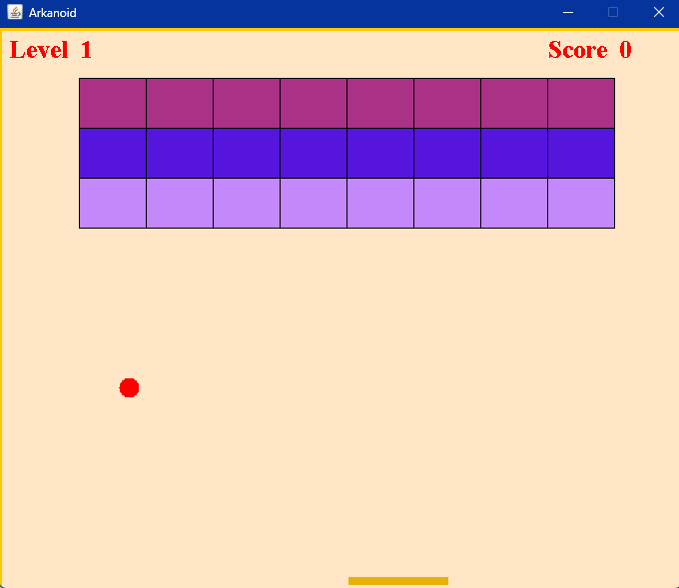
Gameplay screen

Slide 7
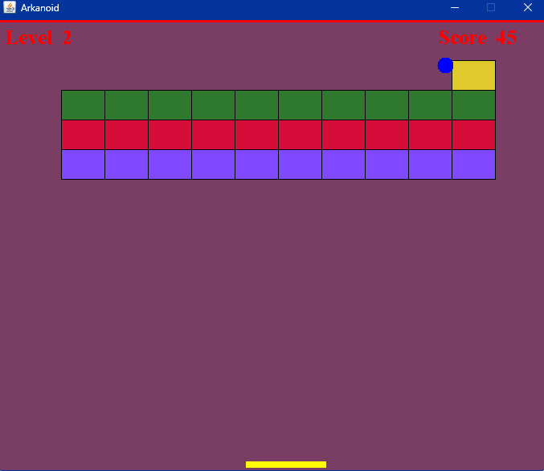
Level 2

Slide 8
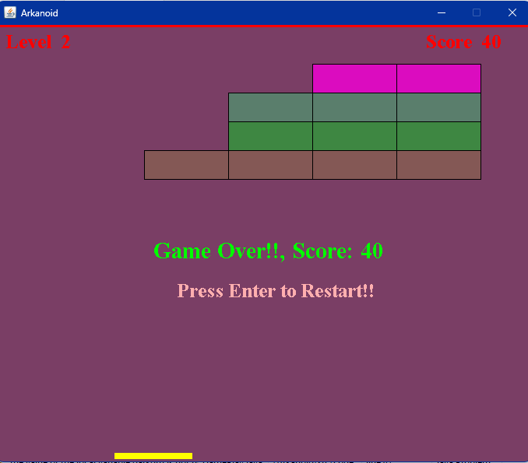
Game over
When ball misses paddle the game gets over

Slide 9
conclusion
The game is currently finished development and is executing properly.
To play it just start the game as per shown in UI and game is played by arrow keys to move paddle .
when ball goes below paddle it moves onto game over screen and score is shown in the screen

Slide 10
Thank You

