Slide 1
CODE BITS 3.0
Over 5 billion people lack access to safe surgery (WHO, 2023), with 143 million more procedures needed annually. India faces a 1:1456 doctor-to-patient ratio, and 80% of rural specialist positions remain vacant (National Health Profile, 2022). 30% of Indian surgery graduates lack hands-on experience (AIIMS, 2023), increasing surgical risks. Traditional training methods fail to provide real-world precision. Augmented Reality (AR) can bridge this gap by enhancing surgical training, planning, and execution, reducing errors, and improving patient outcomes.
Problem Statement Title - Student Innovation
Theme - MedTech
PS Category- Software
Team Name - Mirage

Slide 2


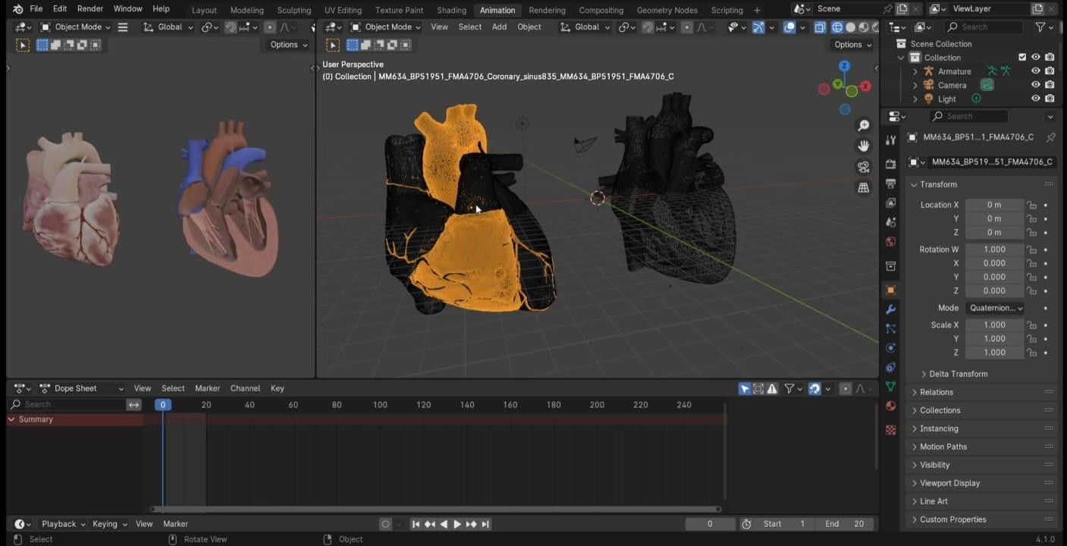
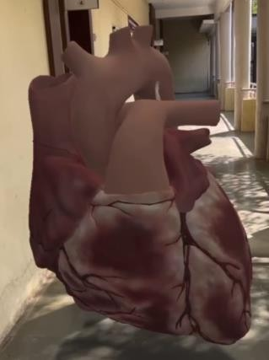

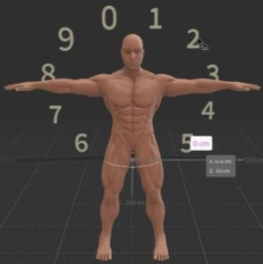


Medical Immersive Reality for Advanced Guided Expertise
Mirage
MediSphereAR Prototype Link :
https://drive.google.com/file/d/1m5PtIdDI9q5AfA8olmCpoc9Cgv7j16gK/view?usp=drive_link
Description: MediSphereAR leverages augmented reality to deliver high-fidelity simulations and patient-specific 3D models, revolutionizing virtual surgeries, advanced medical training and real-time patient education.
Solution Overview:
Augmented Reality Integration:
Partial anomalous pulmonary venous connection
Surgical Simulations: Realistic virtual environments for practice and skill enhancement.
Virtual Surgeries: Preoperative rehearsals to improve precision and reduce errors.
Emergency Response Training: Simulated scenarios for effective emergency preparedness.
b. Medical Imaging Data Integration:
3D Model Creation: Converts CT/MRI scans into interactive 3D AR models.
Custom Models: Patient-specific AR models (e.g., heart with blockages) for targeted diagnosis.
3. Key Benefits:
Enhanced Training: Realistic simulations improve procedural skills and reduce training time.
Informed Decisions: Interactive models aid in better understanding of conditions and treatment
options.
Improved Response: Simulated emergencies enhance preparedness and team coordination.
4. Unique Selling Propositions (USPs):
Complete Anatomy
First in India: Pioneering animated AR assets in healthcare.
Comprehensive Visualization: Offers both external and internal anatomical views. model of
Custom AR Models: Detailed models based on individual medical data.
360-Degree Anchoring: View AR objects from all angles by moving around them.
Digital Indexing: Navigate seamlessly between different AR models.
Working
Heart in Augmented Reality
Shows the interior of the organs

Slide 3




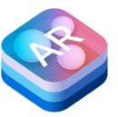












TECHNICAL APPROACH
Mirage
MediSphereAR Implementation Workflow Link:
https://drive.google.com/file/d/1FZ5e1z4qgookIjOcOwp15h6K1zHNqdnZ/view?usp=drive_link
Technology Stack :
MediSphereAR System Architecture Flowchart
User Interface :
ARCore (for Android-specific AR features) , ARKit (for iOS-specific AR features)
Backend Services :
Node.js / Express (for server-side logic and API handling)
Medical Imaging Processing :
DICOM Libraries (for handling and processing medical imaging data)
Data Storage :
Database (for structured data storage)
Cloud Storage (AWS or Google Cloud for scalable data storage)
External Integrations :
APIs/Services (for connecting with external systems and services)
3D Model Storage :
Cloud Storage (AWS or Google Cloud for storing 3D models)
Additional Tools :
User Interface (ARCore / ARKit)
Backend Services (Node.js / Express)
Blender or 3ds Max (for 3D modeling and animation)
OpenCV (for advanced image processing)
Firebase (for backend services and real-time database)
Data Storage (Database/Cloud)
Medical Imaging Processing
( DICOM Libraries )
Methodology:
Data Integration: Convert CT/MRI scans to 3D models using DICOM libraries.
AR Development: Build immersive AR experiences with ARCore (Android) and ARKit .
Backend Setup: Develop server-side logic and APIs using Node.js/Express.
Data Storage: Store 3D models and structured data in AWS or Google Cloud.
External Integrations: Connect with necessary APIs and external services.
Testing: Optimize models and AR functionality for performance across devices.
Deployment: Launch on AR-compatible devices with continuous updates and maintenance.
External Integrations (APIs/Services)
3D Model Storage (Cloud Storage)

Slide 4

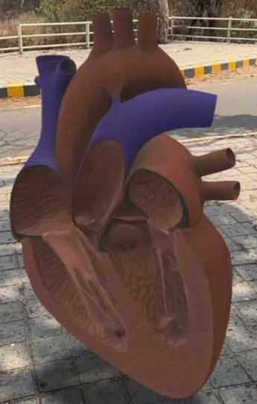

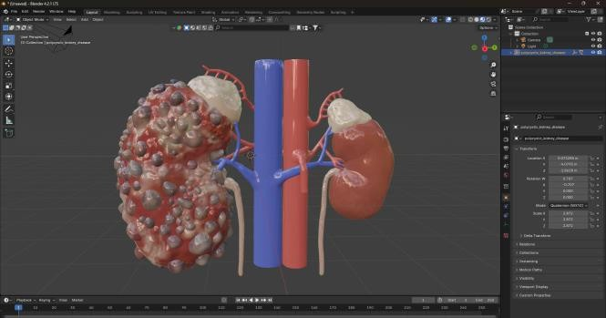

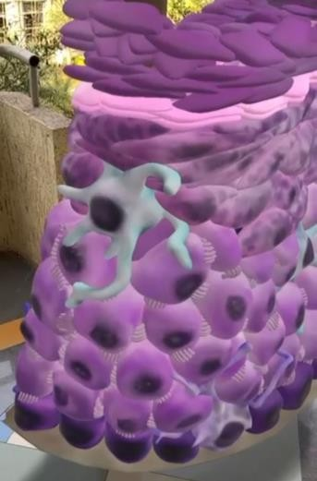

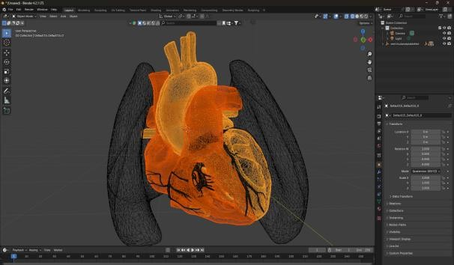
FEASIBILITY AND VIABILITY
Mirage
Link to MediSphereAR’s Drive :
https://drive.google.com/drive/folders/1XUnd1VG6u6FEGE_HbFIJgaWi6DnL01gj?usp=drive_link
Analysis of the Feasibility of the Idea:
Technical Feasibility:
3D Model Integration: Feasible with DICOM libraries, ARCore and ARKit for accurate 3D model rendering.
Cloud Storage: AWS S3 or Google Cloud Storage ensures scalable and efficient handling of large datasets and 3D models.
Market Feasibility:
AR in Healthcare: Market expected to reach $4.7 billion by 2026 with a 29.5%
CAGR (source: Grand View Research).
Polycystic Kidney Disease (PKD)
Potential Challenges and Strategies:
Epidermal Dissection using Augmented Reality
Data Accuracy:
Challenge: Variability in scan quality and resolution.
Strategy: Implement validation protocols and use machine learning for model optimization.
Device Compatibility:
Challenge: Performance may vary across devices.
Strategy: Conduct cross-platform testing and utilize adaptive rendering.
Privacy and Security:
Challenge: Ensuring compliance with regulations.
Strategy: Adhere to HIPAA and GDPR; implement end-to-end encryption and
secure authentication.
Sagittal Sectioning of Heart using Augmented Reality
Ventricular Septal Defect Closure

Slide 5

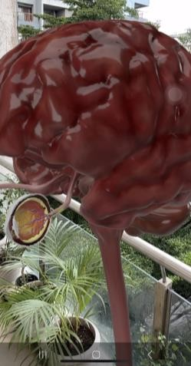
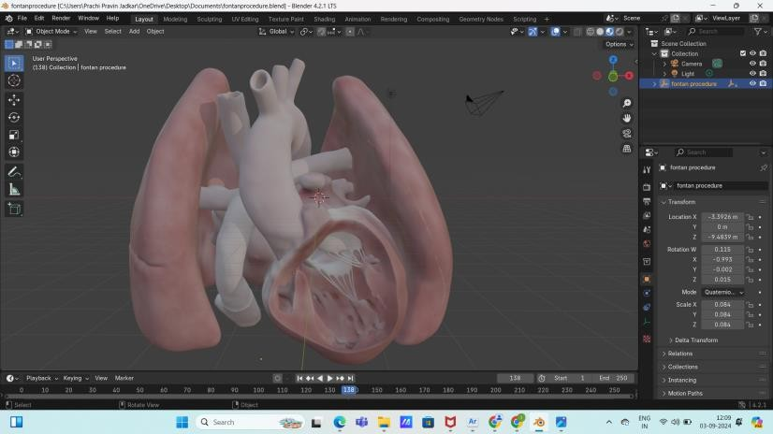



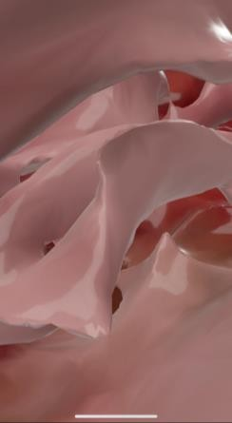
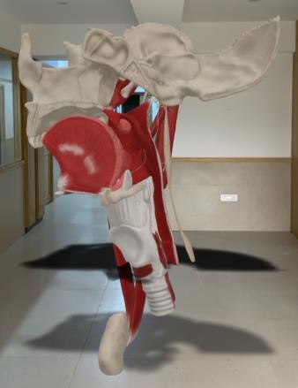
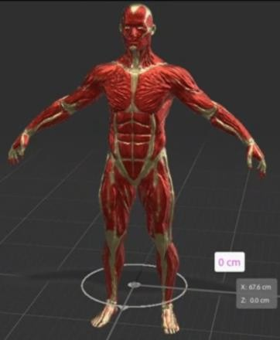
IMPACT AND BENEFITS
Mirage
Impact:
Surgeons & Trainees: Immersive, hands-on training with
real-time feedback to practice complex procedures. Reduces the
learning curve and improves surgical precision.
Remote Surgeons: Surgeons in underserved regions can access state-of- the-art training, improving global surgical skills and reducing malpractice and post-surgical complications.
Patients: Increased safety through virtual rehearsals and better
communication, enhancing patient trust and understanding.
Anatomy of Vision using Augmented Reality
Heart after Fontan procedure
Benefits:
Social: Global access to advanced surgical training, improving healthcare in remote areas.
Economic: Reduces training costs, lowers malpractice risks, minimizes surgical errors and improves operating room efficiency, saving time and resources.
Environmental: Cuts medical waste, reduces resource use, and lowers carbon emissions by allowing remote training without travel to specialized centers.
Pharynx and then
Floor of Mouth
Myology using
Augmented Reality
Interior of Brain

Slide 6

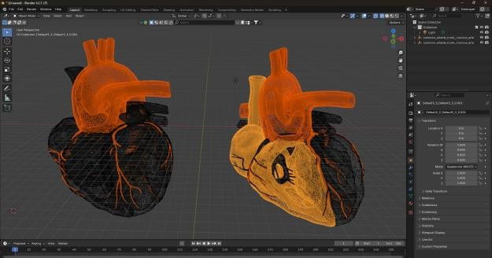

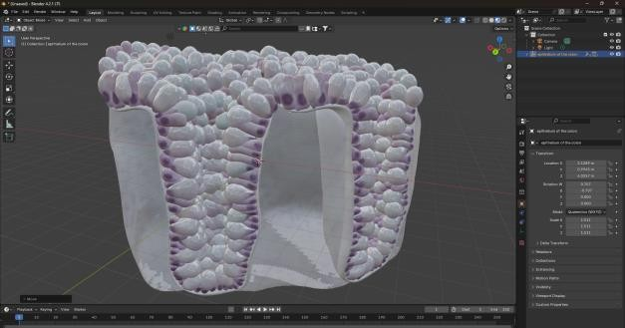
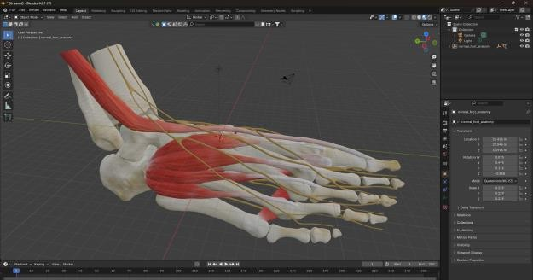
RESEARCH AND REFERENCES
Mirage
Reference Link :
MediVis Anatomy X
Description: MediVis offers advanced AR solutions for medical training and education, including high-fidelity 3D anatomical models.
Link: https://www.medivis.com/anatomy-x
Ventricular Septal Defect (VSD): Hole in heart’s septum, mixing oxygen-rich and poor blood.
Research Link :
Application of Augmented Reality in Healthcare
Description: This article explores the various applications of AR in the healthcare sector, including enhancements in surgical procedures, medical training, and patient care.
Link: https://www.wipro.com/innovation/application-of- augmented-reality-in-healthcare/
Epithelium of Colon: Lining of colon, absorbs nutrients and secretes mucus.
Augmented Reality (AR) in Healthcare
Description: A comprehensive research paper discussing the
implementation of AR technologies in healthcare, including case
Normal Foot Anatomy: 26 bones and joints support movement and weight distribution.
studies and future prospects .
Link:
https://www.researchgate.net/publication/350918578_Augmente d_Reality_AR_in_Healthcare

