Slide 1
SIH-2020 : Software Category
Ministry/ Organization name: Government of Andhra Pradesh
Problem Code: KB186
Project Title: Solutions required to solve the challenges faced by Law
Investigating Officers(LEOs) in Cyber Crimes
Team Name: 6_BIT
Team Leader Name: Ayush Singh
College Code: 1-351235900

Slide 2
Problem Statement: Solutions required to solve the challenges faced by Law Investigating Officers(LEOs) in Cyber
crimes.
Problem Code: KB186
Project Title: LEO assistant
Solution:
A web based mobile application built through Flutter and Dart, runs in the background of phone and access the IP address and Location/GPS co-ordinates of the user.
Using the Selenium package of PYTHON the app will access the WhatsApp messages and send the details of messages to the admin database.
Eg: Time when message was received, location of the receiver, the message recived
Network.list() function of Flutter and Dart will allow us to access the location of receiver and will let us calculate the distance between the sender and receiver address co-ordinates.
get_ip package of Flutter will allow us to access the IP address of the users and will store it in the database.
Native API is used for the OTP verification allowing us to access contact Information of the user.
-> Use of Flutter and Dart will allow us to we can launch our application for both IOS and android at the same
time.

Slide 3
Technology Stack:
Flutter (hybrid application development method)
Selenium package PYTHON
get_ip package (to get IP address)
Native API (verification purpose)
Adobe XD (prototype development)
SDK 24.0+ and IOS version 9+
navIC

Slide 4


USE CASE:
Mobile app login
NATIVE API OTP verification
user
get_ip to access the IP address of the user
Solution to ps 4
admin database
(containing IP and co-ordinates of the receiver)
Network.list() to access the user location and GPS coordinates
Solution to ps 2
Selenium accessing co-ordinates of message
Solution to ps 1 & 3
admin

Slide 5




The sender will send an SOS to Cyber cell with his current location and there will be google map API link which will automatically find the distance by subtracting the distance between sender and receiver location
Solution to ps 5

Slide 6
Dependencies:
-> Proper Native API functioning for OTP verification.
-> get_ip package for accessing location and IP address of the user.
-> Selenium package of PYTHON to access WhatsApp messages.
-> work with the Indian technology navIC of Indian Regional Navigation Satellite System
-> Provide contact information to contact cyber cell.
Show Stoppers:
-> WhatsApp is a 3rd party application, so it may or may not allow the
Selenium package of Python to access the messages.
-> Application may not function properly in background.
-> Network.list() of flutter may not be able to calculate accurate distance
between the two users if Selenium package do not function properly.

Slide 7
Positive aspects
>NavIC – Indian regional navigation satellite
Provides accurate real time positioning
Extended upto 1500km from indian boundary (ps 5)
>Proper native API and Get_ip package – verification of users.
>Provides security to all users (ps 1,2,4)
>Selenium package- security breaches can be handled
>Malicious content will be traced out.
Culprit can be Booked under UAPA act , IPC and IT act of India 2000
(ps 3)

Slide 8
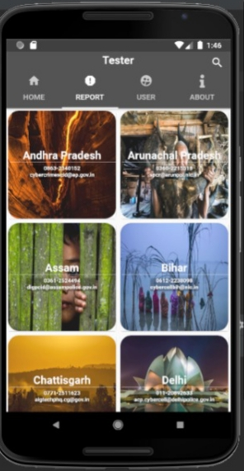
Solution first page consisting all the state information

Slide 9
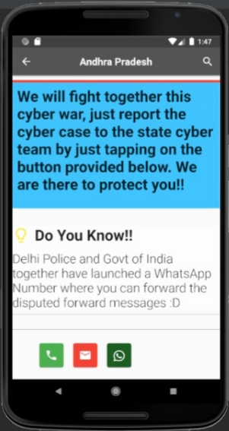
By clicking on any state these options will appear.

Slide 10
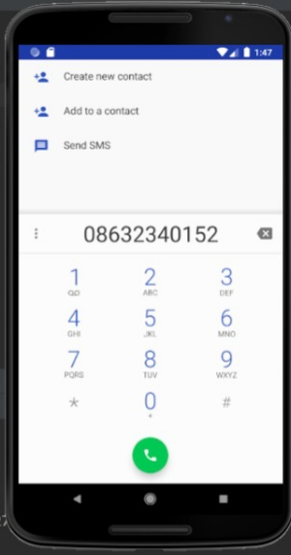
On clicking sms icon this window will appear

Slide 11
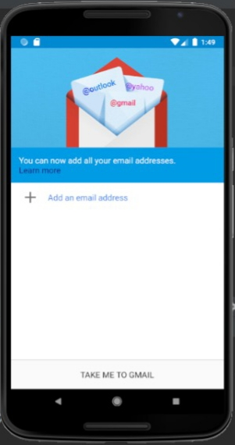
On clicking mail this window appears.

Slide 12
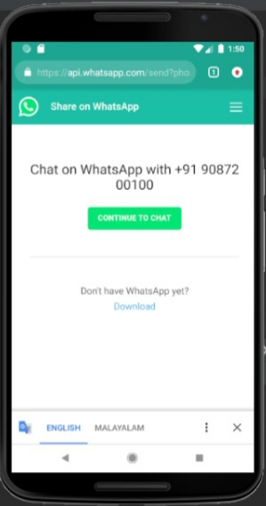
On clicking whats app this will appear.

Slide 13
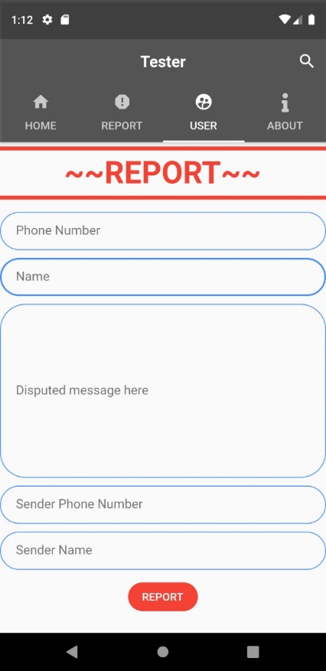
For reporting disputed message

Slide 14
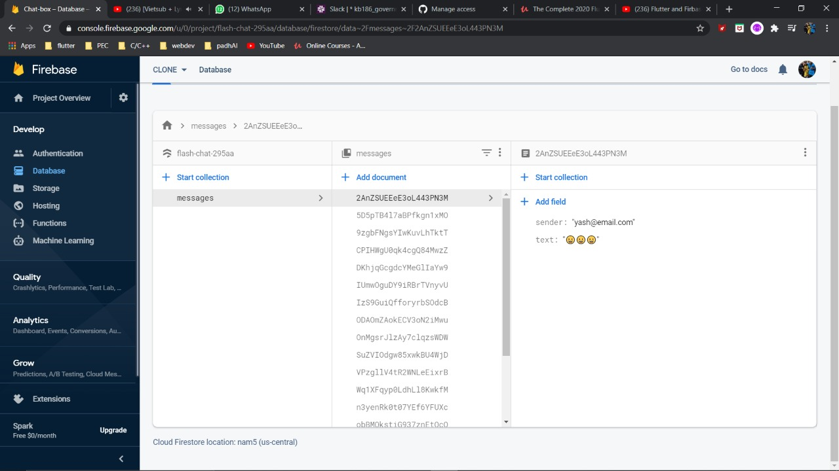
Stored in database for further sharing with authorities. (PS 3)

Slide 15
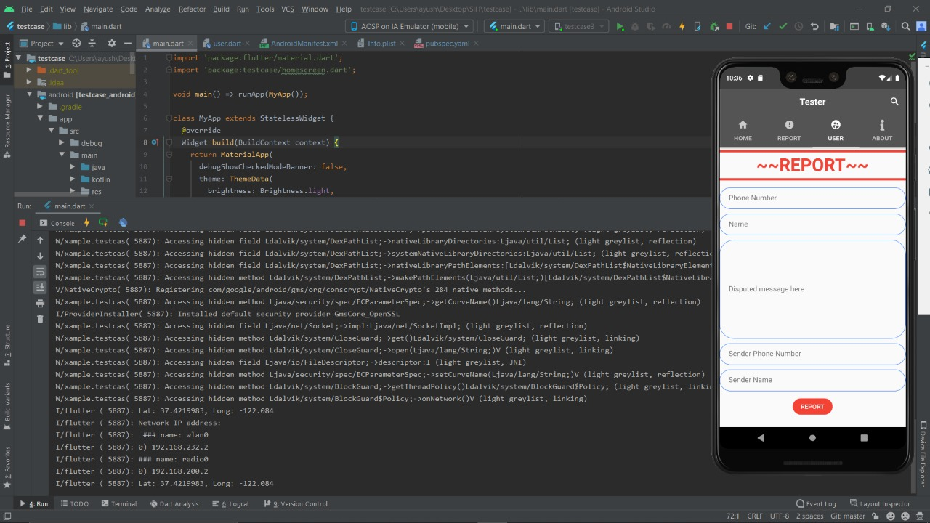
The location of the sender will also be stored for further process (PS 2 & 4)

Slide 16
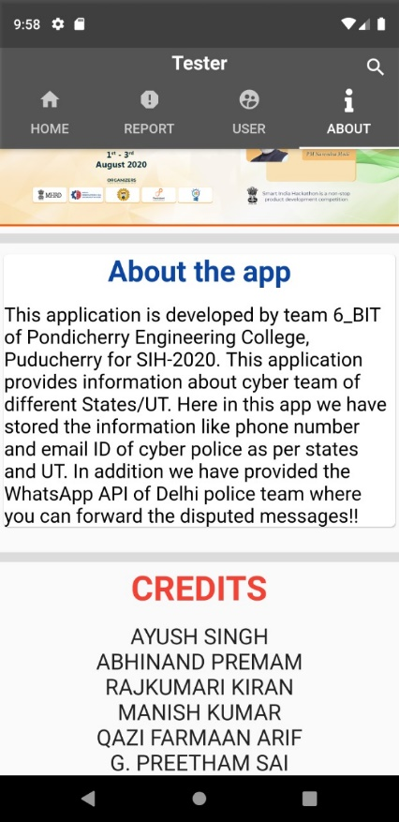
About the application.

