Slide 1
INTRODUCTION TO HR ANALYTICS DASHBOARD

Slide 2



TEAM MEMBERS
AYUSH AGGARWAL
PG24089
VANSH GUPTA
PG24092
LAKSHAY YADAV
PG24093

Slide 3
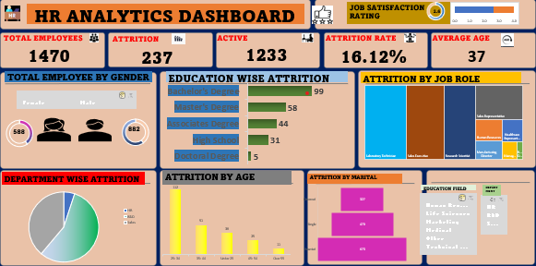

Slide 4

MAIN OBJECTIVES
The main objective of an HR analytics dashboard is to help HR teams make informed decisions about their workforce by providing data-driven insights.

Slide 5
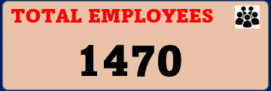
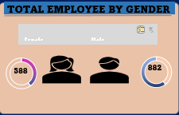
KEY INSIGHTS 1
TOTAL EMPLOYEES BY GENDER
This suggests a gender distribution skewed towards males in the dataset. The insights could be useful for understanding demographic trends or targeting gender-specific strategies.
40%

Slide 6
KEY INSIGHTS 2
EDUCATION BY ATTRITION
This distribution suggests a trend towards higher education levels, with Bachelor's and Master's degrees being the most prevalent.

Slide 7
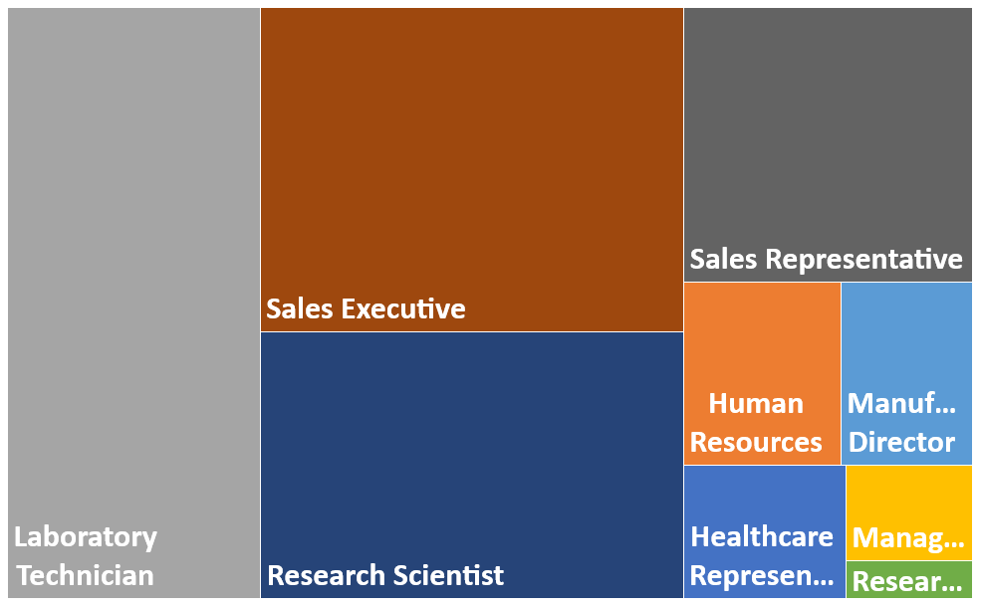
KEY INSIGHTS 3
ATTRITION BY JOB
This suggests a potential focus area for retention strategies in sales and research positions.

Slide 8
KEY INSIGHTS 4
DEPARTMENT WISE ATTRITION
This suggests a significant retention challenge in R&D compared to other departments.

Slide 9
KEY INSIGHTS 5
ATTRITION BY AGE GROUP
The data reveals significant insights into attrition rates across different age groups

Slide 10
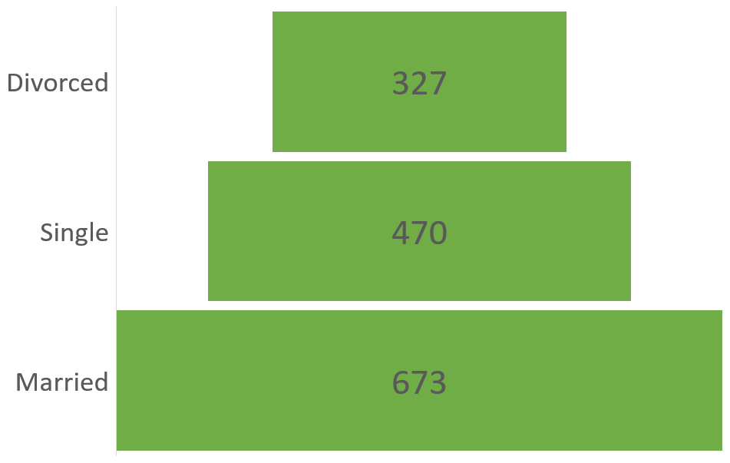
KEY INSIGHTS 6
MARTIAL STATUS
This suggests that marital status may influence attrition, with married individuals experiencing the highest rate.

Slide 11


