Slide 1
INVESTMENT ASSIGNMENT SUBMISSION
Name: Ayush Mandowara

Slide 2
Abstract
Spark Funds is looking to invest in Startups. Since they are in early stages of being an investment fund, they want to invest their money where most other funds are already investing. They have a bracket of 5 Million to 15 Million per round of investment and want to invest in countries where the official language is English, in order to have easier communication with the companies they invest in.
Spark Funds has provided us with the required data sets for the analysis, and our objective is to identify countries & sectors in which they can invest.

Slide 3
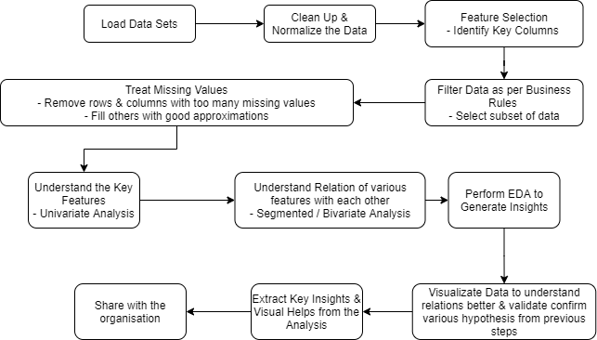
Problem solving methodology

Slide 4
Analysis – Identifying Most Suitable Funding Type
Most companies by count have been funded by Venture Funding
Venture Funding Investment is also suitable as per the business requirement of 5 – 15 Million USD per funding round. The median investment is 5 Million in this type. Other types are either below or above the threshold.
Spark Funds can be a Venture Funding Investor

Slide 5
Analysis – Prominent English Speaking Countries
Most companies in the belong to the USA. It is also most heavily funded country. Prominent Sectors in USA include “Others”, “Cleantech / Semiconductors” & “Social, Finace, Analytics, Adverstising". A total 129 billion+ have been invested here. 15,000+ companies in the USA were funded within our business constraints.
UK is the second most invested country with total investment of 66Billion+ USD. The popular sectors are same as the USA.
India is the third most invest country with total investment of 3Billion+ USD. Sectors “Others” and “Social, Finance, Analytics, Advertising” are prominent here as well. However, instead of “Cleantech”, “News, Search and Messaging” in a more popular investment choice

Slide 6
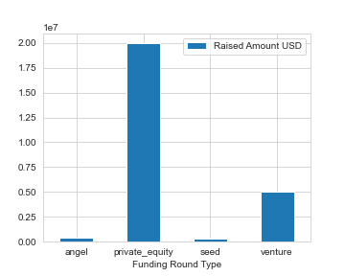
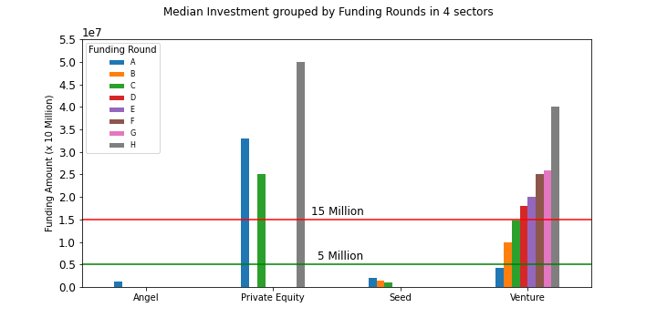
Results – Spark Funds should be a Venture Funding Investor
Median Investments per Funding Type

Slide 7
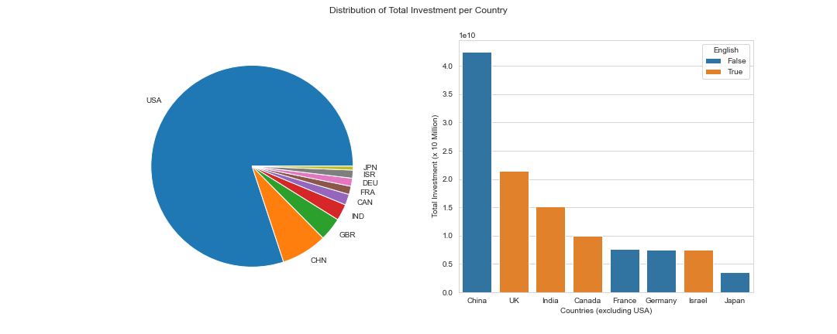
Results – Spark Funds should invest in USA, UK & India

Slide 8
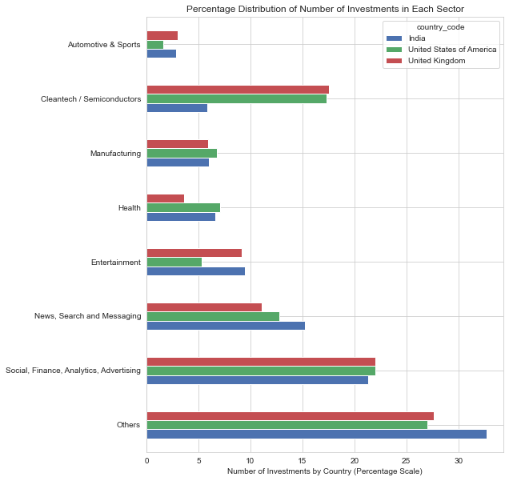
Results – Prominent Sectors in Most Invested Countries

Slide 9
Conclusions
- Spark Funds can is positioned to be a Venture Fund Investor
- It can invest in USA, UK & India
- In USA, it can invest in `Others`, `Cleanteach/Semiconductors` & `Social, Finance, Analytics, Advertising` sectors
- In UK, it can invest in `Others`, `Cleanteach/Semiconductors` & `Social, Finance, Analytics, Advertising` sectors
- In UK, it can invest in `Others`, `Social, Finance, Analytics, Advertising` & `News, Search and Messaging` sectors

