Slide 1
Topic Medicine Delivery Website

Slide 2
HTML:
HTML is the most basic building block of the Web pages.HTML is the language for describing the structure of Web pages.
HTML gives authors the means to: Publish online documents with headings, texts, tables, lists, photos, etc.
Retrieve online information via hypertext links.

Slide 3
CSS:
CSS stands for Cascading Style Sheets . It basically used to style and layout Web pages.
CSS language used for describing the presentation of a document written in a markup language such as HTML or XML.
CSS is the code that styles the web content.
CSS is the cornerstone technology of the world wide web .

Slide 4
JavaScript:
JavaScript is a dynamic computer programming Language.
It is lightweight and most commonly used as a part of web pages , whose implementations allow client-side script to interact with the user and make dynamic pages.
It is an interpreted programming language with Object-Oriented Capabilities.

Slide 5
Project Detail:
This project is totally based on the web technology . We uses HTML,CSS and JS in this project.
Introduction:
We made this website so that the user can easily get the medicine and also can consult to the doctor’s of their choices at any time without having any difficulty.
Users can order the products of their choices from the website at any time from anywhere.
The main motive of this website is to help users in finding doctors and medicine easily.

Slide 6
Header Section:
This section shows the different services that we provide to our user.
Login Section : The user firstly have to register themselves in this website after that they will only get the benefits and if they are already registered they can simply do signup.
Search Section: In this the user can search the product of their choice.
Cart : User can also add the item of their choices in cart.

Slide 7
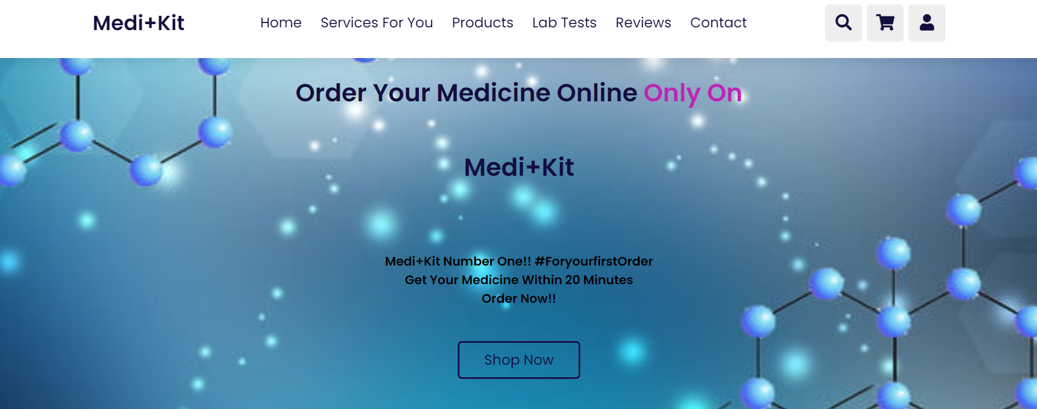

Slide 8
Services For Customer:
Users can directly consult to the doctor if they have any type of symptoms by simply using book now option.
Users can also book their Covid-19 vaccination dose (1st dose,2nd Dose , Booster dose)
Users can also talk to the Doctor with a minimum charge of RS:250.

Slide 9
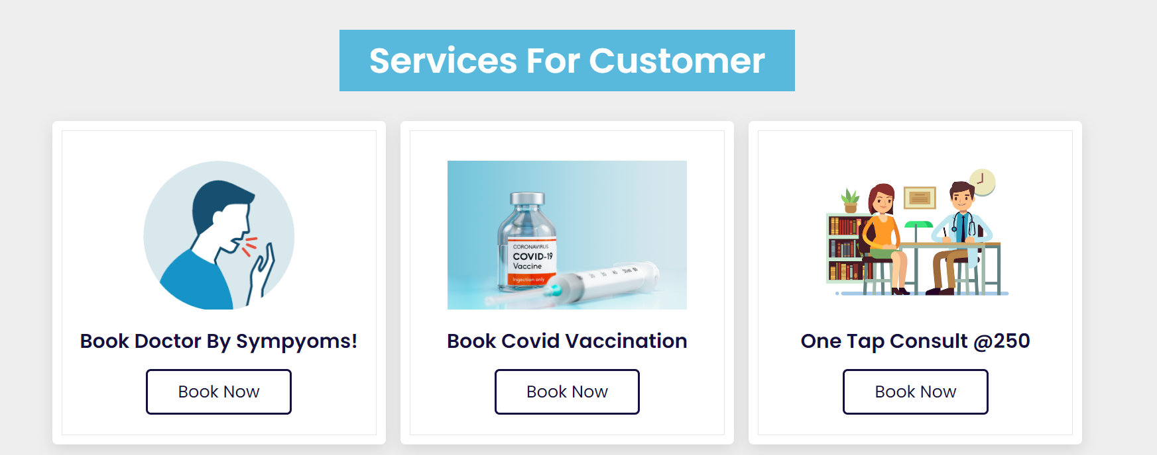

Slide 10
Products:
Our website can provide different types of products to the users along with medicines we also provides hair products , skin-care products , baby care-products , men’s/women’s grooming products .You can get all the products on our website at very reasonable prices.
We can also provides the Patanjali products.

Slide 11
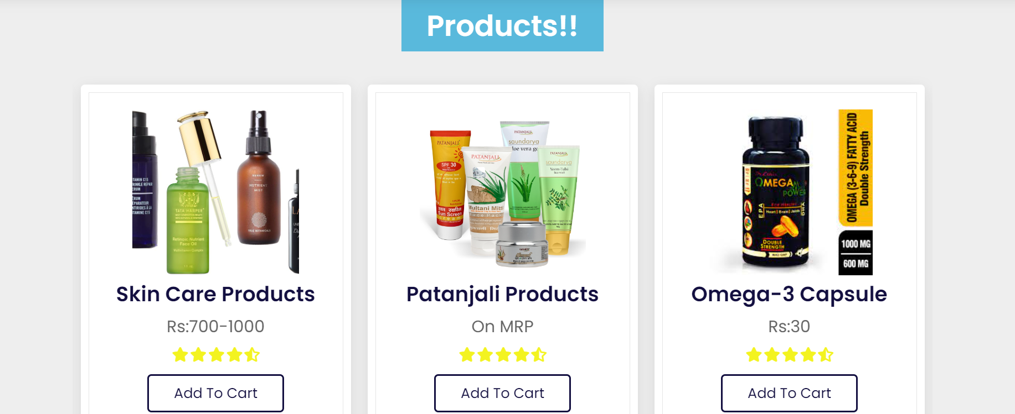

Slide 12
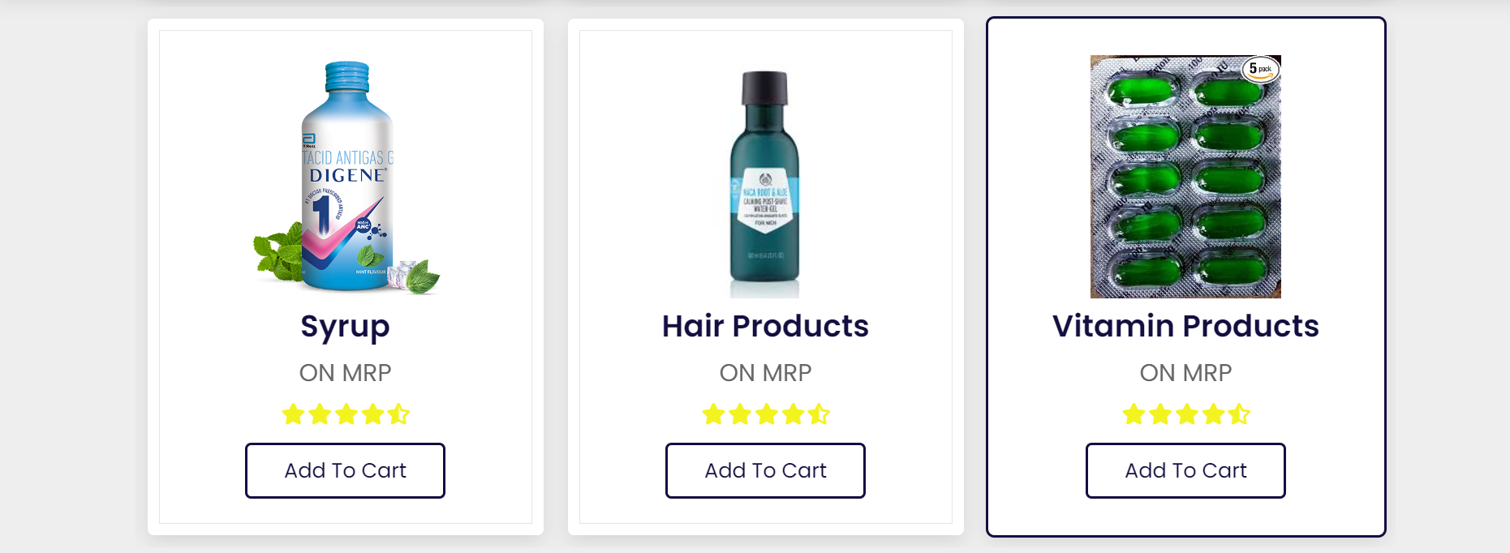

Slide 13
Our features:
All our products are of top brands
We also offer our users the facility of all type of lab tests.
Users can easily consult with the doctor’s.
Delivery with in 20 minutes.
Easy payment methods.

Slide 14
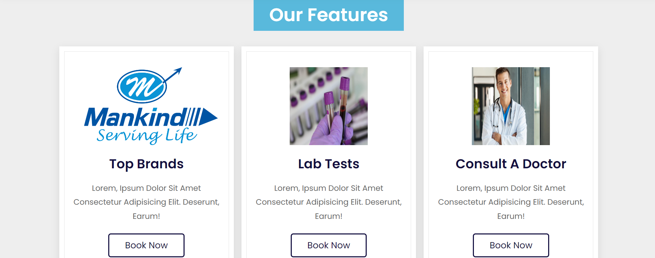

Slide 15
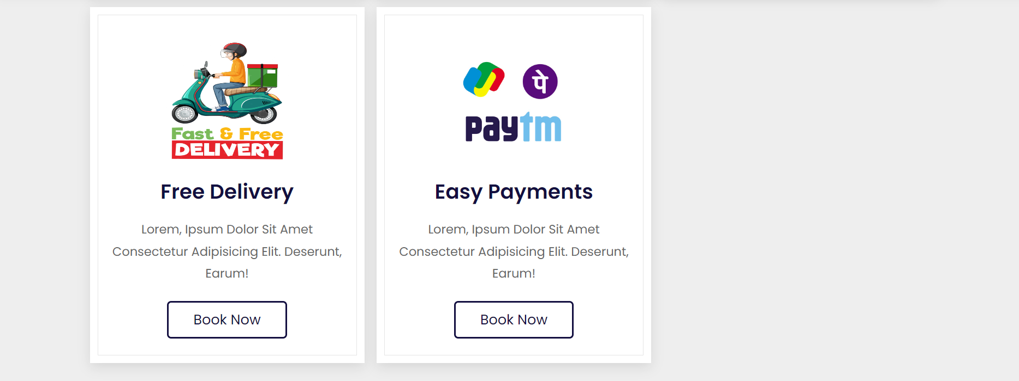

Slide 16
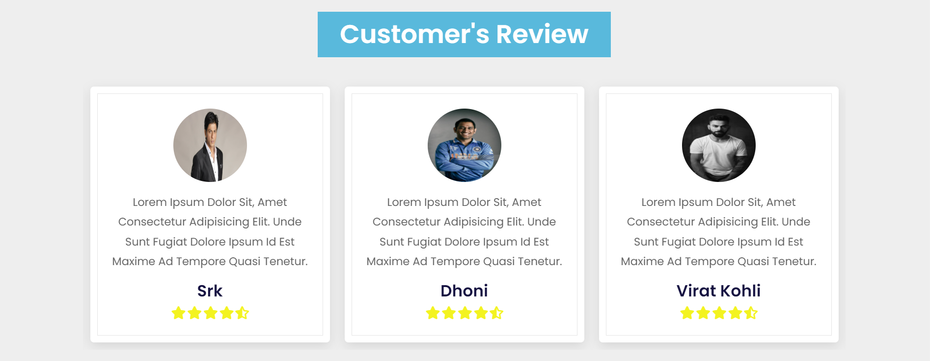
Customer’s Review: You can also give your review according to your choice.

Slide 17
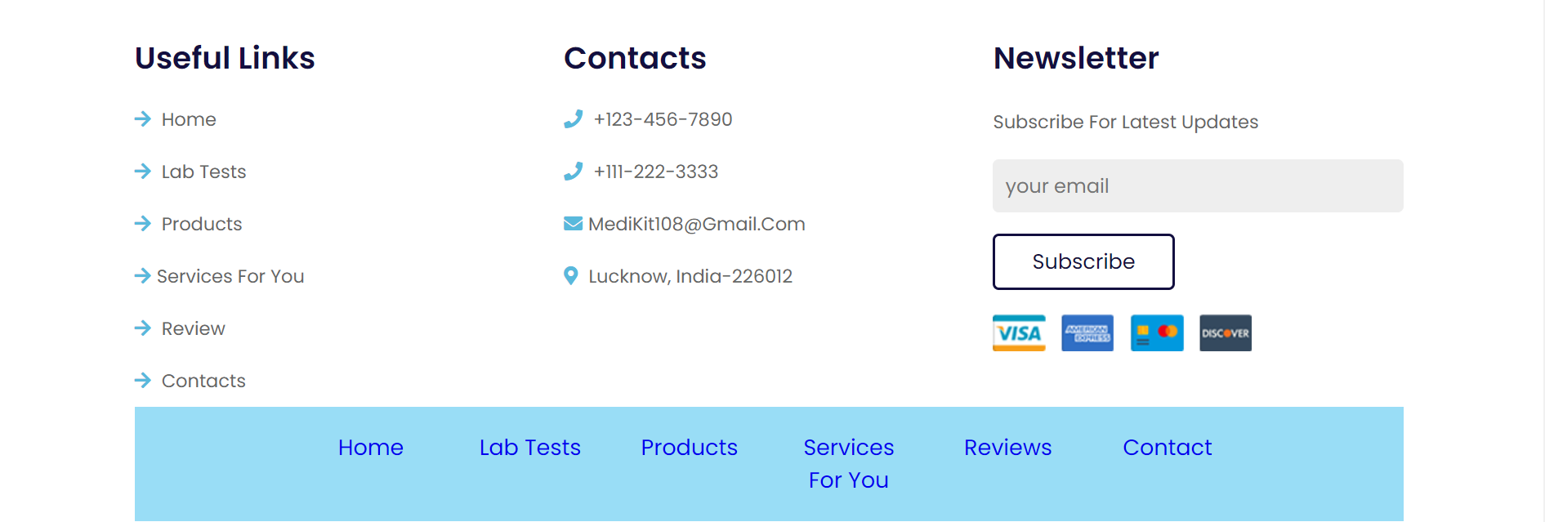
Footer Section: This section contains some links and also the helpline number .In case if you need any help, please visit this section.

Slide 18
Website link:
https://ayushyadav3010.github.io/Final_project_Web_Development/

Slide 19
Thankyou!!

