Slide 1

B.Tech Project Evaluation-1 SENTIMENT ANALYSIS OF LOCKDOWN IN INDIA DURING COVID-19
Presented by :-
Ayushya Nirwan, 2018003532
Abhiraj, 2018014721
Jigyasa Chaudhary, 2018015575
Piyush Chabbra, 2019003228
Under the Supervision of:-
(Dr. Hoor Fatima)
Sharda University, Gr. Noida
DEPARTMENT OF COMPUTER SCIENCE & ENGINEERING
SCHOOL OF ENGINEERING AND TECHNOLOGY
Feb 2022

Slide 2
Contents:
Introduction
Literature Survey
Motivation
Objective
Timeline
Existing Methods
Implementation
Proposed Methods
Proposed Systems
Use Case and ER Diagram
Feasibility Analysis
Future Scope
References

Slide 3
Introduction
Started its first strain in Wuhan, China, the exponential spread of Coronavirus disease (COVID-19) has caused public health crisis regionally and internationally as well [1].
The Centres for Disease Control and Prevention (CDC) actuated its Emergency Operations Centre (EOC), and the World Health Organization (WHO) published its first report regarding the situation about Coronavirus disease 2019 (COVID-19) on January 20, 2020
People were advised to stay at homes and to ensure social distancing lockdown was imposed.
This article aimed to explore the public views in terms of positive,negative and neutral towards Covid-19 through sentiment analysis of social media data.

Slide 4
LITERATURE SURVEY
S. NO | Journal Type with year | Authors | Title | Outcomes
1 | IEEE, 2020 | J. T. Wu, K. Leung, and G. M. Leung, | “Nowcasting and forecasting the potential domestic and international spread of the 2019-nCoV outbreak originating in Wuhan, China: A modeling study | Large cities overseas with close transport links to China could also become outbreak epicentres, unless substantial public health interventions at both the population and personal levels are implemented immediately
2 | JOURNAL, 2020 | R. J. Medford, S. N. Saleh, A. Sumarsono, T. M. Perl, and C. U. Lehmann | “An ‘infodemic’: Leveraging high-volume Twitter data to understand public sentiment for the COVID-19 outbreak, | Twitter is a rich medium that can be leveraged to understand public sentiment in real-time and target public health messages based on user interest and emotion.

Slide 5
S. NO | Journal Type with year | Authors | Title | Outcomes
3 | Journal (2020) | S. Li, Y. Wang, J. Xue, N. Zhao, and T. Zh | “The impact of COVID-19 epidemic declaration on psychological consequences: A study on active Weibo users,” | It may provide references for policy makers to plan and fight against COVID-19 effectively by improving stability of popular feelings
4 | WHO (2020) | World Health Organisation | Statement Regarding Cluster of Pneumonia Case | Over the past week, people with symptoms of pneumonia and reported travel history to Wuhan have been identified at international airports.

Slide 6
S. NO | Journal Type with year | Authors | Title | Outcomes
5 | IEEE Transactions on Computational Social Systems, 2021 | Prasoon Gupta, Sanjay Kumar, R. R. Suman, Vinay Kumar | “Sentiment Analysis of Lockdown in India During COVID-19: A Case Study on Twitter”
6 | Infectious Disease Modelling, 2020 | Biao Tang, Nicola Luigi Bragazzi, Qian Li, Sanyi Tang, Yanni Xiao, Jianhong Wu | “An updated estimation of the risk of transmission of the novel coronavirus (2019-nCov)”

Slide 7
Motivation :
• The use of social media and twitter has increasingly become popular in the pandemic period.
• The effect of the COVID-19 pandemic on the sentiments of the society, mainly due to the tweets and comments of the in uential people of the society and the response to their tweets was the primary source of motivation behind this study.

Slide 8
Objectives:
• The objective of this study is to analyze public perceptions through sentiment analysis regarding black fungus during the time of the COVID-19 pandemic using Machine Learning
• This will provide a deeper understanding of public perceptions towards black fungus during the COVID-19 epidemic in the world
• To increase understanding of public awareness of COVID-19 and black fungus and uncover meaningful themes of concern posted by Twitter users during the pandemic
• This can help the government and policymakers to takes important decisions and actions for controlling the black fungus and COVID-19 outbreaks
• This study helps to identify people’s attitudes towards Black Fungus and other variants of COVID-19.

Slide 9
Timeline :
7th Semester -
Working on research paper Gathering of datasets for sentiment analaysis. Writing algorithm for Sentimental Analysis
8th Semester -
Implementation of machine learning algorithm Training and Testing the model. Publishing research paper

Slide 10
EXISTING METHOD
The existing method in this paper is divided into four stages, data-mining, pre-processing, feature extraction and prediction. The traditional methods are used for prediction. But it requires large memory and result is not accurate.

Slide 11
PROPOSED SYSTEM
The data thus collected can help us in giving the reaction of the citizens regarding the lockdown implemented across the country on behalf of COVID-19. Data can be gathered and refined through the Machine Learning model, which can finally evaluate the detection of the people reaction whether they are positive or negative to the lockdown implemented across the country using Sentimental analysis.

Slide 12
IMPLEMENTATION
Firstly, we have collected dataset.
Later we will load the collected dataset to our working environment.
Necessary pre-processing (removing stop words and applying stemming) steps will be completed here before building our required model.
Dividing the data into train and test splits
Perform building machine learning model in Jupyter notebook which uses Python
The model has been built with the both existing and proposed (SVM).

Slide 13
Use Case diagrams
A use case diagram in the Unified Modeling Language (UML) is a type of behavioral diagram defined by and created from a Use-case analysis. Its purpose is to present a graphical overview of the functionality provided by a system in terms of actors, their goals (represented as use cases), and any dependencies between those use cases. The main purpose of a use case diagram is to show what system functions are performed for which actor. Roles of the actors in the system can be depicted

Slide 14
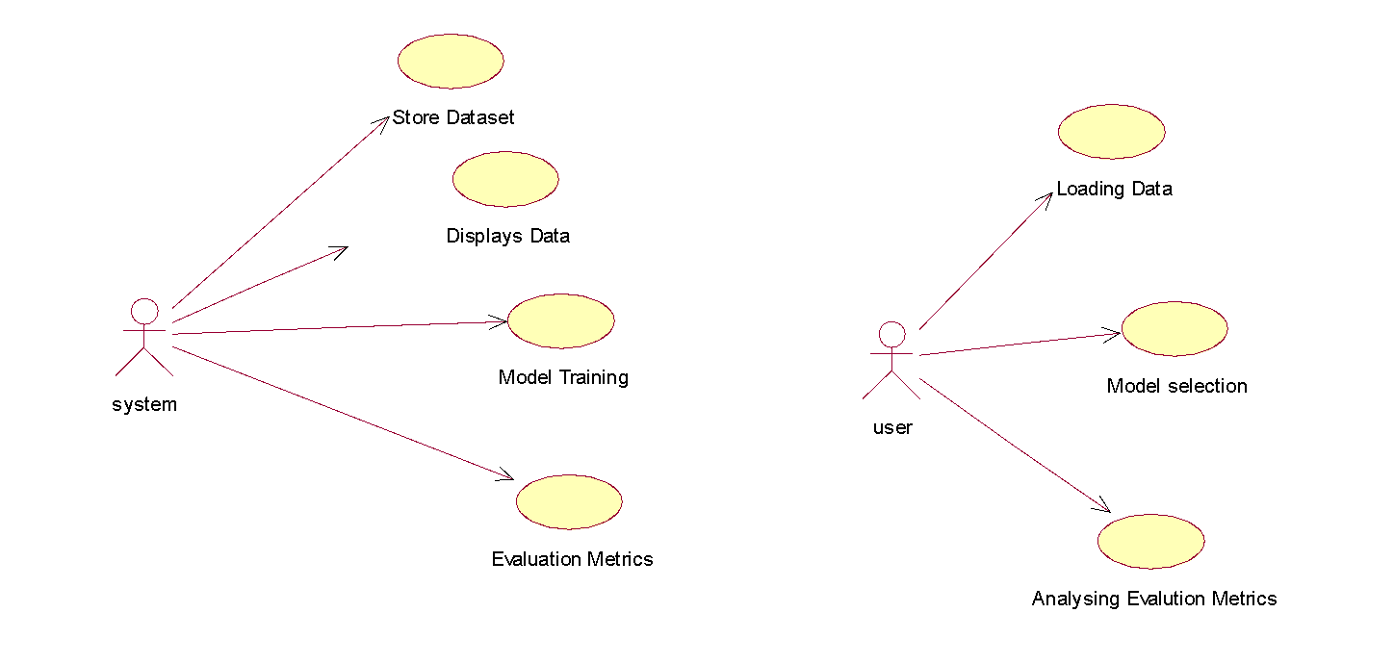

Slide 15
ER-Diagram
An Entity–relationship model (ER model) describes the structure of a database with the help of a diagram, which is known as Entity Relationship Diagram (ER Diagram).
An ER diagram shows the relationship among entity sets. An entity set is a group of similar entities and these entities can have attributes.
In terms of DBMS, an entity is a table or attribute of a table in database, so by showing relationship among tables and their attributes, ER diagram shows the complete logical structure of a database.

Slide 16
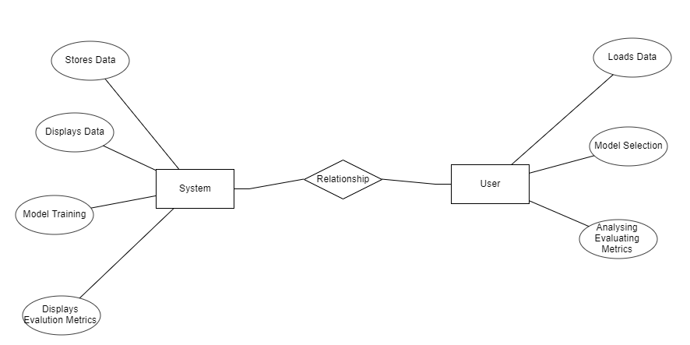

Slide 17
Feasibility Analysis
Economical Feasibility
The practicality of a task is surveyed at this stage and the strategic plan depends on the most well-known project plan and explicit quotes. During the examination of the arrangement a plausibility investigation of the proposed framework will be conducted. This is to affirm that the arranged framework isn't a weight to the corporate In request to investigate the possibility. Three key considerations are involved in possible analysis.
This audit was planned to study the financial impact of the program on the affiliation. The proportion of resource that an association can place assets into investigation and program improvement is limited. Expenses ought to have a clarification. In this manner the structure improved and inside spending plan and this was cultivated in light of the fact that by far most of the advancement used is open in vain. Just extraordinarily planned things should be purchased.

Slide 18
Technical Feasibility
Social Feasibility
This audit was coordinated to study the feasibility of the advancement, that is, the specific essentials of the system. Any refreshed system should not have an interest for open particular resources. This will incite more interest for open particular resources. This will incite more prominent degrees of prominence on the client. A further evolved system should have a limited need, as minor or minor changes are required in executing the program.
A component of the audit is to review the level of structure affirmation by the customer. This consolidates the course of setting up the customer to use the structure properly. The level of customer affirmation depends just upon the systems used to show the customer the structure and get that individual familiar with it. Her certainty ought to be raised so she can in like manner make supportive investigation, which is OK, as she is the individual who uses the last structure.

Slide 19
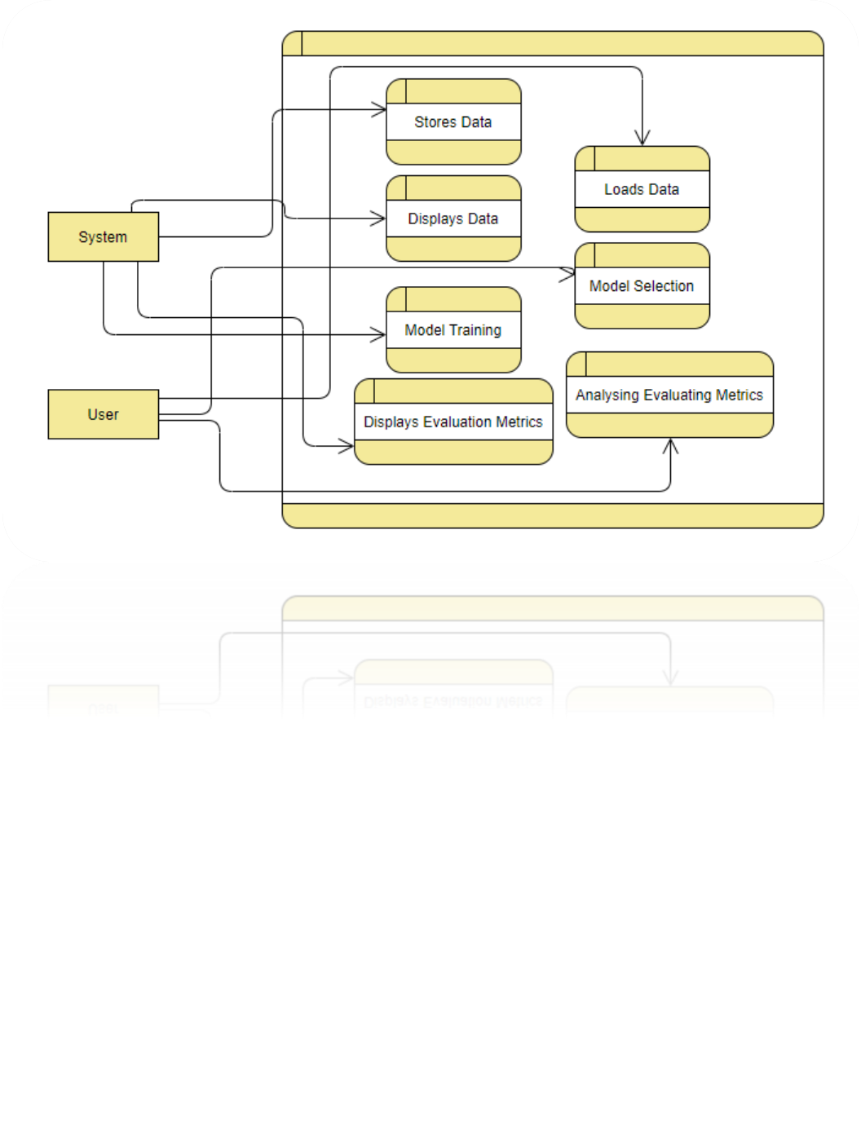
Data Flow Diagram

Slide 20
Methodology.
2. System
2.1 Take the dataset:
System works with the dataset provided to it for model building.
2.2 Data Preprocessing:
In this step system works with the dataset in order to remove stop words and performs stemming.
2.3 Dataset Splitting:
In this phase system splits the dataset into training and testing using Scikit-learn.
2.4 Model Training:
In this phase system trains the dataset using Scikit-learn’s powerful algorithms.
2.5 Testing
In this phase system tests with the testing dataset.
2.6 Generate Score:
In this phase system generates score for the certain used model.
2.7 Comparison:
In this phase, the models build are compared graphically

Slide 21
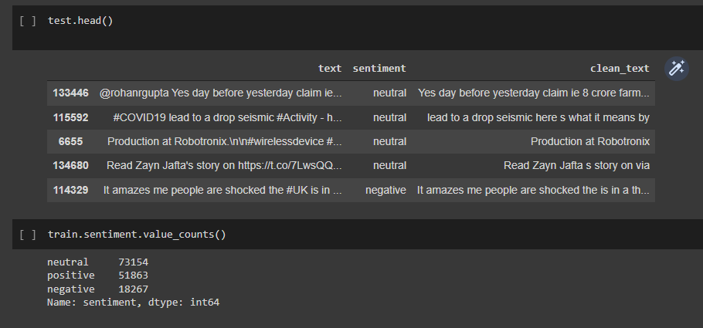
RESULTS

Slide 22
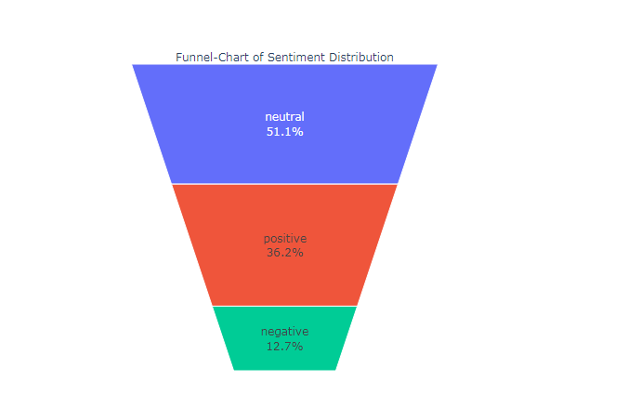
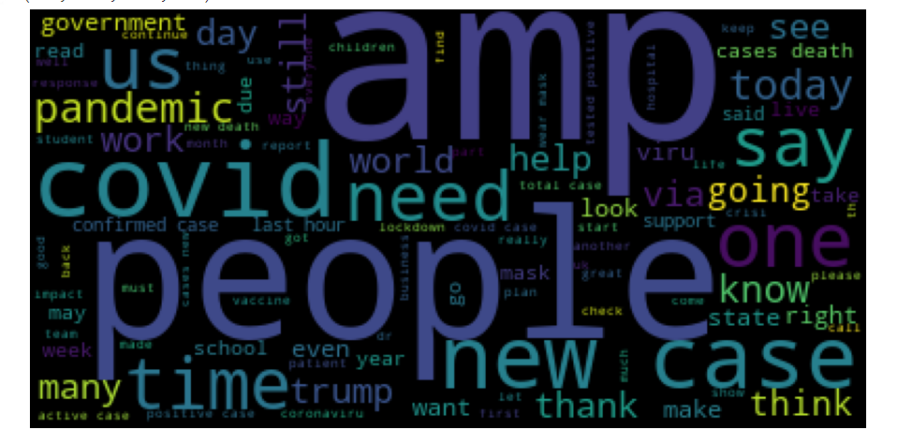
Funnel Graph
Word Cloud

Slide 23
CONCLUSION
The study provides the classification of tweets using a machine learning technique. Here we used Recurrent Neural Network’s architecture (RNN) algorithm. The proposed RNN architecture is based on neural networks and is trained and tested on the dataset collected.
In this project, we will explore sentiment analysis for COVID-19 during lockdown among Indians. We used RNN for modelling purposes generating adequate emotion prediction accuracy. The emotions are classified into 3 groups positive, neutral and negative with an accuracy of around 90%. In future, we may consider a new data for lockdown 2.0 as well and remodel it. It could act as a comparison between sentiments of lockdown 1.0 vs 2.0.

Slide 24
FUTURE SCOPE
The ability to identify numerous classifications could be added to this in the future.
We intend to investigate detection approach with the revised data set and employ the most accurate and relevant machine learning algorithms for detection.

Slide 25
REFERENCES
[1] J. T. Wu, K. Leung, and G. M. Leung, “Nowcasting and forecasting the potential domestic and international spread of the 2019-nCoV outbreak originating in Wuhan, China: A modeling study,” Obstetrical Gynecolo. Surv., vol. 75, no. 7, pp. 399–400, Jul. 2020.
[2] ] R. J. Medford, S. N. Saleh, A. Sumarsono, T. M. Perl, and C. U. Lehmann, “An ‘infodemic’: Leveraging high-volume Twitter data to understand public sentiment for the COVID-19 outbreak,” medRxiv, Jan. 2020, doi: 10.1101/2020.04.03.20052936.
[3] S. Li, Y. Wang, J. Xue, N. Zhao, and T. Zhu, “The impact of COVID-19 epidemic declaration on psychological consequences: A study on active Weibo users,” Int. J. Environ. Res. Public Health, vol. 17, no. 6, p. 2032, Mar. 2020.
[4] WHO Statement Regarding Cluster of Pneumonia Cases, WHO, Wuhan, China, 2020.
[5] Biao Tang, Nicola Luigi Bragazzi, Qian Li, Sanyi Tang, Yanni Xiao, Jianhong Wu,”An updated estimation of the risk of transmission of the novel coronavirus (2019-nCov)”,Infectious Disease Modelling, 2020.
[6] Prasoon Gupta, Sanjay Kumar, R. R. Suman, Vinay Kumar“Sentiment Analysis of Lockdown in India During COVID-19: A Case Study on Twitter”, IEEE Transactions on Computational Social Systems, 2021,

Slide 26
Thank You

