Slide 1
Billing System
Presented by Group6
Rohit Gehlot (33) SEIT-1,
Ayush Yelne (63)SEIT-2,
Pranav Satam (38)SEIT-2,
Date of presentation: 23/05/2021
Under the guidance of: Prof. Pankaj Kunekar
Atharva College of Engineering
Department of Information Technology

Slide 2
Content
1. Introduction
1.1 Introduction
1.2 Motivation
1.3 Problem Statement
1.4 Objectives
2. Literature Survey
2.1 Survey of Existing system
2.2 Mini Project contribution
3. Proposed System
3.1 Algorithm and Process Design
3.2 Software Requirement Specification
3.3 Output Screenshots
4. Conclusion
5. Future work
References
ACE- IT department Corona Tracking App

Slide 3


1. Introduction
1.1 Introduction
The ‘Billing System’ is a Desktop-based application which is used to generate bills of orders received in super market.
This application keeps tracks of all bills generated till date in database.
It contains login system for employees
for making bills.
It has a feature of accessing any bill with
its bill no. from database.
ACE- IT department Billing System

Slide 4


1. Introduction
1.2 Motivation
Earlier, people use to make bills on papers and there was chance of human error and also waste of paper and that increases work load.
Now using this application we can help them to get their work done fast with less errors.
Many people print 2copies of bill,1 for customer and 1 for their shop record. Now with this app it stores all the bills record in database.
So, we got the motivation to create such app that can help people and save the natural resources.
ACE- IT department Billing System

Slide 5
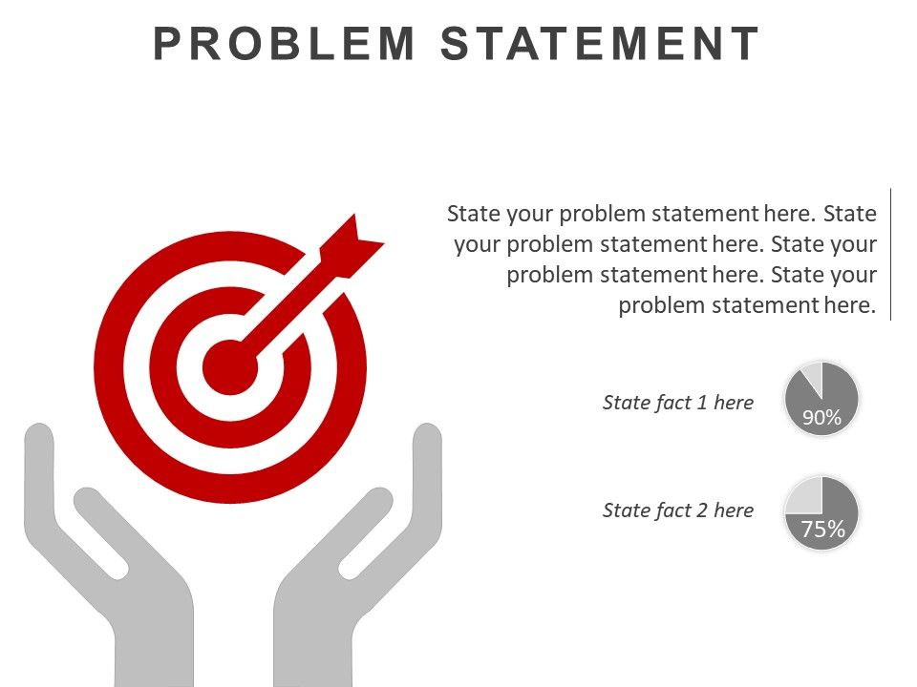
1. Introduction
1.3 Problem Statement
Nowadays, billing process is done either manually or using barcode readers which are highly time consuming. Moreover, barcodes are susceptible to damage and failure rate in barcodes are relatively high.
In order to overcome these disadvantages, the billing process has to be automated.
An automated and intuitive billing solution makes things easier in such a situation.
Current system requires a lot of manual paper work i.e. printing bill, keeping them safe in file with each record and also there is always a chance of human error in calculations and bills getting lost.
So there is need of application that can overcome all these problems and help people reduce work
ACE- IT department Billing System

Slide 6
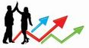

1. Introduction
1.4 Objectives
The main objective of Billing system is to manage details of bills, reduce human error.
Provide a database that can store all information.
Develop a system that will lessen process delay in terms of releasing receipts and customer bill.
ACE- IT department Billing System

Slide 7

2. Literature Survey
2.1 Survey of Existing system
In local grocery shop, there are very less who use the billing system. They make bills on paper and there is chance of error in calculation and also this process takes a lot of time.
It also cause a rush at grocery store which is dangerous in ongoing pandemic.
Instead they can make use of such application that can make bills, store them in database and also errorless and also it saves time.
ACE- IT department Billing System

Slide 8
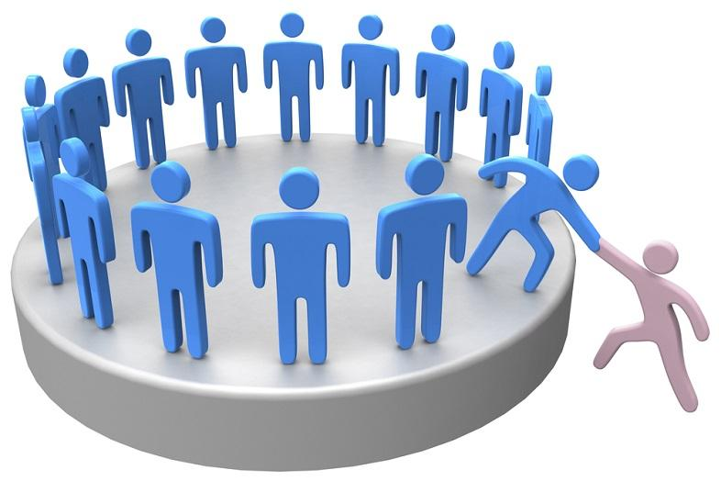

2. Literature Survey
2.2 Mini Project contribution
Billing systems help in automating the time-consuming process like invoice generation, products tracking, other accounting documentation etc.
Moreover such software automatically calculate and apply tax on the taxable products so that you need not worry about the tax at every time of billing.
ACE- IT department Billing System

Slide 9
3. Proposed System
3.1 Algorithm and Process Design
First is admin registration, then login window.
Login details are stored in database.
After successful login, Billing window appears.
Enter details of customers and then select products.
Then click on generate bill and it will also save the bill amount with customer name in database.
ACE- IT department Billing System

Slide 10
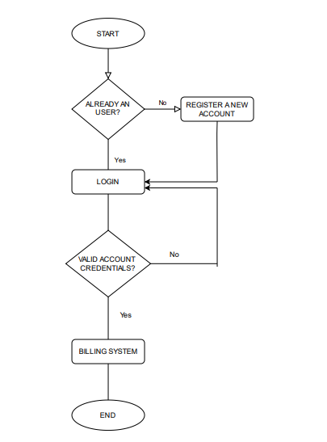
Flowchart
ACE- IT department Billing system

Slide 11
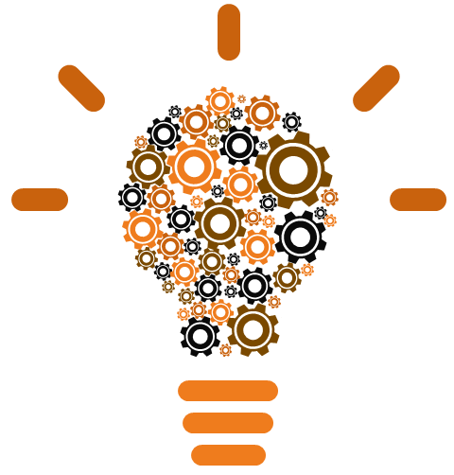
3. Proposed System
3.2 Software Requirement Specification
Visual studio code
Python Version 3.9
Tkinter
Phpmyadmin
Other GUI Software
ACE- IT department Billing System

Slide 12
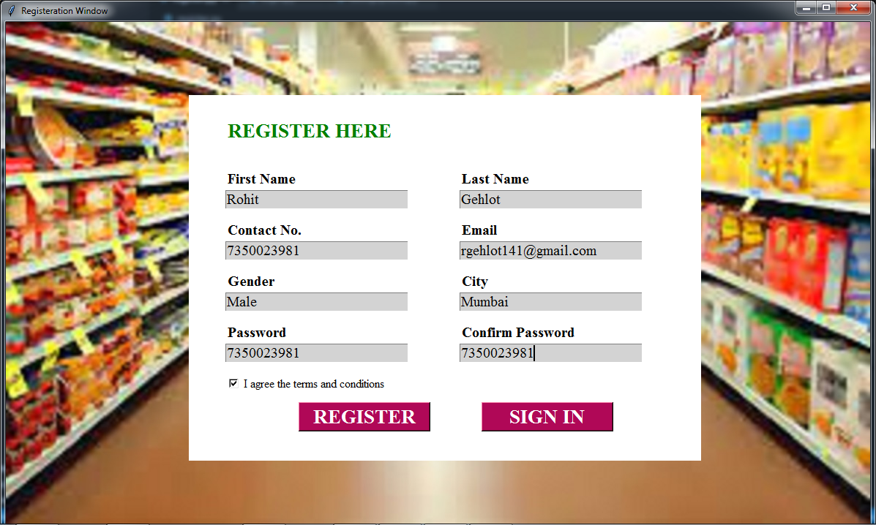
3.3 Output Screenshots
ACE- IT department Billing System

Slide 13
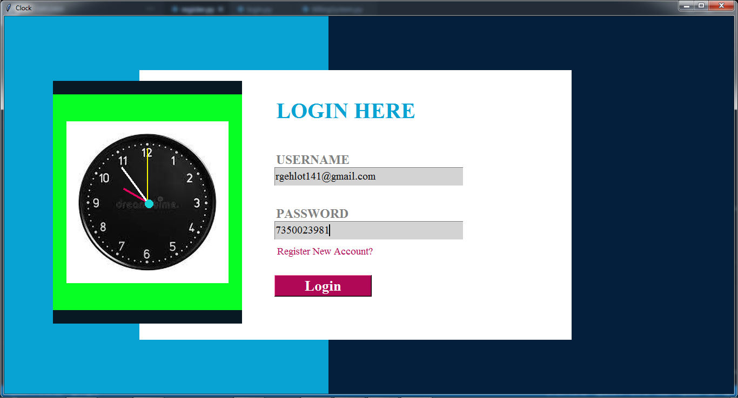
Output:
ACE- IT department Billing System

Slide 14
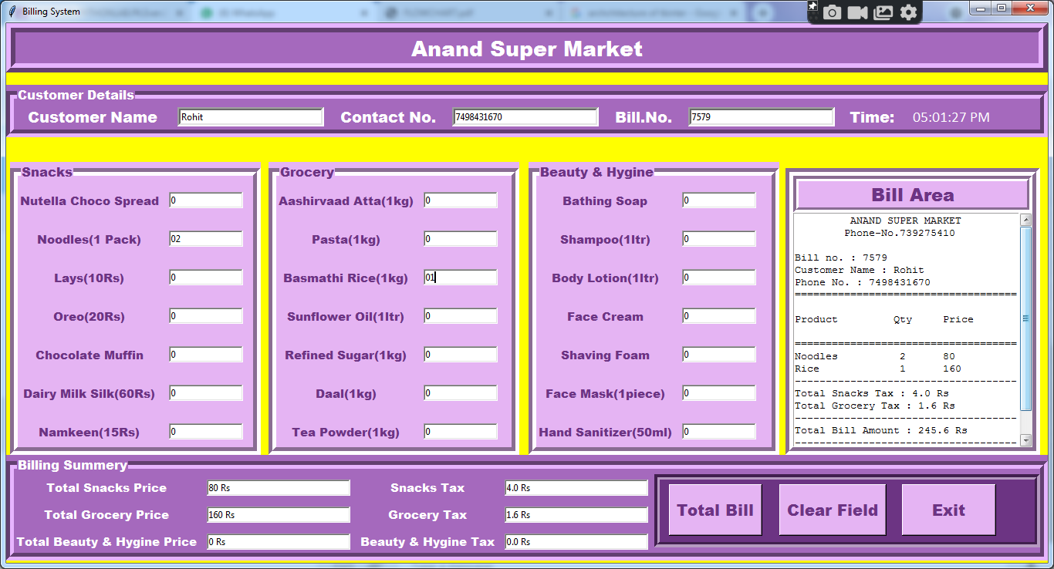
Output:
ACE- IT department Billing System

Slide 15
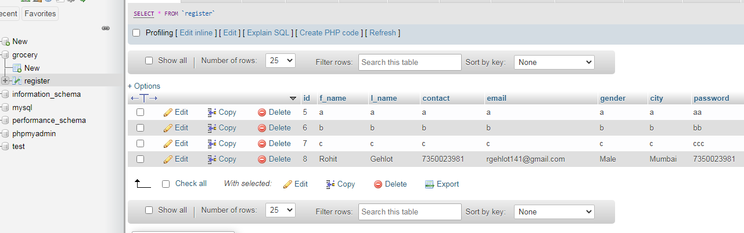
Database Output:
ACE- IT department Corona Tracking App

Slide 16

4. Conclusion
Thus, we created a Billing System that create bills and store them in database for later use.
We created this application using python and php database.
Thus it can be concluded that efficient system is must and we attempted to create such efficient system and serve the community.
ACE- IT department Billing System

Slide 17

5. Future Work
In future, we would be adding online payment options such as upi, credit card, debit card, net banking.
More products will be added in groceries section.
Discount on online payment will be given as an option.
Total amount bill will be sent to mobile no. given by customer.
We will try to make a friendly, easy to use application.
ACE- IT department Billing System

Slide 18
References
https://www.geeksforgeeks.org/python-tkinter-tutorial/
https://www.tutorialspoint.com/python/python_gui_programming.htm
https://realpython.com/python-gui-tkinter/
ACE- IT department Billing System

Slide 19
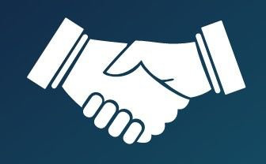
Thank You !!!
ACE- IT department Billing System

