Slide 1
ONLIne Grocery : Dryfruits store
▶ Reported by : -
Name : Kunwar Amar Pratap Singh
Reg. No. : - 12100341
Roll No. : - RK21AN12
Section : K21AN – G1
Name | Regi no. | Roll no | Section
Kunwar Amar Pratap Singh | 12100341 | RK21AN12 | K21AN-G1
MUKUL | 12113606 | RK21ANB44

Slide 2
Description of work :
▶ This project is made possible by myself only. I have tried best of my knowledge to accomplish this task.
I decided to make grocery website which will be helpful to small shopkeepers to share their products online.
I have done this project in visual studio code. I have used external css and java script file.
C:\web develop\food website\index.html

Slide 3
Main page
It is a main page of the website
From here anyone can see about our website.
Divided this website into 3 parts :
Header (Navbar containing left,mid and right part)
Middle (Containing images and content)
Footer (Running Discount offers using Marquee effect)

Slide 4
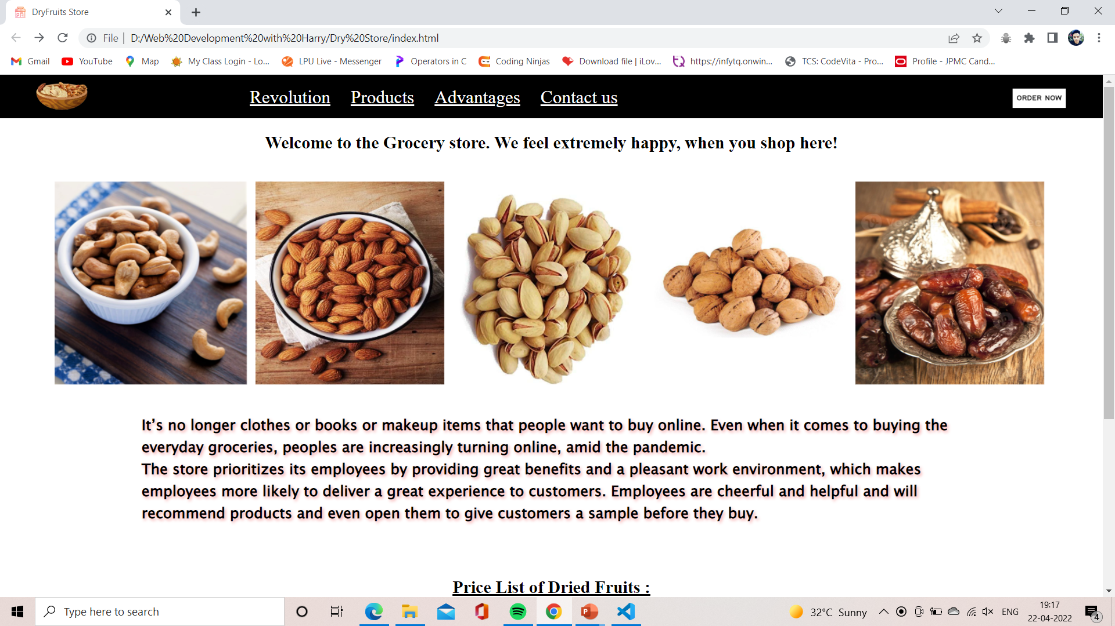
.
▶Tag used: <li>,<img>,<navbar>,<h1>, <h3>, <p>,<marquee>, <a>,<link>
Also used hover property, when you move your cursor on those words, color changes . This is made by using Css property: hover, transition, position, margin, padding, text align, background image etc.

Slide 5
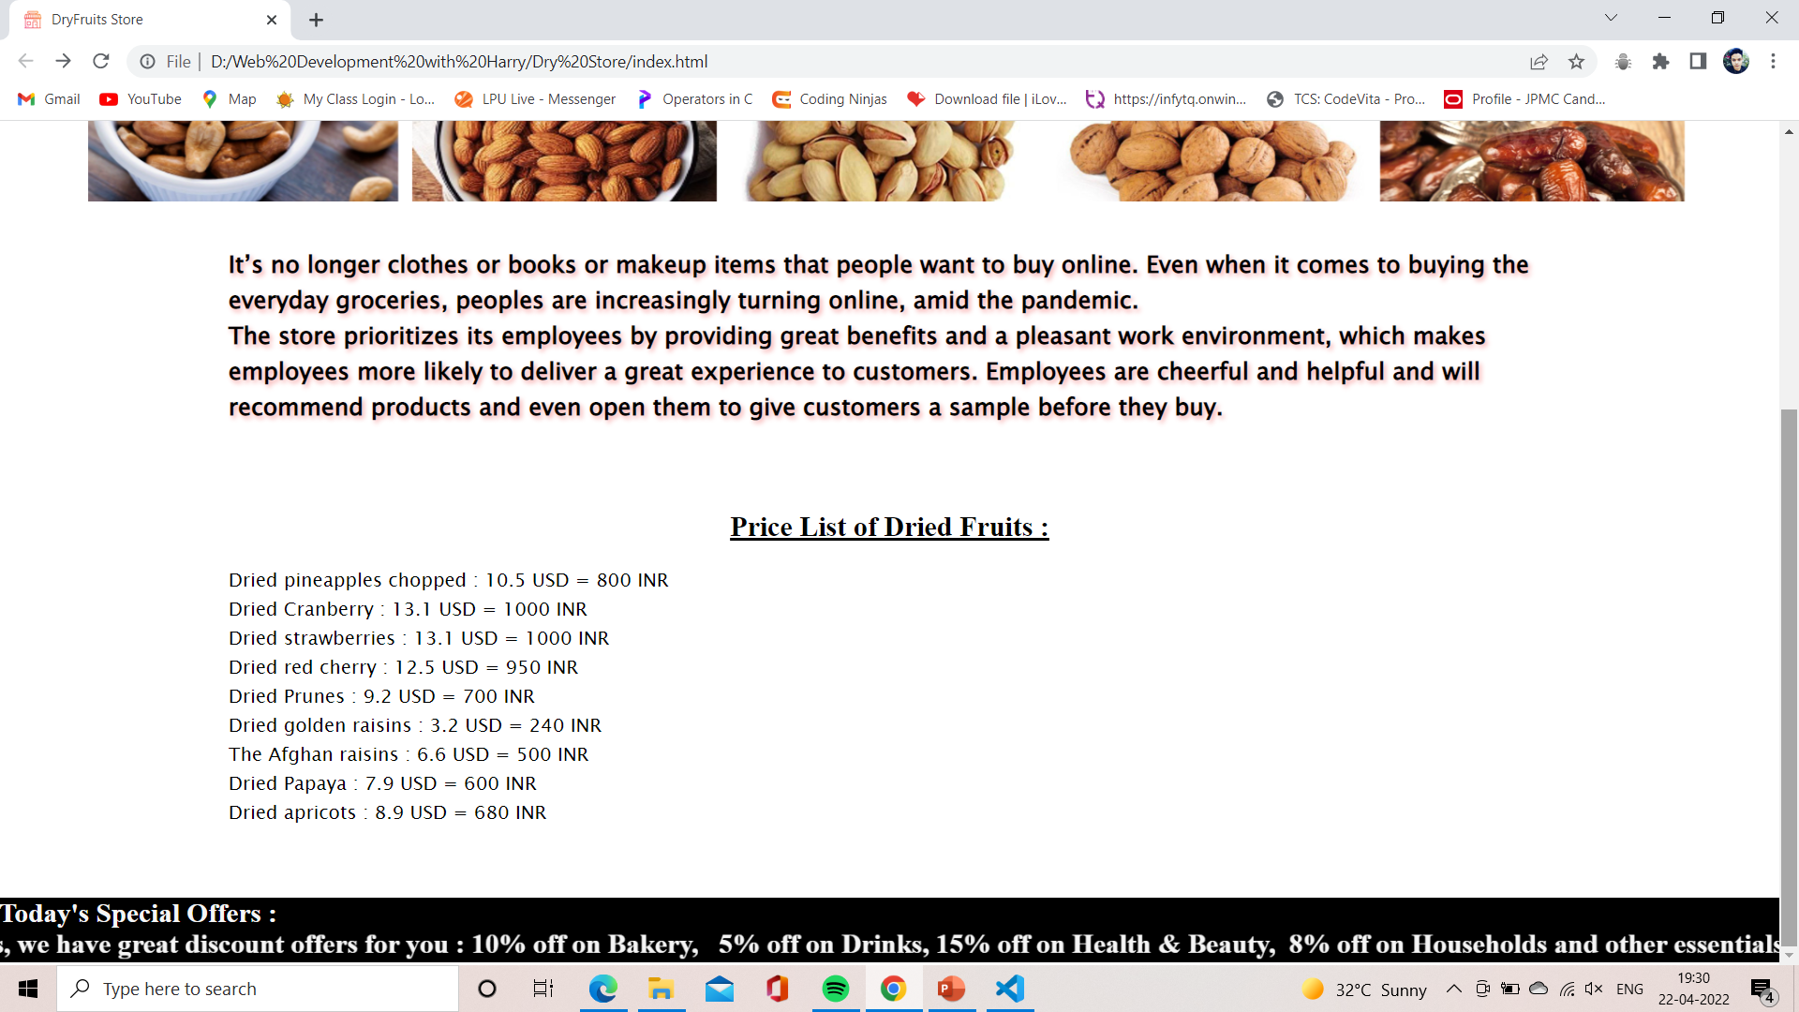
B O T T o m P a g e
▶Tag used: <section>, <div>, <h2>, <h3>, <img>, <a>, <i>, <m a r q u e e>
Here, we worked more on button and it’s hover with the help of css property
: hover, position,font-family, margin-right, margin-left, color, transition, font size, display,
text-decoration etc.

Slide 6
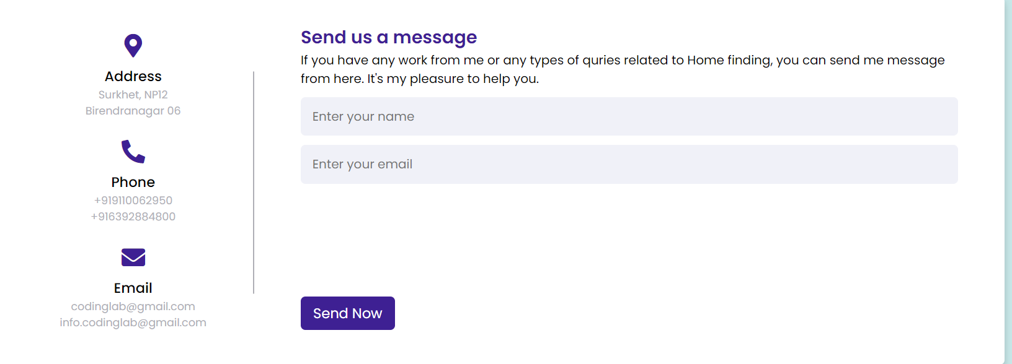
Contact US :
▶Tag used: <section>, <div>, <h1>, <img>, <input-box>, <text
area>, <form action="#">.
CSS PROPERTY: display, flex, padding, margin, border, background, text transform, text align, height, width, font size etc.

Slide 7
▶THANK YOU……
That’s all the information about our website…

