Slide 1

Porto Seguro Safe Driver Prediction
Springboard Capstone Project
By- Ayush Mittal Mentor- Srdjan Santic
Colorado State University Springboard Mentor

Slide 2
Problem-
Inaccuracies in car insurance company’s claim predictions raise the cost of insurance for good drivers and reduce the price for bad ones. It would be great to create a model which can classify between the two drivers group and adjust the insurance price accordingly. Hence, lowering the price for good drivers.
Let’s find the answer.

Slide 3
Clients
The Clients are auto insurance company which can use the prediction models to classify among the good and bad drivers. The first client will be Porto Seguro, Brazil’s largest auto insurance company and the donor of this data set.

Slide 4
About the Data
The data is provided by the Porto Seguro. The data is highly anonymized and no information is provided about the features. The data is divided into the Train and test. The train data has a target column which has 0 for no claim and 1 for claim. Hence, it is a binary classification problem.
The total number of features are 57.
Total categorical features are 14.
Total binary features are 17.
Total continuous features are 26.
Source- https://www.kaggle.com/c/porto-seguro-safe-driver-prediction

Slide 5
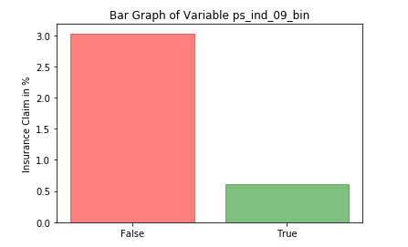
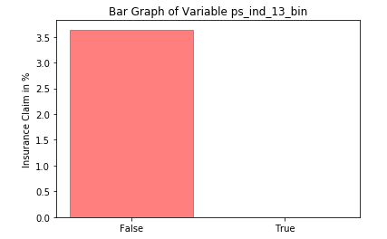
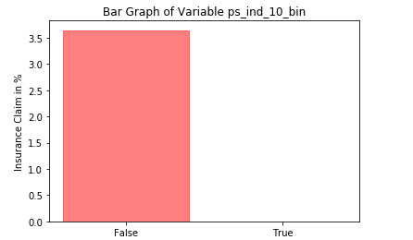
Binary Variable Analysis
'ps_ind_08_bin' variable plays a crucial role on the target variable, 0ut of 3.5 %, 2.9% did not files a claim when 'ps_ind_08_bin' is false and 0.6% filed claim when it is true. Hence a good variable to learn.
Same for the variables, 'ps_ind_10_bin', 'ps_ind_11_bin', 'ps_ind_12_bin', 'ps_ind_13_bin'. Aslo, 'ps_calc_15_bin' and 'ps_ind_20_bin' have a strong association with the target variable.
String association means that how the target variable switches between 0 and 1 with respect to the binary input.

Slide 6
Categorical Variable Analysis
The categorical variable is independent; it means that the variables are something like car categories and are independent to each other and target as well.
The categorical variables are dependent and correlated with the target. It means that the variable presents something like the citations/tickets from the cops.

Slide 7
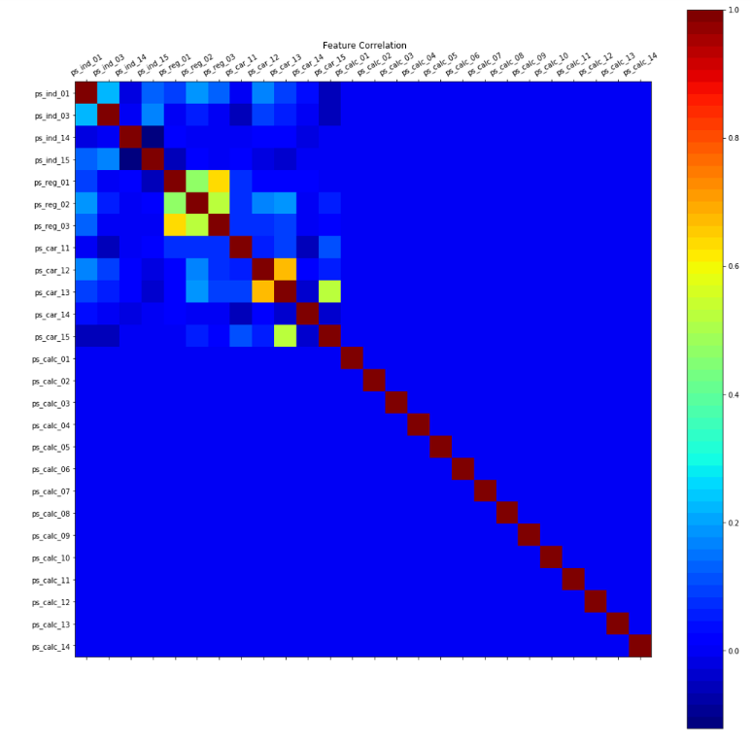
Pearson Correlation
'ps_car_15' with 'ps_car_13', a strong positive correlation is found.
'ps_car_13' with 'ps_car_12', a strong positive correlation is found.
3) 'ps_reg_03' with 'ps_reg_01' and 'ps_reg_02', a strong positive correlation is found.

Slide 8
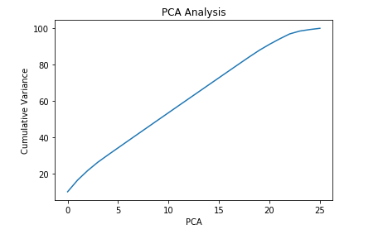
PCA
We found that with 24 PC are good enough to capture all the variance in the data. Below is a graph showing the PCA variance.
But if we choose 24, we are still not able to reduce the dimensionality of data at large. So we plan to stick with the 5 PC only.

Slide 9
Continuous Variables
We calculated the mean, standard deviation and the distribution curves of variables from both the groups.
Our analysis indicates that there is no significant difference between the continuous variables in these two groups.
It will be difficult for the ML models to learn about them because there is no variance among these variables in these two different subsets of data.

Slide 10
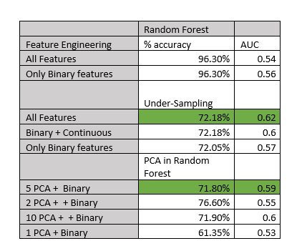
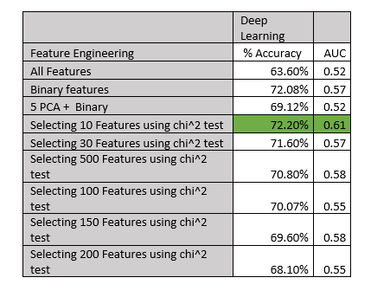
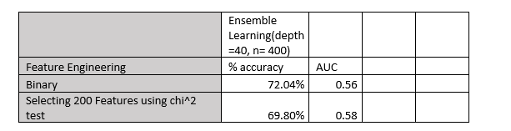
Machine Learning

Slide 11
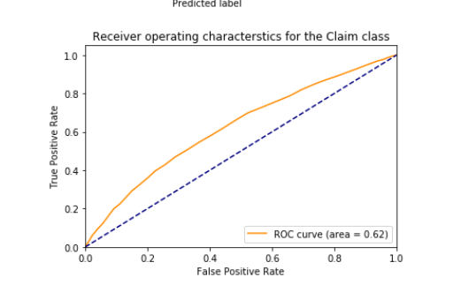
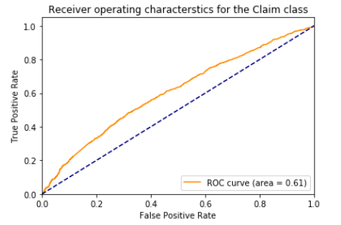
AUC Curves
AUC for Random Forest AUC for Deep Learning

Slide 12
Conclusion
Dataset is a mixture of the categorical, binary and the continuous variables.
The target class (binary) is highly imbalanced, with only 3% of samples belonging to the 'CLAIM' class.
The binary variable analysis is conducted to see how strongly each variable is associated with the target variable. We found that the binary variables are the most important in predictions. For example, these binary variables might be questions like ‘Have you ever met with an accident before.'
PCA is done and concluded that 24 PC represents the 100 % of the variance, but for the sake of simplicity, we will keep PC to be four only. Hence, reducing the dimensionality.
Finally, we concluded that there is no variance in the continuous variable of the different group of people who claimed and who do not claim the insurance.
In feature selection process the univariate feature selection process is implemented and used. It helped in reducing the feature set to 10,20, 50 and 100.
The best performing model for this problem set is Deep Learning and Random Forest.
Deep Learning models are prone to overfitting most of the time, even with the higher number of epochs, the accuracy did not improve.
At last, to solve the problem in great detail, PS should at least reveal the feature name, and what they mean it will be a great help in understanding and solving problem.

Slide 13
Thank You

