Slide 1

Analyzing the factors behind the alcohol consumption and relation with the final grades
Springboard Capstone Project
By- Ayush Mittal Mentor- Srdjan Santic
Colorado State University Springboard Mentor

Slide 2
Problem-
Students who consume a lot of alcohol are known to have bad grades. Also, the reason for alcohol consumption by students is unknown in many cases. Is it just an addiction? Or there are some other factors which control the alcohol consumption.
Let’s find the answer.

Slide 3
Clients
The Client can be schools, US Department of Education, Child Welfare Society or any government and public organizations which play a vital role in the education of teenagers.

Slide 4
About the Data
Large number of feature sets. The most important are-
a) Mather and Father Education
b) Family Relationship
c) Alcohol Consumption (daily and weekly)
d) Study Time, Number of Failures
e) Many other features telling about the background of student
like extra education support, travel time, romantic life and etc.
Two different data sets one for Mathematics class other for Portuguese
Source- https://www.kaggle.com/uciml/student-alcohol-consumption

Slide 5
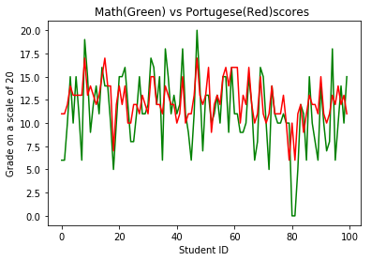
Relationship between scores
No outliers for final grades in Maths and Portuguese data sets.
No Null values in data set
382 common students in both Portuguese and Maths Class.

Slide 6
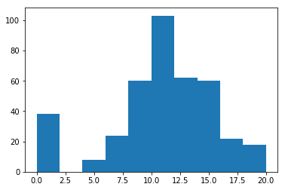
Distribution Of Scores
Maths score distribution Portuguese Distribution
The students of GP school perform better than MS school. GP has a average score in Maths 10.48 and Portuguese 12.5, whereas average for MS is 9.8 and 10.6
Ratio of Male to female is 0.89 (Maths) and 0.69 (Portuguese)
Boys perform better by a point 1 in Maths as compared to girls and vice versa in Portuguese.

Slide 7
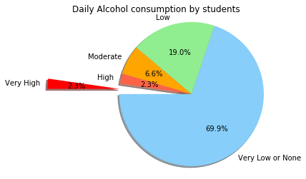
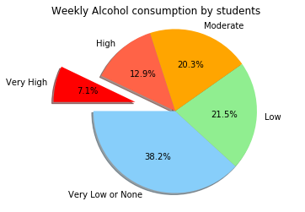
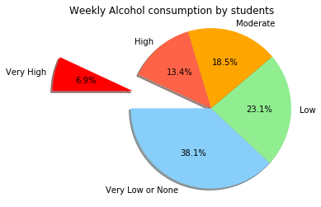

Alcohol Consumption
Mathematics
Portuguese
Shockingly, 24 % of students drink Alcohol illegally, reason, poor family relationship and go out time with friends.

Slide 8
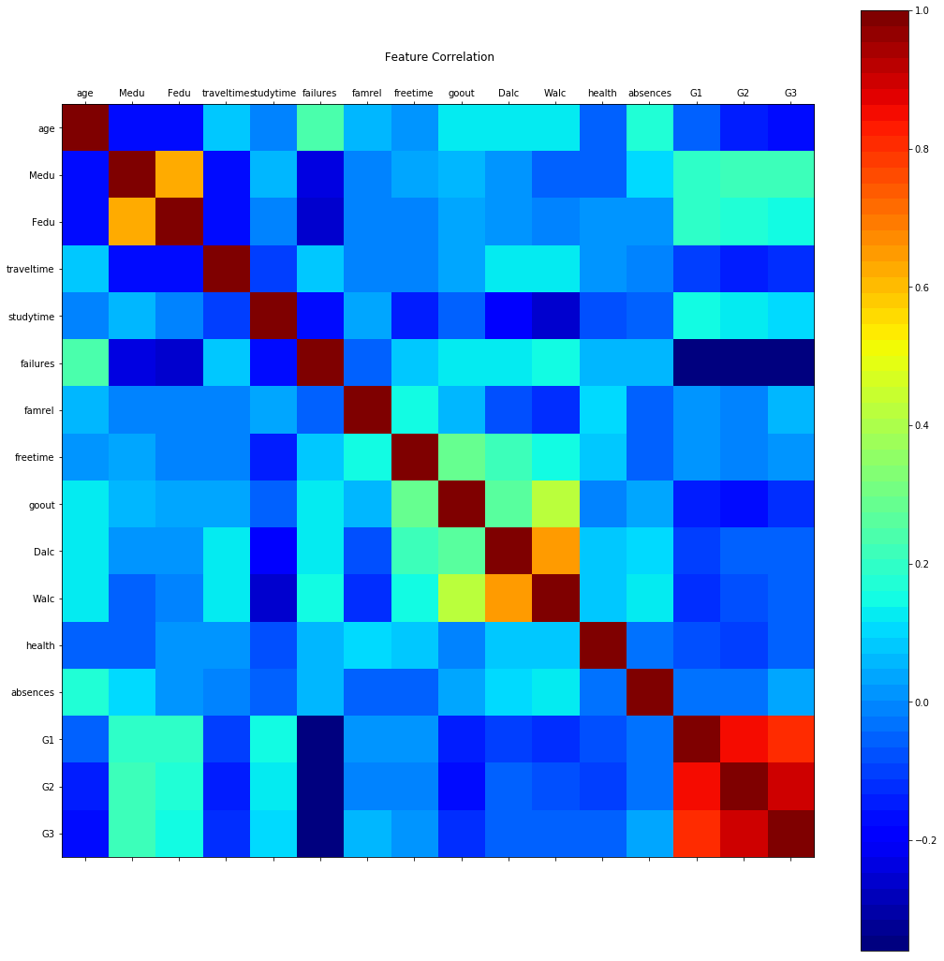
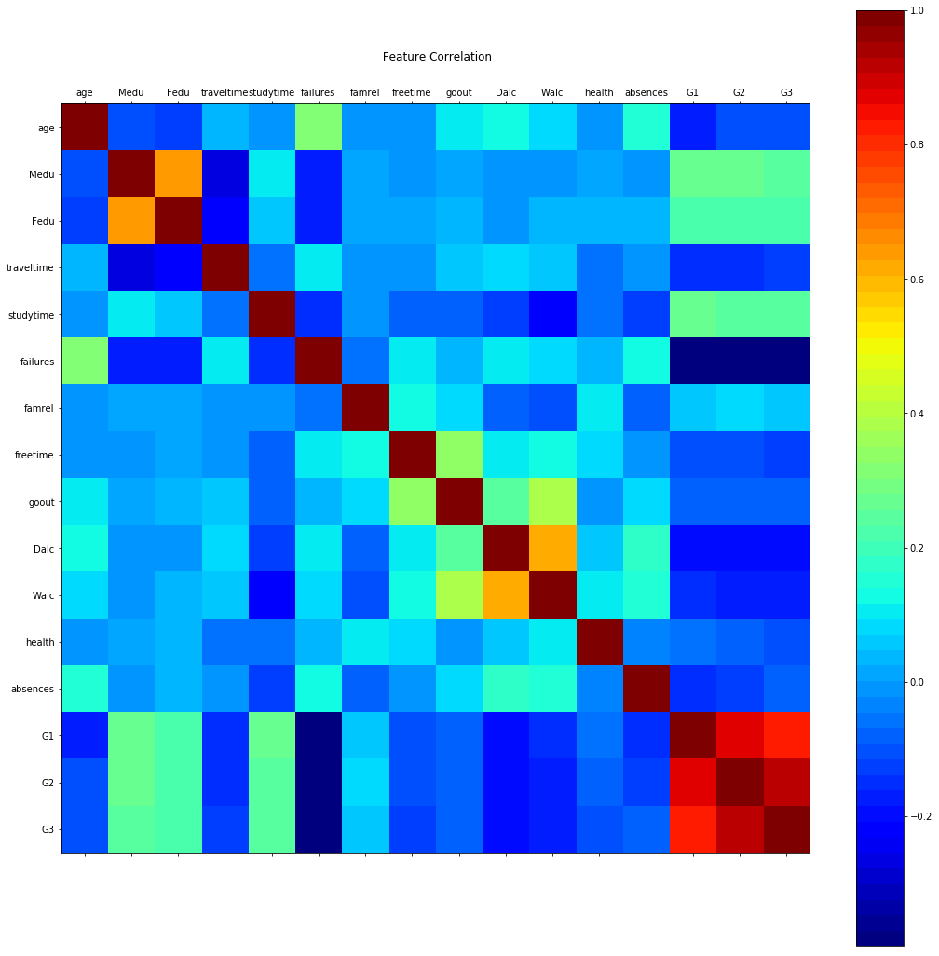
Correlation
Maths Portuguese

Slide 9
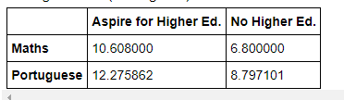
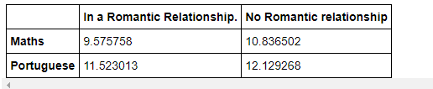
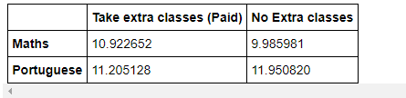
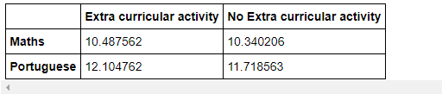
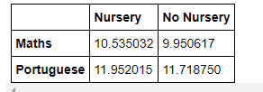
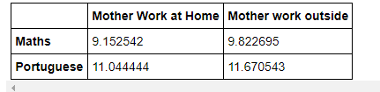
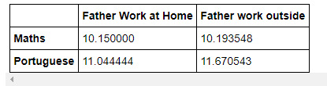
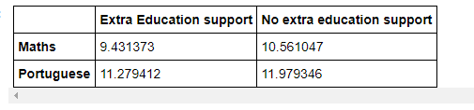
Impact of features on the final Grades

Slide 10
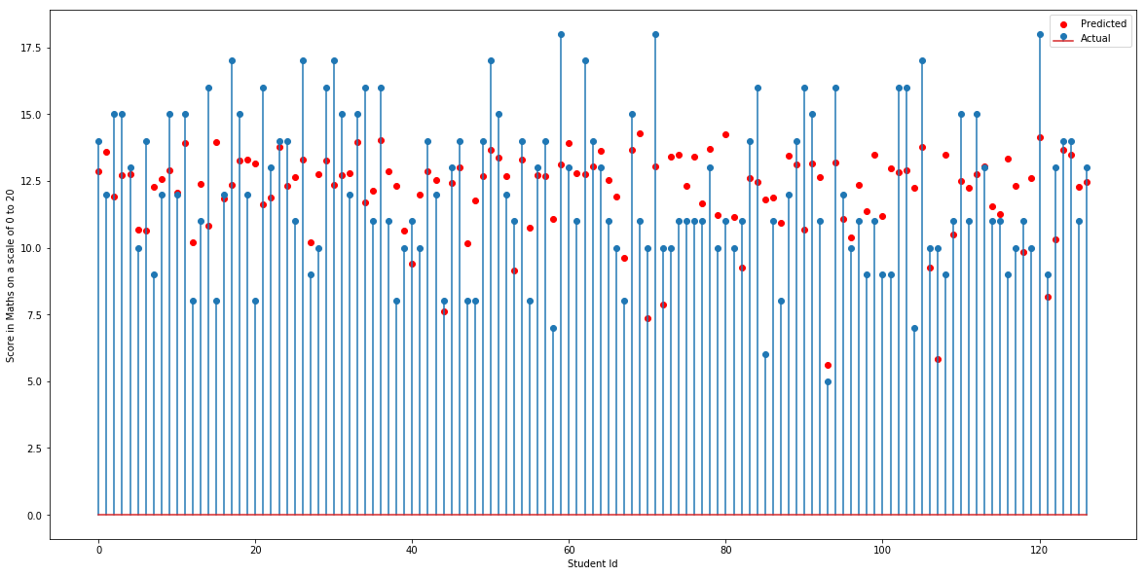
Machine Learning
 | Linear Regression (Maths) |  | Portuguese
 | ABS | MSE | ABS | MSE
With all Features | 3.39 | 4.19 | 2.15 | 2.86
With all Features, but removing students with zero score in finals | 2.32 | 2.77 | 2.02 | 2.52
Taking limited features into consideration | 2.4 | 2.7 | 2.09 | 2.55
 | Support Vector Regression (Maths) |  |  | Portuguese
 | ABS | MSE |  | ABS | MSE
With all features RBF | 3.33 | 4.16
With all features Linear | 3.39 | 4.23
With all features Poly | 4.99 | 7.12
With Optimum C and Gamma for RBF C = 16 and gamma = 0.1 | 3.19 | 3.85
With Limited features and Optimum Values
RBF | 2.29 | 2.82 |  | 2.1 | 2.55
Linear | 2.23 | 2.76 |  | 2.11 | 2.55
Poly | 3.22 | 4.18 |  | 2.2 | 2.99

Slide 11
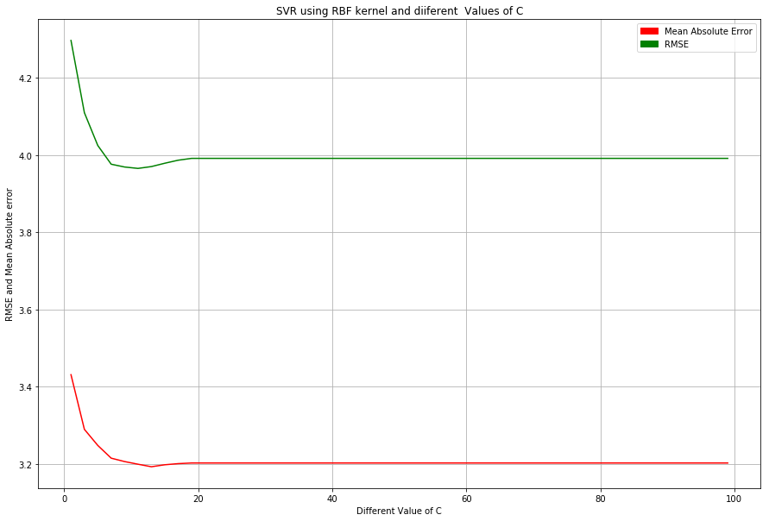
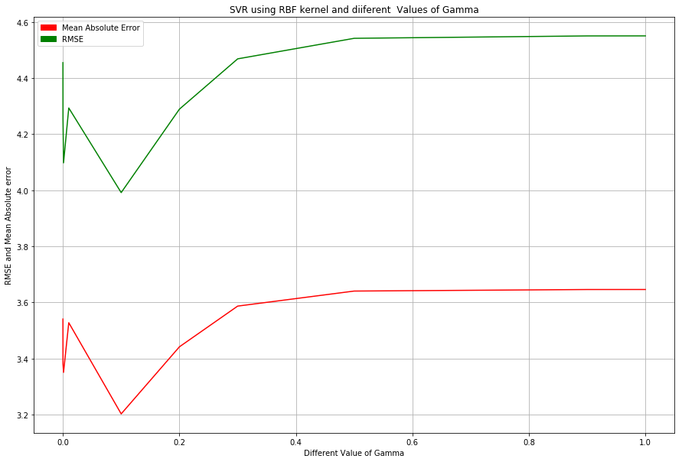
Optimum C and Gamma

Slide 12
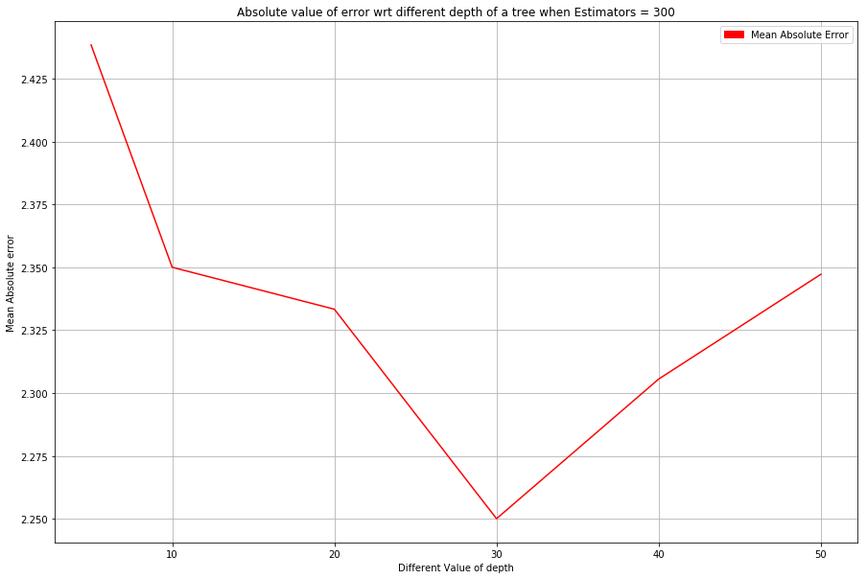
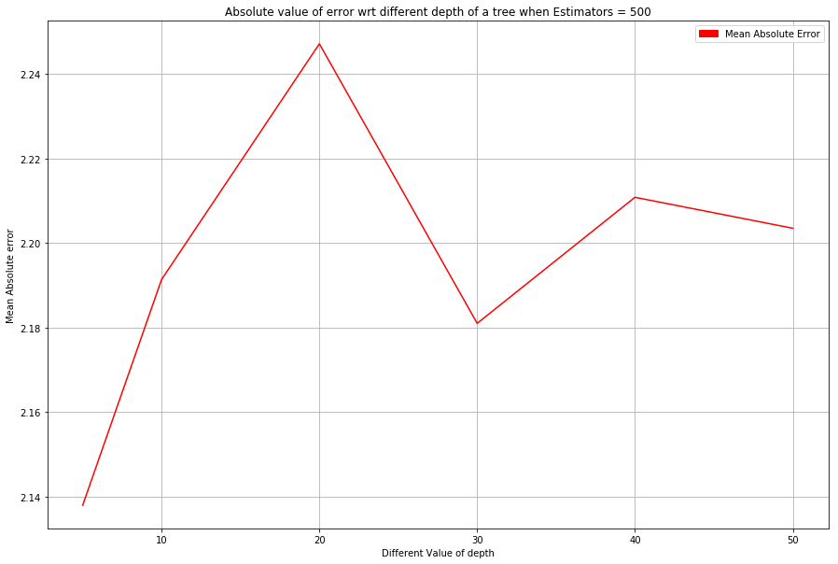
Ensemble Learning
 | Ensemble Learning (Maths)
 | ABS
n =100, d =20 | 2.35
n =200, d =50 | 2.28
n =300, d =30 | 2.25
n =400, d =40 | 2.28
n =500, d =30 | 2.28
n =600, d = 20 | 2.26
 | Ensemble Learning (Portuguese)
 | ABS
n =100, d =5 | 2.165
n =200, d =20 | 2.18
n =300, d =50 | 2.16
n =400, d =40 | 2.17
n =500, d = 5 | 2.14
n =600. d = 50 | 2.18

Slide 13
Features of most Importance
Mother and Father education
Number of Failures in past
Hanging out time with friends
Alcohol consumption
Study time
family relationship strength
These contribute most in final grades of students.

Slide 14
Conclusion
Mother and Father education contributes positive to final grades
Alcohol Consumption is directly related to the strength of a Family relationship.
Also, drinking more alcohol can bring down your grades. However, there are a few exceptions, who believes in "Work Hard and Party hard".
Higher study time results in better grades.
Number of failures are negatively correlated with the student final grade.
In last, it is found in this study that 24 % of student's drink Alcohol illegally, Government shall issue a mandate to the Liquor shops, asking them to strictly verify the Id's of customers who are coming in store to buy Alcohol.

Slide 15
Thank You

