Slide 1


Research Planning & System Design
Chapter 2

Slide 2
Why Research Planning Matters
Without Planning
Projects fail or delay
Budget waste
Poor system quality
With Planning
Clear direction
Efficient resource use
Higher success probability
Planning aligns stakeholders (supervisors, team members, clients) so everyone agrees on what will be delivered and when.

Slide 3
From Idea to Technical Execution
Research Flow Problem → Objectives → Technical Tasks → Implementation → Evaluation
The problem defines what is wrong or missing; the objectives specify what success looks like in clear, measurable terms.
Technical tasks translate these objectives into concrete actions (e.g., “design database schema”, “train model”, “deploy API”) that can be scheduled and assigned.

Slide 4
Translating Objectives into Technical Tasks
Objective: Develop Online Appointment System
Technical Tasks:
Database design
UI design
API development
Testing
Deployment
Each task can be further detailed, for example “Database design → identify entities, define tables and relationships, choose DBMS, create ERD, implement schema.”

Slide 5
Practical Example (Student Project)
If objective = Build Smart Campus Navigation System
Tasks may include:
Requirement gathering
Map data collection
Backend API development
Mobile/Web interface
Testing with students
Requirement gathering may include interviews, questionnaires, and observation to understand how students currently navigate the campus and what problems they face.

Slide 6

Introduction to System Architecture

Slide 7
System Architecture
System Architecture = How system components are structured and interact.
Includes:
Frontend
Backend
Database
External Services
A clear architecture diagram helps you and others visualize data flow from user actions in the frontend to processing in the backend and storage in the database.
Architecture decisions affect scalability, performance, security, and maintainability of your research system.

Slide 8
Types of System Architecture
Monolithic Architecture
Client–Server Architecture
Microservices Architecture
Cloud-based Architecture
Monolithic systems keep all features in one codebase and are simpler to build initially but harder to scale and maintain for large projects.​
Microservices and cloud-based architectures split functionality into smaller services and often run on platforms like AWS or Azure, improving scalability but increasing complexity and deployment effort.

Slide 9
Conceptual Framework Design
Conceptual Framework shows:
Inputs
Processes
Outputs
Relationships between components
Used in both:
Software systems
Academic research
In academic writing, the conceptual framework visually explains how variables or components in your study are expected to influence each other.
For system projects, it provides a high-level picture that connects user needs, system processes, and expected outcomes (e.g., reports, alerts, recommendations).

Slide 10
Selecting Tools and Technologies

Slide 11
Tools and Technologies
Students must consider:
Project requirements
Available skills
Cost
Performance
Community support
Also consider integration needs (how well tools connect with each other) and deployment environment (local, on-premise server, or cloud).

Slide 12
Example Tool Selection
Frontend: React / Next.js Backend: Django / Node.js Database: PostgreSQL / MongoDB Cloud: AWS / Azure / Local Server
React and Next.js support modular UI components and are widely used for modern single-page or server-rendered applications.
Django and Node.js provide robust ecosystems for REST APIs, authentication, and database integration, while PostgreSQL and MongoDB cover relational and NoSQL data models respectively.

Slide 13
Risk Analysis Basics
Risk = Anything that may affect project success
Types:
Technical Risk
Financial Risk
Time Risk
Resource Risk
Technical risks include choosing immature technologies, integration issues, or performance problems under load.
Time and resource risks often come from underestimating effort, overloading team members, or relying on a single key person for critical tasks.

Slide 14
Risk Mitigation Strategies
Technical Risk → Use proven technology
Time Risk → Add buffer time
Resource Risk → Backup team members
Data Risk → Regular backups
You should document each key risk with its probability, impact, and mitigation action in a simple risk register or table.
Risk management is continuous: review risks regularly, update their status, and adjust your plan as the project progresses.

Slide 15
Timeline Planning

Slide 16
Project Timeline Planning
Timeline answers:
What will be done?
When will it be done?
Who will do it?
Common Tool:
Gantt Chart
A Gantt chart visualizes tasks, durations, and dependencies along a calendar, helping you see overlapping work and critical paths.
When planning, be realistic about your capacity, align with course deadlines, and schedule checkpoints for progress reviews and risk assessment.

Slide 17
Example (Student Research Project — 6 Weeks)
Week 1 → Requirements + Research Week 2 → System Design Week 3 → Development Part 1 Week 4 → Development Part 2 Week 5 → Testing + Fixing Week 6 → Deployment + Final Report.

Slide 18
Break Activities into Small Tasks
Large activities must be divided.
Example:
Development →
Frontend coding
Backend coding
API integration
Smaller tasks = More accurate timeline.

Slide 19
Estimate Time for Each Task
Students estimate:
Hours
Days
Weeks
They should consider:
Skill level
Task difficulty
Dependencies (what must be done first)

Slide 20
Tools for preparing timelines

Slide 21
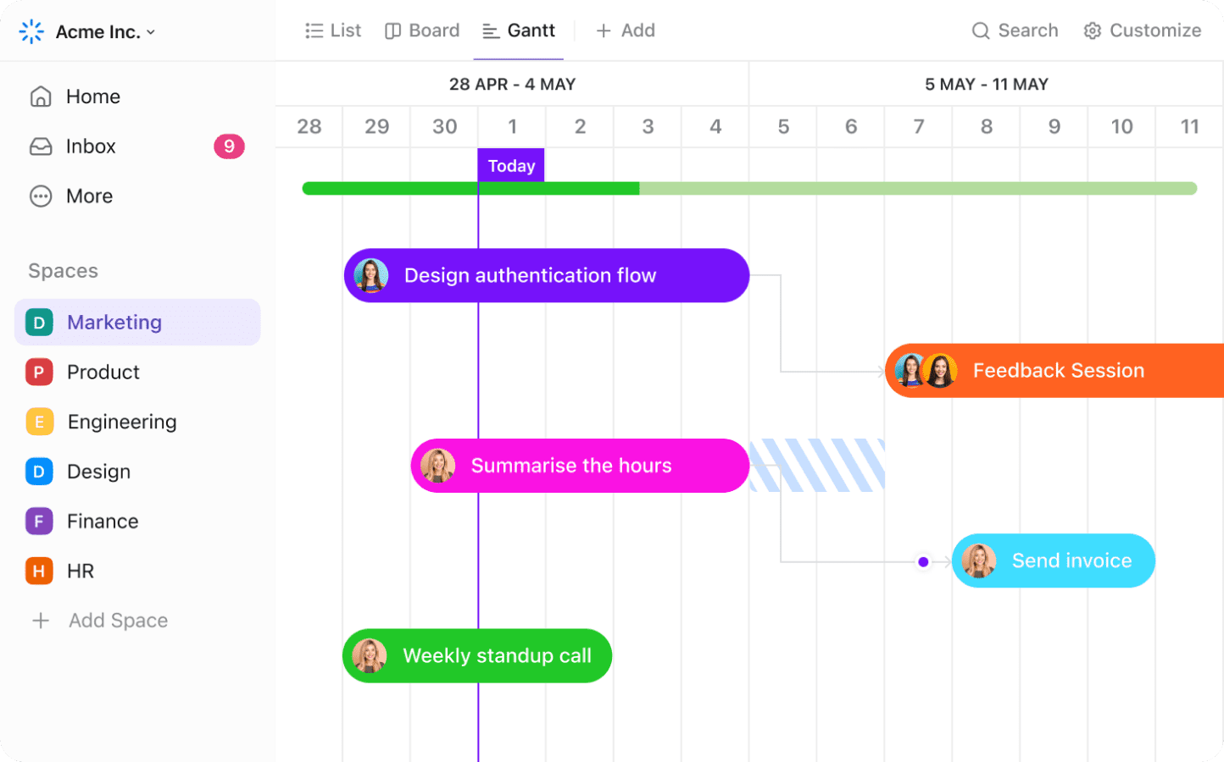
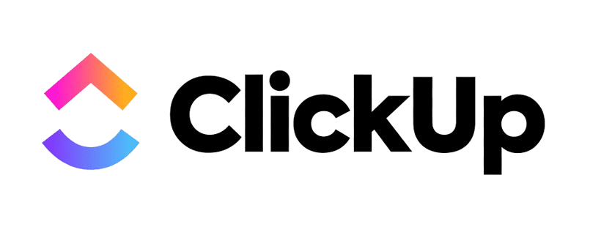
🥇 1️⃣ Best Overall for Student Projects: ClickUp

Slide 22
Contin…
Why it is ideal:
Built-in Gantt charts
Task dependencies
Team assignment
Milestones
Progress tracking
Real-world industry tool
Best For:
Team-based software projects
Your mentorship program
Long-term semester projects

Slide 23
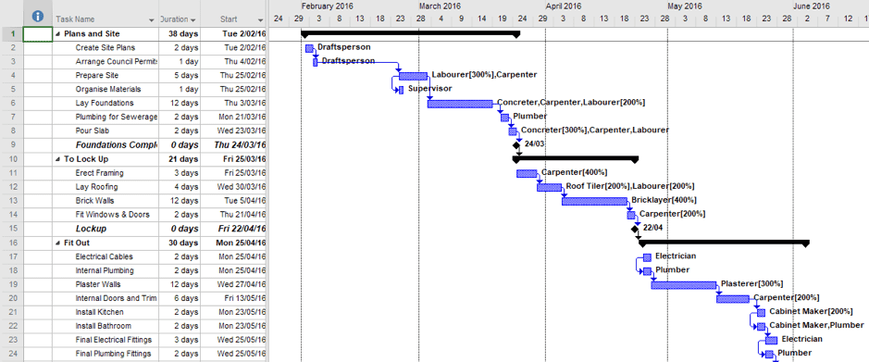
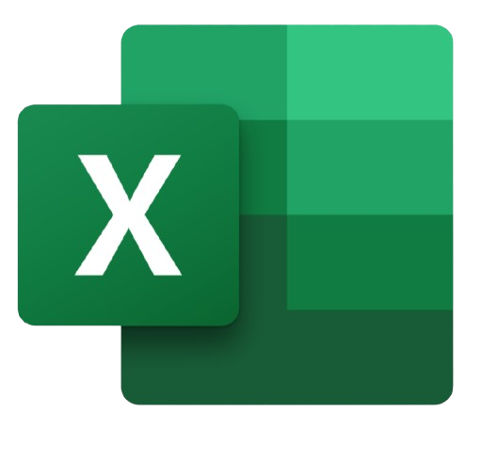
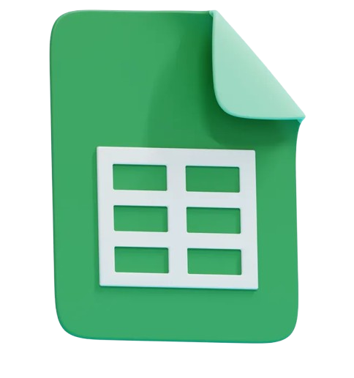
🥈 2️⃣ Most Accessible: Microsoft Excel or Google Sheets

Slide 24
Why:
Very easy
Works offline (Excel)
No learning curve
Students can create:
Task | Start Date | End Date | Duration

Slide 25

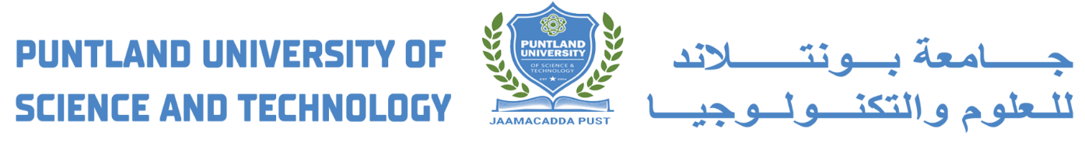

ANY QUESTIONS?

