Slide 1
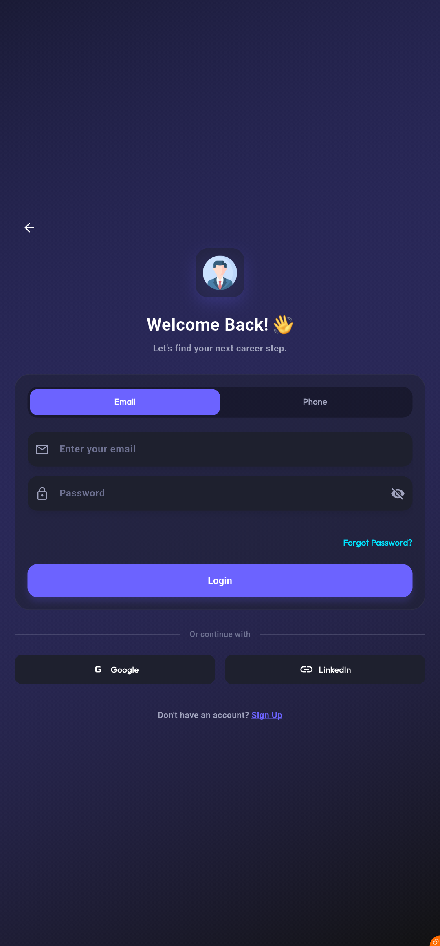
Fursad: Empowering Your Job Search
Welcome to Fursad, a modern, intuitive mobile application designed to streamline the job search experience. We're here to guide you through its core features and future vision, built upon a robust and user-centric design system.

Slide 2
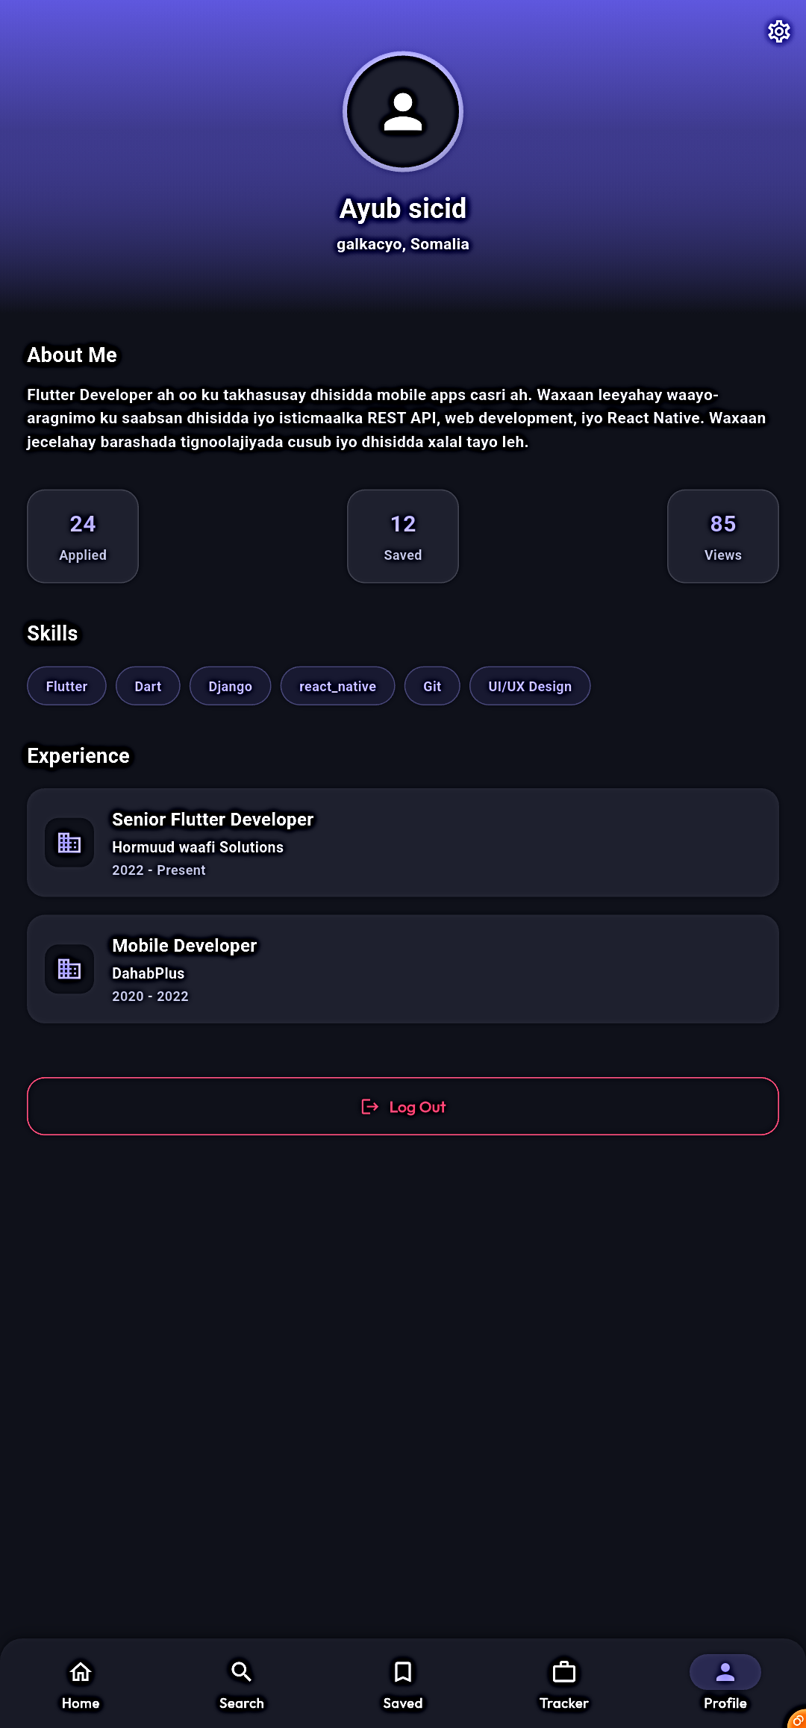
The Onboarding Journey: Discovering Your Dream Role
Visible UI
User Action
Layout Principles
A dark-themed screen highlights a large, glowing purple search icon, with the headline "Find Your Dream Job" and descriptive subtext. Navigation controls and a "Next" button guide the user.
Users can swipe through introductory slides to grasp the app's value proposition or skip directly to authentication, offering flexibility.
The "glassmorphism" effect on the central icon card and the prominent "Next" button strategically direct the user's focus towards progress.

Slide 3


Seamless Access: Authentication & Login
The login screen balances security with ease of use, ensuring a smooth entry into the Fursad ecosystem.
Visible UI
User Action
Layout Choices
A "Welcome Back!" header complements a semi-transparent card for credentials, alongside social login options for Google and LinkedIn.
Users can either input their credentials directly or leverage social providers for a quick and secure authentication process.
The card-based design isolates the form for readability, and tabs efficiently manage different login methods, reducing visual clutter.

Slide 4

Your Personalized Hub: The Home Dashboard
The Fursad home dashboard is designed for immediate engagement, putting key job-seeking tools at your fingertips.
Dynamic Content
User Interaction & Layout
Personalized greeting: "Hello, mr_ayub"
Quickly search for jobs or browse by category.
Prominent Search Bar
Horizontally scrolling "Featured Jobs" with gradients
Effortlessly view top employers.
Click on featured job cards for detailed information.
Categorized chip list for easy browsing
Hierarchy prioritizes the Search action, followed by visually engaging featured cards.
Row of "Top Companies" logos for quick access

Slide 5

In-Depth Insights: Job Details View
Every job opening comes to life with a detailed view, providing all the necessary information to make informed decisions.
1
2
3
Comprehensive Overview
Detailed Description
Call to Action
A header with the company logo (Hormuud) against a branded gradient, followed by key information like Title, Rating, Salary, and Date.
A comprehensive text description allows users to fully understand the role's requirements and benefits.
A fixed "Apply Now" button at the bottom ensures the application process is always prominent and accessible.

Slide 6
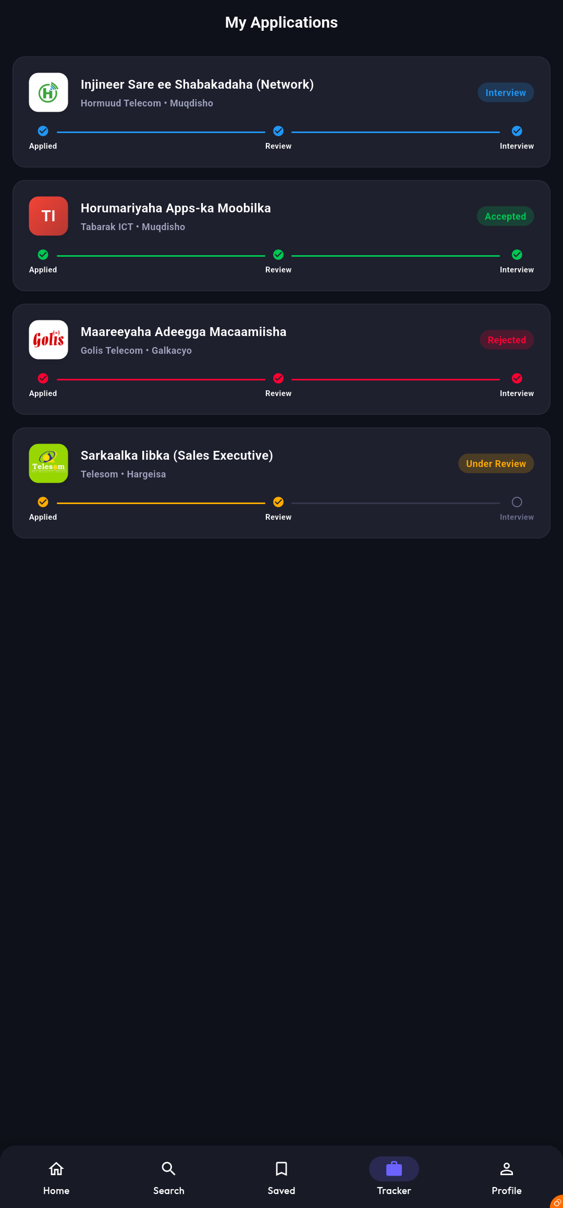
Tracking Your Journey: Profile & Settings
The Profile & Settings screen offers users a personalized space to manage their job search journey and personal information effectively.
Visible UI
User Action
A gradient header with the user's avatar and role ("Software Developer"). A dashboard displays key metrics: "24 Applied", "12 Saved", "85 Views". Actionable tiles link to "Edit Profile", "My Resume", and "Settings".
Users can easily track their job search progress and manage their personal information, keeping their profile up-to-date.

Slide 7
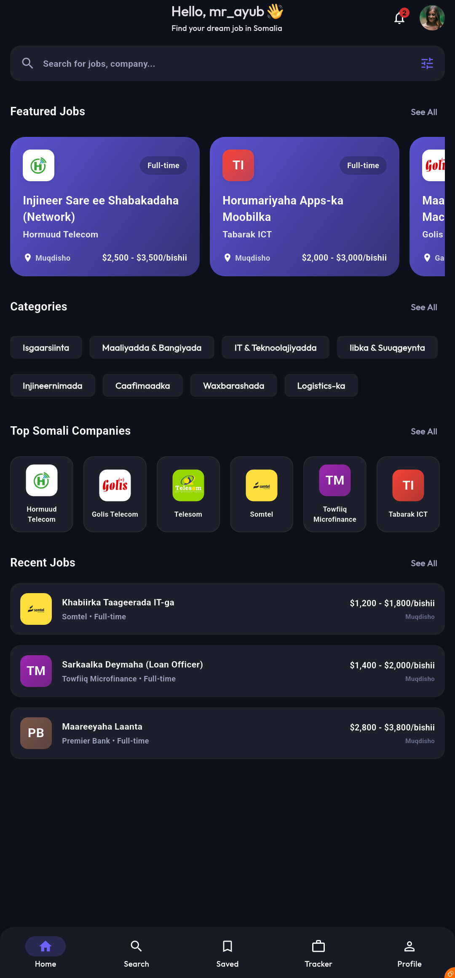
Precision Job Discovery: Search & Filters
Fursad's robust search and filter capabilities empower users to pinpoint their ideal job opportunities with precision.
Intuitive Search
Quick Filters
A dedicated search interface with a text field at the top for quick entry of keywords.
A row of quick filters for Location, Job Type, and Salary to rapidly narrow down results.
Matching Results
The body lists job cards that precisely match the applied search criteria.

Slide 8
The Future is Now: AI Roadmap & Enhancements
Fursad is continuously evolving, with exciting AI-driven features on the horizon to give users an even greater edge in their job search.
AI Resume Analyzer
Impactful Functionality
A futuristic concept screen showcases an "AI Resume Analyzer" with a large holographic circular progress gauge indicating an "85% Score." An automated checklist provides actionable feedback, such as "Strong Action Verbs."
Upload CVs for instant, AI-driven feedback.
Improve hiring chances with targeted suggestions.
Cybernetic aesthetic integrates advanced AI tools seamlessly.

Slide 9


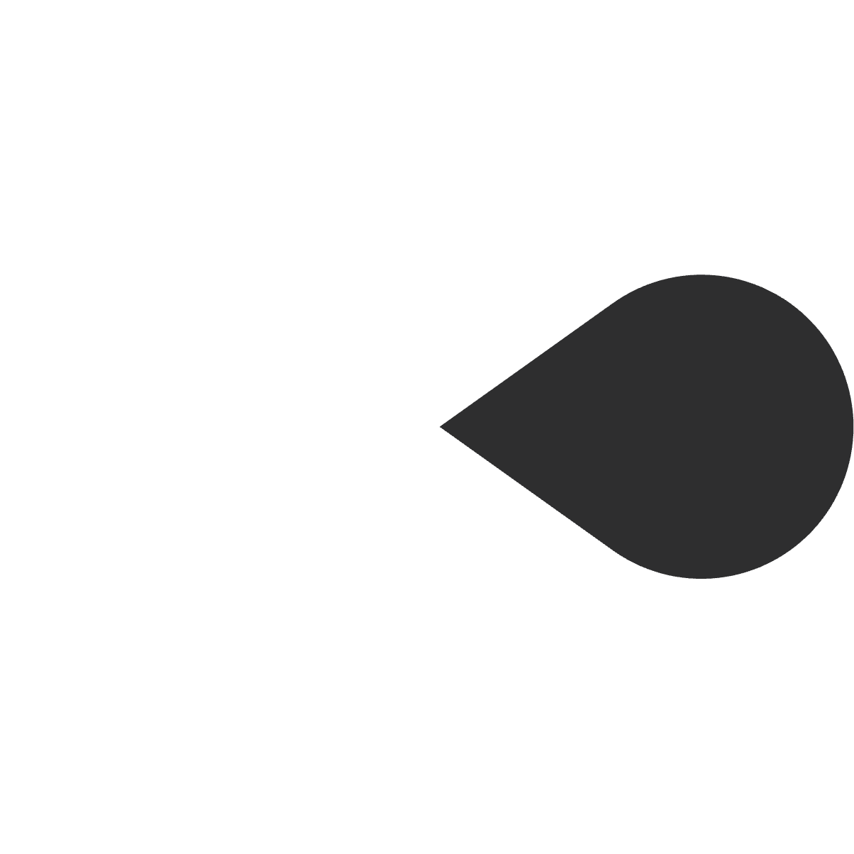


The Fursad Advantage: Key Design Principles
Modern Aesthetics
User-Centric Design
A dark theme with vibrant purple accents creates a sophisticated and engaging visual experience.
Every feature is crafted with the job seeker in mind, prioritizing ease of use and efficiency.
Clear Communication
Concise microcopy and intuitive layouts ensure information is always easy to understand.
Innovative Features
From smart filters to AI tools, Fursad incorporates cutting-edge technology.
Responsive & Adaptive
The app adapts seamlessly across devices, providing a consistent experience.

Slide 10
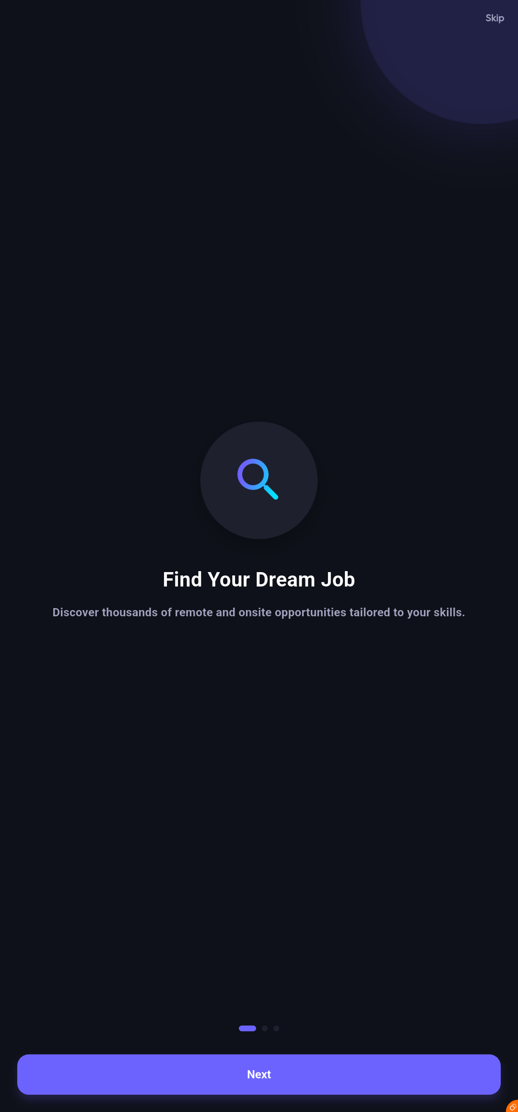

Fursad: Your Partner in Career Growth
Fursad isn't just an app; it's a comprehensive platform designed to support your entire job search journey, from discovery to application and beyond. We are committed to continuously enhancing the user experience and empowering you to achieve your career aspirations.

