Slide 1

PUNTLAND UNIVERSITY OF SCIENCE AND TECHNOLOGY
Faculty of Computer Science and Information Technology
FURSAD
Design and Implementation of a
Web-Based Job Portal System
Prepared by:
Sundus Ahmed Mohamed | Ayub Sicid Cabdiraxman | Ibrahim Ahmed Abdulahi
Supervised by: Mr. Omar Gaciye
Academic Year 2026 – 2027
GRADUATION PROJECT DEFENSE
B.Sc. in Computer Science

Slide 2


Background & Problem Statement
Background
Problem Statement
• Puntland still relies on informal, manual recruitment channels • Qualified graduates remain unemployed due to information gaps • Global platforms (LinkedIn, Indeed) do not serve local needs • No centralized, digital recruitment platform exists locally • Internet-driven recruitment emerged globally since mid-1990s
No centralized job listing source
Inefficient paper-based applications
Poor candidate management for employers
No application status transparency
Data privacy risks via informal channels
Geographic constraints limit access

Slide 3



Research Aim, Objectives & Questions
AIM: Design, develop, and implement Fursad – a secure, user-friendly web-based job portal that modernizes recruitment in the local context.
Research Objectives
Research Questions
1. Review existing online job portal systems & best practices
Q1: How to bridge the gap between job seekers & employers digitally?
2. Gather requirements from HR professionals & job seekers
3. Design Django MVT architecture with MSSQL schema
Q2: What features are essential for a modern local job portal?
4. Implement all core modules: auth, profiles, jobs, applications
Q3: How can Django build a secure, scalable system within academic constraints?
5. Build responsive Bootstrap 5 UI (desktop & mobile)
6. Integrate CSRF, XSS, SQL injection & RBAC security
Q4: What testing methodologies best validate a web recruitment system?
7. Perform unit, integration & UAT testing

Slide 4



Literature Review Highlights
LinkedIn
Indeed
Glassdoor
• 930M+ members
• Global aggregator
• Company reviews
• Professional networking
• Broad listings
• Salary insights
• White-collar focus
• Limited employer control
• Needs critical mass
• Limited local market
• No local focus
• Not locally viable
Research Gap & Project Justification
Localization Gap: No dedicated digital recruitment platform exists for Puntland's local employment market. Accessibility Gap: Most global platforms are inaccessible to users with limited digital literacy. Technology Gap: No existing system combines local focus, simplicity, and modern web security.

Slide 5
Development Methodology
Sprint 1
Sprint 2
Sprint 3
Sprint 4
Weeks 1–2
Weeks 3–4
Weeks 5–6
Weeks 7–8
✓ Project setup
✓ Job Seeker Profile
✓ Job Search & Filter
✓ Admin Dashboard
✓ Database schema
✓ Company Profile
✓ Application Submission
✓ UI Refinement
✓ User Auth (Register / Login / Logout)
✓ Job Posting Module
✓ Application Tracking
✓ Testing & Bug Fixes
✓ COMPLETED
✓ COMPLETED
✓ COMPLETED
✓ COMPLETED
Data Collection Methods
Supervisor Interviews:
Job Seeker Surveys:
Platform Analysis:
Structured sessions with Mr. Omar Gaciye for guidance on requirements & architecture
42 responses: 85% difficulty finding jobs; 79% want tracking; 92% prioritize ease of use
Detailed review of LinkedIn, Indeed, and Glassdoor for feature benchmarking

Slide 6






System Architecture
CLIENT LAYER
Job Seekers | Employers | Administrators
Web Browser
WEB SERVER LAYER
Django Application Server
HTTP Request Handling • URL Routing • Response Generation
APPLICATION LAYER
coreapp
jobsapp
companyapp
shaqodoonapp
applications
adminapp
DATABASE LAYER
Users • Profiles • Jobs • Applications
Microsoft SQL Server

Slide 7

Database Design — Microsoft SQL Server
Microsoft SQL Server • Version 12.0.2269.0 • 4 Core Entities • Django ORM Integration
auth_user(Admin)
JobSeekerProfile
CompanyProfile
▸ id (PK)
▸ sh_username
▸ c_username
▸ username
▸ skills
▸ company_name
▸ email
▸ resume (FILE)
▸ description
▸ password (hashed)
▸ location
▸ Government lenses
Job
JobApplication
▸ title
▸ job (FK→Job)
▸ company (FK→Company)
▸ applicant (FK→Seeker)
▸ job_type
▸ status
▸ is_active
▸ applied_date
Relationships:
Company_DB → Job (1:N) | Job → Application_DB (1:N) | shaqod_DB → Application_DB (1:N)

Slide 8
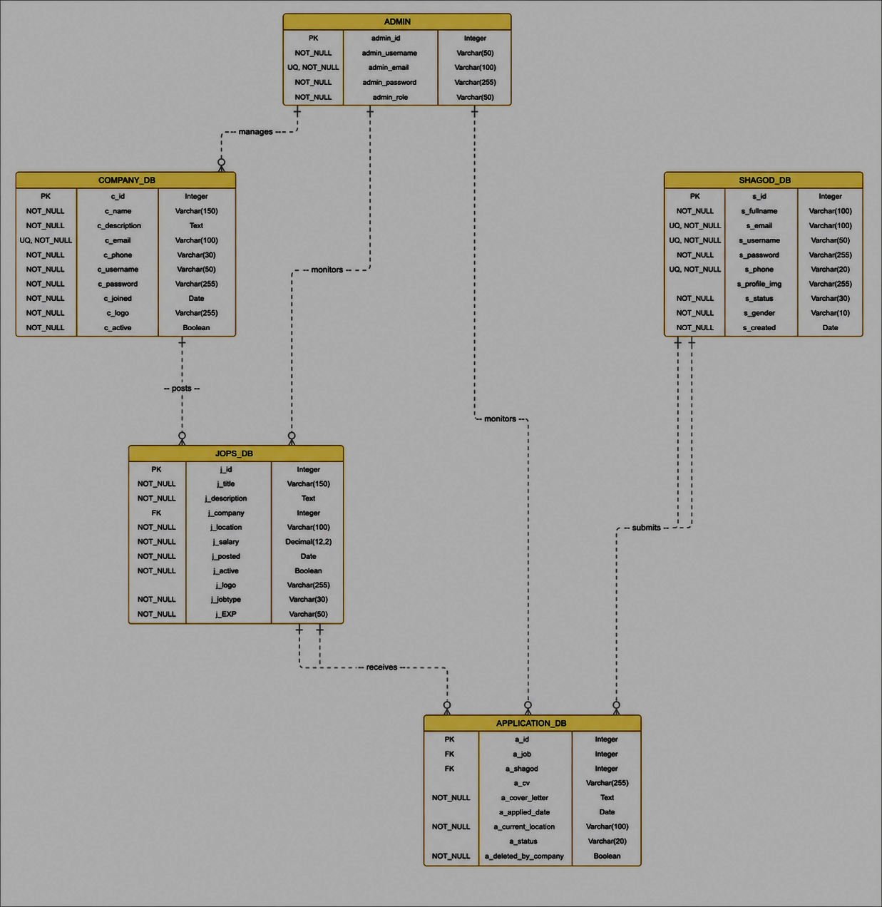
ERD

Slide 9







Technology Stack
Backend
Frontend
Database & Tools
Python
HTML5 / CSS3
MS SQL Server
Primary Language
Structure & Style
Django 6.0.4 LTS
Bootstrap 5.3
Git/GitHub 2.40
Web Framework
Responsive UI
Version Control
JavaScript
VS Code
Interactivity
Code Editor

Slide 10





System Modules & Key Features
User Authentication
Profile Management
Job Management
• Two registration paths (Seeker/Employer)
• Job Seeker: skills, resume,
• Full CRUD for job listings
• PBKDF2-SHA256 password hashing for admin
• Employer: company info, logo, industry
• Job types: Full-time, Part-time, Contract
• Role-based access control (RBAC)
• Resume upload (PDF/DOC)
• Activate/deactivate without deleting
• Secure session management
• Profile photo with Pillow processing
• Employer dashboard with stats
Job Search & Apply
Application Tracking
Admin Dashboard
• Keyword search (title + description)
• status display for seekers
• Django built-in admin panel
• Filter by location & job type
• Status: Pending → Under Review → Accepted/Rejected
• CRUD for all models
• One-click application submission
• Bootstrap badges (color-coded)
• Search, filter & monitor platform
• Duplicate application prevention
• Employer full applicant profile view
• Application activity overview

Slide 11
Functional & Non-Functional Requirements
Functional Requirements
Non-Functional Requirements
FR-01
Users register as job seeker or employer
NFR-01
Security
Passwords hashed via PBKDF2-SHA256
FR-02
Registered users log in/out securely
FR-03
Job seekers create/edit profiles & upload resume
NFR-02
Usability
Fully usable on 320px screens and above
FR-04
Employers post, edit & delete job listings
FR-05
Job seekers search and filter job listings
NFR-03
Performance
Page load < 3 seconds under normal conditions
FR-06
Job seekers apply for jobs with single click
FR-07
Job seekers view status of submitted applications
NFR-04
Reliability
Graceful error handling with clear user messages
FR-08
Employers view and manage received applications

Slide 12




Security Implementation
CSRF Protection
SQL Injection Prevention
XSS Prevention
Django CsrfViewMiddleware enabled on all forms. Every form includes csrf_token tag. Prevents cross-site request forgery attacks. Invalid tokens return HTTP 403 Forbidden.
Django ORM uses parameterized queries throughout. All database interactions filtered via ORM abstraction. All injection attempts blocked in security testing.
Automatic HTML escaping in all Django templates. User-submitted content sanitized before rendering. All injected script tags neutralized.
Password Security
Role-Based Access Control
Secure File Upload
PBKDF2-SHA256 algorithm with 180,000 iterations and random salt. No plain-text passwords stored. Django password strength validators enforced.
@login_required decorator on all sensitive views. Role checks prevent cross-role access (seeker ↔ employer). Unauthenticated access redirected to login page.
File type and size validation Files stored outside web root in static directory. Served via Django's file serving, not direct URL access.

Slide 13
Testing Strategy & Unit Testing Results
Unit
Integration
Functional
Usability
Security
43 test cases
All PASS
7 scenarios
All PASS
End-to-end
workflows
8 real users
observed
SQL/XSS/
CSRF tested
Unit Tests: 43/43 Passed
Security Test Results
SQL Injection
BLOCKED ✓
XSS Attack
BLOCKED ✓
CSRF Forgery
BLOCKED ✓
Unauth Access
REDIRECTED ✓
Role Cross-Access
DENIED ✓
Plain-text Passwords for admin
NOT STORED ✓

Slide 14
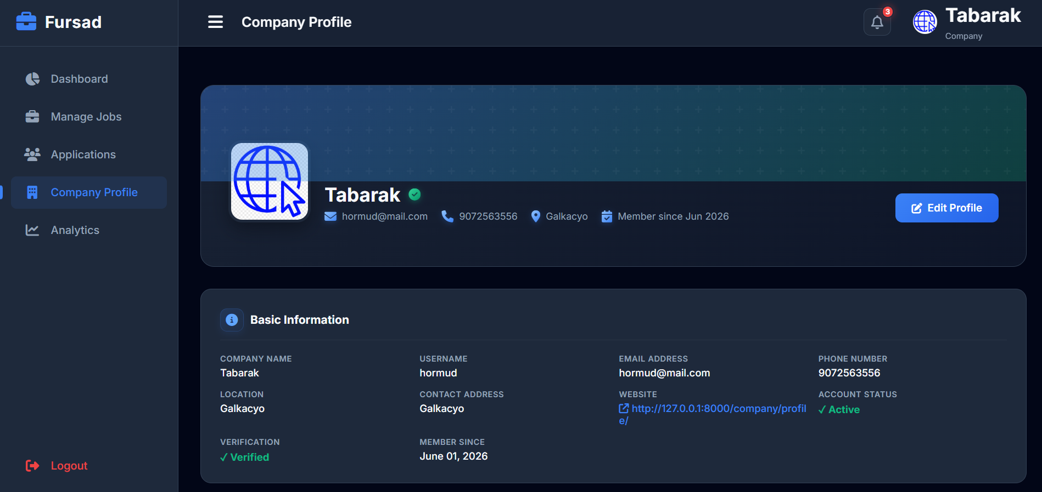

Slide 15
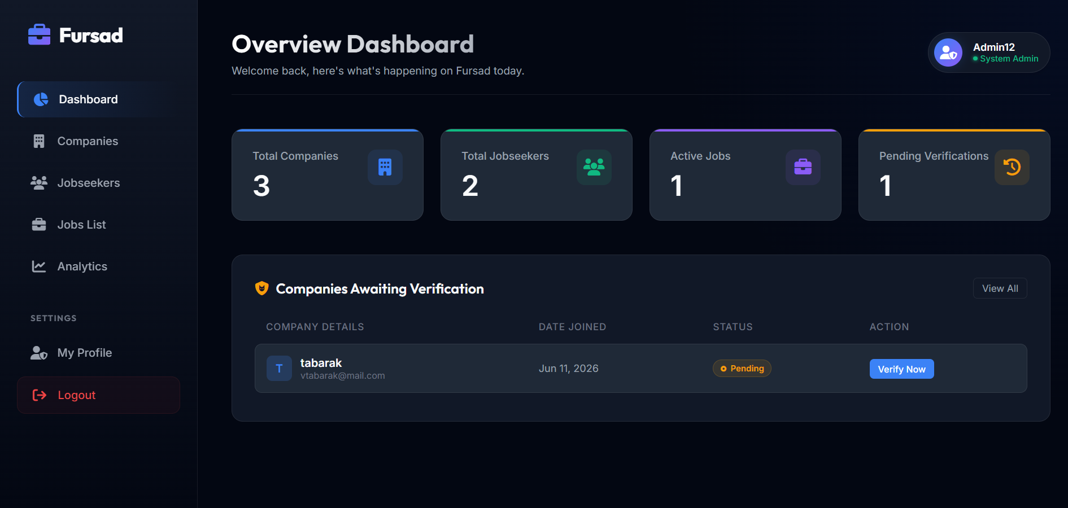

Slide 16
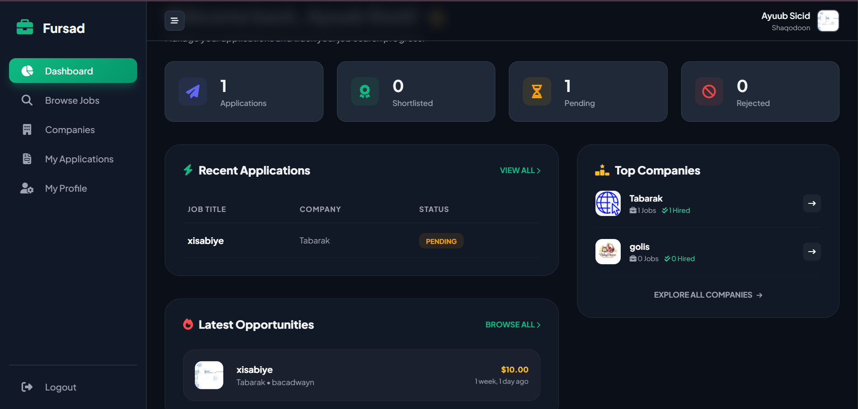

Slide 17
Integration Testing Results
ID | Scenario | Expected / Actual Outcome | Result
IT-01 | Job seeker registers → completes profile → views listings | User created; profile saved; listings display correctly | PASS
IT-02 | Employer registers → posts job → job appears in search | Employer account & job listing saved; appears in public search | PASS
IT-03 | Seeker applies → employer sees application → updates status → seeker sees update | Full application lifecycle with real-time status sync | PASS
IT-04 | Unauthenticated user attempts to apply for a job | User redirected to login page | PASS
IT-05 | Job seeker attempts to access employer dashboard | Redirected to home with access denied message | PASS
IT-06 | Employer deactivates job listing | Job disappears from public search immediately | PASS
IT-07 | Job seeker applies twice to the same job | Second application rejected; user sees 'already applied' message | PASS
7 / 7 Integration Scenarios: ALL PASSED | System modules interact correctly across all tested workflows

Slide 18
User Acceptance Testing (UAT) Results
8 Participants: 4 Job Seekers (recent graduates) + 4 HR Professionals as Employers
100%
Rated Good or
Excellent Overall
88%
Rated Apply Process
Excellent
43
Unit Tests
All Passed
12/12
Requirements
Fully Met
Participant Feedback:
"Clean & professional interface" • "Application tracking feature was excellent" • "Significant improvement over paper-based processes"

Slide 19
System Evaluation — All Requirements Met
ID | Type | Requirement Description | Status
FR-01 | Functional | Users register as job seeker or employer | ✓ Fully Met
FR-02 | Functional | Registered users log in and log out securely | ✓ Fully Met
FR-03 | Functional | Job seekers create/edit profiles, upload resume | ✓ Fully Met
FR-04 | Functional | Employers post, edit, and delete job listings | ✓ Fully Met
FR-05 | Functional | Job seekers search and filter job listings | ✓ Fully Met
FR-06 | Functional | Job seekers apply for jobs with single click | ✓ Fully Met
FR-07 | Functional | Job seekers view status of submitted applications | ✓ Fully Met
FR-08 | Functional | Employers view and manage received applications | ✓ Fully Met
NFR-01 | Security | Passwords hashed using PBKDF2-SHA256 | ✓ Fully Met
NFR-02 | Usability | System usable on screens 320px and above | ✓ Fully Met
NFR-03 | Performance | Page load times under three seconds | ✓ Fully Met
NFR-04 | Reliability | System handles user errors gracefully | ✓ Fully Met
12 / 12 Requirements — 100% Fully Met

Slide 20



Achievements & Contributions
Practical Contributions
Technical Contributions
Academic Contributions
Fully functional, deployable web application
Django MVT with MS SQL Server integration
Documents modern web dev for local context
Directly addresses real recruitment problems
43 passing unit tests & 7 integration scenarios
Agile methodology applied end-to-end
3 user roles with distinct dashboards
Multi-layer security (CSRF, XSS, SQLi, RBAC)
Demonstrates technology for social impact
All 12 defined requirements fulfilled
Responsive Bootstrap 5 UI (320px+)
Reference for future developers in the region

Slide 21
Conclusion & Future Recommendations
Conclusion
Future Work
Fursad is a fully functional, secure web-based job portal
Email Notifications:
Auto alerts via SendGrid/Mailgun on status changes
Successfully addresses informal recruitment challenges in Puntland
AI-Powered Job Matching:
scikit-learn / NLP recommendation engine
Django MVT + MSSQL proved ideal for this multi-role platform
Native Mobile App:
React Native / Flutter with Django REST API
All 12 requirements met; 100% UAT satisfaction achieved
Real-Time Messaging:
Django Channels + WebSockets for employer-seeker chat
Demonstrates that modern web tech can solve local real-world problems
Advanced Analytics Dashboard:
Platform usage, job market trends, skills insights
Agile methodology ensured structured, iterative delivery
Social Authentication:
OAuth 2.0: Google / LinkedIn sign-in
Project is ready for deployment and further development
Resume Parsing:
Auto-populate profile from uploaded resume files

Slide 22
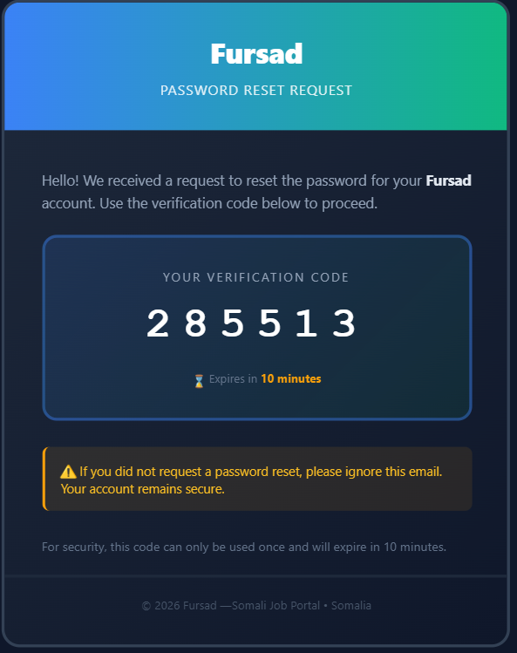
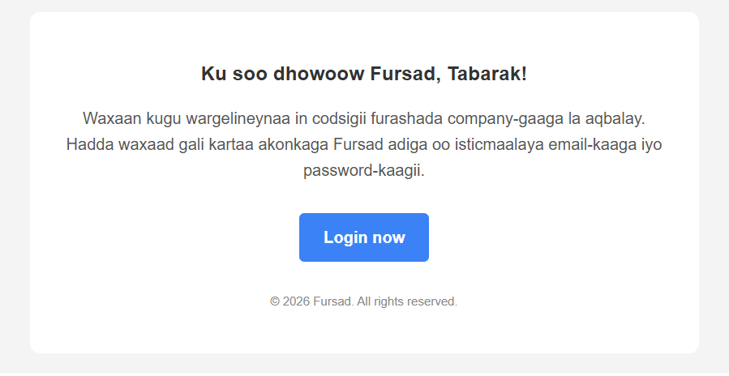

Slide 23
Thank You
FURSAD — Web-Based Job Portal System
Puntland University of Science and Technology
Department of Computer Science | B.Sc. Graduation Project | 2026–2027
Presented by:
Sundus Ahmed Mohamed | Ayub Sicid Cabdiraxman | Ibrahim Ahmed Abdulahi
Supervised by: Mr. Omar Gaciye
Questions & Discussion

