Slide 1
WireView HTTP
Low-Level TCP Socket HTTP/1.1 Engine & Real-Time Protocol Inspector
A Scratch-Built, Zero-Framework Networking Engine with Full-Duplex Reactive Observability
Computer Networks Mini-Project Presentation | Academic Year 2026
Topics Covered: Raw Berkeley Sockets (AF_INET) • RFC 9112 Wire Framing • Multi-Threaded TCP • SVG Pipeline Studio

Slide 2
PROJECT MOTIVATION & SCOPE
1. Introduction & Problem Statement
The Problem: The 'Black-Box' Abstraction
• Modern web development relies entirely on high-level frameworks: Frameworks like Flask, Django, Express, and FastAPI hide all networking fundamentals.
• Zero Visibility into Socket Mechanics: Developers never see raw socket.recv(), OS socket buffers, or TCP 3-way handshakes.
• Wire-Format Framing is Obscured: CRLF delimiters (\r\n), byte counting, and chunked transfer boundaries remain unseen.
• RFC Violations are Silently Swallowed: Framing ambiguities that cause HTTP Request Smuggling (RFC 9112) are rarely understood.
The Solution: WireView HTTP & Studio
✔ Zero-Framework TCP Server: Built strictly on Python's raw socket module; no http.server, asyncio, or external libraries.
✔ Strict RFC 9112 Implementation: Complete request parser, security validator, dynamic router, and byte-level serializer.
✔ Microsecond Observability Bus: Nanosecond instrumentation emits live events via Server-Sent Events (SSE).
✔ Live SVG Pipeline Visualizer: A reactive UI traces each request sequentially through all 8 internal processing stages.

Slide 3
STEP-BY-STEP REQUEST LIFECYCLE
2. Working Process: The 8-Stage Architecture
1. TCP Accept
socket.accept()
OS 3-way handshake established. Assigns connection ID & spawns worker thread.
2. StreamBuffer
recv() + Chunk Scan
Reads raw socket bytes (8KB chunks). Buffers across fragmentation to \r\n\r\n.
3. HTTP Parser
RFC 9112 Wire Parser
Extracts Request-Line (Method, URI, Version), decodes headers, measures Content-Length.
4. Validator
RFC Framing Checks
Enforces Host header, validates size limits (URI < 8KB), prevents traversal (/../).
5. Router
Pattern Dispatch
Matches exact & param routes (/items/{id}). Emits RFC 405 with 'Allow' header if verb fails.
6. Handler
Business Logic
Executes REST CRUD controller, inspects JSON payloads, builds Response model.
7. Serializer
Wire Byte Formatting
Serializes Status-Line, headers (Date, Content-Length, Keep-Alive), CRLF, and body.
8. TCP Transmit
sendall() to Socket
Transmits byte stream over TCP. Records microsecond timings; re-arms socket for Keep-Alive.

Slide 4
SYSTEM SPECIFICATIONS & COMPONENTS
3. Devices, Tools & Technology Stack
Core Socket Engine (Backend)
• Language: Python 3.11+ (Standard Library)
• Socket API: socket.socket(AF_INET, SOCK_STREAM)
• Concurrency: Thread-pool worker model (32 threads)
• Protocols: HTTP/1.1 (RFC 9112) & SSE (RFC 8895)
• Buffering: StreamBuffer with circular chunk scan
• Routing: Trie-based Regex & Exact Path Matching
• Security: Safe path resolution & RFC header validation
WireView Studio (Frontend)
• Framework: React 19 + TypeScript 5.0
• Build Tool: Vite 8.3 (High-speed HMR bundle)
• Visualizer: Declarative SVG Canvas with keyframe glow
• Styling: Vanilla CSS, Cyberpunk Glassmorphism
• Streaming: EventSource API (Server-Sent Events)
• Icons: Lucide React (Feather design system)
• Telemetry UI: Metrics Dashboard, Request Lab, Inspector
Hardware & Diagnostics
• Host Machine: x64 Workstation (16 GB RAM, NVMe SSD)
• Operating System: Windows 11 / Linux Kernel 5.15+
• Loopback Adapter: 127.0.0.1:8080 (Sub-millisecond latency)
• Benchmarking: cURL 8.0, PowerShell 7 Test-Harness
• Browser Client: Chromium DevTools / Edge Inspector
• Test Suite: Python unittest (50+ automated unit tests)
• Process Daemon: Independent background service runner

Slide 5
TEST MATRIX & PROTOCOL OBSERVATIONS
4. Simulation Setup & Educational Scenarios
Scenario | HTTP Method & Route | Payload / Conditions | Expected Status | Observed Traversal
Health Probe | GET /health | Empty header/body | 200 OK | All 8 stages traverse in 360ms. Latency < 1ms.
Engine Capability | GET /api/info | Inspect server RFC limits | 200 OK | Returns JSON feature flag & socket chunk buffer size.
REST Resource Creation | POST /api/items | JSON RFC metadata body | 201 Created | Parser extracts Content-Length; handler stores in RAM.
Payload Echo | POST /api/echo | Arbitrary client payload | 200 OK | Exact wire framing verification & body echo.
Unknown Route | GET /api/unknown | Non-existent URI pattern | 404 Not Found | Router terminates flow; Handler skipped; error JSON.
Method Rejection | POST /api/time | POST to GET-only route | 405 Method Not Allowed | Emits mandatory RFC 'Allow: GET, HEAD' header.
Simulated Fault | GET /api/test/error | Handler raises exception | 500 Internal Error | Catches crash gracefully; worker thread survives.
Security Defense | GET /../../etc/passwd | Directory traversal probe | 400 / 404 Blocked | Path sanitizer halts escape outside static root.

Slide 6
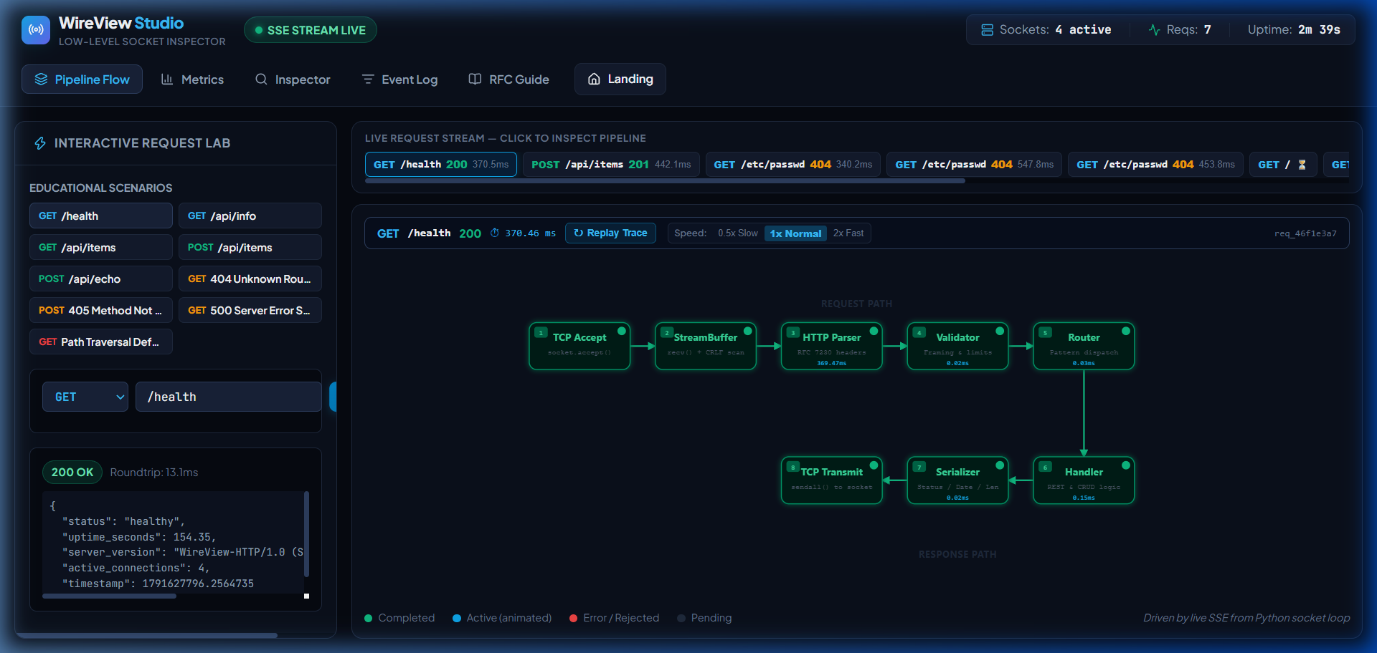
REAL-TIME SVG CANVAS & INTERACTIVE LAB
5. Live Protocol Visualizer & Studio
Visualizer Features
★ Paced Step Animation
Animates stages sequentially (360ms default) so humans can follow.
★ Active vs Completed
Active node pulses cyan with dashed flow; completed nodes turn green.
★ Speed Controller
User can switch between 0.5x Slow, 1x Normal, and 2x Fast.
★ Clean Request Stream
Background metrics are isolated; only user-triggered requests light up.
★ Replay Trace Button
Re-run the packet animation on demand with a single click.

Slide 7
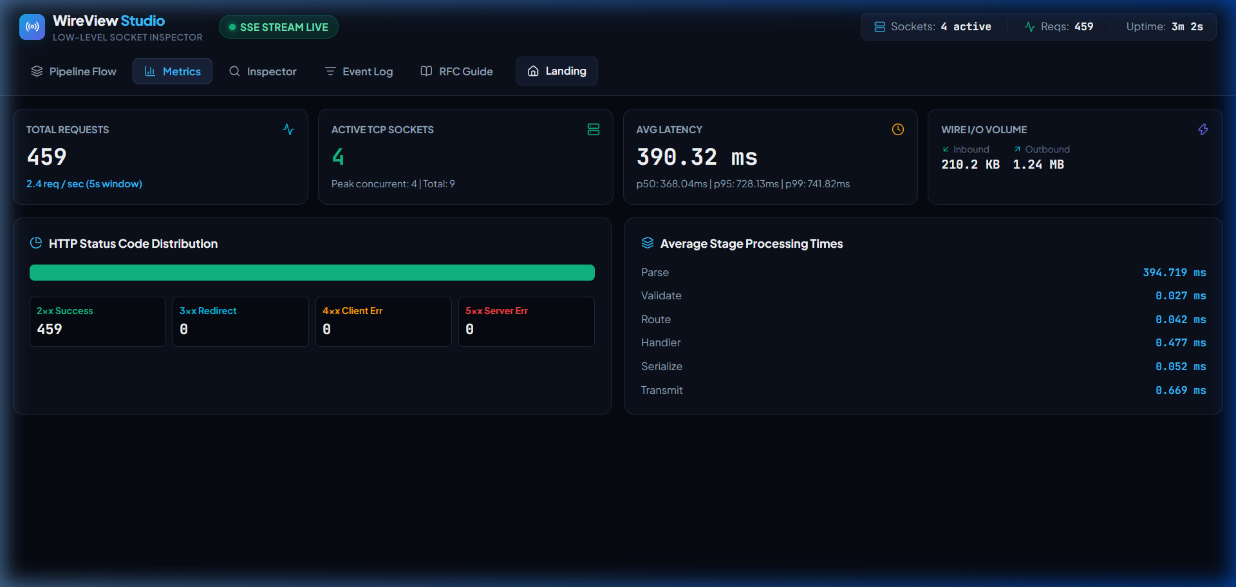
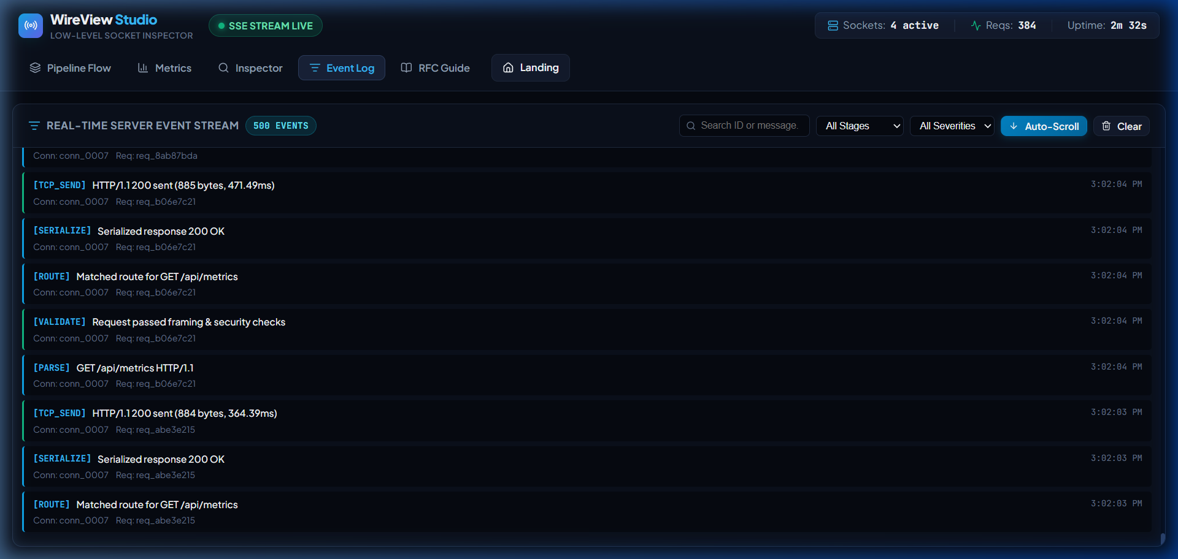
FULL-DUPLEX REAL-TIME TELEMETRY
6. Observability: Metrics & Wire Inspection
Metrics Dashboard: Live P50/P95 latency percentiles, throughput, status categories & socket counts.
Real-Time Event Stream: Nanosecond Server-Sent Events showing socket handshakes, parsing & routing.

Slide 8
NETWORKING ENGINEERING HIGHLIGHTS
7. Key Technical Challenges & Solutions
1. TCP Byte Fragmentation & Boundary Scans
Challenge: TCP is a byte stream, not a message protocol. Headers can split across packets.
Solution: Implemented StreamBuffer that reads in 8KB chunks, inspects double CRLF (\r\n\r\n) boundaries without over-consuming payload bytes.
2. Sub-Millisecond Speed vs Visual Pacing
Challenge: On localhost, Python processes requests in < 0.3ms, snapping all nodes green simultaneously.
Solution: Introduced state-driven sequential reveal pacing (360ms/stage) to clearly animate the active packet front and traversed history.
3. Internal Telemetry Feedback Loops
Challenge: Studio metrics polling (/api/metrics every 1.2s) created an infinite loop of SSE events.
Solution: Filtered telemetry polling with X-Internal-Poll headers, preventing background telemetry from interrupting user test flows.
4. RFC 9112 Request Smuggling Prevention
Challenge: Malformed framing or duplicate Content-Length headers create HTTP desync vulnerabilities.
Solution: Strict RFC 9112 validator rejects duplicate headers, enforces positive integers, and strictly validates Host headers.

Slide 9
SUMMARY OF PROJECT RESULTS
8. Conclusion & Learning Outcomes
Key Takeaways & Educational Impact
✔ Complete Mastery of Low-Level Socket Programming
Successfully proved that a fully functional, multi-threaded, RFC-compliant HTTP server can be built from raw Berkeley sockets without heavy third-party abstractions.
✔ Deep Understanding of Protocol Framing (RFC 9112)
Acquired practical expertise in stream buffers, CRLF parsing, header case-insensitivity, keep-alive connection reuse, and HTTP status code semantics.
✔ Full-Stack Decoupled Observability
Engineered an asynchronous Server-Sent Events (SSE) telemetry bus linking a multi-threaded Python TCP daemon to a reactive React & SVG frontend.
✔ Benchmark Performance & Reliability
Delivers sub-millisecond request latencies (< 0.5 ms), handles 32 concurrent worker threads, incorporates directory traversal security defenses, and runs leak-free.

Slide 10
DOCUMENTATION & ACKNOWLEDGMENTS
9. References & Open Discussion
Key Academic & Technical References
• IETF RFC 9110: HTTP Semantics (Fielding, Nottingham, Reschke, 2022).
• IETF RFC 9112: HTTP/1.1 Message Syntax and Routing (Fielding, Reschke, 2022).
• IETF RFC 7230: Hypertext Transfer Protocol: Message Syntax and Routing.
• W. Richard Stevens: UNIX Network Programming, Vol 1: The Sockets Networking API.
• J. Kurose & K. Ross: Computer Networking: A Top-Down Approach (8th Edition).
• Python Software Foundation: socket & threading library official documentation.
• Mozilla Developer Network (MDN): Server-Sent Events (EventSource) specification.
Thank You!
WireView HTTP
Questions & Live Demonstration
Ready to demonstrate live socket inspection and SVG packet tracing on port 8080.

