Slide 1
Velocity — Customer Context Layer
The layer that gives each AI agent exactly the context its job needs — across many brands
Notes:
Open here, one breath. I didn't build one agent — I built the layer that makes all of them possible. A CDP tells you WHO; this tells the agent WHAT it needs, right now.

Slide 2
Slide 1 · Thesis
I didn't build one agent. I built the layer that makes all the agents possible.
A CDP answers "who is my customer?" But an agent about to act doesn't need a 360° profile — it needs the few facts that change its decision, right now.
We built the layer that answers: "what does THIS agent need to know about THIS customer to do THIS job, at the moment it acts?" — and across many brands, the data compounds into a moat no single brand can build.
---
Notes:
Open here, one breath. I didn't build one agent — I built the layer that makes all of them possible. A CDP tells you WHO; this tells the agent WHAT it needs, right now.

Slide 3
Slide 2 · The problem
Velocity's customer data is scattered across storefront, payments, courier, WhatsApp, web sessions, marketing — and the same person shows up as several different records.
There are ~10 products on the roadmap (WISMO, COD→prepaid, RTO prevention, cart recovery, winback, upsell…). Every one fails the same way: it acts on partial context.
The bottleneck isn't the agents. It's the context they stand on. Fix that once, and every agent — today's and the ones not built yet — gets better at the same time.
---
Notes:
Data is scattered and the same person is several records. Ten products on the roadmap, every one fails the same way — partial context. The bottleneck isn't the agents; it's the context underneath.

Slide 4
Slide 3 · The reframe (+ my method)
The method: I didn't design the data model in a vacuum. I let the agents' needs be the forcing function — each agent declares what it needs to act, and that defines what the layer must serve. That's why it serves products we haven't built yet.
---
 | CDP / "profile-first" | Context Layer / "job-first" (ours)
Question | Who is this customer? | What does this agent need to act?
Output | One big profile | A tight, ranked bundle per task
New product | Re-query, re-decide what matters | Declare a Context Contract
Cost at the model | Whole profile every prompt | Only the job's fields (~70–90% smaller)
Notes:
THE key slide. CDP is profile-first; we're job-first. I let the agents' NEEDS be the forcing function — each declares what it needs, that defines the layer. That's why it serves products not built yet.

Slide 5
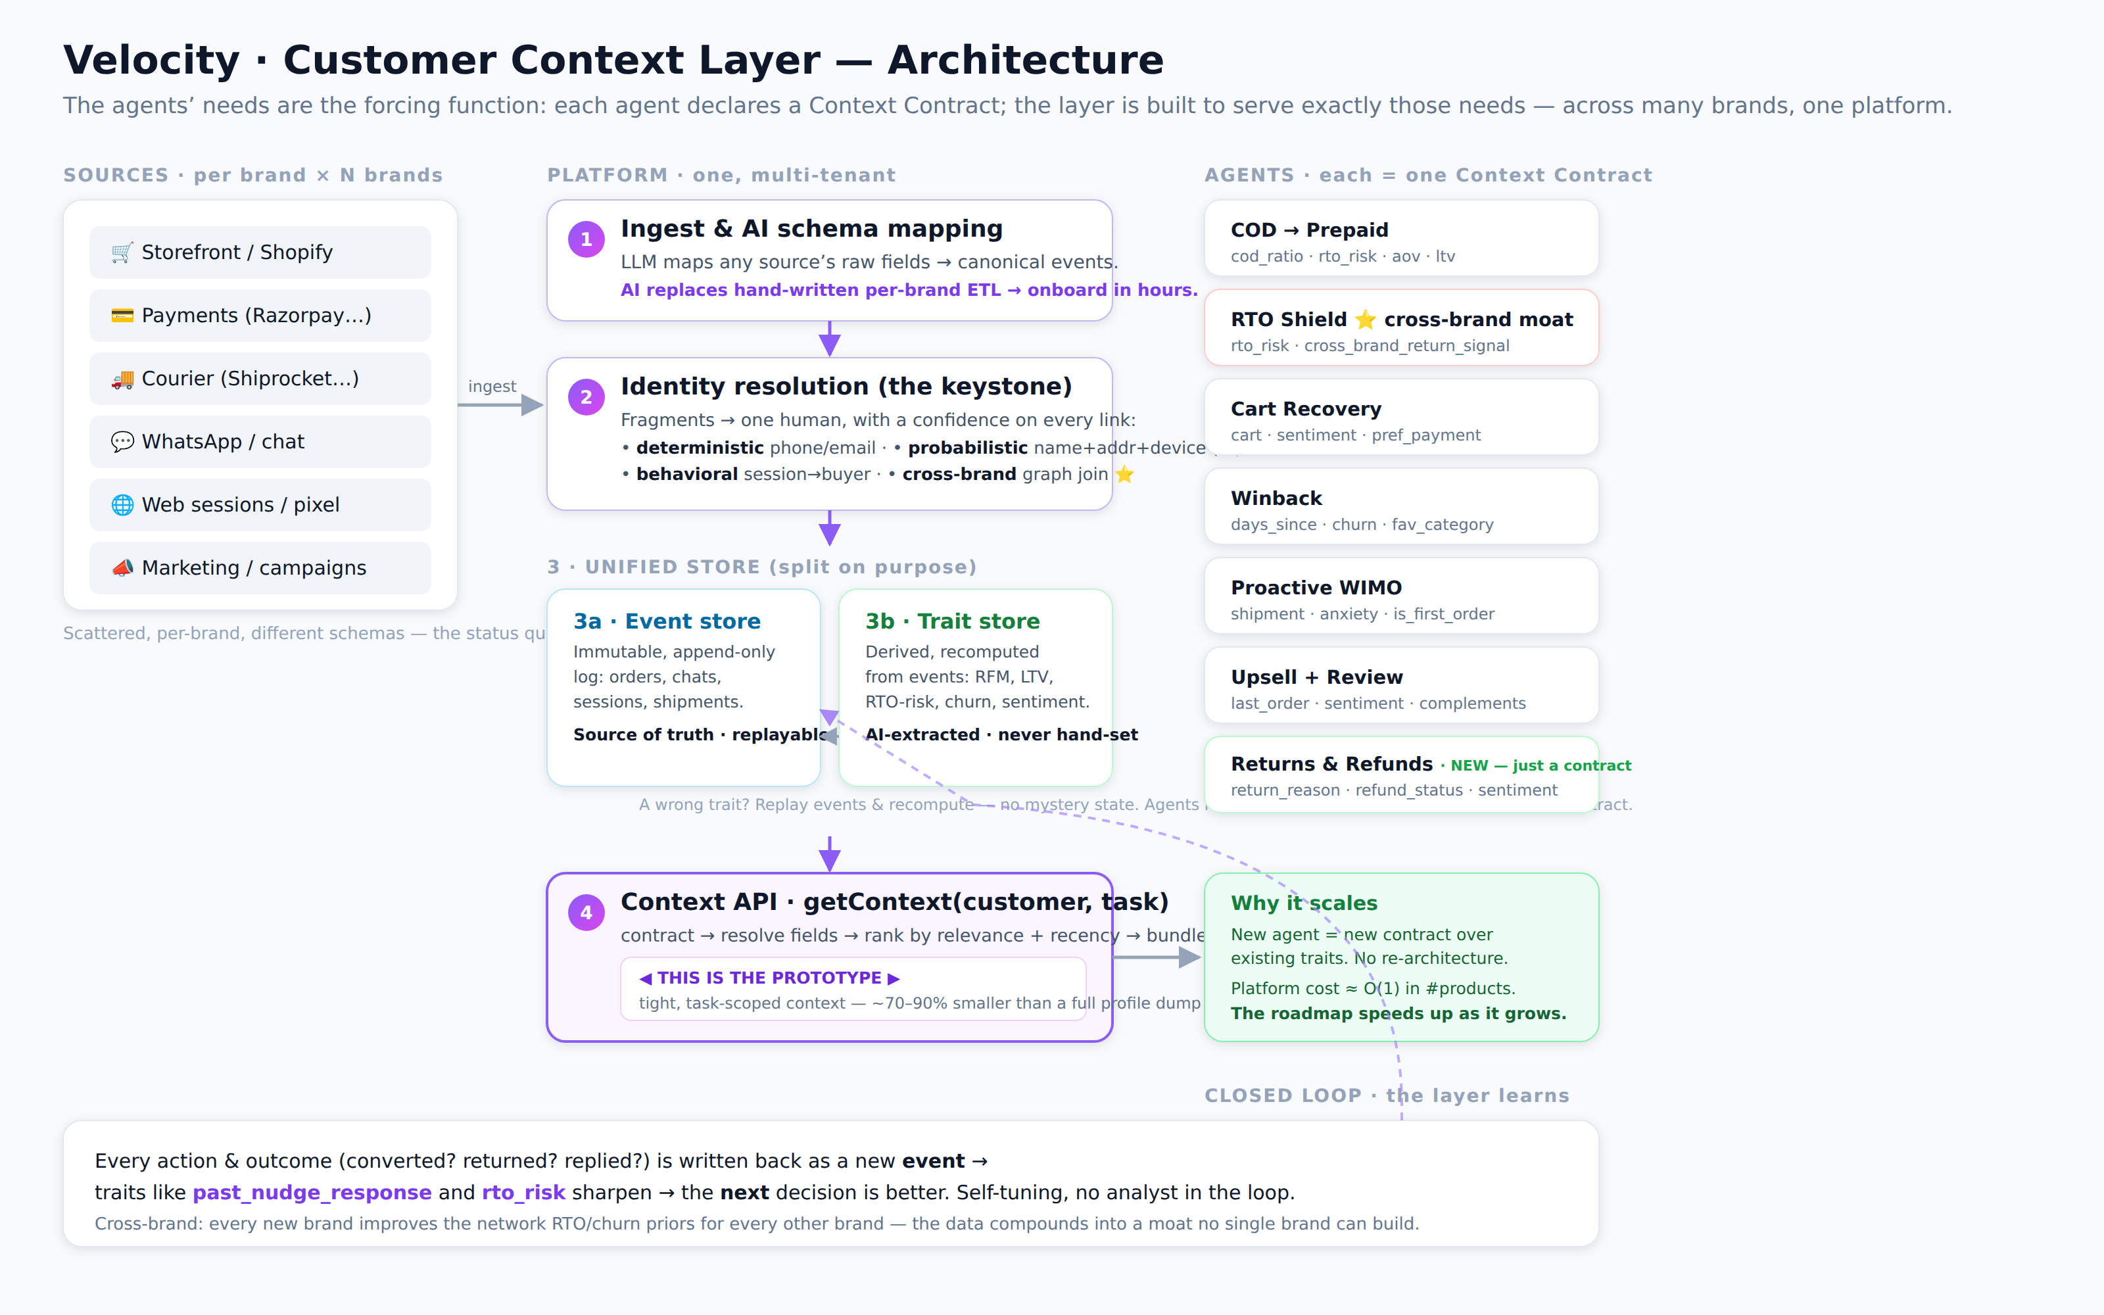
Slide 4 · Architecture (one picture)
Sources → ① AI schema map → ② identity → ③ event + trait store → ④ Context API → agents (incl. Returns & Refunds) → closed loop
Notes:
Left to right: sources are the mess. One — AI maps any schema to events. Two — identity, the keystone. Three — event store is truth, trait store derived. Four — the Context API, that's the prototype. Then agents, each a contract — including Returns & Refunds, added as just a contract. Bottom — the closed loop.

Slide 6
Slide 5 · #1 Unify — identity + two stores
Identity resolution (the keystone). Fragments → one human, with a confidence on every link: deterministic (phone/email) → probabilistic (name+address+device, AI) → behavioral (session→buyer) → cross-brand graph join. We tune for precision over recall — a wrong merge is worse than a missed one. Prototype: Priya's 4 records → 1.
Two stores, on purpose. Event store = immutable facts (replayable truth). Trait store = derived signals (RFM, RTO-risk, churn, sentiment), recomputed from events, never hand-set. A wrong trait? Replay and recompute — and because agents read traits, recomputation never breaks a contract.
---
Notes:
Don't rush it — the keystone. Three escalating signals, each with confidence. Precision over recall: a wrong merge is worse than a missed one. Cross-brand is the same graph one level up. Two stores: events are truth, traits recomputed.

Slide 7
Slide 6 · #2 AI-first — AI does the work, not rules/humans
The prototype demonstrates the last two live: type an audience in English → AI builds the segment; minimal context → Claude writes the WhatsApp message.
---
Where | Today (manual) | With AI
Ingestion | Hand-map each brand's schema | LLM maps any schema → canonical events
Identity | Exact-match rules only | Probabilistic matcher with confidence
Traits | Analysts write SQL segments | Model extracts sentiment, intent, RTO-risk
Segmentation | Marketer waits on data team | Plain English → live segment (shown)
Action | Static templated copy | Per-customer message from the bundle (shown)
Notes:
Criterion two. Five places AI replaces rules or humans. The prototype shows the last two live — English to segment, minimal context to message. If you have a key, run live here.

Slide 8
Slide 7 · #3 The cross-brand moat
A single brand sees Vikram place one COD order and return it — annoying, not a pattern.
Velocity sees 4 of 5 returned across three brands. So the next COD order — at a brand he's never bought from — gets COD paused and prepay required before we ship at a loss.
No single brand can build this. It only exists because we're one platform serving many brands — and every brand that joins improves the RTO/churn priors for every other brand. The data layer isn't a cost center; it's the network effect.
---
Notes:
Strongest slide — slow down. One brand sees one return; we see four of five across three brands. We pause COD before shipping at a loss. No single brand can build this; every brand makes the priors better. The moat.

Slide 9
Slide 8 · #4 Scale — the Context Contract is the whole trick
• A contract is a small declarative list of trait/event keys + decision logic.
• It reads the existing trait store — usually needs zero new data.
• A new trait, computed once, is then available to every future agent.
Result: platform cost ≈ O(1) in number of products. Multi-tenant by default; cross-brand sharing is governed (derived scores, never raw PII). The roadmap speeds up as it grows.
---
Notes:
How it scales. New product equals a new contract over existing traits. No re-architecture. Returns & Refunds is the proof — I added it as a contract last week. Cost stays flat per product.

Slide 10
Slide 9 · #5 Build first vs defer — and why
Prioritized by value × data-readiness × reversibility-of-risk.
Build first: Foundation (identity + stores + Context API) → then low-regret, clean-data agents: Proactive WIMO, Cart Recovery, COD→Prepaid (strong signal, reversible, immediate value).
Defer (and why): RTO Shield (needs volume — pausing COD on a good customer is a costly false positive) · Winback (needs more history) · autonomous send, broad broadcasts, returns adjudication, ML retraining infra (high blast radius or money/policy — earn trust first).
The restraint is the answer: the prototype has no DB, no auth, no real integrations — on purpose. Knowing what not to build is the same judgment this question tests.
---
Notes:
Criterion five. Foundation first — nothing works without identity and the stores. Then low-regret agents: WIMO, cart, COD-to-prepaid. Value times data-readiness times reversibility of risk.

Slide 11
Slide 10 · The one line
Today's WhatsApp agent gets smarter the day this layer ships.
Every future agent just declares a contract over the same data.
And because it's one platform across many brands, the data compounds into a moat no single brand can build.
Why it's the right answer, not just an answer: fixes the shared bottleneck (not one feature) · AI-first and proven live · serves products not built yet · the restraint signals seniority.
The prototype makes it clickable. This deck is how it scales.
Notes:
Close on this, then stop. Today's agent gets smarter now; every future agent is just a contract; across brands the data compounds into a moat. Then the four reasons it's the right answer.

