Slide 1
Velocity — Customer Context Layer
How to unify e-commerce customer data so AI agents can rely on it, across many brands
Notes:
Open here, one breath. I didn't build one agent — I built the layer that makes all of them possible. A CDP tells you WHO; this tells the agent WHAT it needs, right now.

Slide 2
Slide 1 · The thesis
I didn't build one agent. I built the layer that makes all the agents possible.
A CDP answers one question: "Who is my customer?" But an agent about to act doesn't need a 360° profile. It needs the few facts that change its decision, right now.
We're not building a CDP. We're building the layer that answers:
"What does THIS agent need to know about THIS customer to do THIS job, at the moment it acts?"
— and because it's one platform across many brands, the data compounds into a moat no single brand can build.
Every agent on the roadmap fails the same way: it acts on partial context. Fix the context layer once, and every agent — today's and the ones not built yet — gets better at the same time. Everything below follows from taking that one sentence literally.
---
Notes:
Open here, one breath. I didn't build one agent — I built the layer that makes all of them possible. A CDP tells you WHO; this tells the agent WHAT it needs, right now.

Slide 3
Slide 2 · The problem, stated precisely
Velocity already runs a live WhatsApp agent and has 10 products on the roadmap (WISMO, COD→prepaid, RTO prevention, cart recovery, winback, upsell, segmentation, returns…).
Every one of them fails the same way: the agent acts on partial context.
• Data sits in scattered silos: storefront, payment gateway, courier, WhatsApp, web sessions, marketing tool — per brand, times N brands.
• The same human appears as 4 different records. No agent can reason about a customer it can't resolve.
• Each new product re-plumbs the same data from scratch → the roadmap slows down as it grows, instead of speeding up.
The bottleneck isn't the agents. It's the context they stand on.
---
Notes:
Data is scattered and the same person is several records. Ten products on the roadmap, every one fails the same way — partial context. The bottleneck isn't the agents; it's the context underneath.

Slide 4
Slide 3 · The reframe: profile-first vs job-first
The CDP is a component inside our layer (the unified store). The product is the contract + resolution + serving on top of it.
---
 | CDP / "profile-first" | Context Layer / "job-first" (ours)
Question | Who is this customer? | What does this agent need to act?
Output | One big profile, all fields | A tight, ranked context bundle per task
New product | Re-query, re-join, re-decide what matters | Declare a Context Contract over existing traits
Cost at the model | Whole profile in every prompt | Only the fields the job needs (≈70–90% smaller)
Failure mode | Noise drowns the signal; cost scales with data | Adding agents/brands stays O(1) on the platform
Notes:
THE key slide. CDP is profile-first; we're job-first. I let the agents' NEEDS be the forcing function — each declares what it needs, that defines the layer. That's why it serves products not built yet.

Slide 5
Slide 4 · The method (the part I most want you to grade)
I didn't design the data model in a vacuum and hope agents could use it. I let the agents' needs be the forcing function.
• List the agents we want (today's 7 + the roadmap).
• For each, write down the literal fields it needs to make its decision.
• The union of those needs defines the trait store. The per-agent subset defines its contract.
This is why the layer serves products we haven't built yet: a new agent is a new contract over traits that already exist — or a small number of new traits that the next agent can also reuse. The data model is demand-driven, not speculative.
---
Notes:
Three steps: list agents, write the fields each needs, the union is the trait store and the subset is its contract. Demand-driven, not speculative.

Slide 6
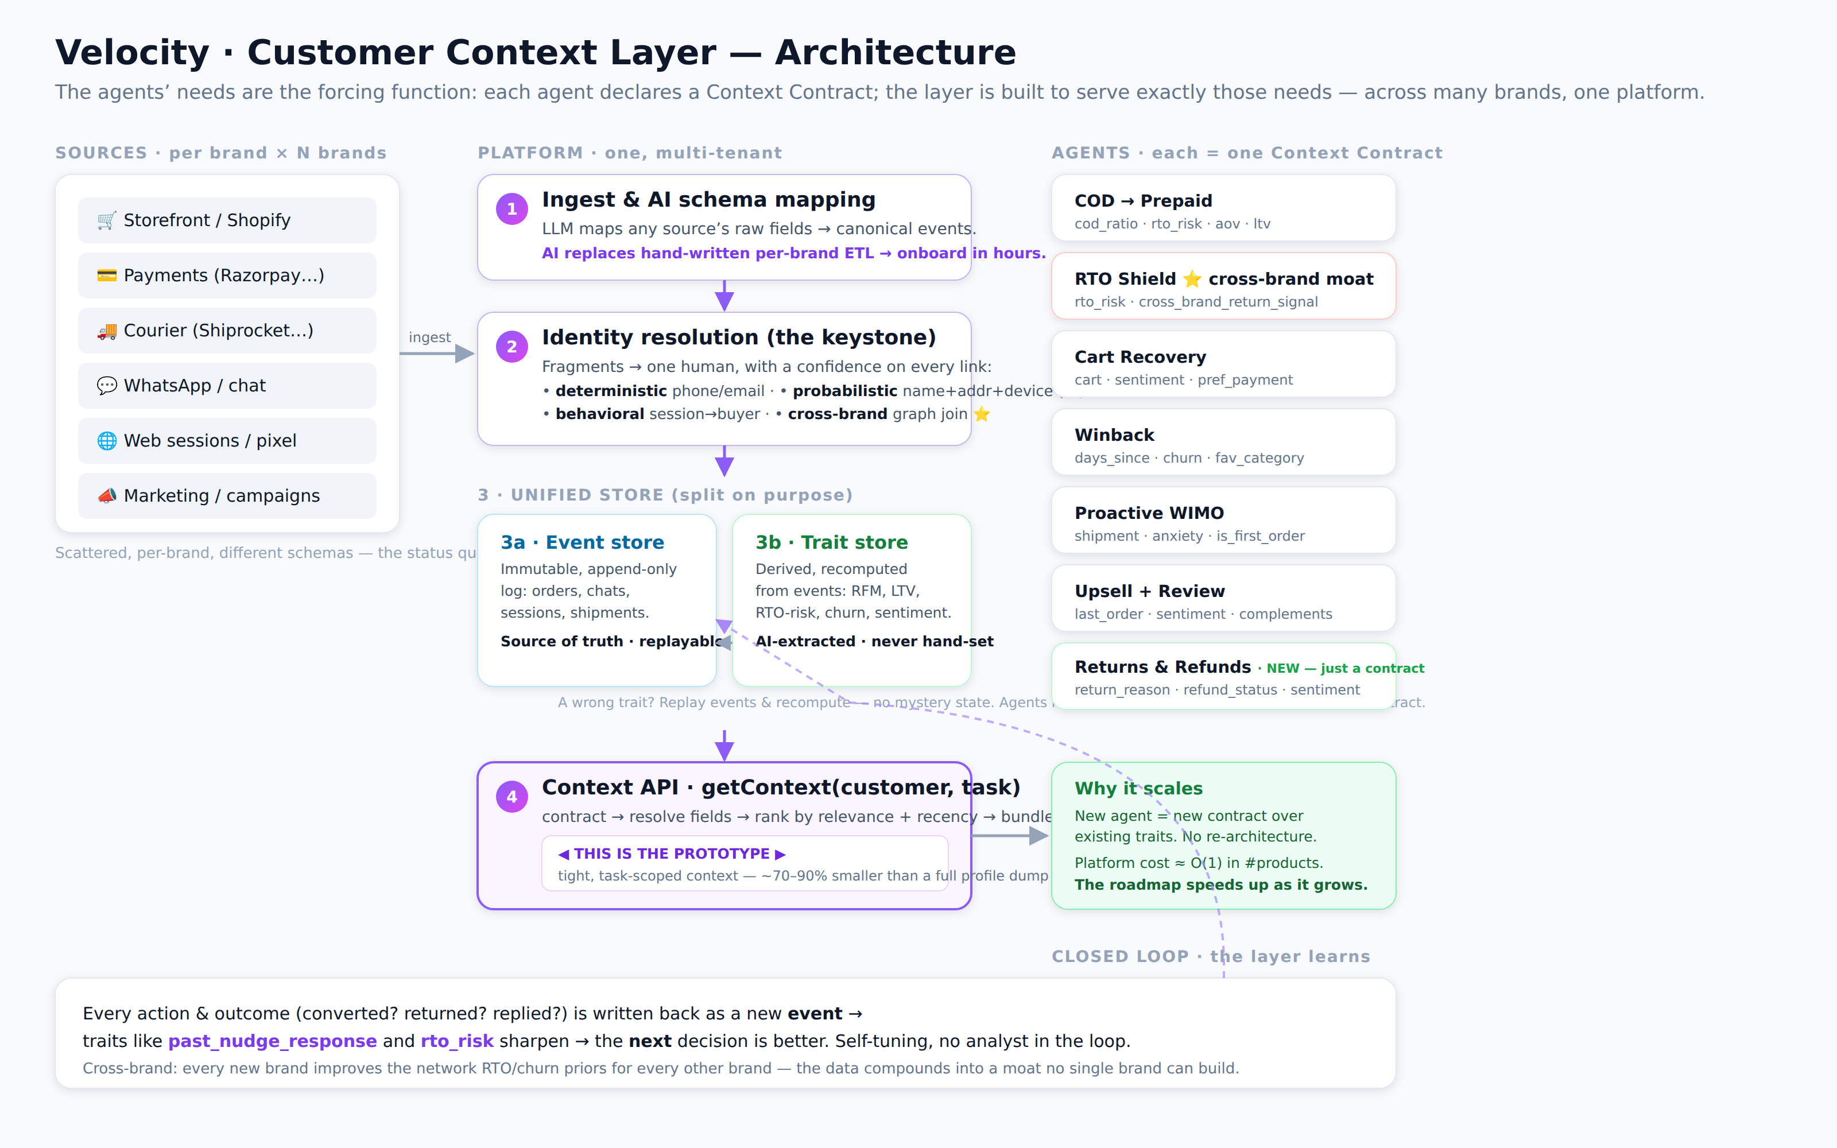
Slide 5 · Architecture (one picture)
Sources → ① AI schema map → ② identity → ③ event + trait store → ④ Context API → agents (incl. Returns & Refunds) → closed loop
Notes:
Left to right: sources are the mess. One — AI maps any schema to events. Two — identity, the keystone. Three — event store is truth, trait store derived. Four — the Context API, that's the prototype. Then agents, each a contract — including Returns & Refunds, added as just a contract. Bottom — the closed loop.

Slide 7
Slide 6 · #1 Unify, part 1 — Identity resolution (the keystone)
Nothing downstream works until "4 records → 1 human." Three escalating signals, AI-graded:
• Deterministic — exact phone/email/account match. High precision, does ~70% of the work.
• Probabilistic (AI) — fuzzy name + address + device, scored by a model. "P. Sharma" + same address + same device ≈ "Priya Sharma". Every link carries a confidence, never a silent merge.
• Behavioral — an anonymous session tied to a known buyer by device + geo + browse pattern.
Output is an identity graph with a confidence per edge. Low-confidence merges are held for review, not auto-joined — wrong merges are worse than missed ones.
Cross-brand is the same machinery, one level up: the same phone across Aurelia + Kettle + Voxa is one node in Velocity's graph even though no single brand can see it. (This is the moat — slide 10.)
---
Notes:
Don't rush it — the keystone. Three escalating signals, each with confidence. Precision over recall: a wrong merge is worse than a missed one. Cross-brand is the same graph one level up. Two stores: events are truth, traits recomputed.

Slide 8
Slide 7 · #1 Unify, part 2 — Why two stores, not one
Event store (immutable): every order, message, session, shipment as an append-only fact. Source of truth. Replayable.
Trait store (derived): RFM, AOV, LTV, RTO-risk, churn-score, sentiment, segment — recomputed from events, never hand-set.
Why split them:
• Trust & auditability — a trait is wrong? Replay the events and recompute. No mystery state.
• Schema stability — new agents read traits, not raw tables. We can change how a trait is computed without breaking any agent.
• This is what makes contracts cheap — a contract is just a list of trait/event keys. Adding a trait never breaks an existing contract.
---
Notes:
Events immutable truth; traits recomputed. A wrong trait? Replay and recompute. Agents read traits, so recomputation never breaks a contract.

Slide 9
Slide 8 · #2 AI-first — where AI does the work, not rules or humans
We push the manual/rules work onto models at five points:
The prototype demonstrates the last two live. The deck claims the first three — same pattern, applied earlier in the pipeline.
---
Where | Today (manual/rules) | With AI
Ingestion | Engineers hand-map each brand's CSV/API schema | LLM maps any source schema → canonical events. New brand onboards in hours, not a sprint.
Identity | Exact-match rules only; rest dropped | Probabilistic matcher scores fuzzy links with confidence
Traits | Analysts define segments in SQL | Model extracts sentiment, intent, anxiety, RTO-risk from raw events
Segmentation | Marketer writes SQL / waits on data team | Plain English → live segment (shown in prototype)
Action | Templated, static copy | Per-customer message generated from the task bundle (shown in prototype)
Notes:
Criterion two. Five places AI replaces rules or humans. The prototype shows the last two live — English to segment, minimal context to message. If you have a key, run live here.

Slide 10
Slide 9 · #3 Features — today's 7, then what brands don't have
Built on the layer today (in the prototype): COD→Prepaid · RTO Shield · Cart Recovery · Winback · Proactive WIMO · Upsell+Review · Returns & Refunds. Each is just a contract + decision logic + message — the 7th (Returns & Refunds) was added as a pure contract, no re-architecture.
New capabilities the layer unlocks that brands can't do today:
• Anticipatory, not reactive — WIMO that messages before the customer asks, because we see "in transit + first order + 2 prior anxious chats."
• Cross-brand cold-start — a brand-new customer to Brand X already has an RTO-risk prior from their behavior on Brands Y/Z. Day-one intelligence.
• Self-tuning agents — every send + outcome (converted? returned? replied?) writes back as an event → traits like past_nudge_response sharpen the next decision. The layer learns.
• One agent, many jobs — the same customer flows through whichever contract fits the current moment; no per-product data project.
---
Notes:
Six agents today plus the new stuff brands can't do: anticipatory, self-tuning, cross-brand cold-start. Contracts on one layer, not separate products.

Slide 11
Slide 10 · #3/#4 — The cross-brand moat
A single brand sees Vikram place one COD order and return it. Annoying, not a pattern.
Velocity sees Vikram across three brands: 4 of 5 orders returned. Now the next COD order — at a brand he's never bought from — gets COD paused and prepay required before we ship at a loss.
• No individual brand can build this. It only exists because we're one platform serving many brands.
• It compounds: every brand that joins makes the RTO/churn priors better for every other brand.
• This is the defensibility. The data layer isn't a cost center — it's the network effect.
---
Notes:
Strongest slide — slow down. One brand sees one return; we see four of five across three brands. We pause COD before shipping at a loss. No single brand can build this; every brand makes the priors better. The moat.

Slide 12
Slide 11 · #4 Scale — the Context Contract is the whole trick
• A contract is a small declarative list of trait/event keys + decision logic.
• It reads the existing trait store. 90% of the time it needs zero new data.
• When it needs a new trait, that trait is computed once from events and is then available to every future agent.
Result: platform cost is roughly O(1) in number of products. The roadmap accelerates as it grows instead of bogging down — the opposite of the "re-plumb every time" status quo.
---
Notes:
How it scales. New product equals a new contract over existing traits. No re-architecture. Returns & Refunds is the proof — I added it as a contract last week. Cost stays flat per product.

Slide 13
Slide 12 · #4 Scale — multi-tenancy & governance (the unglamorous part that decides if this is real)
• Tenant isolation by default — every event/trait is brand-scoped; agents read only their brand's data.
• Cross-brand is a privileged, governed join — network signals (RTO/churn priors) are shared as derived scores, never raw PII across brands. A brand never sees another brand's order; it sees "elevated network RTO risk."
• Consent & data residency — India DPDP-aware; per-brand consent flags travel with the customer; PII minimized in prompts (the contract already limits what reaches the model).
• Auditability — because traits are recomputed from the event log, every agent decision is explainable after the fact.
---
Notes:
The unglamorous part. Brand-isolated by default; cross-brand shares derived SCORES, never raw PII. DPDP-aware. Auditable because traits recompute from the log.

Slide 14
Slide 13 · #5 — What I'd build first (and why)
Prioritized by value × data-readiness × reversibility-of-risk. Build where the data is already clean and the downside of a wrong action is low; defer where it isn't.
Phase 0 — Foundation (weeks 0–4). Identity resolution + event store + trait store + Context API.
Why first: everything else is worthless without it, and it's the highest-leverage, lowest-glamour work. No agent ships until "4 records → 1 human" is trustworthy.
Phase 1 — High-value, low-regret agents (weeks 4–8).
• Proactive WIMO — data is already clean (order + shipment status), worst case is a friendly extra message. Near-zero downside, immediate CX win, extends the agent that's already live.
• Cart Recovery — strong signal (live cart), reversible, fast revenue.
• COD→Prepaid — direct margin impact; the nudge is low-risk even when the model is wrong.
Phase 2 — Higher-stakes, needs more history (weeks 8–16).
• RTO Shield (incl. cross-brand) — highest revenue protection, but pausing COD on a good customer is a costly false positive. Ship only once the RTO model and cross-brand graph have enough volume to trust.
• Winback — needs ≥6–12 months of history per cohort to size offers correctly.
• Upsell + Review — easy, but lower urgency; good "fast follow."
---
Notes:
Criterion five. Foundation first — nothing works without identity and the stores. Then low-regret agents: WIMO, cart, COD-to-prepaid. Value times data-readiness times reversibility of risk.

Slide 15
Slide 14 · #5 — What I'd deliberately defer (and why)
The senior signal is the restraint: the prototype itself has no DB, no auth, no real integrations — on purpose. Knowing what not to build in a 1–2 day window is the same muscle as knowing what to defer on the roadmap.
---
Deferred | Why later
Fully autonomous send (no human in loop) | Earn trust first with suggestion-mode + sampled review. Autonomy is a dial, not a launch toggle.
Broad marketing broadcasts | High blast radius, low per-message intelligence — it's the least differentiated use of the layer. Do the 1:1 agents first; broadcasts are easy to bolt on once segments are trusted.
Returns/refunds adjudication | Touches money + policy + emotion. Needs governance and brand-specific rules before AI decides.
Self-serve "build your own agent" for brands | Powerful, but only after the contract format and trait catalog have stabilized on our own agents.
Deep ML retraining infra | Pre-computed/heuristic traits are good enough to ship Phases 1–2. Build the ML platform when a trait's accuracy is the actual bottleneck — not before.
Notes:
What I'd cut, and why. Autonomous send, broadcasts, returns adjudication, ML retraining — high blast radius or money/policy. Earn trust first. The restraint is the signal.

Slide 16
Slide 15 · Risks & honest open questions
• Identity false-merges — mitigated by confidence thresholds + human review of low-confidence joins; we tune for precision over recall early.
• Cross-brand privacy — share derived scores, never raw PII; needs legal sign-off per DPDP before GA.
• Cold-start for tiny brands — network priors help, but a brand with 50 orders won't have stable traits; fall back to platform-wide priors + conservative actions.
• Model cost at scale — the contract (small payloads) is itself the cost control; cache traits, batch trait extraction, reserve live generation for high-value moments.
---
Notes:
Be honest. Real risks: identity false-merges and cold-start for tiny brands. Mitigations: confidence thresholds plus review; platform-wide priors plus conservative actions.

Slide 17
Slide 16 · The one line
Today's WhatsApp agent gets smarter the day this layer ships.
Every future agent just declares a contract over the same data.
And because it's one platform across many brands, the data compounds into a moat no single brand can build.
Why this is the right answer, not just an answer:
• It fixes the shared bottleneck every agent has — not one feature in isolation.
• It's AI-first and proven live — English → segment, minimal context → real message.
• It serves products not built yet — new agent = new contract, no re-architecture.
• The restraint is deliberate — no DB, no auth, no fake integrations; knowing what not to build is the same judgment the roadmap question tests.
The prototype makes it clickable. This deck is how it scales.
Notes:
Close on this, then stop. Today's agent gets smarter now; every future agent is just a contract; across brands the data compounds into a moat. Then the four reasons it's the right answer.

