Slide 1
What is ROBLOX Moderation

Slide 2
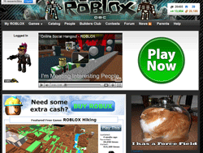
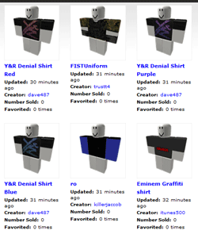
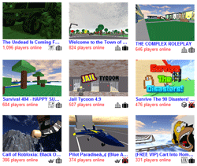
Moderation filters 3 areas of ROBLOX
Website
User Generated Uploads
3D Game Worlds

Slide 3
User Generated Text is Pre-filtered
Website
3D Game Worlds
Users type text as messages, comments, names of things, and game chats
Bad Word Auto-Filters
OK, to
Website or screen
Bad, to Moderator
Review
Moderators review using the Abuse Queue

Slide 4

Users may report bad content
Website
3D Game Worlds
Users click the Report Abuse link to alert mods to bad behavior or inappropriate content
Moderators review using the Abuse Queue
OK, no action
Bad
Bad content is removed from website, user sent to User Queue for punishment

Slide 5
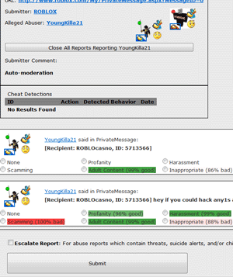
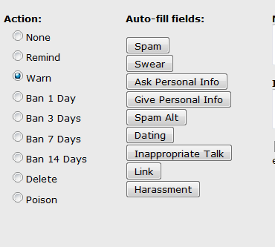
Text Moderation Workflow Screens
Abuse Review Queue
User Punishment Queue

Slide 6
User Generated Uploads are Pre-viewed
User created content images
T-shirts, Shirts, Pants, Decals, Ads, Badges, Group Logos
Human Moderators
Moderators punish in User Queue
OK, to
Website
Bad, to Punishment
Block for reasons*
*Privacy, Trademark, Competitors

Slide 7
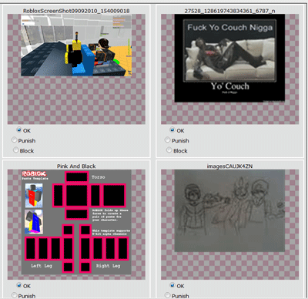
Image Moderation Workflow Screen
Human moderators preview each user uploaded image and decide if it should be sent to the website or not.
Images are displayed to moderators 15 per page.

