Slide 1


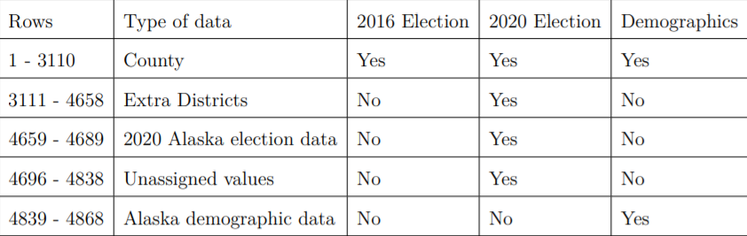
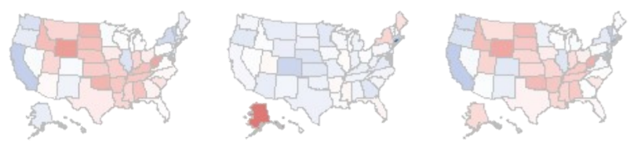
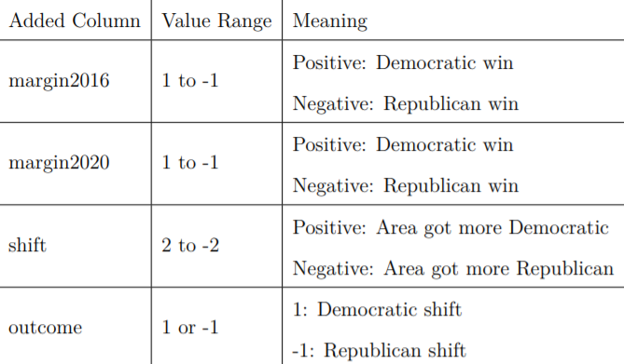
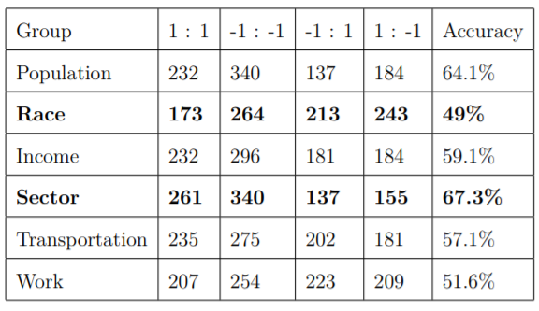
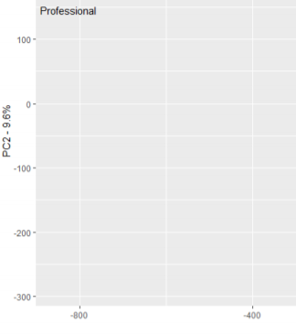
KNN Classification for Top Demographic Indicators of Voter Shift Between
2016 and 2020 Presidential Elections
Andrew Wang
Andrew Wang
What are the top demographic indicators of voter shift between the last two presidential elections?
Describe voter shift between last two elections
Identify top demographic indicator of voter shift
Two major current trends in voter shift are:
Increasing ethnic diversity among voters
The role of minority voters has become more pronounced, and these voters tend to favor Democrats (Daniller, 2020)
Democrats won 57% of the Asian vote in 2000, 73% in 2012 (Hudak & Stenglein, 2016).
Urbanization and the increasing urban rural divide
The polarization between urban and rural areas has increased
Democrats had a 5% victory margin in urban areas in 2012, 17% in 2018 (amp, 2019)
Republicans had a 29% victory margin in rural areas in 2012, 38% in 2018 (amp, 2019)
Research Purpose
Background
Methods
The United States electorate has gone through large shifts in the last few decades
Maintaining an understanding of these shifts is critical to understanding how our communities are changing
The election of 2020 gives us a unique opportunity to do this, with its record turnout numbers. (Rabinowitz, 2020).
Data: 2016 election, 2020 election, demographics (Schacht, 2020)
FIPS codes appended to counties (Lorenzo, 2020)
Initial dataset: 4868 rows, 51 columns
Cleaned dataset: 3031 rows, 51 columns
Results
Voter shift
2016 Vote Margins Voter Shift 2020 Vote Margins
Average 3% Democratic shift
40 states shift Democratic
5 states flip parties
Average Democratic: 3-6%
Average Republican: 1-2%
Democrats flip Georgia
Milestone for Democrats
Future elections may see Democrats making further progress into traditionally Republican states of the South and Midwest
Added columns to model voter shift
K-nearest neighbors (KNN) classification algorithm
Split demographic data into 6 groups for parsing
KNN shows how well data can predict shift
Best demographic grouping identified from this
Principle Component Analysis (PCA)
Applied to best demographic group
Dimension reduction determines best overall factor
KNN Analysis
PCA Results
Implications
PCA analysis run on employment sector group
Professional sector is most responsible for variation
Professional sector has negative value – it is inversely correlated to variation
As professional decreases, variation increases
Discussion
Large blue shift may lead to strong Republican states being contested in future elections
Sector is the best indicator of voter shift
Possibly due to the correlation between educational level and employment sector
Much of the Republican party’s voting base is non-college educated whites
Certain sectors were hit harder by the pandemic – more unemployment
Race is the poorest indicator of voter shift
Traditionally it has been one of the top factors for pundits to use
These inaccuracies highlight its limitations – modern race profiling lacks nuance
It over generalizes race
Ex: Puerto Ricans – traditionally Democratic, Cubans – traditionally Republican; both are counted as Latinos in race modelling
references
amp, U. N. (2019). How the rural vs. urban mindset fuels today’s politics.
www.usnews.com/news/best-states/articles/2019-05-14/demographic-shifts-incitiesand-states-bring-political-changes-too
Daniller, A. (2020). Americans’ immigration policy priorities.
www.pewresearch.org/fact-tank/2019/11/12/americans-immigration-policypriorities-divisionsbetween-and-within-the-two-parties/
Hudak, J., & Stenglein, C. (2016). How demographic changes are transforming u.s.
elections. www.brookings.edu/blog/fixgov/2016/09/13/how-demographic-changesare-transforming-u-s-elections/
Rabinowitz, K. (2020). 2020 turnout is the highest in over a century.
www.washingtonpost.com/graphics/2020/elections/voter-turnout/
Schacht, E. (2020). Election, covid, and demographic data by county.
www.kaggle.com/etsc9287/2020-general-election-polls
Lorenzo, P. D. (2020). 2. mapping the us. cran.r-project.org/web/packages/usmap/vignettes/mapping.html
Employment sector is the strongest predictor
Race is the weakest predictor
Our race modeling is flawed
Total population tends to overpredict Republican victories
Shows rural areas are not as Republican as thought
Limitations
Future research
Around 100 counties were missing from analysis due to naming discrepancies at the time of data collection.
Relationship between political leaning and sector
Where is this supported in legislation?
How can race be modelled more accurately to reflect political beliefs?

