Slide 1
Demographic Indicators of Voter Shift Between 2016 and 2020 Presidential Elections
Andrew Wang
Notes:
https://docs.google.com/document/d/1egYCgb2BdRSMHxRy0f-tzxoYfNVTOxEuowZ0OdfXRzA/edit

Slide 2
Introduction
Question: What is the demographic factor that best indicates voter shift in the last two presidential elections?
Voter shift: difference in voting margins
Hypothesis: Total population is the best indicator
Urban-rural divide
COVID-19 pandemic

Slide 3
Background
U.S. society and demography is changing rapidly
Electorate shift analysis provides insight into U.S. communities
Top trends and ideas:
Increasing ethnic diversity in voting – favors Democrats
Increasing urbanization – favors Democrats
This study looks at factors as a whole
As opposed to the narrowed scale of previous studies

Slide 4
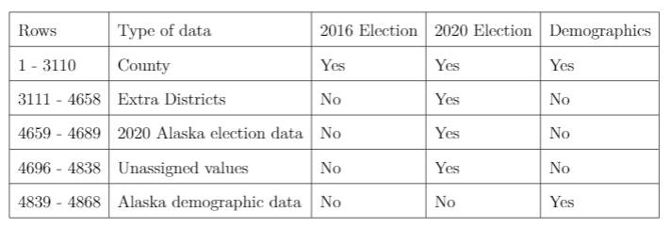
Data
Election, COVID , and Demographic Data by County
2016 election results
2020 election results
2017 American Community Survey 5-year estimate

Slide 5
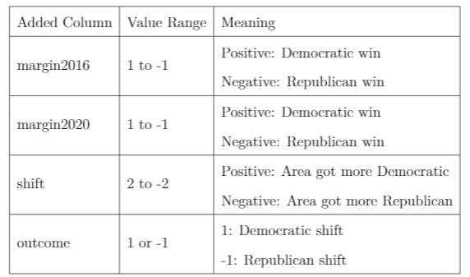
Methods
Margins calculated off voter percentages
Shift calculated off difference in margins
Demographic data split into groups
Groups put through K-nearest neighbors classification algorithm to find best group
Principal Component Analysis performed on best group to determine ultimate factor

Slide 6
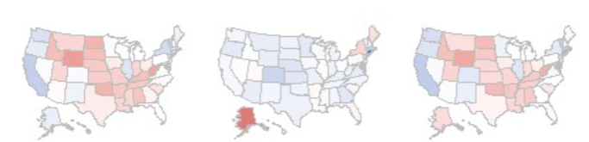
Results: Voter Shift
Slight shift Democratic: 3% Democratic on average
40 states shift Democratic
5 states flip parties
Democrats make progress in Midwest and South
Democratic victory in Georgia is a big milestone
Strong Republican states may become battleground states in the future
2016 Vote Margins Voter Shift 2020 Vote Margins

Slide 7
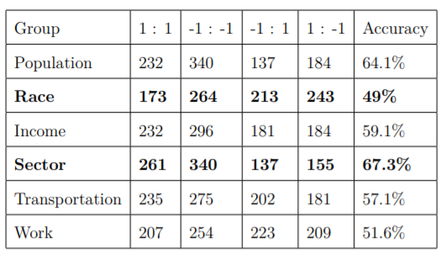
Results: KNN classification
70-30 training-testing split
Sector is the most accurate
Race is the least accurate
Interesting because race is often used as a predictor of voting trends
Indicates the limitations of race modelling
Population likely to overpredict Republican wins
Indicates rural areas are not as Republican as believed

Slide 8
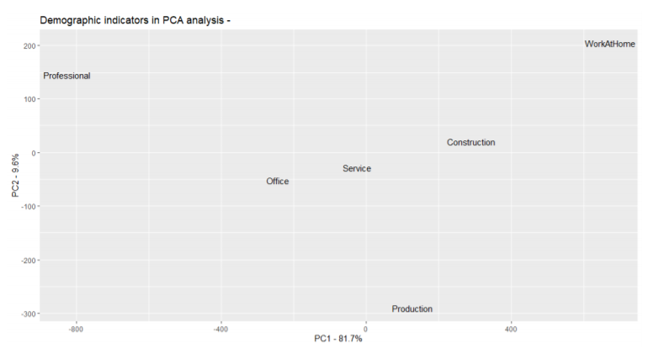
Results: PCA
Professional sector responsible for the most variance
Inverse relationship to variance

Slide 9
Conclusions
Slight Democratic shift over the last four years
Professional sector is the best indicator
Race is not as accurate as previously thought

Slide 10
Future Work
Why is sector important?
What are the relationships between sector and political leaning?
Where is this backed up policy decisions?
How can race be more accurately measured to reflect political belief?

