Slide 1


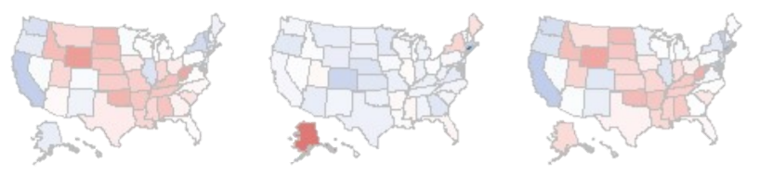
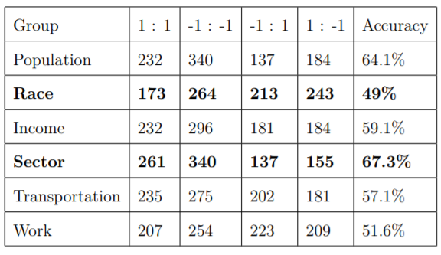
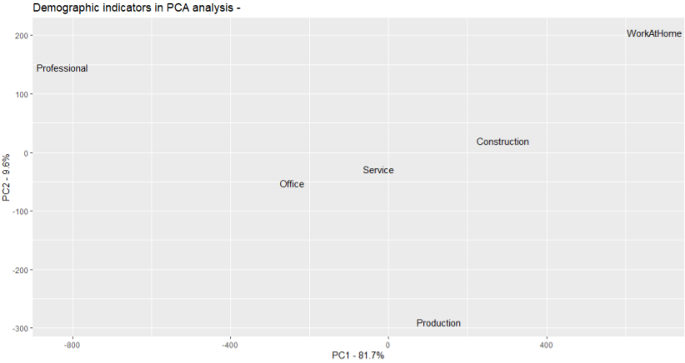
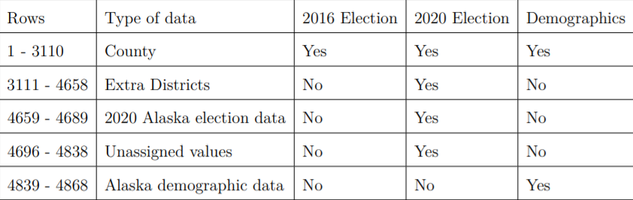
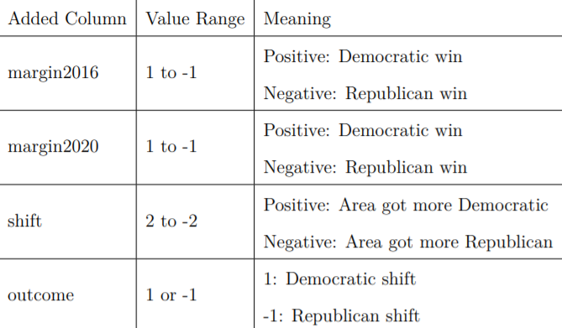
KNN Classification for Top Demographic Indicators of Voter Shift Between
2016 and 2020 Presidential Elections
Andrew Wang
What are the top demographic indicators of voter shift between the last two presidential elections?
Describe voter shift between last two elections
Identify top demographic indicator of voter shift
Background
2016 Vote Margins Voter Shift 2020 Vote Margins
Research Purpose
Results
The United States electorate has gone through large shifts in the last few decades. Maintaining an understanding of these shifts is critical to understanding how our communities are changing and how we can increase voter engagement. The election of 2020 gives us a unique opportunity to do this, with its record turnout numbers. (Rabinowitz, 2020).
Voter shift
United States experienced a slight Democratic shift, with 3% on average Democratic across all states. 40 states shifted Democratic, with five states flipping parties, giving Biden the Electoral College votes necessary to win. Average Democratic shift was 3-6%, while the average Republican shift was 1-2%. Flipping of Georgia marks a Democratic milestone, and the strengthening of Democrats may see many traditional Republican states in the Midwest and South become battleground states in the next election.
Two major current trends in voter shift are:
Increasing ethnic diversity among voters. The role of minority voters has become more pronounced, and these voters tend to favor Democrats (Daniller, 2020). Democrats won 65% of the Latino vote in 2000, rising to 73% by 2012. Similar trends are seen for Asians and African Americans, rising from 57% to 73% and 90% to 93%, respectively (Hudak & Stenglein, 2016).
Urbanization and the increasing urban rural divide. The polarization between urban and rural areas has increased. In 2012, Democrats had a 5% margin over Republicans in urban areas, but this increased to 17% in 2018 (amp, 2019). This is also reflected in rural areas, the margin growing from 29% to 38% between 2012 and 2018 for Republicans (amp, 2019).
PCA Results
Methods
Data
KNN Analysis
After running a PCA on the Sector group, the professional sector is the most responsible for variation in the group. However, it had a negative correlation to variation. This is reasonable as the sector values are percentages which sum to 100, so therefore as the professional sector’s size decreases the other sectors can be expected to increase, creating variation.
Primary dataset was drawn from Kaggle, it is a combination of 2016 and 2020 election results with a 2017 American Community Survey demographic report (Schacht, 2020). A tabular breakdown of the data is seen to the right. 2016 election data for Alaska was manually added in and Extra districts were removed because they missed demographic data.
Based off the KNN table, employment sector is the strongest predictor of voter shift, and race is the worst predictor. One further outstanding trait is the tendency for total population to overpredict Republican victory.
For mapping purposes Federal Information Processing Standards (FIPS) codes were appended to the counties(Lorenzo, 2020) .
Initial dataset: 4868 rows, 51 columns
Cleaned dataset: 3031 rows, 51 columns
Implications
Discussion
references
Sector being the most accurate indicator was a surprise. The accuracy of sector could be due to the correlation between industry and party affiliation, as much of the Republican party’s voting base is non-college educated whites, it’s reasonable that they hold more jobs in sectors like construction and production. Given the COVID-19 pandemic, these sectors with without a large digital aspect where also hit harder, and its reasonable to infer that unemployment was higher in those sectors. With higher unemployment its reasonable to conclude that more voters would vote for the challenger rather than the incumbent.
It was surprising that race was the poorest indicator though, as race has been one of the top demographic factors for political pundits to use in modelling. Its inaccuracy here highlights some of its limitations, modern race collection lacks nuance, as it over generalizes racial categories. One example of this is in the grouping of Latino. Puerto Ricans and Cubans vote very differently, yet they are both put into the group of Latino. This kind of grouping is one of the limitations of racial modelling.
amp, U. N. (2019). How the rural vs. urban mindset fuels today’s politics.
www.usnews.com/news/best-states/articles/2019-05-14/demographic-shifts-incitiesand-states-bring-political-changes-too
Daniller, A. (2020). Americans’ immigration policy priorities.
www.pewresearch.org/fact-tank/2019/11/12/americans-immigration-policypriorities-divisionsbetween-and-within-the-two-parties/
Hudak, J., & Stenglein, C. (2016). How demographic changes are transforming u.s.
elections. www.brookings.edu/blog/fixgov/2016/09/13/how-demographic-changesare-transforming-u-s-elections/
Rabinowitz, K. (2020). 2020 turnout is the highest in over a century.
www.washingtonpost.com/graphics/2020/elections/voter-turnout/
Schacht, E. (2020). Election, covid, and demographic data by county.
www.kaggle.com/etsc9287/2020-general-election-polls
Lorenzo, P. D. (2020). 2. mapping the us. cran.r-project.org/web/packages/usmap/vignettes/mapping.html
Preparation and modelling
To model voter shift, columns calculating the margins, shift, and outcome were added to the dataset. The margins are calculated as the difference between Democratic and Republican vote percentages, with the shift calculated as the difference between the two margins. The outcome is a binary indication
The cleaned dataset still composed over thirty columns of demographic data. This data was put into groups for more efficient analysis through KNN, being split into population, race, income, sector, transportation, and work.
The two methods used here were the K-nearest neighbors classification algorithm and Principle Component Analysis. KNN was used initially to identify the best demographic group of the six groups, and Principle Component Analysis was then applied to the specific group to yield the variable of the group responsible for the highest variance.
Limitations
Future research
Around 100 counties were missing from analysis due to naming discrepancies at the time of data collection.
Future research should look into the relationship between employment sector and political leaning, as well as how it is reinforced through policy decisions. Furthermore, future research should look at how race can be more accurately measured to reflect political belief.

