Slide 1
Milestone 2
BY: Aviv Yaaran and Zach Werle

Slide 2
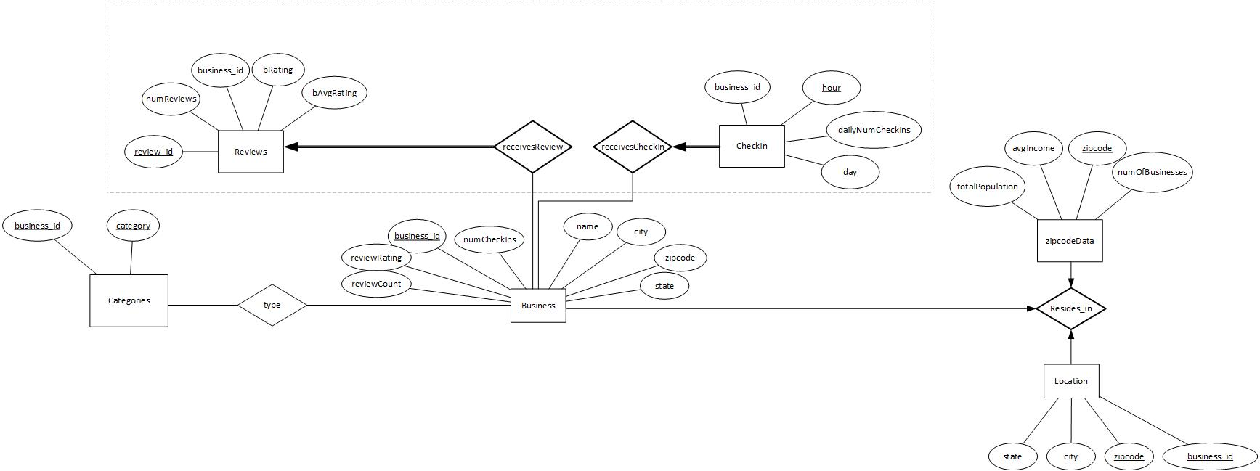
ER DIAGRAM
Notes:
(Aviv)
Notes:
This ER Diagram shows how a businesses yelp data is structured within our database.
The Business entity set; I would say is like our primary set as it identifies key attributes about the business
The Reviews & CheckIn entity set are related to business as they receive ratings and check-in stamps of their business from yelp users.
Respectively, their relationship with business is essential to know what reviews and how many check-ins a business got.
The Categories entity set classifies a business using a business_id, in which it can identify with one or more categories.
A business on our application will need to know what category a business falls in, so the relationship “type” was defined to classify it
The zipCodeData & Location entity set contains all the important info a region/zip code should contain including the total population and the average income within the region/zip code
So, the relationship “resides_in” was created to define where a business resides, and to store local financial and population data

Slide 3
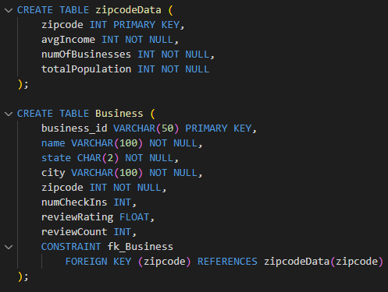
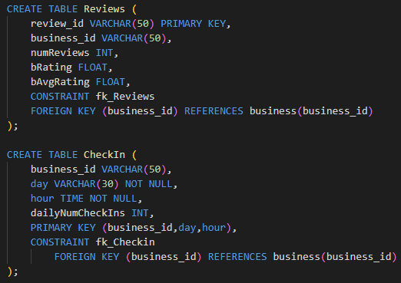
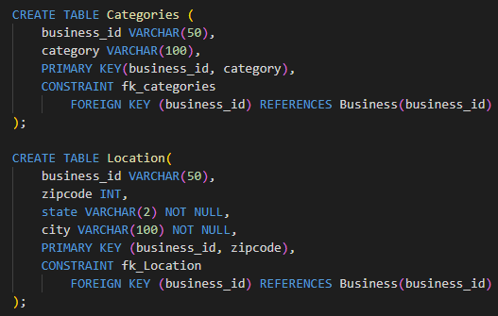
DDLs FOR THE ENTITY SETS
Notes:
(Aviv)
To begin, we must define the zipCodeData table before Business due to the foreign key constraints
The zipCodeData contains:
A Zipcode which is our primary key, avgIncome, numOfBusinesses, and totalPopulation
All of which was extracted from the zipData.sql file and the numOfBusiness were counted on our part.
A business contains:
A business_id (primary key) , name, state, city, zipcode, the number of checkins for that business, its review rating, and the number of reviews received.
To relate to the zipCodeData table creation above, the zipcode attribute becomes a foreign key to business relating to the zipcode in the zipCodeData table
The categories table contains:
A business_id, and a category where they are both the primary keys for this relation
A business can have more than one category, so to tackle this within our database, we made the business_id reference the business_id in Business so a business can reference a category more than once without it being restricted to one tuple and business_id
The Location table contains:
A business_id, zipcode, state, and city in which the business_id and zipcode are the primary keys
The business_id references again to the business_id in the Business table so the database understands where a business is located.
The Reviews table contains:
A review_id which is the primary key, business_id, number of Reviews, business rating, and the average rating of that business.
The business_id references again to the business_id in the Business table so the database understands the review statistics for that business.
The CheckIn table contains:
business_id, day, hour, and daily checkin amount
The primary keys are the business_id, day, and hour
The business_id references again to the business_id in the Business table so the database understands the checkin statistics for that business.

Slide 4
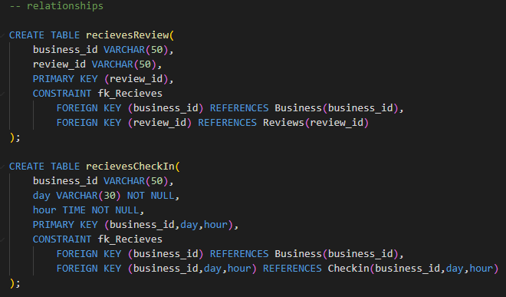
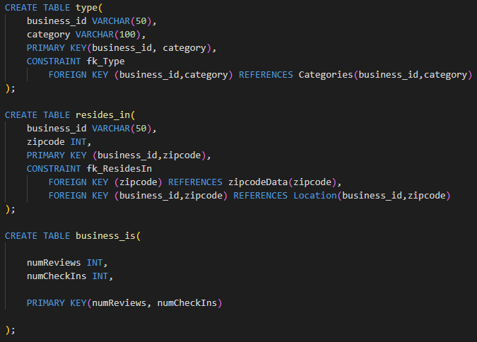
DDLs FOR THE RELATIONSHIPS
Notes:
(Aviv)
Now to understand how each of those relations previously mentioned create relationships between one another:
reivewsReview relationship is created between Reviews and Business tables,
With review_id made the primary key; the relationship table references the business_id and review_id to their respective tables (Business) and (Reviews)
receivesCheckin relationship contains the business_id, day and hour in which they are all primary keys
Business_id references business_id to the Business relation
And business_id, day and hour reference the same to the Checkin relation.
The type relationship table contains the business_id and category in which they are again primary keys and are also referenced as foreign keys to the Categories relation.
The resides_in relationship table contains the business_id and zipcode, both of which are primary keys
zipcode references zipcode in the zipCodeData relation as foreign keys so the database knows what kind of statistics to pull depending on the zipcode of that business
And the business_id and zipcode together respectively reference as foreign keys to the Location relation so the database query can know where a business ‘resides in’
Finally, the business_is relationship table contains the number of reviews and number of check-ins for a business
They are both made the primary keys for this relation

Slide 5
METRICS
HOW DO WE DETERMINE WHAT IS:
SUCCESSFUL
POPULAR
A business is determined to be successful if:
The reviewRating (Primary variable) is higher than 3.5
3.5 is the threshold for a business to be considered “successful”
The reviewCount (Secondary variable) is in the conversation just to reflect customer engagement within the business.
A business is determined to be popular if:
The numCheckIns (Primary variable) is higher than the average check-ins
Which is determined by the average checkIns for that business category in its respective zip code
And if the numCheckIns exceeds the average:
This suggests it is popular.
The reviewCount (Secondary variable) is also in the conversation to reflect the reviewCount is also high:
This helps justify a popular business.
Notes:
Just read the slides (Zach)

Slide 6

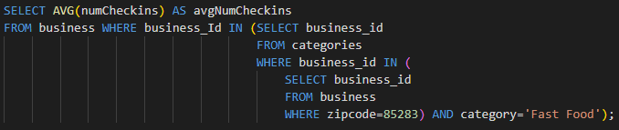
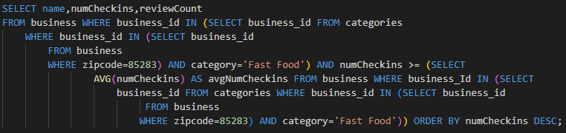
METRIC QUERIES
SUCCESSFUL BUSINESS QUERY EXAMPLE
POPULAR BUSINESS QUERY OF NumCheckIns EXAMPLE
POPULAR BUSINESS QUERY EXAMPLE
(SPECIFIC TO ZIP AND CATEGORY)
Notes:
Just read the slides (Zach)
(After this slide, Demo the UI)

