Slide 1
Through the
Yellow Gate

Slide 2
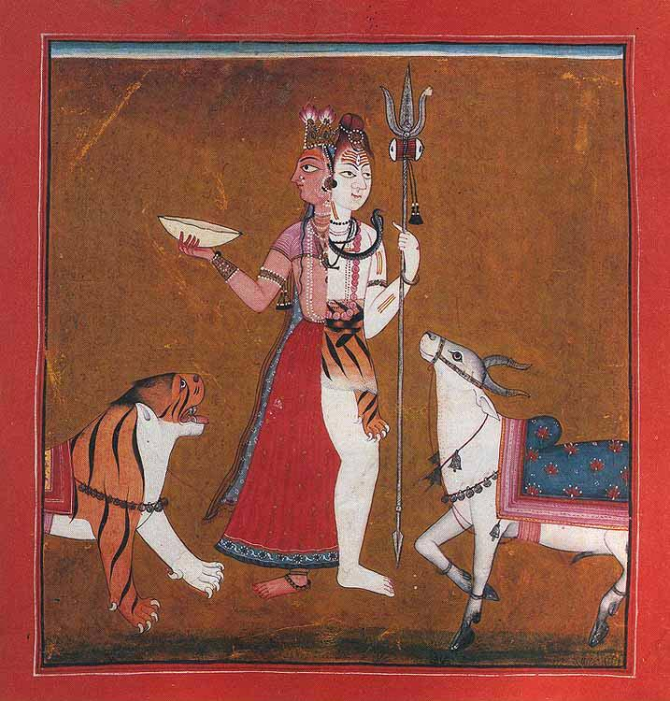
Ardhanārīśwara

Slide 3
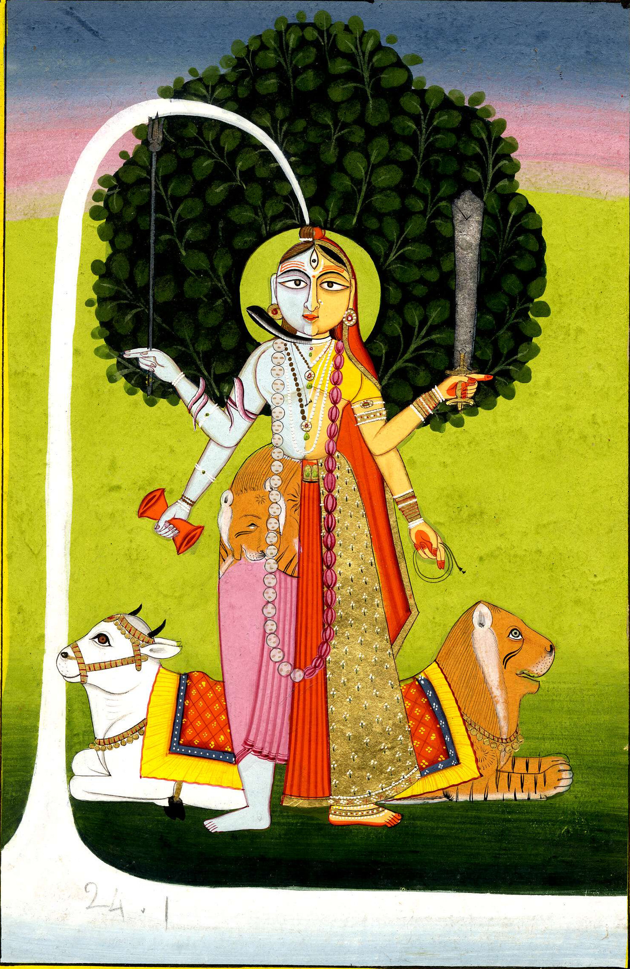
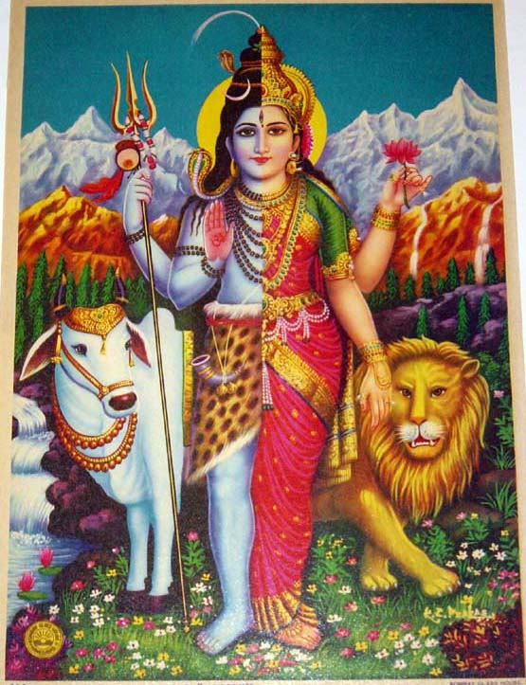

Slide 4
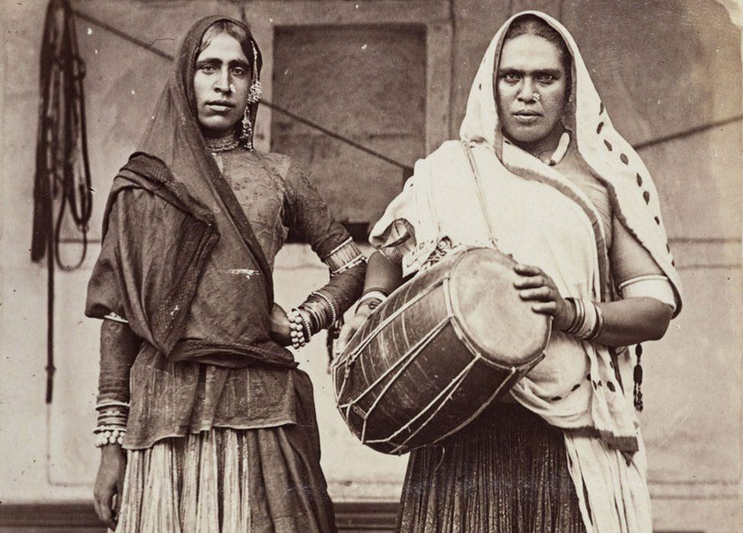
Hijra

Slide 5
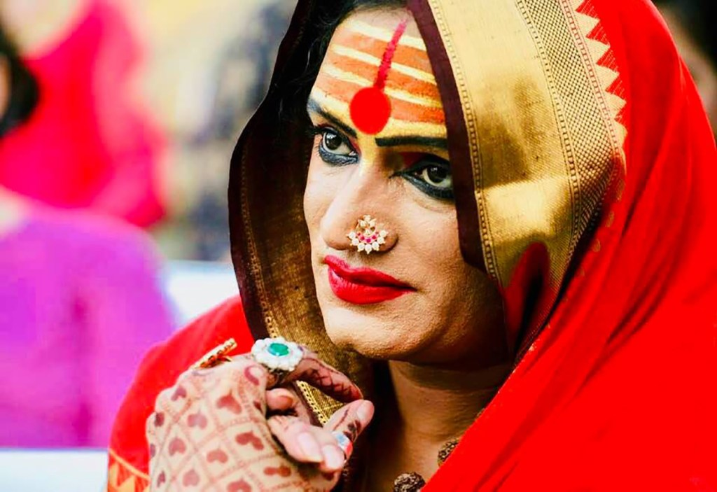
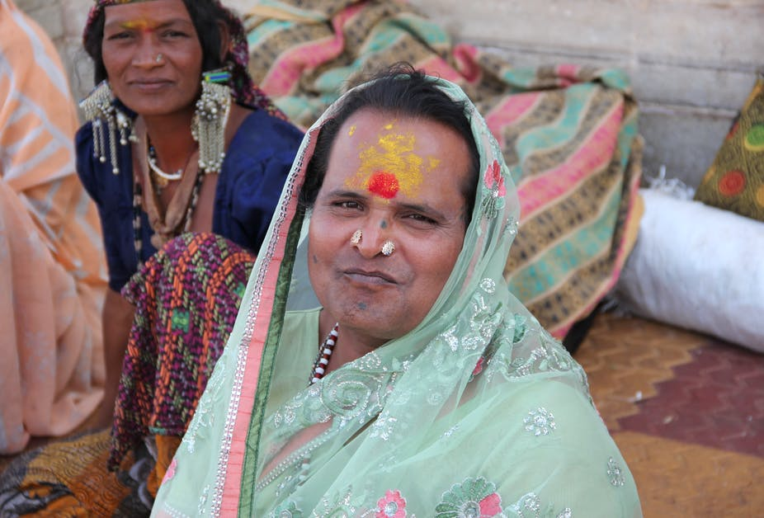

Slide 6
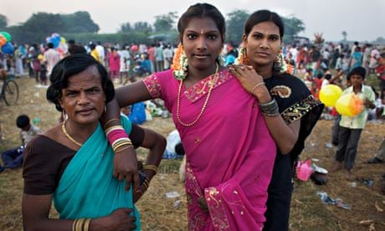

Slide 7
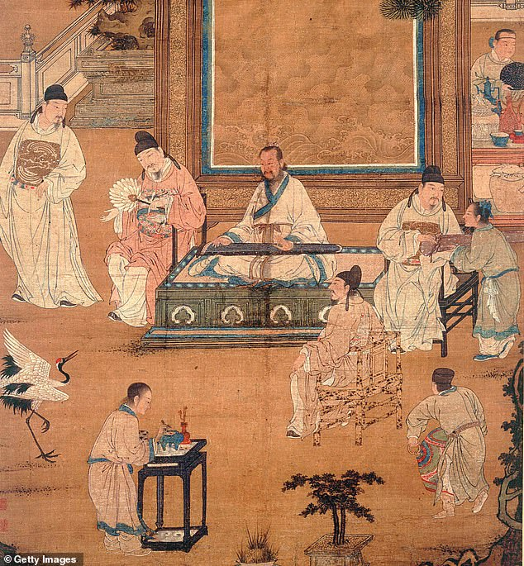
Imperial Eunuchs

Slide 8
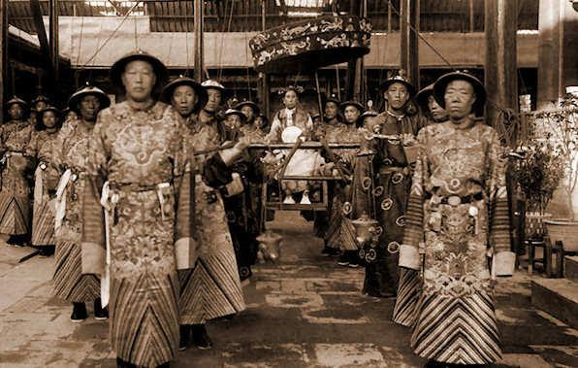

Slide 9
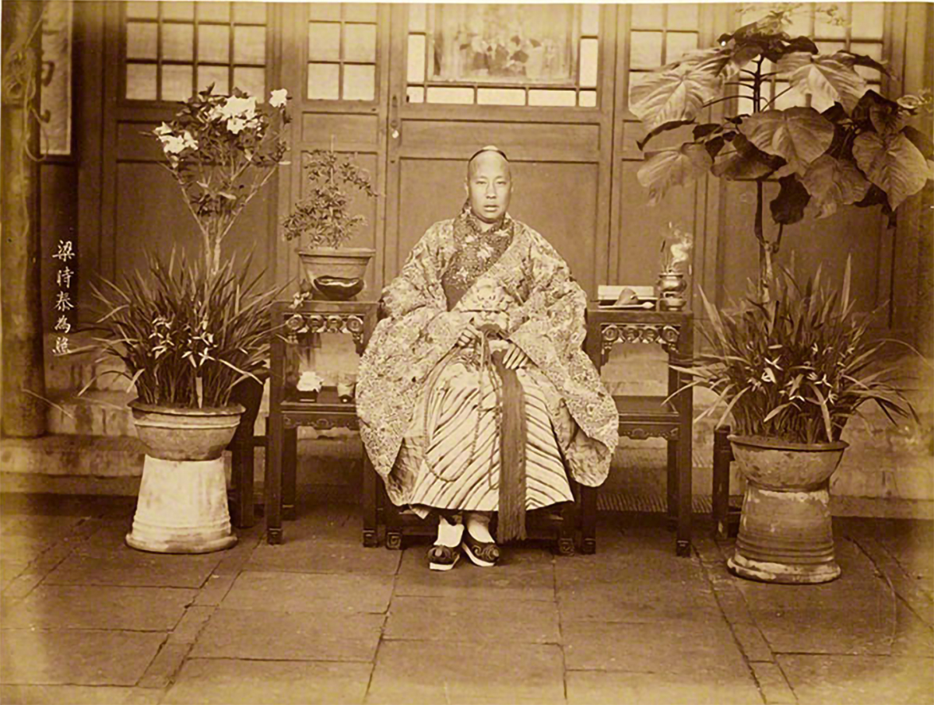
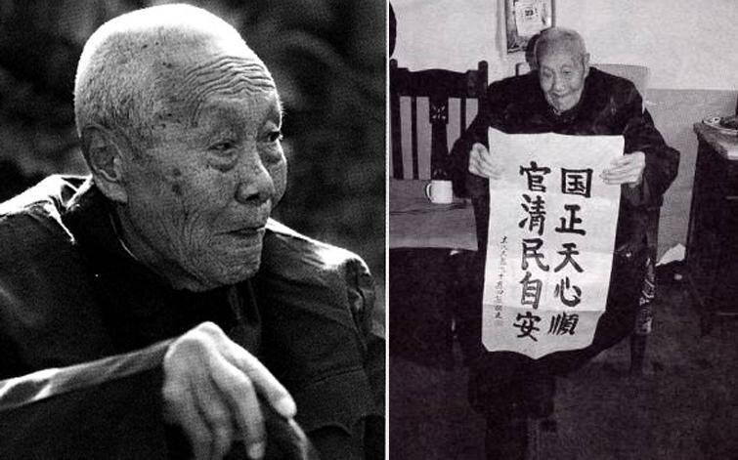

Slide 10
https://www.academia.edu/45662764/Through_the_Yellow_Gate_Ordination_of_Gender_Nonconforming_People_in_the_Buddhist_Vinaya

Slide 11

Tilorien.org

