Slide 1
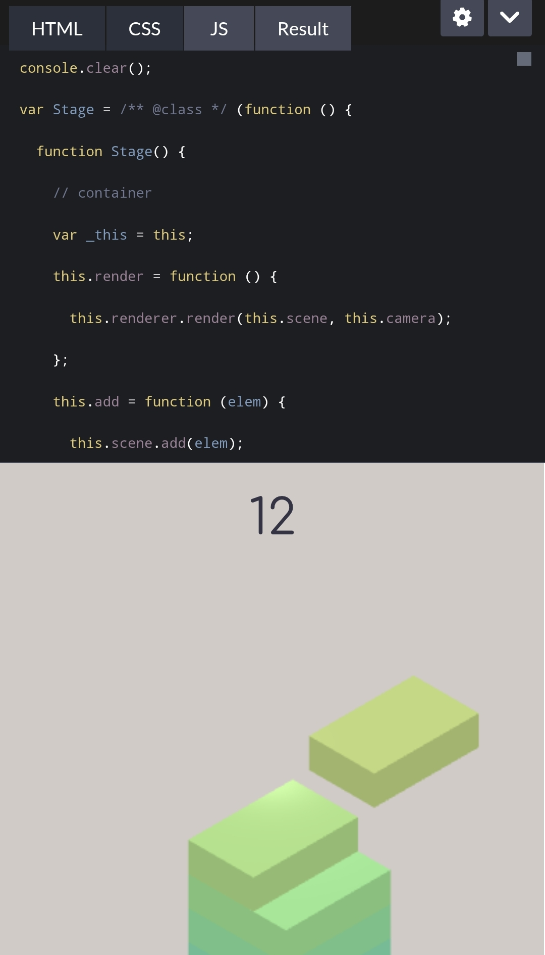

RESULTS AND SCREENSHOTS
Tall tower screenshot. Game over screen. High score example.
3/21/2024 Annual Review
10

