Slide 1
PF PROJECT
20K-0275 SYED ABDULLAH
20K-0278 MUHAMMAD AYYAN TAHIR

Slide 2
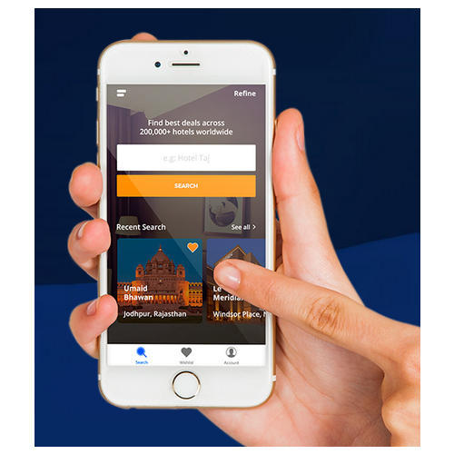
HOTEL BUDDY
This console application is designed to allow the user to book a hotel suiting his needs.
The customer can go through a variety of hotels and compare prices , location , services offered etc
They can determine the most feasible one, and book the one that best suits their needs.

Slide 3


THE IDEA BEHIND THIS
This project was inspired by other popular Hotel booking apps such as Trivago , Pobyt etc. In Pakistan the tourism industry is expanding day by day and this means more demand for hotels . Since Pakistan does not have a competitive local booking app and registration can be hectic and the commission is costly , we decided to create HOTEL BUDDY which provides easy and instant bookings for the customers and low commission rates which are satisfactory to the hotel entrepreneurs.

Slide 4
INPUTS USER(CUSTOMER)
Firstly, user will be asked to input basic details(name, phone no etc) in order to sign up.
Once the account is made the user will login with his/her ID.
The user will then enter their City name and the area in which they want to find the hotel
The date they want to book the hotel on and the no of rooms required after they had gone through the services offered by different hotels.

Slide 5
INPUTS ADMIN
Basic details in order to sign up
The ID in order to login
Input Hotel name in order to view commission and monitor ratings
Input customer Id and Hotel in order to delete a record.

Slide 6
INPUTS HOTEL REPRESENTATIVE
User will enter the no of rooms available in their hotel and prices
If the hotel offers discounts , then a promo code can be entered
The hotel name and basic details in order to sign up
The services offered by the hotel
The city and the area in which the hotel is located
The ID in order to login

Slide 7
SALIENT FEATURES
All the users(admin,customer,hotel staff) can update their basic details and Login IDs and passwords
The admin can update or delete hotel records and customer records
The hotel representative can update the services they offer,the price for stay, the no of rooms they have , the date slots available and promo codes they offer through which the customer can have discounts

Slide 8
ADVANTAGES
Customer can find the hotel based upon the nearest location and can go through all the services offered and pricing in order to determine the best hotel suitable to his/her needs and can rate that particular hotel
Admin can monitor all the ratings and if they believe that a certain hotel is not performing up to the mark , they can remove that hotel in order to maintain the app’s reputation
Hotel representative can also view the ratings provided by the user and they can improve their hotel by updating services and offering promo codes

Slide 9

DISADVANTAGE
With the introduction of HOTEL BUDDY people will switch from to tour operators and travel agencies to more online bookings. This will result in closure of these businesses and will reduce the no of jobs available in the tourist sector. Hence the only drawback is that there will be some small scale unemployment .

