Slide 1
Traffic Sign Classifier
Muhammad Ayyan Tahir 20k-0278 | BCS-6A
Syed Abdullah 20k-0275 | BCS-6A
Muhammad Fahad 20k-0441 | BCS-6C

Slide 2
Table of Contents
Introduction
The Dataset
The Model
Training
Testing
Solution
Conclusion
References

Slide 3
Introduction
Traffic sign classification is a critical task for self-driving cars and driver support systems.
The goal of building a CNN-based traffic sign classification system is to improve road safety by increasing the accuracy and reliability of traffic sign recognition.
Doing so will reducing the chance of accidents caused by human error.

Slide 4
The Dataset
The Dataset used in our model is GTSRB - German Traffic Sign Recognition Benchmark. (https://www.kaggle.com/datasets/meowmeowmeowmeowmeow/gtsrb-german-traffic-sign).
This Dataset contains 43 classes to classify up to 43 different type of traffic signs.
The Dataset contains over 50000 images of Traffic signs.
The Image data is converted into a numpy array and this array is now segregated into label and data and in this way we will be preprocessing over our data.
We have split our label and data into train and test using train_test_split in which 25% of data is reserved for testing and remaining 75% is used for training our model.

Slide 5
The Model
We have used Sequential class to build our CNN model as it allows us to build a layer by layer model in increasing efficiency.
We have used RELU activation function to avoid vanishing gradient problem.
Batch normalization is added to improve convergence speed, regularization, gradient flow, and allow for higher learning rates during training.
Dropout layers are added to prevent overfitting.

Slide 6
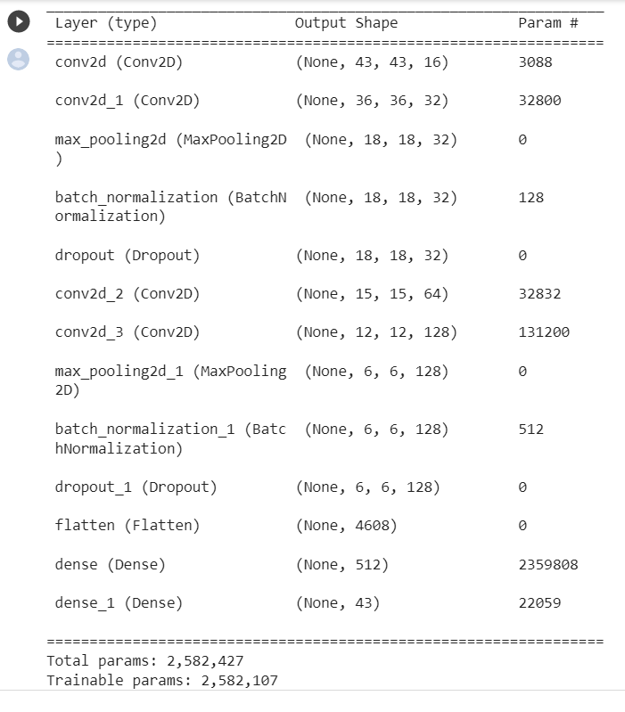
The Model
Fig 1.

Slide 7
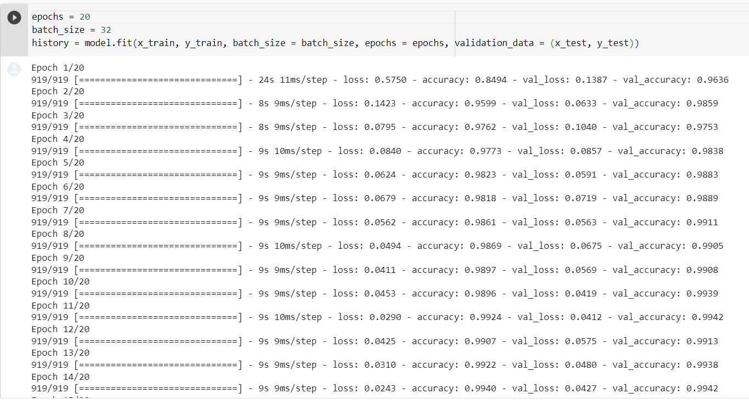
The model was compiled and ran over 20 epochs where each epoch consisted of 919 samples

Slide 8
Training
Data is trained over 20 epochs and a batch size of 32.
The learning rate is set to 0.001.
The model has a testing accuracy score of around 96-97%.
Total Loss while training data is 0.0165%.

Slide 9
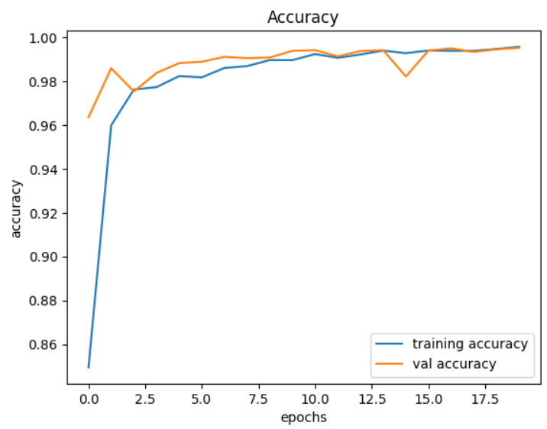
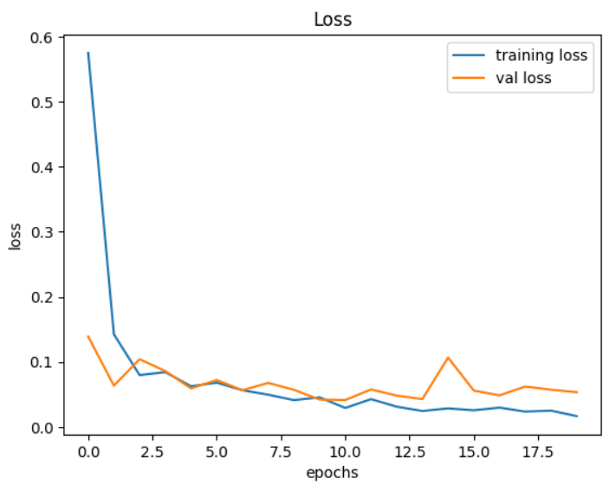
Validation and Training Curves
Accuracy
Loss
Fig 2.
Fig 3.

Slide 10
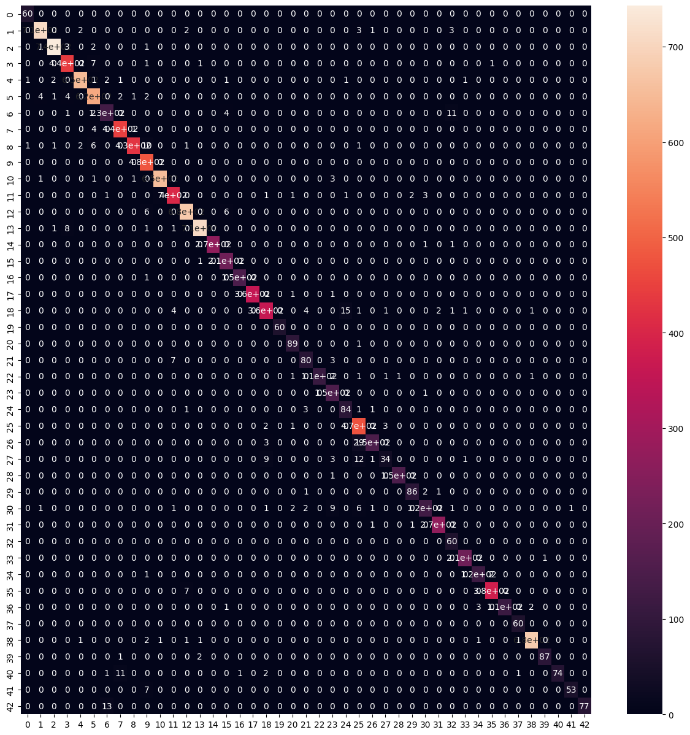
Confusion Matrix
A 43 * 43 confusion matrix generated as we had 43 classes in our dataset
Each row represents the actual label
Each column represents the predictions made by the model.
The diagonals represent the correctly predicted values.
Off-diagonal elements represent the number of misclassifications
Fig 4.

Slide 11
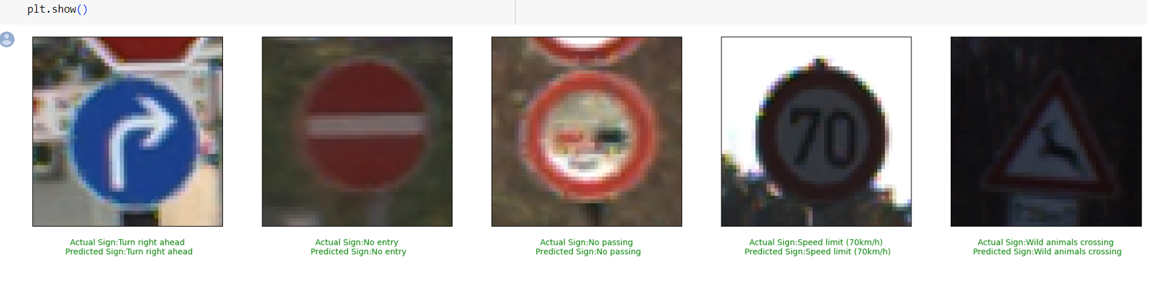
Testing
We have tested the data by providing 5 randomly chosen 5 images from the dataset and have used the model to predict what type of sign do the images represent.
Fig 5.

Slide 12
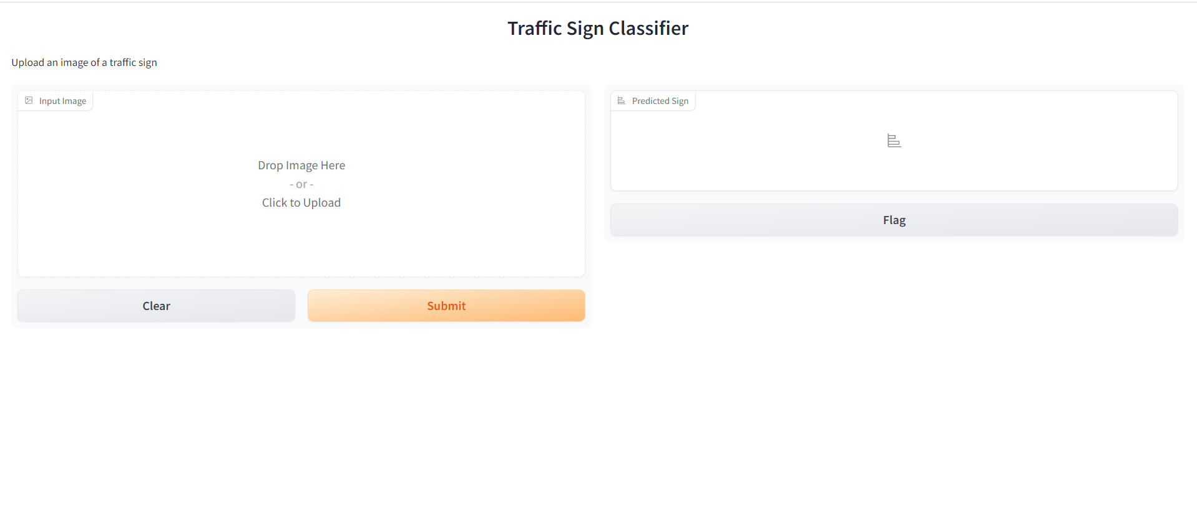
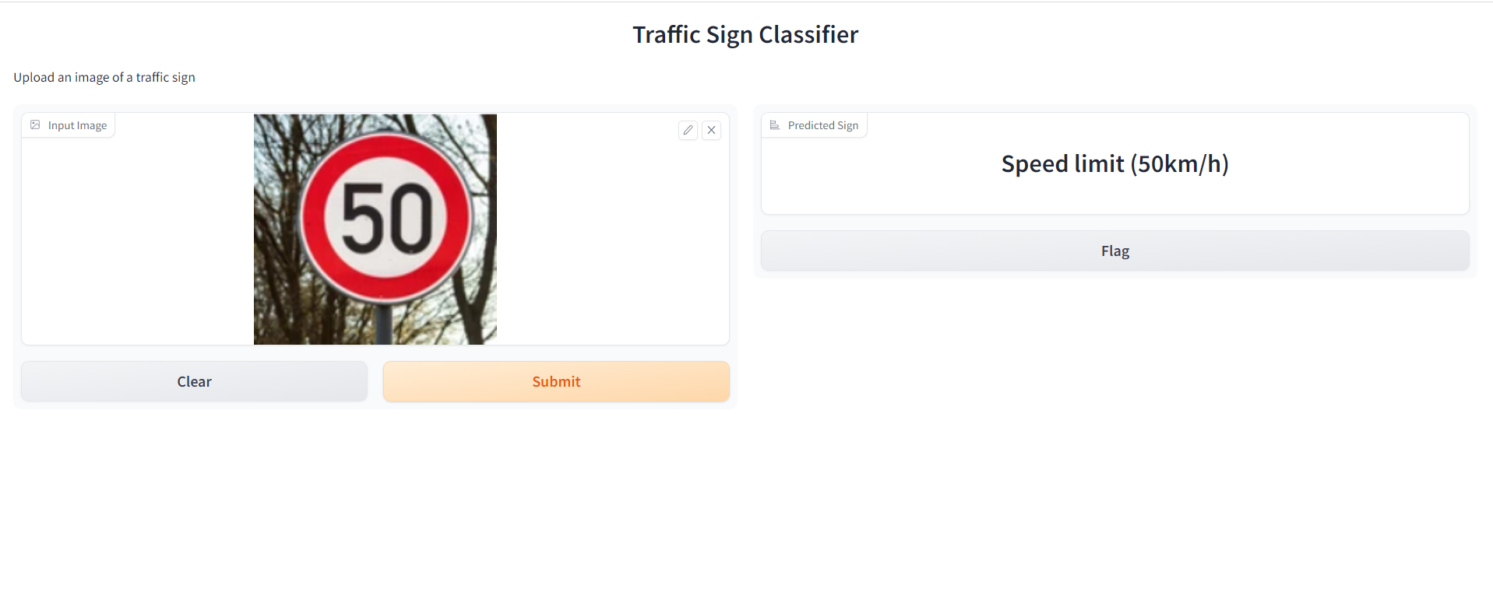
Ready To Use Solution
We have built a simple , ready to use webapp using the gradio framework in python. We have also deployed this live and anyone can access it using the following link
https://2648db93583726e25f.gradio.live
Takes image as an input from the user
The app uses the model loaded at the backend to correctly classify the signs

Slide 13
Conclusion
We successfully trained a CNN model by using the appropriate kernel sizes , filters and layers
We achieved 96 percent testing accuracy and built a ready to use webapp
The webapp we built is giving accurate results on the images input by the users.
The webapp is live and anyone can access it to educate themselves about different traffic signs.
The webapp can be used in driving schools ,traffic police institutions etc .
The web app can help increase road safety by providing drivers with an accurate classification of traffic signs

Slide 14
References
Yacharki. (n.d.). Traffic Signs Image Classification - 95.22% CNN. Retrieved from https://www.kaggle.com/code/yacharki/traffic-signs-image-classification-95-22-cnn
[1] Nain, N. (2021, December 9). Traffic Signs Recognition Using CNN and Keras in Python. Analytics Vidhya. https://www.analyticsvidhya.com/blog/2021/12/traffic-signs-recognition-using-cnn-and-keras-in-python/.

Slide 15
THANK YOU

