Slide 1
Variation of ATE for different yaw profiles
 | Flat (along z-axis) ATE (m) | Sine (along z-axis) ATE (m)
Yaw along velocity direction | 1.767 | 1.630
Yaw pointing 30 degrees from velocity direction (towards building face) | 1.368 | 0.937
Yaw always pointing towards building face | 0.672 | 0.683

Slide 2
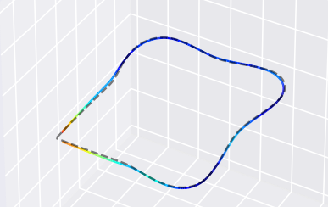
Yaw along velocity direction

Slide 3
Yaw pointing 30 degrees from velocity direction

Slide 4
Yaw always pointing towards building face

