Slide 1
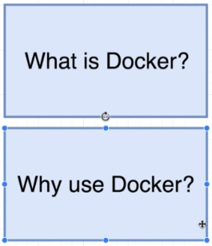
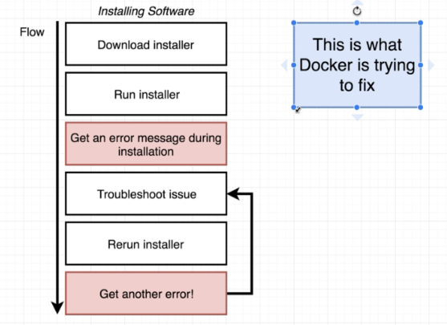

Slide 2
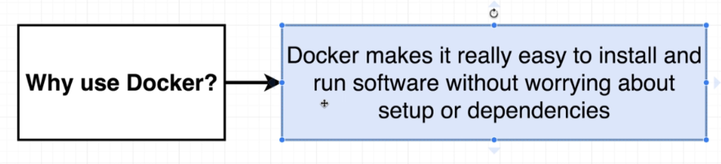
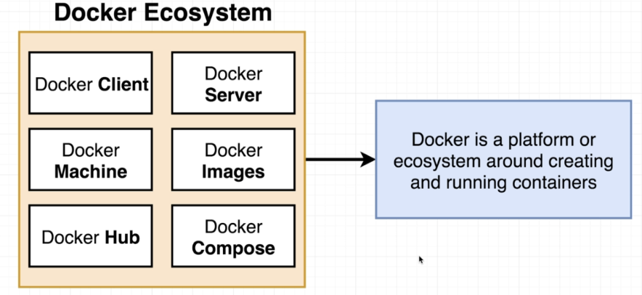

Slide 3
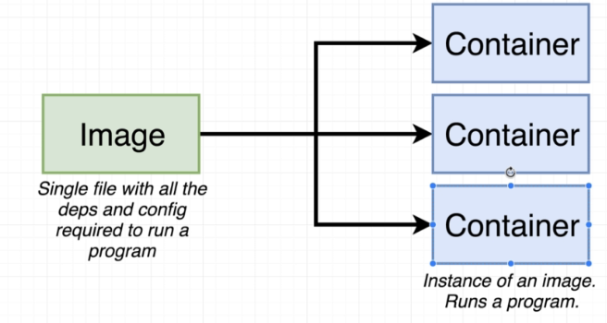
Relation ship between Image and container

Slide 4
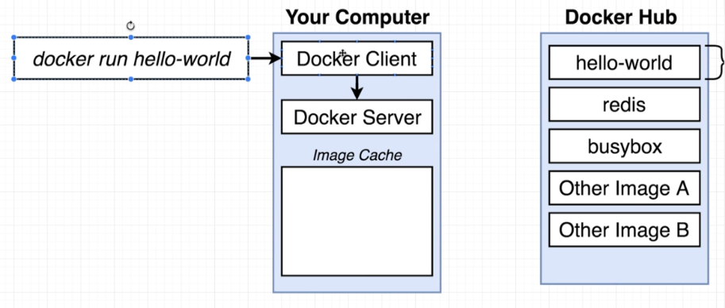
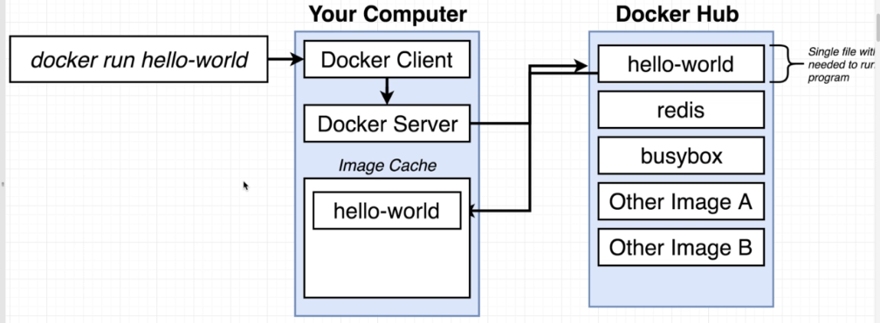
Running Hello World Program using Docker

Slide 5
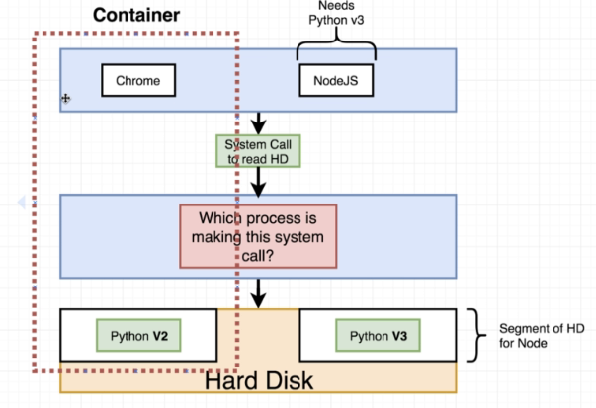
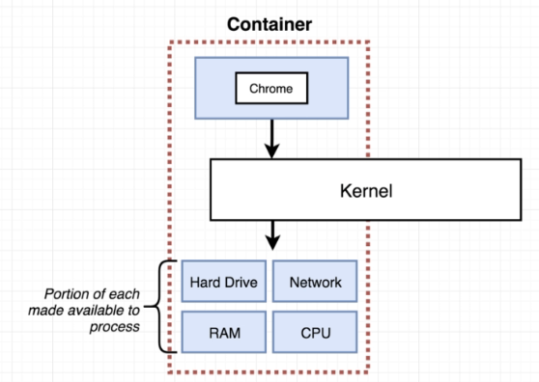
Background for a container

Slide 6
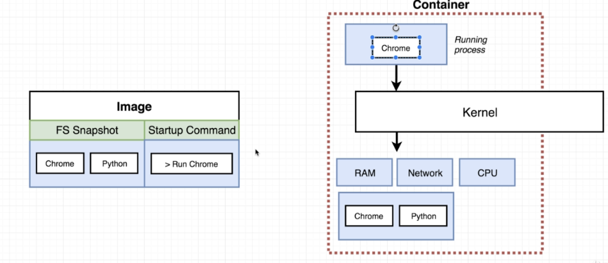
Relation ship between Image and container

Slide 7
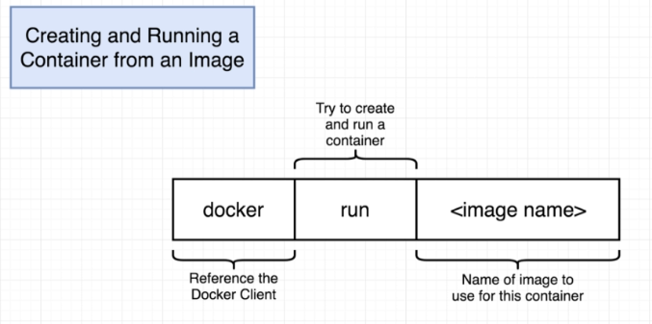
Docker in Detail

Slide 8
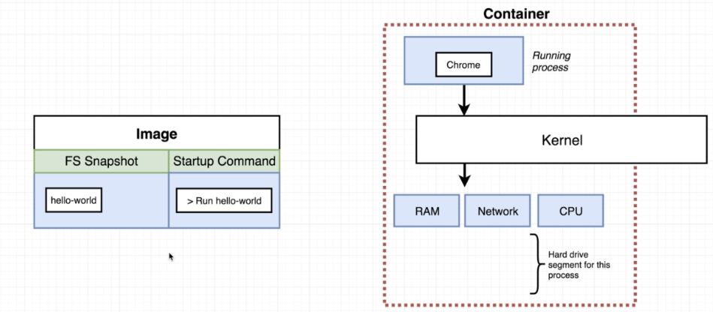
How Hello World Program Works:

Slide 9
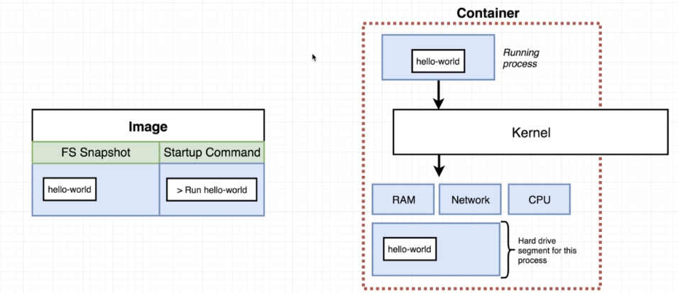
Copying the snapshot of the image to the hard drive.
hello-world command should be given in running process.

Slide 10
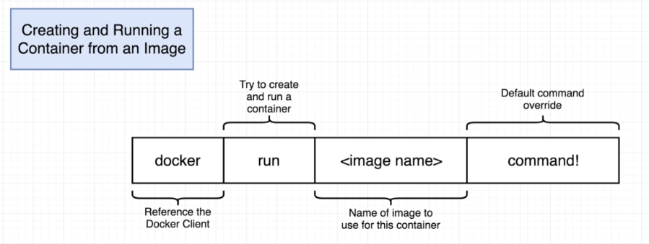
Docker override command

Slide 11
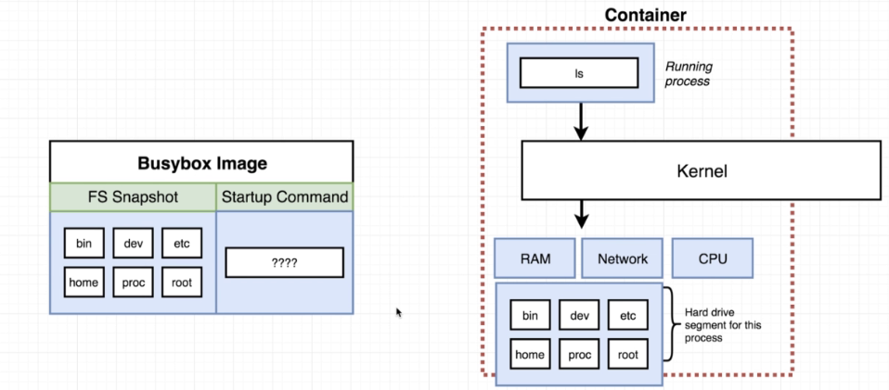
Explanation for Busybox Image

Slide 12
Commands:
Override command
->docker run busybox echo hi there
Listing all running containers:
->docker ps
->docker ps –all
Delete all stopped containers:
->docker system prune
Logs of a container
->docker logs containerId
Executing command in a running container:
docker exec –it <container id> sh
Isolation of a container:
1st terminal:
docker run –it busybox sh
2nd terminal:
docker run –it busybox sh
3rd terminal:
docker ps
Now go to 1st terminal
touch hithere

Slide 13
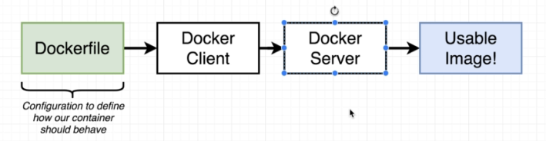
Building Images
A Docker file is a plain text file
This Docker file is going to define how our container behaves.

Slide 14
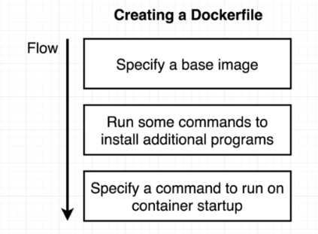
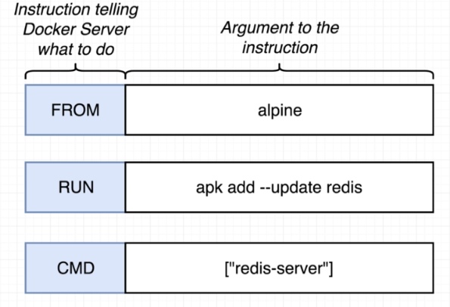
Docker File Flow

Slide 15
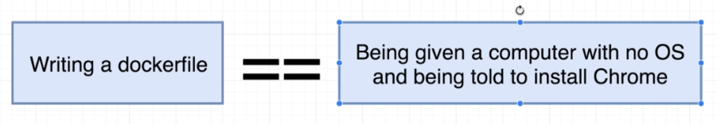
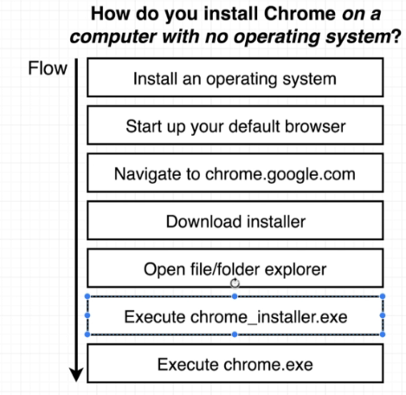
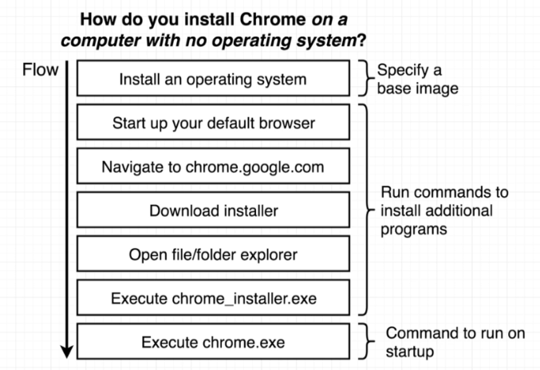

Slide 16
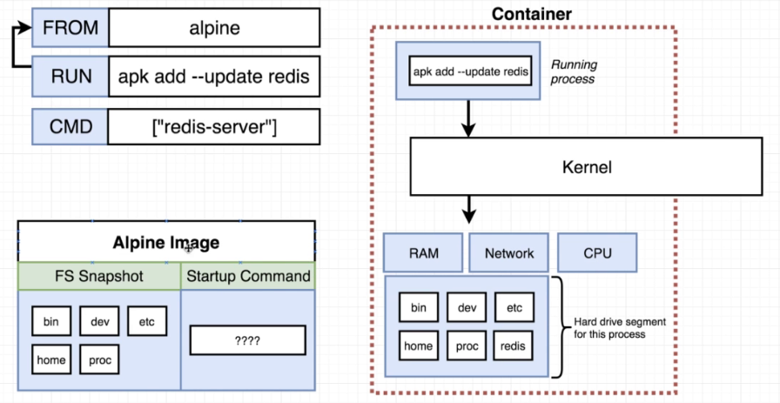
Internal of Docker:

Slide 17
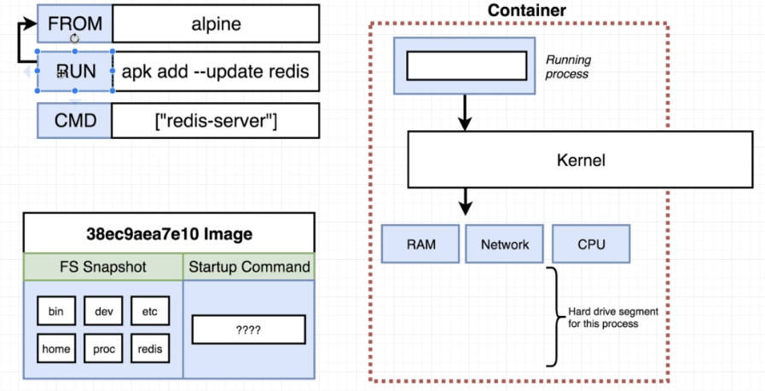
Step 2:

Slide 18
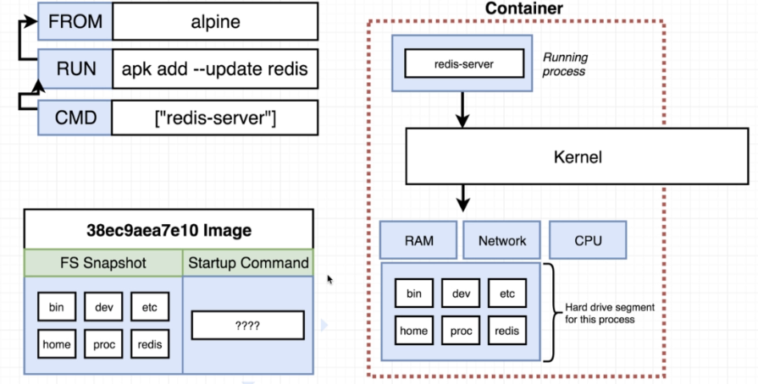
Step 3:

Slide 19
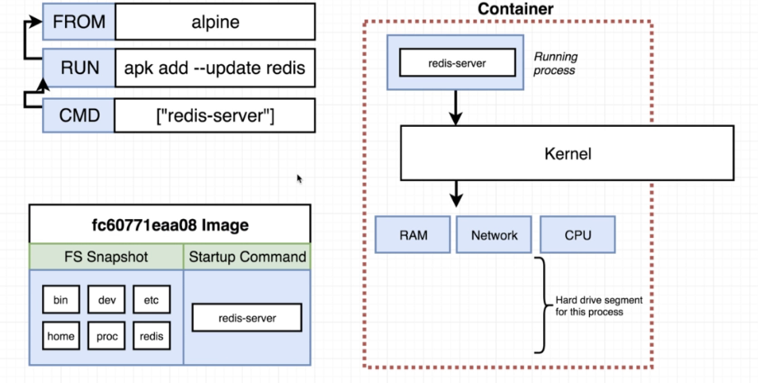
Step4:

Slide 20
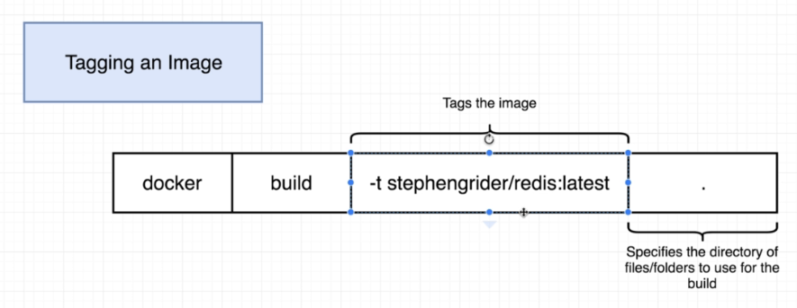

Slide 21
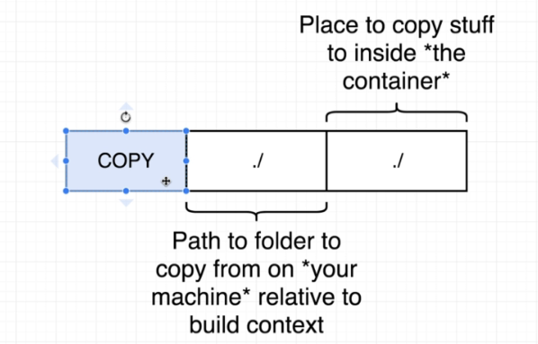

Slide 22
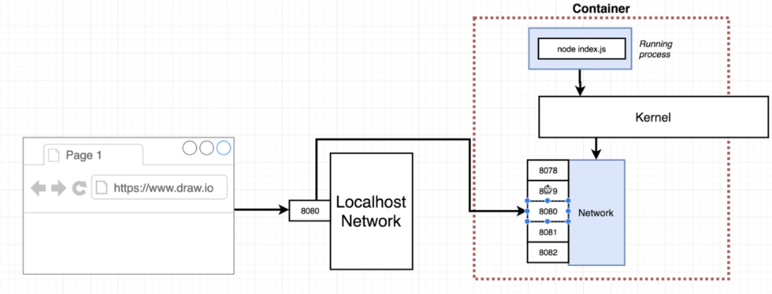
Port Routing Solution

Slide 23
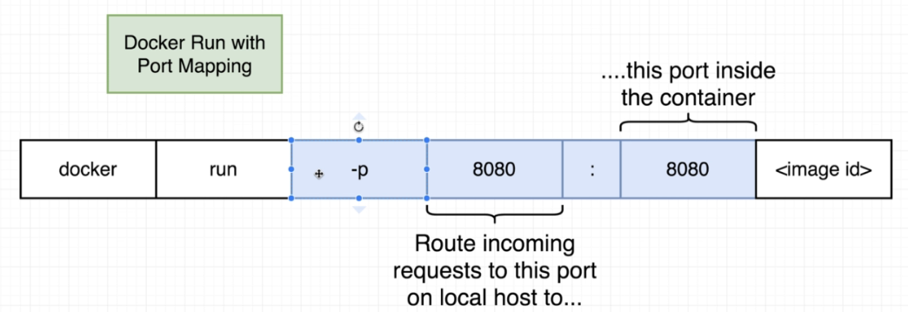
Docker run command:

Slide 24
Your computer
Options for connecting these containers
Docker container
Python web App
Docker container
Mysql DB
Using Docker Docker CLI’s Network
Features
Use Docker compose

Slide 25
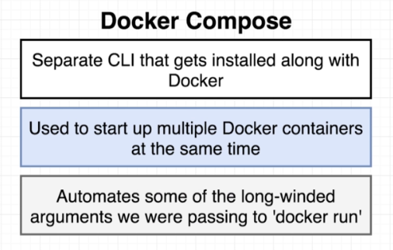

Slide 26
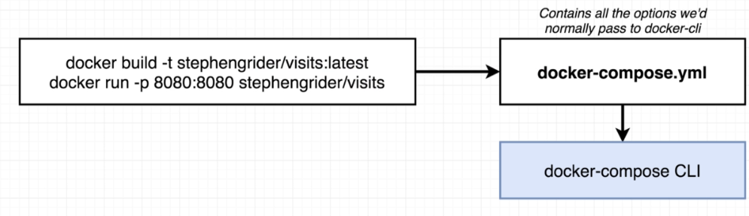

Slide 27
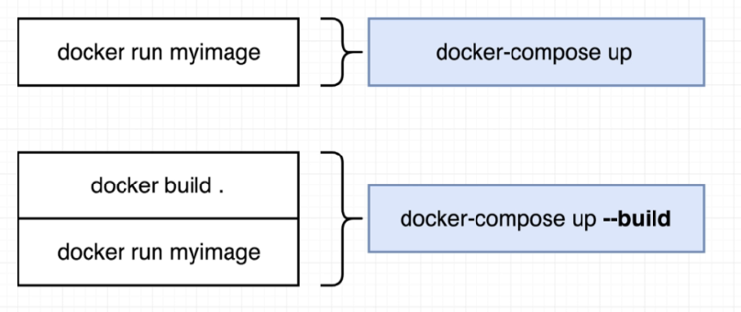

Slide 28
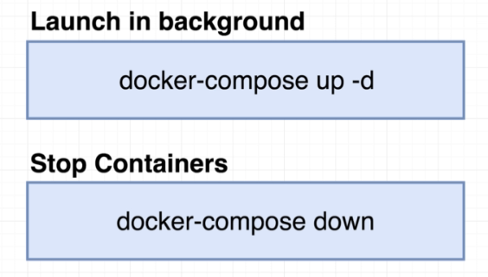

Slide 29
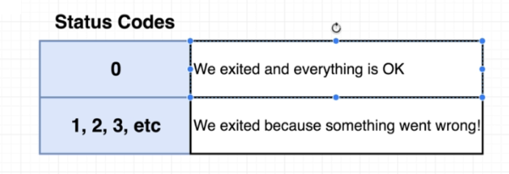
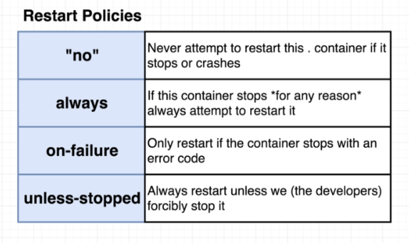

Slide 30
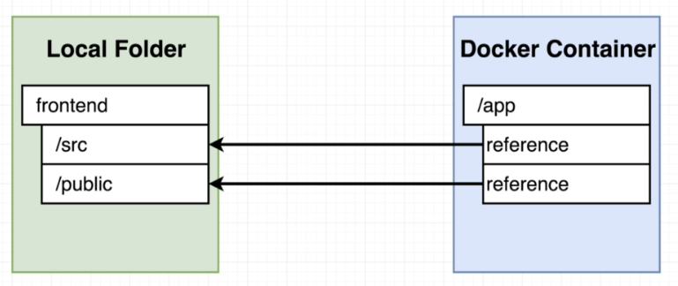
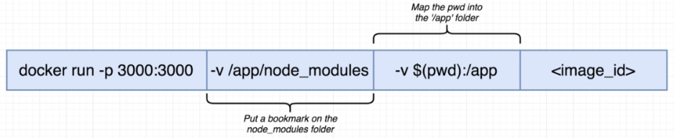

Slide 31
