Slide 1

Enhancing Cybersecurity: Superior Performance of Ensemble Methods and Tree-Based Models in Detecting Trojan Horse Attacks.
Name:Ayyappa Swami Adduri
Programme: MCA
Semester:04
PAPER ID: ICICTA_ 167
Research Paper Presentation-2024

Slide 2
Content
Abstract
Introduction
(Existing Problem, Propose System)
Literature Review
Methodology
( Diagram, Datasets, Algorithm)
Results
Conclusion
References
Screenshots

Slide 3
ABSTRACT
As the threat emanating from Trojan horse malware continues to increase, identifying and preventing the attack on computer systems is a vital endeavor in protecting data. The area of application of this project revolves around the use of current machine learning to create a highly effective detection system for Trojan horse malware. Using the given dataset with the Trojan type of malicious network packets and legitimate ones, the project will establish the best machine learning algorithms for classifying threats. Several of the critical processes that need to be accomplished regarding the development of the project are as follows: data cleansing, data transformation, selection of models, and assessment of models. Four specific models of supervised learning techniques are used in this present work: Decision Trees, Random Forests, Gradient Boosting, and Logistics Regression. Based on the experiment and the analysis of the setout measures of accuracy, precision, recall, and F1-score, the project aims at identifying which of the various models is most effective in detecting Trojan horse malware within a network. By following the findings of the project, one can gain an understanding as to how well various machine learning techniques can work in addressing Trojan horse attacks. By improving the knowledge on the subject of malicious network activity, entities can strengthen their protections against cyber threats, which further helps build the security of the ecosystem, reducing the impact of such threats.
3

Slide 4
Introduction
With the faculties of the world becoming increasingly intertwined online, cyber security risks remain rife, especially in equipment infected with Trojan horse malware. These programs are also known to mimic other files and programs, gaining access into computer networks, thus inflicting potential harm.
Existing Problem
This project focuses on the advancement of microbial Trojan horse detection through the application of state of the art machine learning. To achieve the goal, a dataset of benign and intrusive network packets will be considered as a starting point to train & test the ability of the ML models to distinguish between normal and malicious/intrusive behavior. This way, the project hopes to help in the improvement of the existing measures that address cybersecurity threats and risks.
Propose System
In an attempt to address the emergence of new hazards, this project is aimed at improving the defense of digital systems by machine learning algorithms to prevent Trojan horse attacks. By a mechanism of a comprehensive experimental and comparative analysis of the specified approaches as applied to large-scale systems, the project seeks to establish the best models of identifying malicious network activities to improve the overall cybersecurity climate in the context of growing interconnectedness of computer networks.
4
4

Slide 5
The key components and processes of the proposed system are as follows:
Data Collection and Preprocessing
Data Preprocessing
Model Selection and Training
Model Evaluation and Selection
Deployment and Monitoring
Visualization and Interpretation
By implementing this advanced machine learning-based detection system, organizations can significantly improve their ability to identify and mitigate Trojan horse malware attacks, thereby enhancing the overall security of their digital ecosystems.

Slide 6
LITERATURE REVIEW
Deep Learning in Intelligent Transportation Systems Bhuyan et al. (2016) provide a comprehensive survey of deep learning techniques for image feature learning in intelligent transportation systems. While their focus is on transportation, the deep learning methodologies discussed, such as convolutional neural networks (CNNs), are highly relevant to network traffic classification, suggesting potential cross-domain applications of these techniques .
Beigi, Haffner, and Franke (2017) propose "Deep Packet," a novel deep learning approach for classifying encrypted traffic. Their method leverages deep neural networks to analyze packet headers and payloads, achieving high accuracy without requiring decryption. This approach demonstrates the potential of deep learning in handling complex, encrypted data, overcoming limitations of traditional heuristic-based methods
Lee, Kim, and Lee (2017) introduce a machine learning method for network protocol classification, emphasizing the use of supervised learning techniques. Their approach involves extracting features from traffic flows and applying algorithms such as decision trees and support vector machines (SVMs). The study shows promising results in accurately identifying various network protocols, highlighting the effectiveness of ML in this application .
Karagiannis et al. (2004) investigate the state of P2P traffic, questioning whether it is declining or simply becoming harder to detect. Their study employs traffic analysis techniques to reveal that while traditional P2P traffic may be decreasing, new forms of P2P applications continue to emerge, often using sophisticated methods to evade detection. This highlights the dynamic nature of network traffic and the need for adaptable classification methods

Slide 7
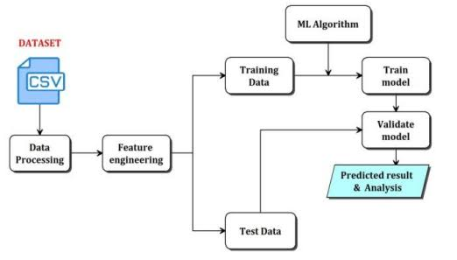
METHODOLOGY

Slide 8
DATA SET AND DESCRIPTION
Dataset Selection:
Find and download a suitable dataset containing the data concerning the traffic in the network the preferable choice
being the dataset containing labelled examples of both the normal packets and the packets containing malware.
Make sure that the data set reflects realities and contain various types of activity and traffic in the network.
Data Sources:
Evaluate different options for data collection, such as open source, cybersecurity datasets, or use of paid data if needed.
Starting with sources from cybersecurity organizations, research institutes, and datasets used for academic purposes only.
Data Characteristics:
Admiral does not only indicate that the dataset contains sufficient features and attributes required for Machine learning models
but also ensure that these features are appropriate for training the models for Trojan horse detection.
Features of interest could include information about the network protocol used, details about the packets such as packet
metadata, originating and destination IP addresses, time, and tags showing whether or not attack like Trojan horse malware is present.
8
8

Slide 9
DATA PREPARATION
Identify and Handle Missing Values:
Check for missing values in each column and decide on an appropriate strategy to handle them (e.g., imputation, removal).
Data Type Conversion:
Ensure that each column has the correct data type. For example, 'Age' should be numeric, 'Gender' could be categorical, and 'Occupation' might be categorical as well.
Normalize/Scale Data:
If necessary, normalize or scale numerical features to ensure they are on a similar scale. This is especially important for machine learning algorithms that are sensitive to feature scaling.
Encode Categorical Variables:
Convert categorical variables like 'Gender', 'Occupation', 'BMI Category', and 'Sleep Disorder' into numerical representations using techniques like one-hot encoding or label encoding.

Slide 10
Decision Tree:
• Working Process:
1. Decision Tree recursively splits the feature space into partitions based on feature values.
2. At each node, the algorithm selects the feature that best separates the data according to a chosen criterion (e.g., Gini impurity, entropy).
3. The splitting process continues until a stopping criterion is met, such as reaching a maximum tree depth, minimum number of samples in a leaf node, or purity threshold.
4. During prediction, new data samples are traversed down the tree based on feature values until a leaf node is reached, and the majority class in that node is assigned as the prediction.
10

Slide 11
KNN Classifier:
For a given test instance, KNN calculates the distance between the test instance and all instances in the training dataset.
The distances are typically calculated using Euclidean distance, but other metrics such as Manhattan or Minkowski distances can also be used.
The algorithm then selects the K nearest neighbors (the instances with the smallest distances).The majority class among the K nearest neighbors is chosen as the predicted class for classification tasks.
For regression tasks, the average value of the K nearest neighbors is used as the prediction.
Logistic Regression:
Logistic Regression is a widely used statistical model for binary classification tasks. It predicts the probability that a given input instance belongs to a particular class.
Logistic Regression models the relationship between the input features and the probability of the target class using a logistic function (sigmoid function).
The logistic function ensures that the predicted probabilities are between 0 and 1.
Logistic Regression estimates the parameters (weights) that maximize the likelihood of the observed data.
The model is trained using techniques like Maximum Likelihood Estimation (MLE) or optimization algorithms like Gradient Descent.

Slide 12
RESULTS
Indeed, the performance of the models differ significantly as exhibited during the comparative analysis. Thus, Decision Tree with 0. 828 accuracy, 0. 977 precision, 0. 977 recall, and high F1 value of 0. 977 and, MCC and kappa coefficients closer to 1 indicates this model has excellent classification power in comparison to other models. The accuracy and balanced precision and recall scores also suggest that all other methods including Random Forest, Hist Gradient Boosting, and Light GBM attain high performance as well. Extra Trees Classifier performs poorly compared to the other classifiers with AUC-ROC of 0. 929, but it is still quite good as a classification model. KNN Classifier performs fairly well but is slightly less accurate than the other models. This is despite the fact that Logistic Regression is one of the oldest models used for classification with a relatively low accuracy and F 1 score when compared to the other models which suggest that the model may have some difficulties when it comes to distinguishing between the two classes in an imbalanced dataset. All in all, ensemble methods and tree based models exert higher efficiency in the exploration of this two-class classification problem than logistic regression.
12

Slide 13
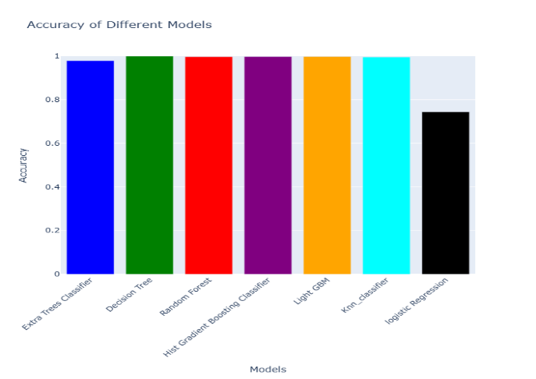

Slide 14
CONCLUSION
Trojan horse attacks are part of the modern type of threats, which may lead to direct losses and affect individuals, organizations, and even governments in the context of the modern world with the help of technology. Understanding them and how to counteract such attacks is vital in the contemporary world where technology has become predominant. The analysis of our study involved employing a dataset comprising of malicious and benign network packets particularly in the Trojan category to compare several machine learning models. The investigation of the models’ performance manifests that independent models (Random Forest, Hist-Gradient Boosting, LightGBM) and tree dependent models (Extra Trees Classifier, Decision Tree) performed very well, practically achieving a perfect accuracy, precision, recall, and F1-measure, together with high MCC and kappa coefficients. More specifically, Decision Tree advanced in classification performance and proved to excel a number of other models. Nonetheless, the K-Nearest Neighbors (KNN) classifier was also diagnosed to learn well, but when compared to it Logistic Regression seemed to under-perform with lesser accuracy as well as AUC of 0. 83 for both classes. To sum up, the thorough evaluation of the given approaches clearly demonstrates the high efficiency of the sophisticated ensemble techniques and decision trees for complex cybersecurity tasks, advancing the protection against Trojan horse threats in the context of modern digital systems.
14

Slide 15
References
Beigi, M., Haffner, P., & Franke, K. (2017). Deep packet: A novel approach for encrypted traffic classification using deep learning. IEEE Access, 5, 19767-19775.
Lee, B., Kim, H., & Lee, S. (2017). A new method for network protocol classification using machine learning techniques. In 2017 International Conference on Information and Communication Technology Convergence (ICTC) (pp. 1198-1200). IEEE.
Bernaille, L., & Teixeira, R. (2006). Early application identification. In ACM SIGCOMM Computer Communication Review (Vol. 36, No. 4, pp. 97-108).
Karagiannis, T., Broido, A., Brownlee, N., & Claffy, K. C. (2004). Is P2P dying or just hiding?. In Proceedings of the 2004 ACM SIGCOMM conference on Internet measurement (pp. 207-220).
Bhuyan, M. H., Bhattacharyya, D. K., Kalita, J. K., & Sarma, K. K. (2016). A comprehensive survey of deep learning techniques for image feature learning in intelligent transportation system. IEEE Transactions on Intelligent Transportation Systems, 17(12), 3287-3296.
Benson, T., Akella, A., & Maltz, D. A. (2010). Network traffic characteristics of data centers in the wild. In Proceedings of the 10th ACM SIGCOMM conference on Internet measurement (pp. 267-280).
Kim, H., Kang, K. W., & Park, T. (2018). Machine learning-based network protocol classification scheme for intrusion detection systems. Journal of Information Processing Systems, 14(4), 1090-1102.
15

Slide 16
THANK YOU
Paper ID: ICICTA_167

