Slide 1
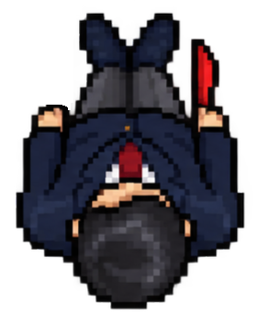



Entering the shiai-jo
Always from the same side as the shinpan-in seats are located
Mae!
Shinpan-in seats
Number of steps will vary according to court size (9~11 m). Do not search center by gazing
8-10 steps

Slide 2
Entering the shiai-jo
Step in with right, left, right ~1m
Ippomae!

Slide 3
Entering the shiai-jo
Rei!

Slide 4
Taking the Standard Formation
aprox. 1 m
3. This results in a larger base of the trapezoid of ~4 m
Isosceles trapezoid that determines the initial formation:
shorter base: mean distance of the two fukushin in shinpan-in lin-up
legs: the path the fukushin must walk in straight line within the kaishisen to form the Shinpan-in starting locations
larger base: the resultant distance between fukushin after formation of this geometrical relationship
Isosceles triangle that must be constantly kept between the three shinpan during movement:
vertex: mainly occupied by shushin (may change in transitions)
sides: the path the shinpan must walk in rotation
base: same as the trapezoid’s larger base
median/bisector: orthogonal to the axis between competitors
2. Fukushin must walk within the kaishisen in straight line
aprox. 1 m
1. Considering a mean shoulder width of 0,50 m and shoulder-to-shoulder distance of 0,15 m, the shorter base of the trapezoid is 1,30 m

Slide 5

Taking the Standard Formation
Always turn inward

Slide 6
Shinpan-in Rotation
1. All shinpan hold both shinpanki in right hand
2. Walk in straight line from initial position to destiny
(i.e. the line is inner than the walk path for initial formation, in red dashed line)
3. All shinpan separate each shinpanki in the correspondent hand in sync.

Slide 7
In case of shinpan alternation, it is usually done in this position, after acting as shushin.
The leaving shinpan-in walks to the fukushin’s position, turns directly to the entering shinpan-in and rolls up the shinpanki (white inside)
Alternation after Rotation
Synchronizing the timing in which the leaving shinpan-in finishes rolling up and putting the shinpanki to rest at their right side, the entering shinpan-in steps in and both bow (rei).

Slide 8
Alternation after Rotation
The leaving shinpan walks out backwards and bows (rei) to the court
The entering shinpan takes their position and unrolls the shinpanki.
All shinpan separate each shinpanki in the correspondent hand in sync.

Slide 9
Alternation of other shinpan-in
The leaving shinpan walks out backwards and bows (rei) to the court
In case of Fukushin, they enter from the sides.
In case of Shushin, from the front, but always from the same side as Shinpan-in seats
Shinpan-in seats

Slide 10
Leaving the shiai-jo
1. All shinpan roll-up the shinpanki together and hold in the right hand at body side
2. Fukushin must walk within the kaishisen in straight line (same line as when the initial formation)

Slide 11
Leaving the shiai-jo
Always turn inward

Slide 12
Leaving the shiai-jo
Shinpan-in seats
Rei!
“Hidari” or “Migi” depending on where the shinpan-in seat are located
Hidari/migi muke

Slide 13
Leaving the shiai-jo (with group alternation)
Mae!
Shinpan-in seats
Start walking in sync
Mae!

