Slide 1
Eye on Surveillance
EOS
Analysis of NOPD’s Surveillance Data Requests to the Real-Time Crime Center

Slide 2
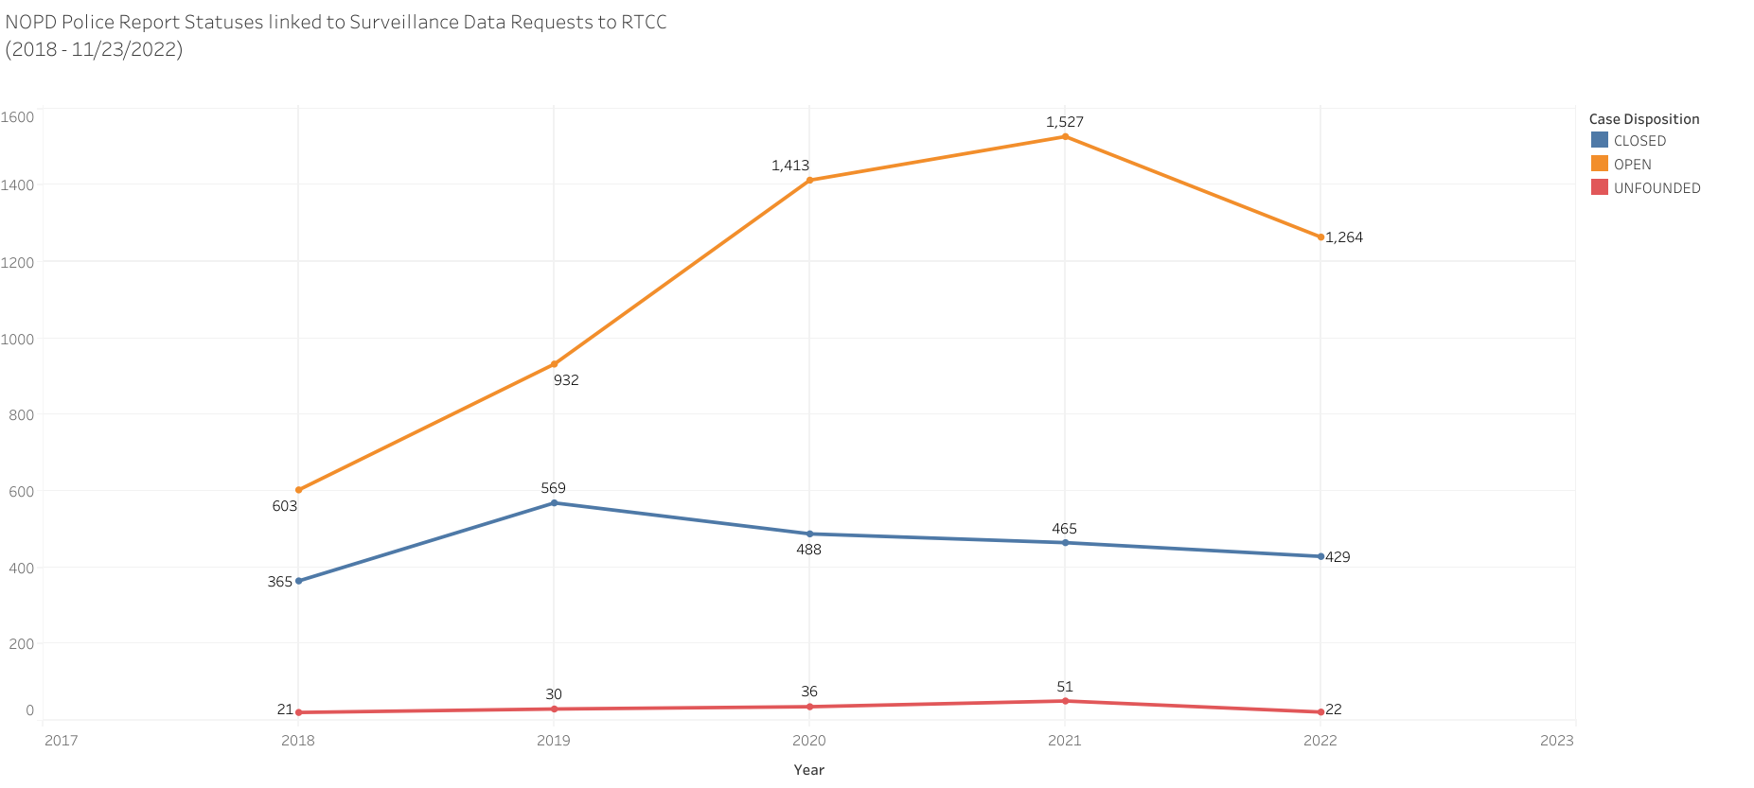
Police Report Data

Slide 3
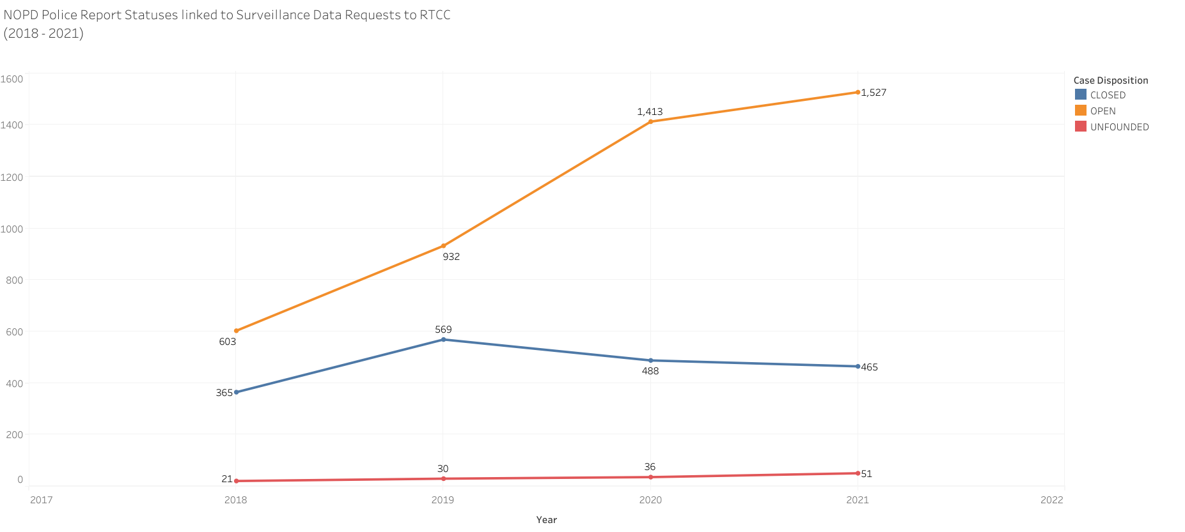
Police Report Data

Slide 4
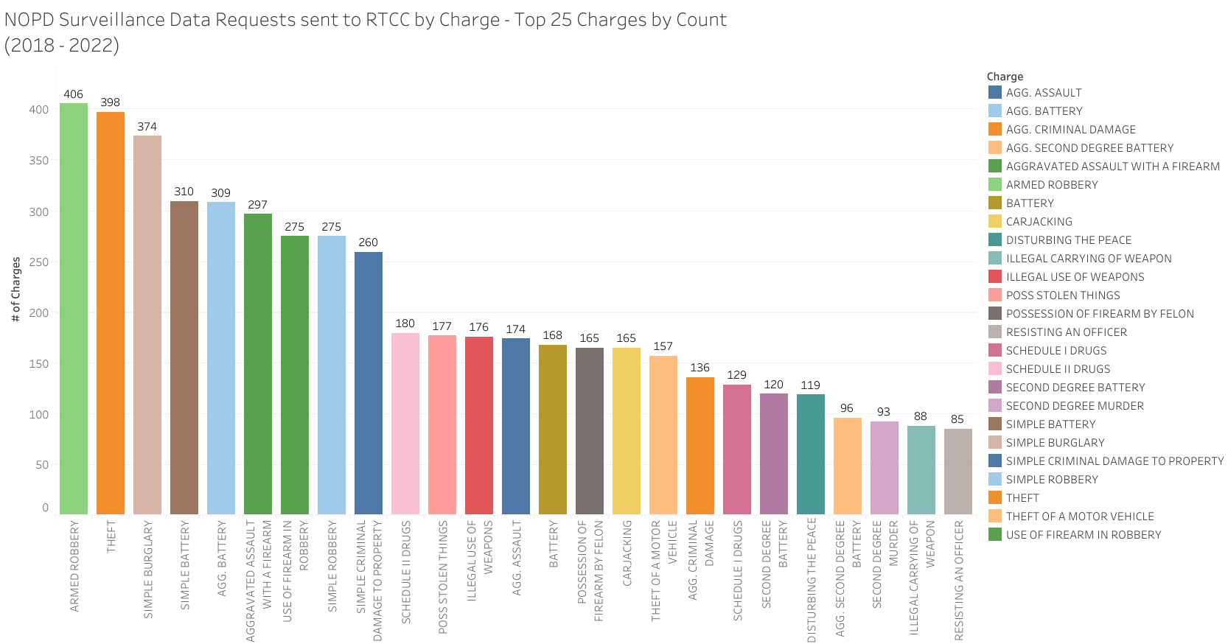
Police Report Data

Slide 5
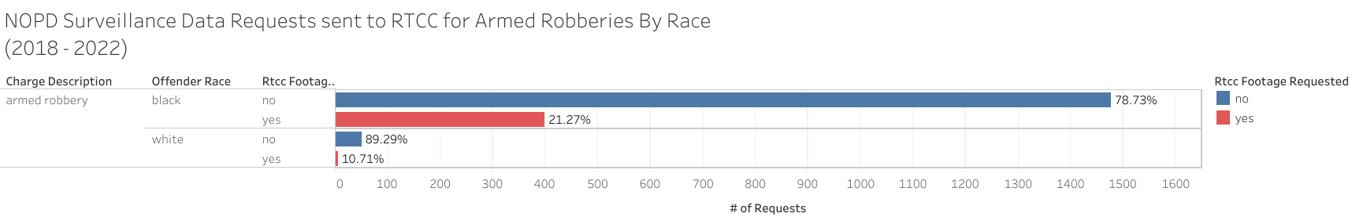
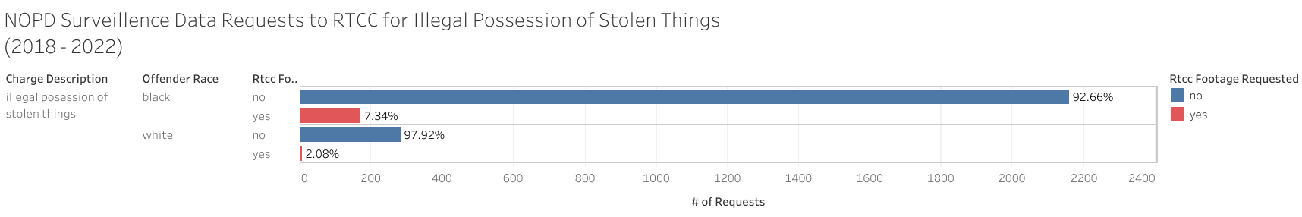
Police Report Data

Slide 6
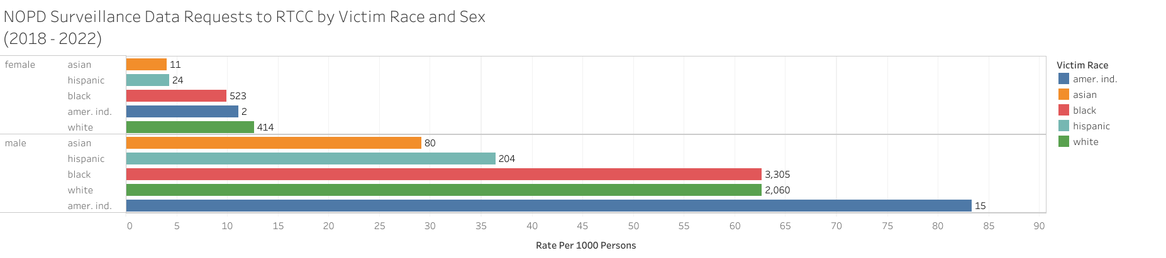
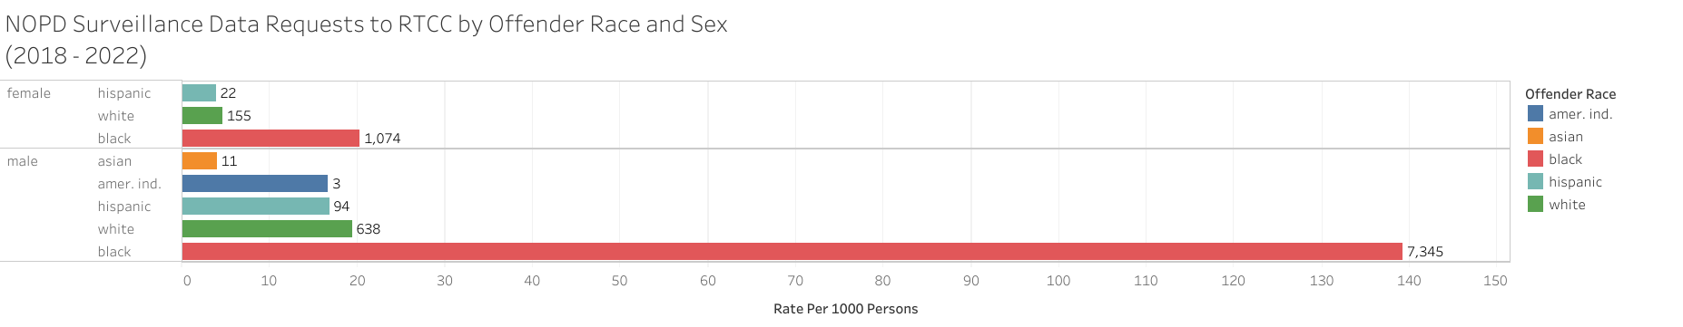
Police Report Data

Slide 7
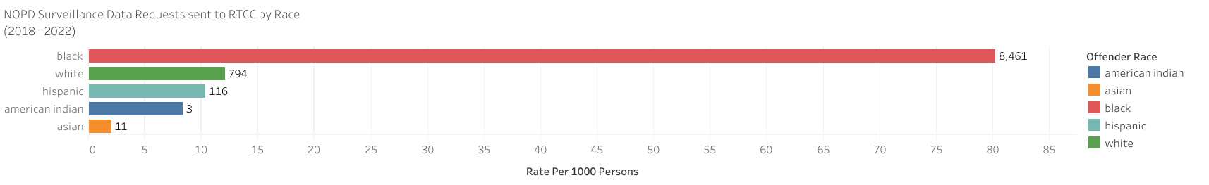
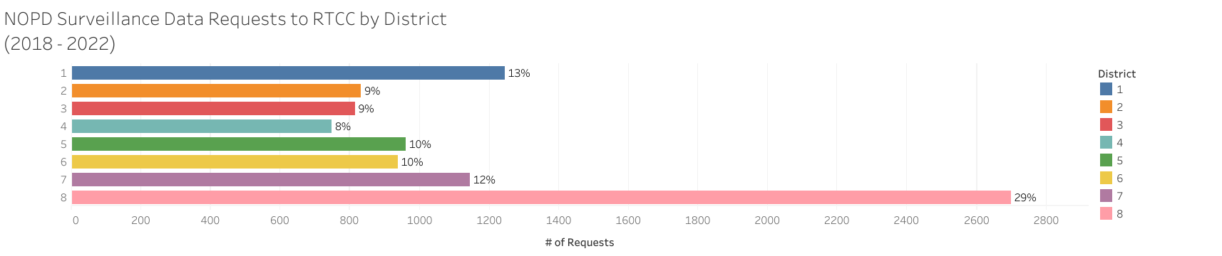
Police Report Data

Slide 8
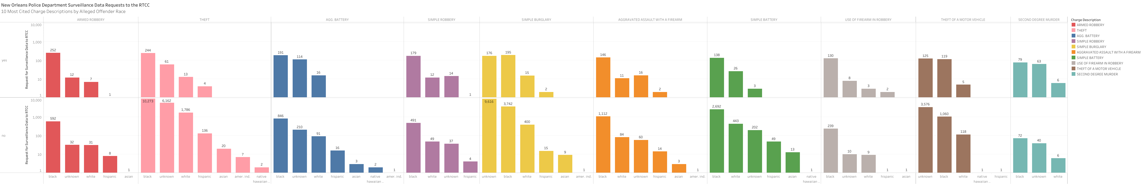
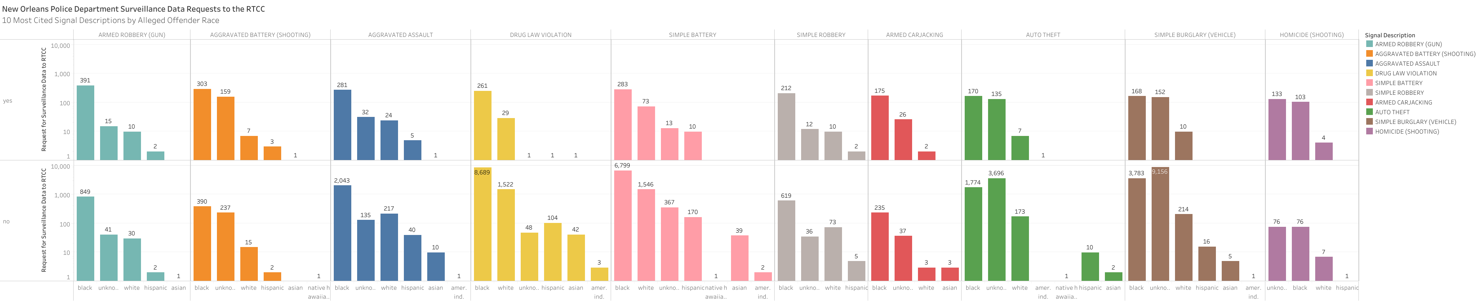
Police Report Data

Slide 9
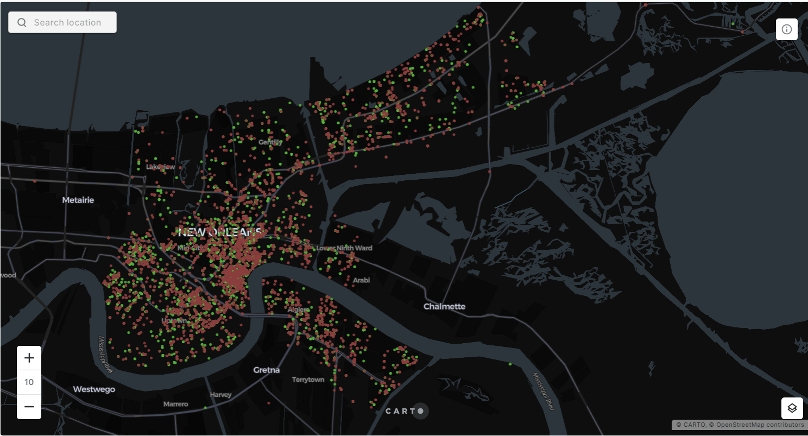
Police Report Data Red dots indicate an incident that occurred between 7pm-6am Green dots indicate an incident that occurred between 7am-6pm

