Slide 1
IS 507
Introduction to Software Engineering
Modeling Functional (Behavioral) Requirements

Slide 2
Behavioral Requirements
Statements of;
  services the system should provide,
  how the system should react to particular inputs,
  how the system should behave in particular situations,
  in some cases, what the system should not do.

Slide 3
Behavioral requirements-Example
Build a box with three buttons and two lights and behave in a particular way:
  There shall be three inputs. They shall be buttons. They shall be named On, Off, and A.
  There shall be two outputs. One shall be a green light and one shall be a red light. They shall be named G and R.
  After on is pushed and before off is pushed, the system shall be termed powered-on.
  After off is pushed and before on is pushed, the system shall be termed powered-off.

Slide 4
Example (cont.)
While powered off, no lights shall be on.
If A has been pushed while R is on, G should be on and R should be off.
If A has been pushed while G is on, R shall be on and G shall be off.
At no time shall more than one light be lit.
If one of the lights burns out the other bulb shall flash on and off in 2 seconds intervals.
When the malfunctioning bulb is replaced, the bulb shall not flash and the system shall return to its normal operation.

Slide 5
Problems
Difficult to explain behavior unambiguously.
  Does the system count the number of press A’s while one of the lights burned out?
  Semantics of the words are not well-defined.
    A model may provide us with a richer, higher level, and more semantically precise set of constructs
Richness of the primitive constructs.
  Could a 5000 pages SRS document be useful?
    The size of the document rarely has a relationship to the complexity of the problem
    Use a formal technique when we cannot afford to have the requirement misunderstood

Slide 6
System modelling
System modeling helps the analyst to understand the functionality of the system and models are used to communicate with customers
Different models present the system from different perspectives
  External perspective showing the system’s context or environment
  Behavioral perspective showing the behavior of the system
  Structural perspective showing the system or data architecture

Slide 7
Problem Analysis Techniques
Function Oriented Problem Analysis
Object Oriented Problem Analysis
State Oriented Problem Analysis

Slide 8
Function Oriented
Problem Analysis
A hierarchy of functions are created
  also called processes, transforms, transactions, bubbles and activities
Root of the hierarchy:most abstract function
  most general
  e.g. provide voice communication
Leaf nodes of the hierarchy: least abstract functions
  most detailed functions
  e.g. generate dial tone
Fundamental to most of these techiques is some combination of two notations:
DFDs and Data dictionaries

Slide 9
A DFD shows
what kind of information will be input to and output from the system,
where the data will come from and go to, and where the data will be stored.
It does not show information about the timing of process or information about whether processes will operate in sequence or in parallel
wikipedia

Slide 10
Data Flow Diagrams (DFDs)
Shows how the data flows through a system
data
Data on move
Transformation
Transformations of data into other data
Ext. Entity
Sources and destinations of data
data
Data in static storage (e.g. Database)

Slide 11
Main Points
All names should be unique
DFD is not a flowchart
  Arrows in a flowchart represent order of events
  Arrows in a DFD represent flowing data
There is no order
  cannot insert construct for decisions (conditionals)
Do not get stuck in details
  Defer error conditions & error handling
    except when the purpose of the system is to find errors

Slide 12
A level 0 data flow diagram:
Customers
Orders
Shipping Info
Warehouse
Order
Processing
Acknowledgments
Accounts Dept.
Accounting Info
Notes:
The circle - Order Processing - represent the system.
The rectangles - Customers, Warehouse and Accounts Dept. - are terminals.
They represent the part of the world that interacts with system.
The arrows represent flows of data between the terminals and the system - customers send orders to the order processing system and receive acknowledgements.

Slide 13
exercise
a small mail order catalogue system that allows people to shop from home.
When a customer receives the catalogue and wants to buy something, they can telephone, fax or email their order to the company.
The company gets the order and sends the goods and an invoice.
when orders enter the system they are stored in the system for further use
When the customer receives the goods with a delivery note, they send payment and receive a receipt for their payment.

Slide 14
payment
order
Mail order system
Customer
receipt
goods
invoice
catalogue
delivery note

Slide 15
delivery note
Process orders
order
goods
order
invoice
Customer
Customer
Orders file
catalogue
order
Payment process
receipt
payment

Slide 16
DFD - Leveling
Trivial applications are simple enough to represent as a single DFD
In cases where you need more detail
  Draw the most highest & most abstract level with just one bubble
    Show all external inputs/outputs and terminators
  Decompose the system and represent as a DFD with multiple bubbles
    Parts of the system represented by each of these bubbles are then decomposed as more detailed DFD’s
  This process may be repeated as many levels as necessary

Slide 17
DFD Leveling
System Name
Level-0 DFD
2
3
Level-1 Diagram
1
1.2
2.2
3.2
1.1
2.1
3.1
2.3
3.3
2.4
Level-2 Diagrams

Slide 18
Rules of decomposition
It is important to preserve the numbers of inputs/outputs between levels
I₁
A
O
I
A
O
I₂
I₁
A₁
A₃
O
A₂
I₂
Functional decomposition
Data decomposition

Slide 19
Rules of decomposition
It is important to preserve the numbers of inputs/outputs between levels
I₁
A
O
I
A
O
I₂
I₁
A₁
A₃
O
A₁
A₃
O₁
I₁
O
I
O₂
A₂
I₂
A₂
I₂
Functional decomposition
Data decomposition

Slide 20
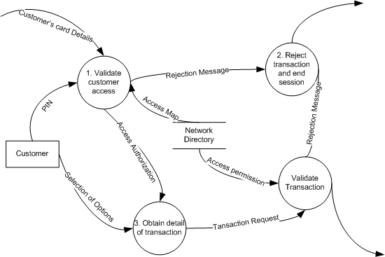
DFD example for an ATM system

Slide 21
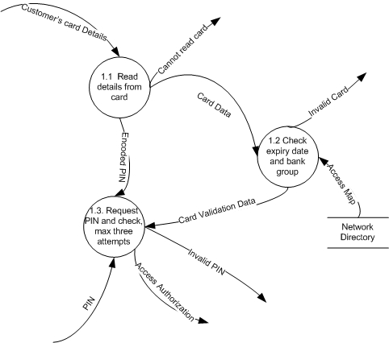
DFD example for ATM system

Slide 22
Another Example
Vending machine
Customers inserts coins and then selects an item to purchase. The machine looks up the price table for that item. If the customer has overpaid, the machine dispenses the change. If the payment is not sufficient, machine expects more payments until it is sufficient. Finally, the machine dispenses the selected product
Notes:
Bunu daha textual yaz

Slide 23
Another Example
Data-control flow diagram
1 Get
customer
payment
Coins
Returned coins
2
Dispense
change
Payment
Sufficient
payment
3
Validate
payment
Change
due
Product
6
Dispense
product
Price table
Price
4 Get
product
price
Valid selection
5 Get
valid
selection
Products
Customer selection

Slide 24
Data Dictionaries
Repositories to store information about all data items defined in DFDs.
Typical information includes:
  Name of the data item and aliases
  Description/purpose: Textual description of why it exists
  Related data items: To capture relationships such as total invoice amount should be equal to unit price x number of units sold
  Range of values: record all possible values
  Data flow: Name of processes to receive and originate data
  Data structure/definition: Describe composition of data item in terms of other data items.

Slide 25
Function Oriented Problem Analysis Techniques
Structured Requirements Definition (SRD)
Structured Analysis and Design Technique (SADT)
Structured Analysis and System Specification (SASS)
Modern Structured Analysis
Problem Statement Language/Problem Statement Analyzer (PSL/PSA)
...

Slide 26
Context Diagrams in SADT
The level 0 data flow diagram:
Customers
Orders
Shipping Info
Warehouse
Order
Processing
Acknowledgments
Accounts Dept.
Accounting Info
Notes:
The circle - Order Processing - represent the system.
The rectangles - Customers, Warehouse and Accounts Dept. - are terminals.
They represent the part of the world that interacts with system.
The arrows represent flows of data between the terminals and the system - customers send orders to the order processing system and receive acknowledgements.

Slide 27
Difficulties in level 0 Data-flow Diagrams
Interactions among problem domains are not always require a data flow.
The domains that do not interact with the system but have significance to describe requirements are not represented.
The concerns that should be focused at this level cannot be easily separated
  such as specification of the machine,
  problem domain characteristics that should be considered,
  requirements that should be satisfied

Slide 28
Structured Requirements Definition (SRD)
Step 1. Define a user-level DFD
  Interview with all the stakeholders to learn what that individual receives as inputs and generate as outputs. Draw a different DFD for each stakeholder.
Step 2. Define a combined user-level DFD
  Merge all like bubbles to create an integrated diagram. Need to resolve inconsistencies in perspectives.
Step 3. Define the application level DFD
  Draw a dotted line around the part of the diagram that corresponds to the system under analysis. Collapse this area into a single bubble.
Step 4. Define the application level functions
  For each function X performed by the organization for its environment, number the system level inputs/outputs to show the order of events

Slide 29
LOCS
LOCS corporation specializes in selling computer related books at low prices to computer specialists. It does this by mailing every month to every one of the current subscribers the following:
  A brief synopsis of the latest selection-of-the-month book
  A catalog of other available books
  A postcard on which whether or not they want the latest selection-of-the-month and/or other selections from the catalog
When the company started its business three years ago, it did so with a small office and three employees, and all work was performed manually. The company now sells thirty thousand books per month and employs a full time staff of twenty. The company recently purchased a Unix based workstation thinking it would solve the problems. The company has contacted us to evaluate its operations and develop an automated system using the workstation. It is not at all clear at this point whether or not to automate: payroll and human resources; inventory, conveyor belts, and robots to move books; accounts payable and receivable; and so forth.

Slide 30
SRD for LOCS
Organization chart of LOCS (given)
General
manager
Sales
Purchasing
Membership
Administration
Sales
distribution
Order
filling
Buying
Inventory
Personnel
Accounting
Printing

Slide 31
Sales: Sales Distribution and
Order Filling
Brochures
in envelopes
Envelopes and
brochures
Printing
Sales
Distribution
Customers
Membership
Mailing labels
Inventory
Books
Books
Book
requests
Order
Filling
Membership
Customers
Order information
Accounting
Order details
Orders

Slide 32
Purchasing: Buying and Inventory
Books
Books for
inventory
Inventory
processes
Buying
Publishers
Purchase orders
Purchase order details
Accounting
Book names
and quantities
Books from inventory
Books for inventory
Sales
Inventory
Buying
Book names
and quantities
Book requisitions

Slide 33
Membership
Mailing list
Order
information
Order
Filling
Printing
Membership
Enrollment information
Advertisements
Potential
customers
Applications

Slide 34
Administration: Personnel and Printing
Employee requisitions,
salary action requests
Employment ads.
Media
All
Divisions
Personnel
Letters of acceptance/rejection
Potential
employees
Salary action,
new employees
Applications,
resumes
Envelopes with
mailing labels,
Brochures
Mailing lists
Sales
Distribution
Membership
Printing
Advertisements

Slide 35
Administration: Accounting
Order
Filling
Customers
Employees
Paychecks
Invoices
Order
details
Accounting
Payments
Deposit
Checks
Bank
P. O.
Details
Receipt/withdrawal
Publishers
Buying

Slide 36
Exercise
Individual exercise :
  Define a combined user level DFD.
  Can you identify any inconsistencies?

Slide 37
Inconsistencies in User-level DFDs
Books from inventory
Books for inventory
Sales
Inventory
Buying
Book names
and quantities
Book requisitions
Inventory
Books
Books
Book
requisitions
Order
Filling
Membership
Customers
Order information
Accounting
Order details
Orders

Slide 38
Updated DFD
Sales is an Aggregate organization
  Order-filling claims to send book requisitions to Inventory and receive books in return.
  Inventory claims that it receives book requisitions from sales and send books in return.
  Update DFD as follows:
Books from inventory
Books for inventory
Order
Filling
Inventory
Buying
Book names
and quantities
Book requisitions

Slide 39
Inconsistencies in User-level DFDs
Sales organization was mistaken:
  According to sales distribution mailing labels are received by them directly from membership
  According to membership it does not create mailing labels but send mailing lists to printing which in turn sends mailing labels to sales distribution
  Update DFD as follows:
Envelopes with
mailing labels,
and brochures
Brochures
in envelopes
Sales
Distribution
Printing
Customers

Slide 40
Inconsistencies in User-level DFDs
Functional and support organizational perspectives tend not to be complementary.
  Functional organizations tend to stress their primary functional purpose rather than their interfaces to support organizations.
Too much detail in support organization.
  Accounting and personnel do not appear on other DFDs.
  Solution:
  Delete those support information flows (if there is no plan to automate them), or
  Add them to all functional organizations’ DFDs (to achieve consistency).

Slide 41
Combined User-level DFD
Brochures
in envelopes
Sales
Distribution
Customers
Envelopes with mailing labels, brochures
Bank
Invoices
Deposits
Books
Payments
Orders
Accounting
Receipt/withdrawal
Order
Filling
Order
details
Printing
Checks
Publishers
Books from
inventory
P.O.
details
Inventory
Book
requisitions
Books
Books names
and quantities
Buying
Purchase
orders
Potential
Customers
Order
information
Books for
inventory
Applications
Membership
Enrollment
information
Advertisement
Mailing list

Slide 42
Combined User-level DFD
Brochures
in envelopes
Sales
Distribution
Customers
Envelopes with mailing labels, brochures
Bank
Invoices
Deposits
Books
Payments
Orders
Accounting
Receipt/withdrawal
Order
Filling
Order
details
Printing
Checks
Publishers
Books from
inventory
P.O.
details
Inventory
Book
requisitions
Books
Books names
and quantities
Buying
Purchase
orders
Potential
Customers
Order
information
Books for
inventory
Applications
Membership
Enrollment
information
Advertisement
Mailing list

Slide 43
Depict System Under Analysis
B1- Brochures
in envelopes
B6-Deposits
Customers
Bank
B2- Orders
B7- Receipts
B3- Invoices
LOCS
C3-Withdrawals
B4- Books
B5- Payments
C1-Purchase orders
A1- Enrollment
information
C2-Books
Potential
Customers
Publishers
C4-Checks
A2- Applications
A- Soliciting new customers
B- Selling books
C- Buying books

Slide 44


Slide 45
Problem Analysis
Primary goal - understanding
  Learning about the problem domain
  Find out the actual user
  Understanding the needs of the users
  Understanding constraints on the solution
Example modeling
  Jackson context diagrams

Slide 46
Problem Context
You are an engineer planning to build a bridge across a river.
  Visit the site.
  How hard the wind is blowing.
  Picture the bridge yourself.
You are examining the problem context.
Problem
Domain
System
part of the world
your customer is interested
What you build
interact directly

Slide 47
Initially - Problem Context
To understand the problem, understand the problem domains
  What parts of the world are in it?
  How are they interconnected?
  What are their significant properties?
  What properties can you exploit?
  What interactions can they have with your system?

Slide 48
Problem context vs Solution context
Think in solution domain: (at this phase, don’t !)
  Programming languages, database management systems, module decomposition, …
  As the work progress keep asking your customer: will this machine solve your problem?
    As the problem is not understood the solution is very unlikely to be satisfactory.
Think in problem domain:
  What properties it has right now?
  What properties your customer wants you to bring about?
Notes:
A frequent mistake is to think in solution domain in this phase. As we discussed during the firs lecture there are far to many solutions we generate that does not solve the problems of our customers. Part of the problem is our willingness to solve the problems we only partially understand. As the work progress we keep asking our customers: Will this machine solve your problem? As the problem is not understood the solution is very unlikely to be satisfactory.
In this early phase we in fact need to think in problem domain. We need not focus on "how" or "what" questions. The programming languages, design methodologies and database management tools are not relevant. We need to focus on "where" questions. We need to think about the problem domains our solution will interact with, find out what properties they have right now, and what properties your customer wants you to bring about.

Slide 49
Jackson’s Context Diagram
Show all the domains relevant to the problem requirement (not just directly those providing input to the machine).
The connections are just a line (all communication is not necessarily of dataflow kind).
System is just one of the domains.
Example: a simplified context diagram of the compiler construction problem:
Source
Program
Compiler
Executable
Program
Notes:
the compiler construction problem we are involved with three domains: Compiler, Source Program and Executable Program. There is a shared event between the Compiler and the Source program since the compiler reads the source program to be compiled.

Slide 50
Example: Patient Monitoring Problem
Patients are in intensive-care unit
Analog devices monitor their pulse rate, temperature etc.
The system is to check each patient’s specified factors, at specified frequencies against specified safe ranges.
The factors are to be stored in a database.
An out of the range factor will be reported to the nurse’s station.
The system should also check that the analog devices working properly and report to nurse’s station.

Slide 51
Problem Domains
The principle of domain relevance
  Everything that’s relevant to the requirements must appear in some part of the problem domain.
Patients - nurse’s station - analog devices
  The requirements will be expressed in terms of them.
    The patients shall be monitored according to …
    The nurse’s station shall be notified …
    The analog devices shall be monitored and any …
Nurses
  Not included we do not concern with nurses actions in response to the alarm messages.

Slide 52
Two More Domains
Safe range and frequency specifiers
  Necessary by the principle of domain relevance.
  If it is left out there will be no part of the application domain the related requirements could refer.
Database
  Is it part of the problem or the solution?
  The description is not enough to resolve the problem.
Notes:
Database
Is it part of the problem or the solution?
If we already have a database to be used for the solution it should be represented as part of the problem. If we need to redesign the database which will be used within this solution only then it is part of the solution domain and should not be represented.

Slide 53
Patient Monitoring Context Diagram
Included:
The machine must check their status
Can’t include patients without it
Analog
Devices
Database
System
Nurse’s
Station
Patients
Range &
Frequency
Specifiers
Not directly connected:
But they are of central interest

Slide 54
exercise
The user or cellular subscriber asks for access to the cell phone system
The cell phone system interacts with the product system to determine what type of access is required, text, voice, MMS, data etc.
The content management system records the details of the transaction (let's say this is a voice call) caller ID, Duration and dialled number are recorded.
The financial system updates the account of the user.
Notes:
Financialsystem
Cellular portal
Content management system
Products system
Cellular subscriber

Slide 55
Domain Containment
Necessary when one domain is entirely contained in another domain.
Editor example
  Texts are certainly an important part of the problem domain:
    It will be required to define behavior and properties of texts.
  Text domain is contained entirely in the editor domain.
Users
Editor
Text objects
Notes:
Texts are certainly an important part of the problem domain:
It will be required to define behavior and properties of texts but text domain is contained entirely in the editor domai n

Slide 56
Frame Diagrams
It shows the principle parts of a problem frame:
  Domains and domain relationships.
An extension of Jackson’s context diagrams (which enables identification of the problem)
  1.The system domain is shown by a double outline.
  2.Includes domain relationships – depicted by ellipses:
    conditions among domains that are required to hold.
Notes:
Context diagrams depict "where the problem is located" while problem diagrams depicts "what is the problem".

Slide 57
Symbols and an Example
System domain
Domain relationship
Domain
Connection
Containment
Source
Program
Language
and Computer
Semantics
Compiler
Executable
Program
Machine Domain
Requirement

Slide 58
Simple Editor
Context diagram:
Users
Editor
Text objects
Problem frame diagram:
Edit
operation rules
Operation properties
Users
Editor
Text objects
Operation requests
System
Work-pieces
Simplifications:
Text objects might be interrelated in various ways
There may be requirements to report on the use of the tool

Slide 59
exercise
A microchip computer is required to control a digital electronic speedometer and odometer in a car. One of the car's rear wheels generates pulses as it rotates. The computer can detect these pulses, and must use them to set the current speed and total number of miles travelled in the two visible counters on the car's fascia. The underlying registers of the counters are shared by the computer and the visible display

Slide 60
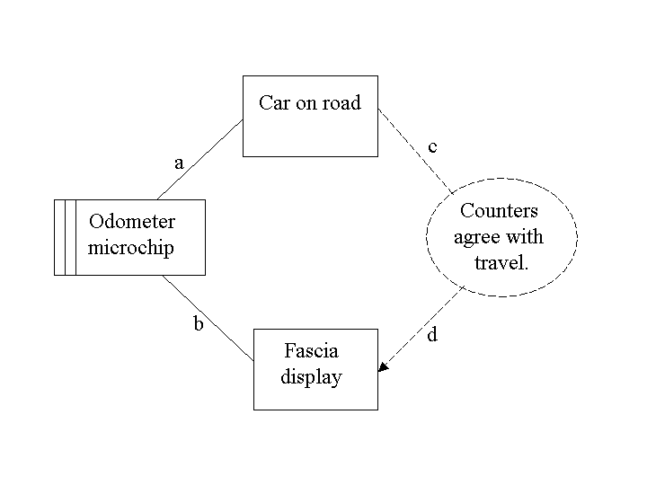
exercise

