Slide 1
Review Session: Regression Using MS Excel
Professor Friedman's Statistics Course by H & L Friedman is licensed under a Creative Commons Attribution-NonCommercial-ShareAlike 3.0 Unported License.

Slide 2
Overview
In this review, we look at regression problems done in MS Excel. In the next few slides we will see a few different regression problems and how to interpret the output.

Slide 3
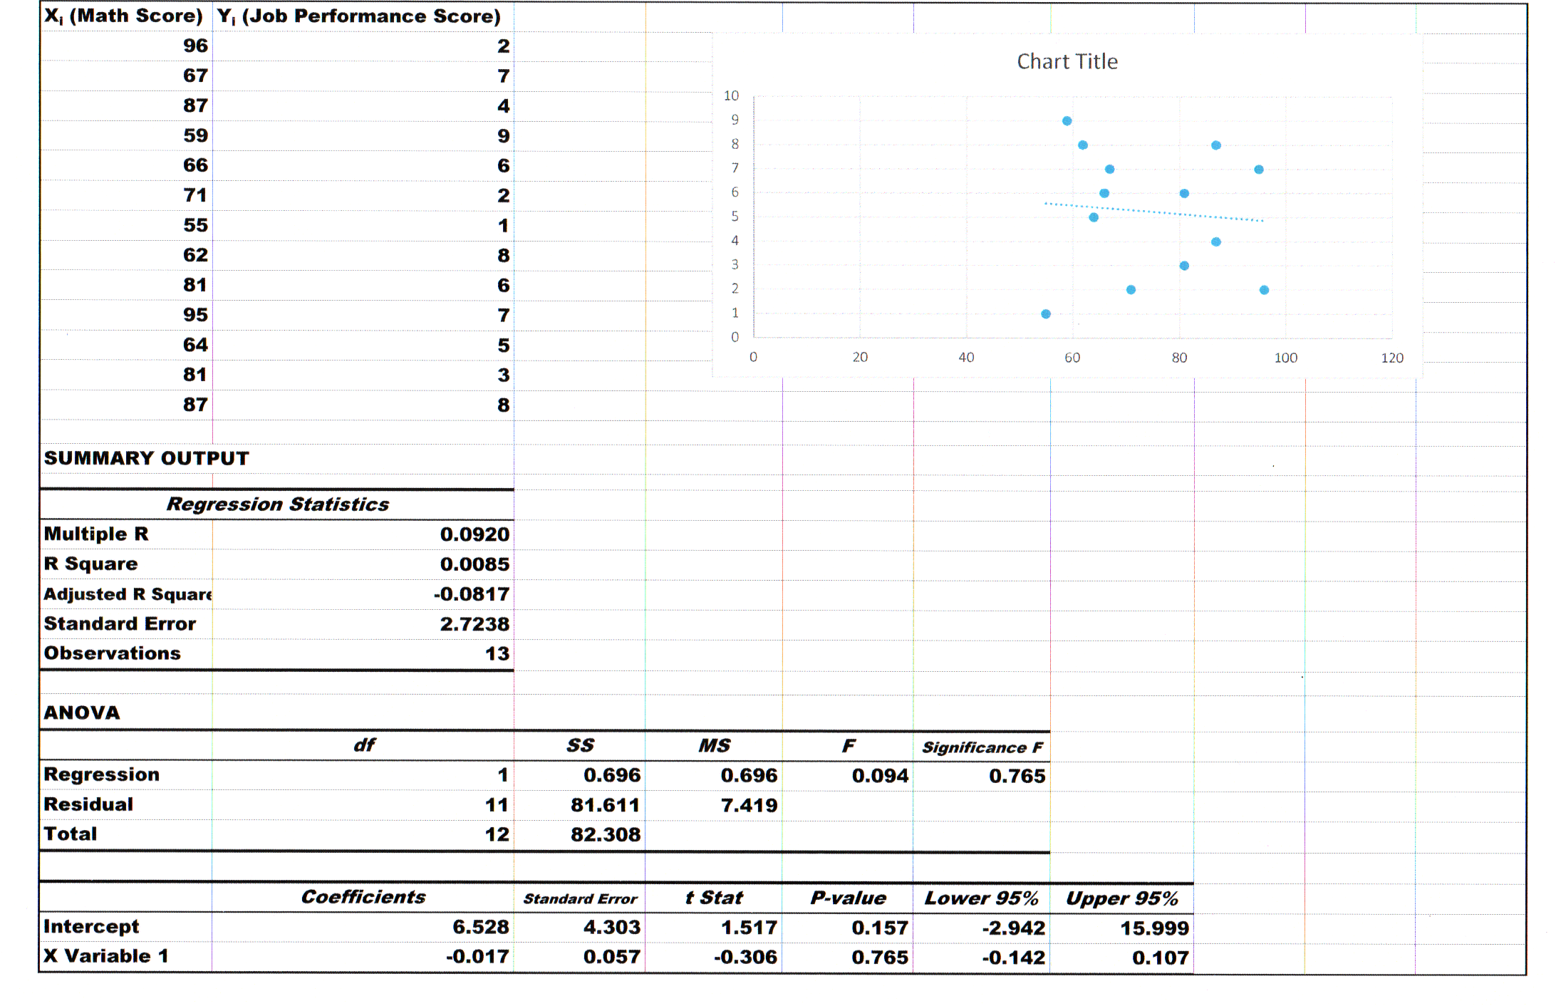
Problem 1
Not significant (>.05)
The Probability of (Sample Evidence | X and Y are unrelated) = .765
b₀ (constant)
b₁ (slope)

Slide 4
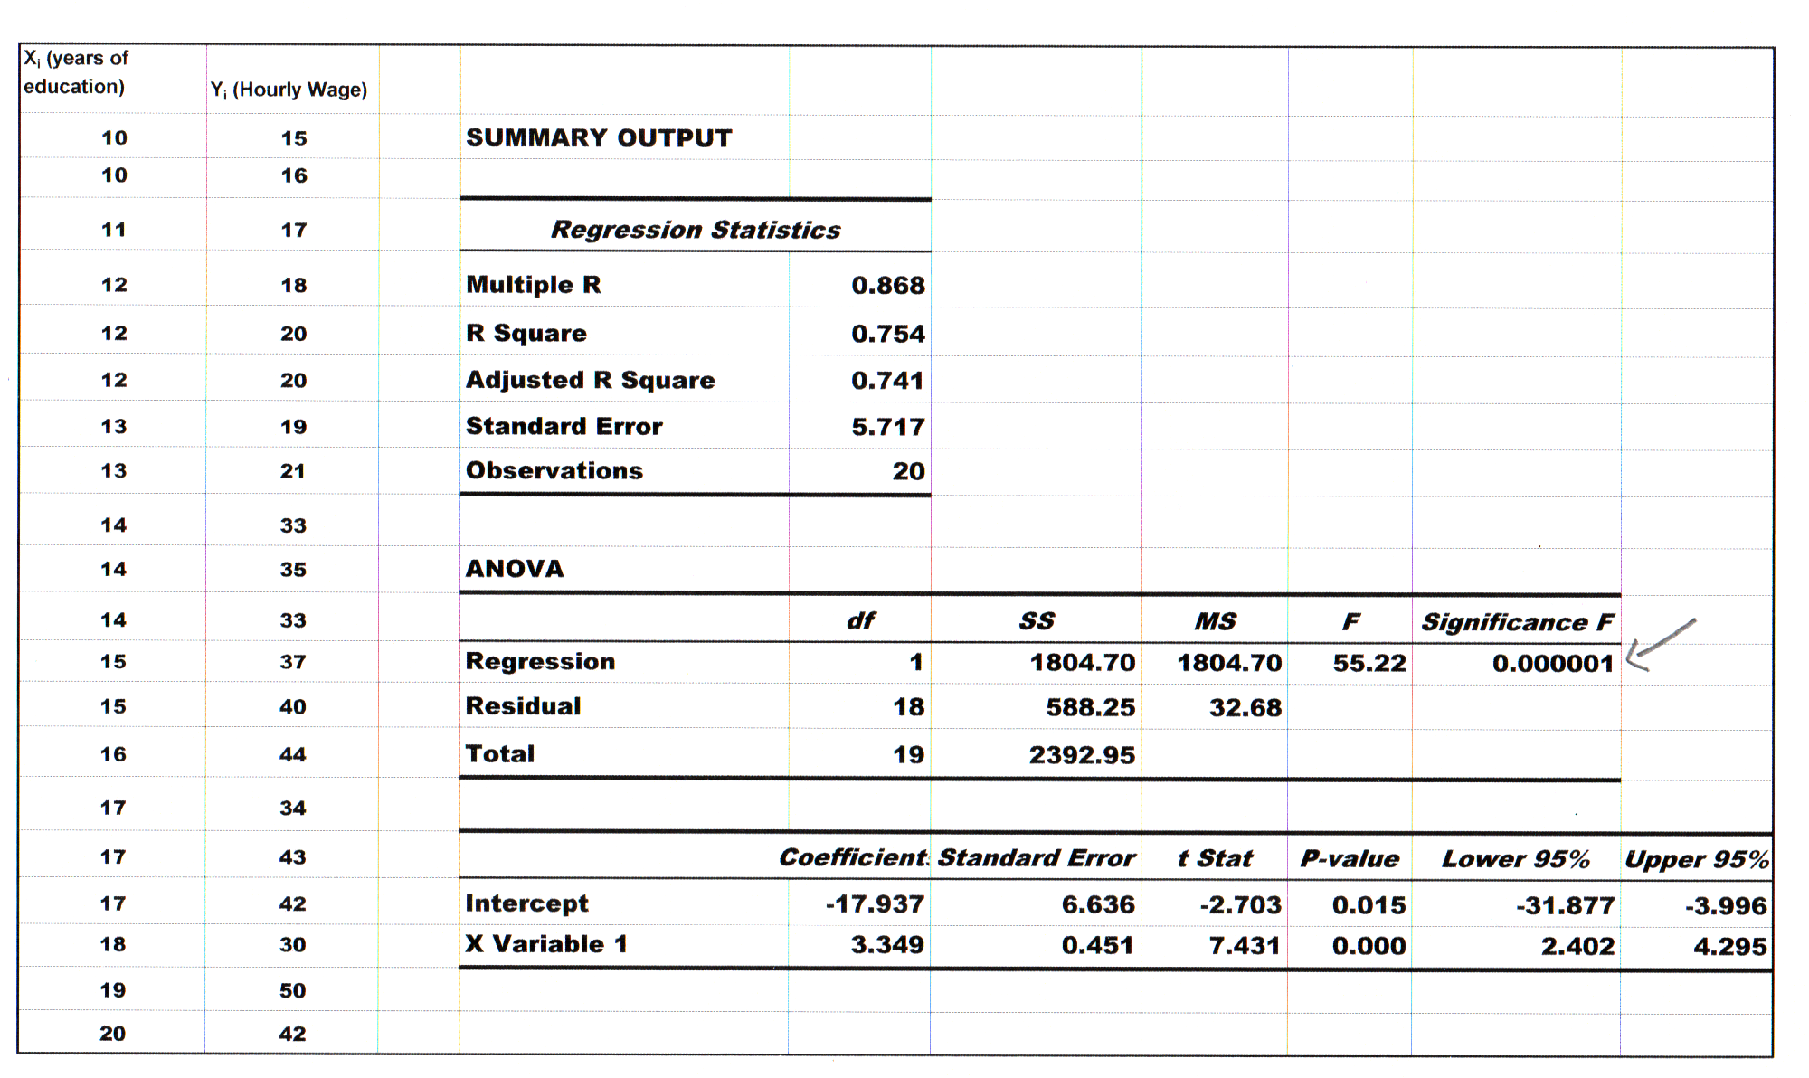
Problem 2
Is the regression significant?
What is the value of b₀? b₁?
What is the regression equation?
What is the correlation coefficient?
What is the proportion of variation in Hourly Wage (Y) that is explained by Years of Education (X)?

Slide 5
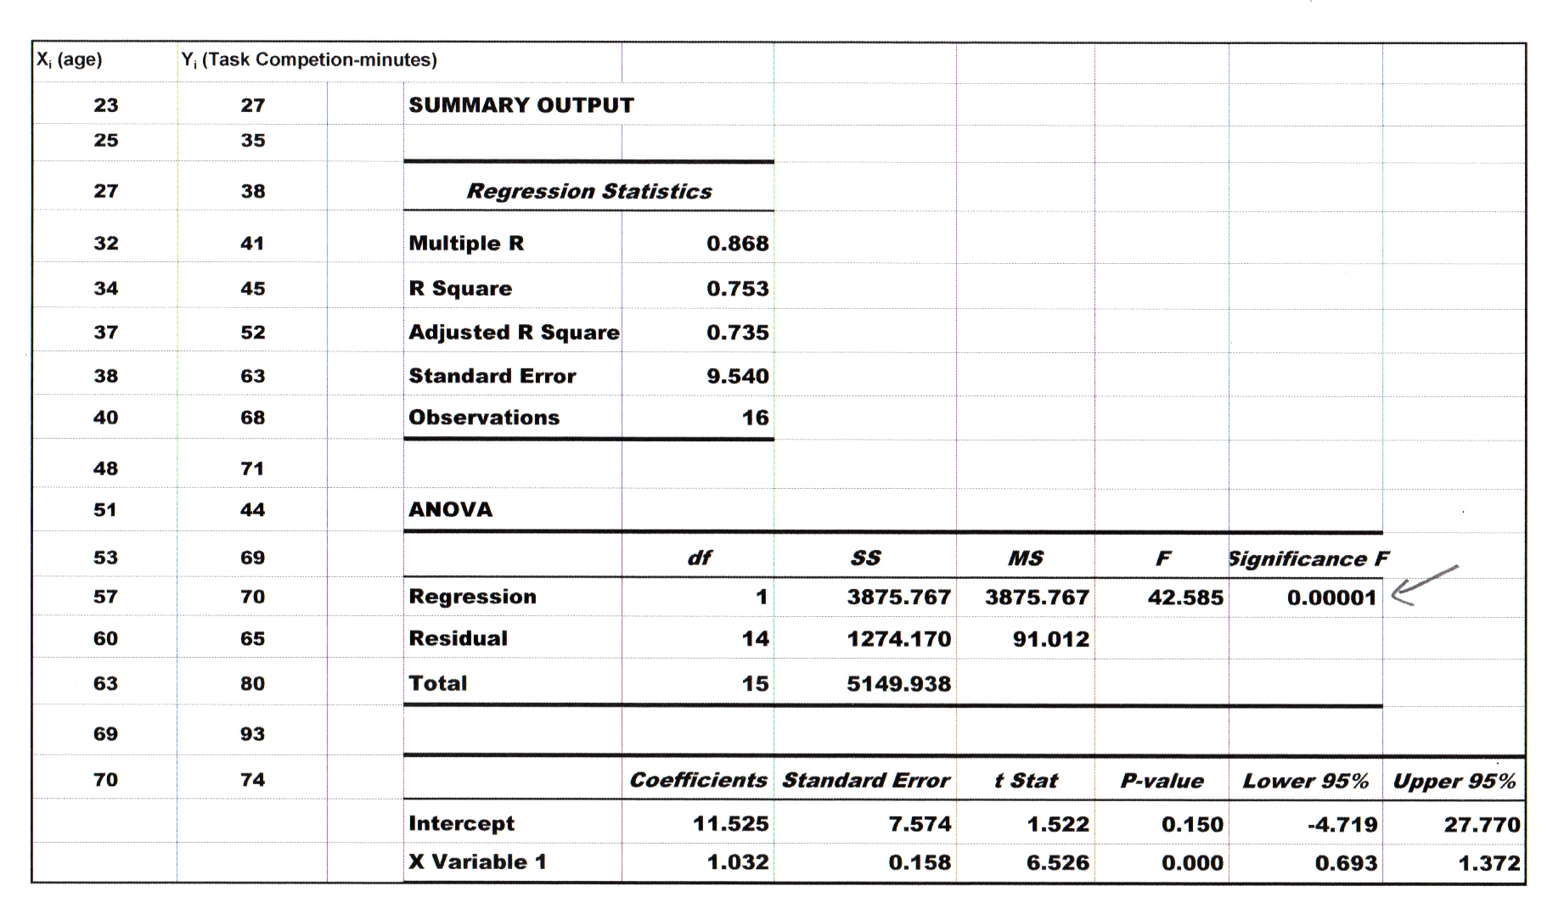
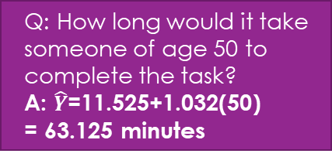
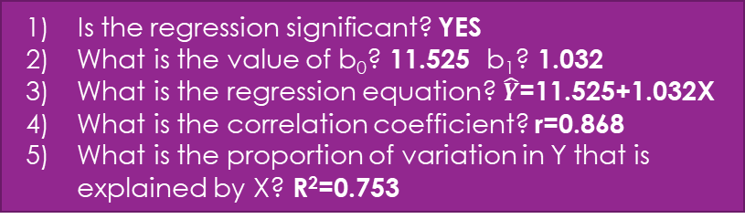
Problem 3
Is the regression significant? YES
What is the value of b₀? 11.525 b₁? 1.032
What is the regression equation? $\hat{Y}$=11.525+1.032X
What is the correlation coefficient? r=0.868
What is the proportion of variation in Y that is explained by X? R²=0.753
Q: How long would it take someone of age 50 to complete the task?
A: $\hat{Y}$=11.525+1.032(50)
= 63.125 minutes

Slide 6
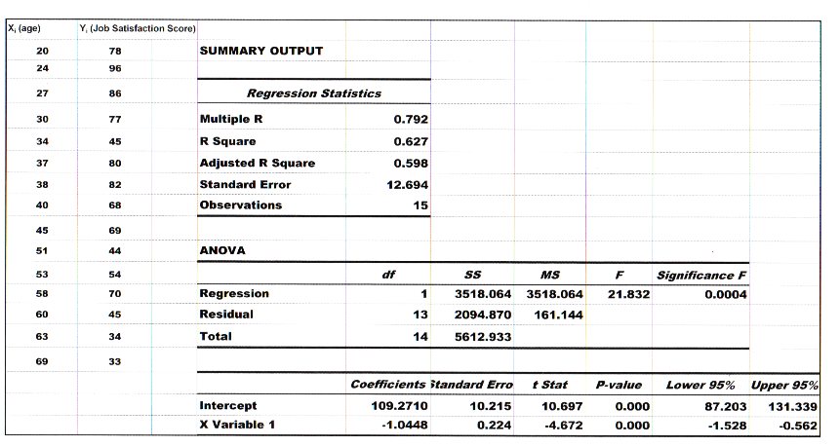
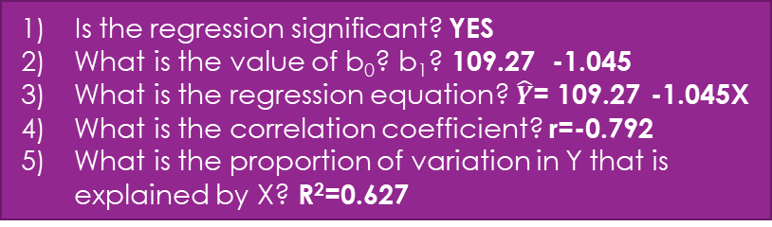
Problem 4
Is the regression significant? YES
What is the value of b₀? b₁? 109.27 -1.045
What is the regression equation? $\hat{Y}$= 109.27 -1.045X
What is the correlation coefficient? r=-0.792
What is the proportion of variation in Y that is explained by X? R²=0.627

Slide 7
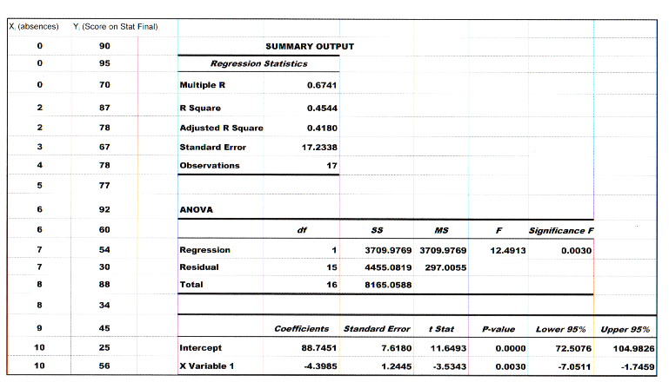

Problem 5
Is the regression significant? YES
What is the value of b₀? b₁? 88.75 -4.40
What is the regression equation? $\hat{Y}$= 88.75 -4.40X
What is the predicted score on the stat final for someone who is absent 8 times? $\hat{Y}$= 88.75 - 4.40(8) = 53.55
What is the correlation coefficient? r=-0.674
What is the proportion of variation in Y that is explained by X? R²=0.454

Slide 8
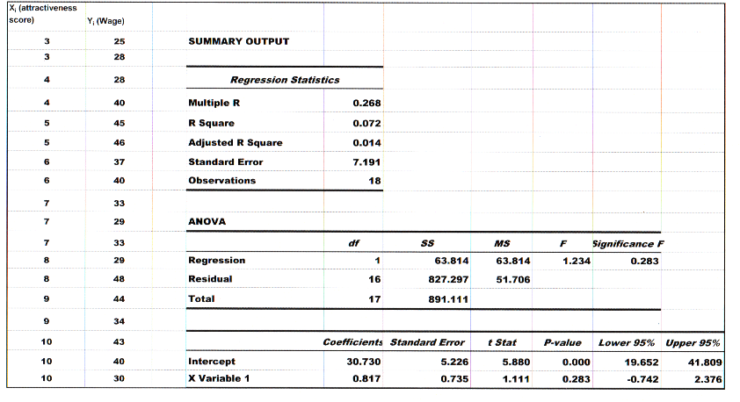
Problem 6
Is the regression significant? NO
What is the correlation coefficient?
r=0.268 (not different from 0)
What is the proportion of variation in Y that is explained by X?
R²=0.072 (not different from 0)

Slide 9
Conclusion
This lecture was designed in part to help students review and get comfortable with the interpretation of Regression problems done with MS Excel. Remember, the best way to prepare for the exam is to do as many practice problems as you can possibly find.

